Slide 1
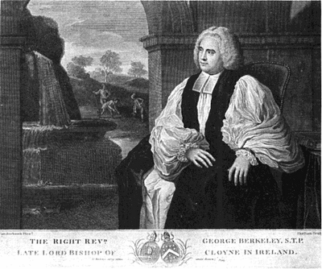
Berkeley’s Idealism
Principles of Human Knowledge
George Berkeley
Esse is percipi

Slide 2
Skepticism
“I know the meaning but I don’t know the analysis”
How theory-laden is language?
Eddington’s table
numbers
Berkeley’s “revisionary metaphysics”: ordinary language isn’t very theory laden so
We should “speak with the vulgar but think with the learned”
“The sun rises”

Slide 3
Berkeley was Irish
Sure and ‘tis sometimes said we Irish Men think backward to everyone else. -----Berkeley Notebooks
Born 1685 near Kilkenny; died Oxford 1753
Work in optics, foundations of calculus
In America, trying to open theological college
Anglican Bishop of Cloyne
Principles of Human Knowledge, Three Dialogues arguing for idealism

Slide 4
Anyone who surveys the objects of human knowledge will easily see that they are all ideas that are either actually imprinted on the senses or perceived by attending to one’s own emotions and mental activities or formed out of ideas of the first two types, with the help of memory and imagination.
Notes:
“All knowledge comes from experience” We can adopt different accounts of common sense and empirical science claims and math and logic.

Slide 5
What we will consider…
Ontology: Berkeley’s Immaterialism
Arguments and criticism of arguments
The Core Argument (PHK 4)
The Refrigerator Light Gotcha Argument (“The Master Argument” in PHK 22-23)
Some objections and responses to Berkeleian idealism
The persistence of unperceived objects
The distinction between reality and illusion/dreaming
The legitimacy of Science

Slide 6
Berkeley’s Ontology
Ontology

Slide 7
What is there?
Dualism: There are two different kinds of substances—material substance and spiritual substance (vide Descartes)
Materialism: Everything is material; only material objects exist. (contemporary variant, Physicalism)
Berkeleian Idealism (“Immaterialism”): There are only spiritual substances (finite substances and God) and their ideas.
To be is to be perceived
or to be a perceiver.
Notes:
Why Physicalism? Contemporary naturalists don’t want to be committed to “material substance” as characterized by Berkeley and want to recognize physical items, like fields, that aren’t in any ordinary sense “material.”

Slide 8
But what about physical things?
Ordinary physical objects are just collections of ideas
Smelling supplies me with odours; the palate with tastes; and hearing conveys sounds to the mind in all their variety of tone and composition. And when a number of these are observed to accompany each other, they come to be marked by one name and thus to be thought of as one thing. Thus, for example, a certain colour, taste, smell, shape and consistency having been observed to go together, they are taken to be one distinct thing, called an ‘apple’. Other collections of ideas constitute a stone, a tree, a book, and similar perceptible things.
Notes:
Note he’s playing on ambiguity between sensations and sensible qualities.

Slide 9
Ideas: Against Abstraction
[W]e are told ·by the supporters of ‘abstract ideas’·, the mind can consider each quality on its own, abstracted from the others with which it is united in the object, and in that way the mind forms abstract ideas…I deny that I can perform ‘abstraction’ in the standard meaning of that word, which covers two kinds of mental performance: (1) conceiving abstractly and in isolation a quality that couldn’t exist in isolation ·as we are said to do with colour and motion·; and (2) forming a general notion by abstracting from particulars in the way I have described, ·as we are said to do with man and animal·. There is reason to think that most people are like me in this respect. [PKH Intro 7, 10]

Slide 10
Ideas are inert
Argument for the inertness of ideas [PHK 25]
Since ideas are mind-dependent, they only the characteristics that they’re perceived to have.
We don’t perceive them to have causal power
So they must be causally inefficacious.
Note: Berkeley appeals to the inefficaciousness of ideas in a novel argument for the existence of God.

Slide 11
Spirits
The only substances are spiritual substances, i.e. God and finite spirits
There is no material substance (contra Locke) in which sensible properties “inhere”
Spirits have ideas (not vice versa)
Spirits are active, causes—ideas are inert, have no causal power
There are only ideas and the spirits that have them: To be is to be perceived or to be a perceiver

Slide 12
Esse is Percipi
Ordinary physical things exist only if, and only when, they are “perceived,” i.e. thought-about: there are no unthought-about things!
All the choir of heaven and furniture of the earth, in a word all those bodies that compose the mighty structure of the world, have no existence outside a mind; (1) for them to exist is for them to be perceived or known; consequently (2) so long as they aren’t actually perceived by (i.e. don’t exist in the mind of) myself or any other created spirit, they must either have no existence at all or else exist in the mind of some eternal spirit; because it makes no sense—and involves all the (3) absurdity of abstraction—to attribute to any such thing an existence independent of a spirit.
Notes:
Esse is percipi
Humanly unperceived things either don’t exist or only exist because God perceives them
“Abstraction” is impossible: no Cheshire Cat Smiles without Cheshire Cats.

Slide 13
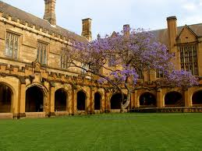
Refrigerator Light & Tree in the Quad
“There was a young man who said "God Must find it exceedingly odd To think that the tree Should continue to be When there's no one about in the quad." Reply: "Dear Sir: Your astonishment's odd; I am always about in the quad. And that's why the tree Will continue to be Since observed by, Yours faithfully, God.”
http://www.youtube.com/watch?v=TwhfTExM080&feature=relmfu
Notes:
This is the thesis Berkeley defends—now on to the arguments for it.

Slide 14
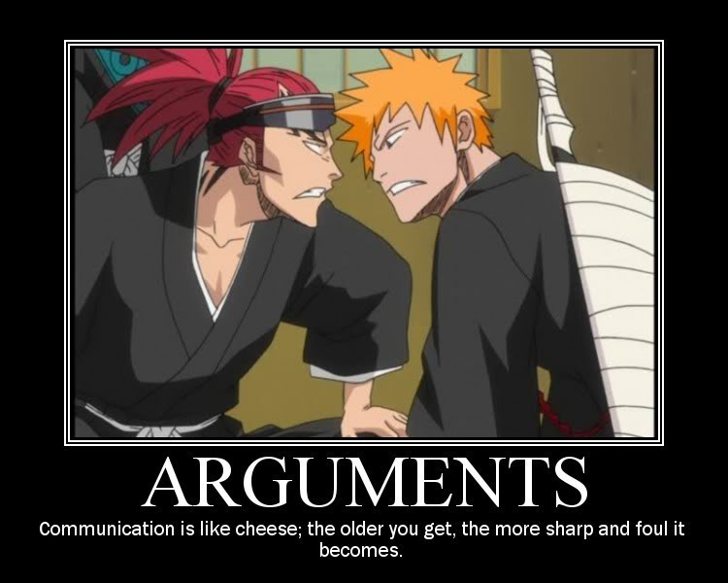
Arguments
Notes:
2 basic arguments for Berkeleian Idealism

Slide 15
The Core Argument
It is indeed widely believed that all perceptible objects— houses, mountains, rivers, and so on—really exist independently of being perceived by the understanding. But… [this belief] involves an obvious contradiction. For what are houses, mountains, rivers etc. but things we perceive by sense? And what do we perceive besides our own ideas or sensations? And isn’t it plainly contradictory that these, either singly or in combination, should exist unperceived? [PHK 4]
We perceive ordinary objects
We perceive only ideas
Therefore, ordinary objects are ideas

Slide 16
The Core Argument
We perceive ordinary objects
We perceive only ideas
Therefore, ordinary objects are ideas
There are (at least) two ways to defeat this argument:
Representationalist Response: “perceive” is ambiguous and means something different in premises 1 and 2
Direct Realist Response: premise 2 is false. We perceive ordinary material objects directly.

Slide 17
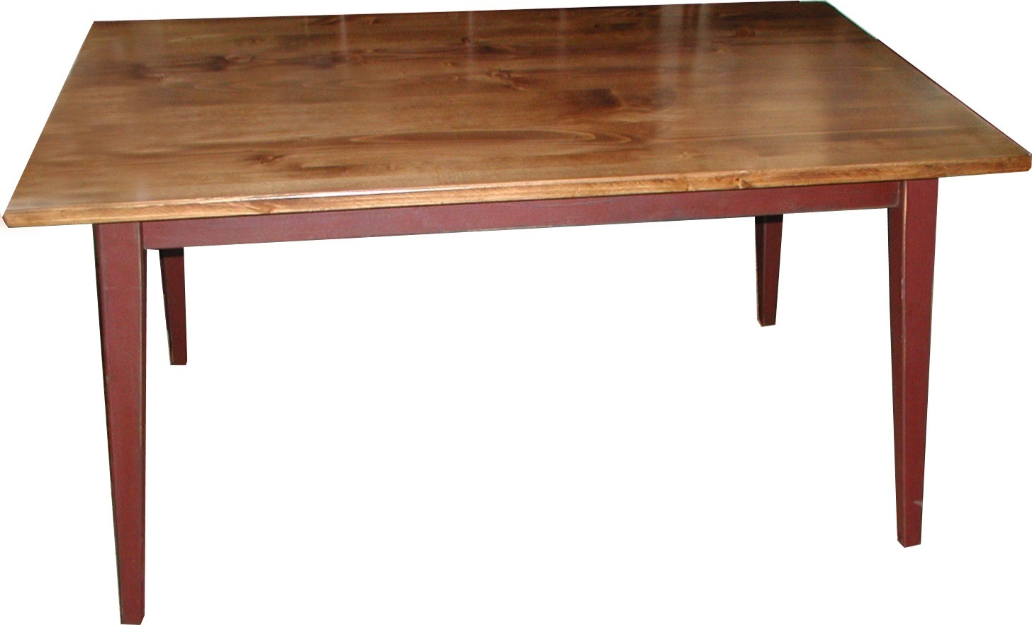
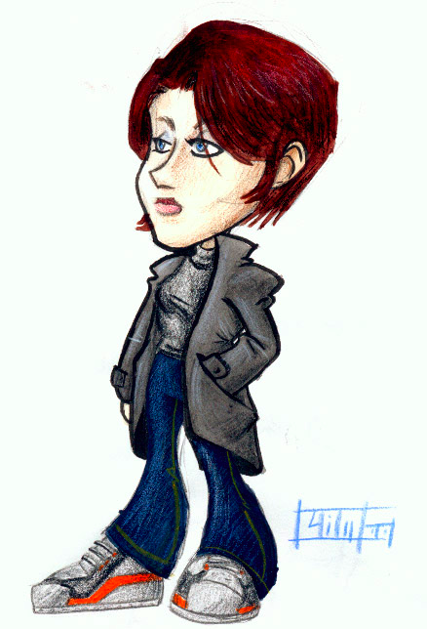
The Representationalist’s Response
immediately perceived
mediately perceived
“Perceive” is ambiguous between “mediately perceive” and “immediately perceive, so the argument is invalid
Things “out there” (material objects) both cause and resemble our ideas

Slide 18
Berkeley rejects Representationalism
Representationalism forces us to skepticism since we can’t know how our ideas are caused or whether they resemble whatever causes them
Suppose it were possible for solid, figured, movable substances to exist outside the mind, corresponding to the ideas we have of bodies—how could we possibly know that there are any such things? [PHK 18]
Representationalism is incoherent since non-ideas can’t literally resemble ideas—since they can’t in principle be compared
‘But’, you say, ‘though the ideas don’t exist outside the mind, still there may be things like them of which they are copies or resemblances, and these things may exist outside the mind in an unthinking substance.’ I answer that the only thing an idea can resemble is another idea [PHK 8]
Notes:
So we can’t directly observe causation—we never can.
Unfair: pictures can resemble 3 d objects in some respects. Sounds like verificationism.
Problem of causation between different kinds of substances, as with descartes.

Slide 19
The Direct Realist Response
The Core Argument
We perceive ordinary objects
We perceive only ideas
Therefore, ordinary objects are ideas
According to Direct (sometimes called “Naïve”) Realism we perceive ordinary, public physical objects directly—not “mediately” via sense data or ideas.
Premise 2, according to the Direct Realist is thus false so the argument is unsound.

Slide 20
Berkeley’s Responses
The Primary/Secondary Quality Distinction fails
Relativity Arguments
Denial of “abstract ideas”: The inconceivability of unperceived objects
The notion of Material Substance (vide Locke) is incoherent—and wicked:
How great a friend material substance has been to atheists in all ages were needless to relate. All their monstrous systems have so visible and necessary a dependence on it that when this corner-stone is once removed, the whole fabric cannot choose but fall to the ground insomuch that it is no longer worth while to bestow a particular consideration on the absurdities of every wretched sect of atheists. [PHK92]

Slide 21
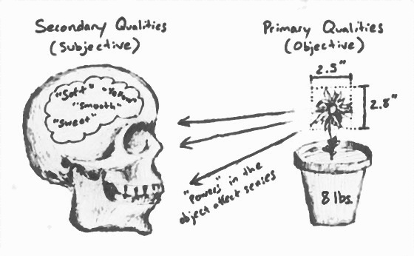
Primary and Secondary Qualities

Slide 22
Primary and Secondary Qualities
Those who assert that shape, motion and the other primary qualities exist outside the mind in unthinking substances say in the same breath that colours, sounds, heat, cold, and other secondary qualities do not. These, they tell us, are sensations that exist in the mind alone, and depend on the different size, texture, and motion of the minute particles of matter. They offer this as an undoubted truth that they can prove conclusively. Now if it is certain that (1) primary qualities are inseparably united with secondary ones, and can’t be abstracted from them even in thought, it clearly follows that (2) primary qualities exist only in the mind, just as the secondary ones do
Primary qualities can’t be “abstracted” from secondary qualities, e.g. can’t imagine extension without color [PHK 10]
The arguments that purport to show secondary qualities are subjective can be deployed to show that primary qualities are.
Some modern philosophers argue that certain perceptible qualities have no existence in matter or outside the mind; their arguments can be used to prove the same thing of all perceptible qualities whatsoever…In short, the arguments that are thought to prove that colours and tastes exist only in the mind have as much force to prove the same thing of extension, shape and motion. [PHK 14-15]
Notes:
On abstraction, contra Locke.

Slide 23
Relativity Arguments
Large and small, and fast and slow, are generally agreed to exist only in the mind. That is because they are entirely relative: whether something is large or small, and whether it moves quickly or slowly, depends on the condition or location of the sense-organs of the perceiver.
Observer-relativity of a sensible quality shows that it’s “subjective” i.e. our sensation doesn’t resemble a cause “out there.”
All sensible qualities (“primary” as well as “secondary”) are observer-relative
Therefore, all sensible qualities are subjective.

Slide 24
The Refrigerator Light Argument
‘surely there is nothing easier than to imagine trees in a park, for instance, or books on a shelf, with nobody there to perceive them.’ I reply that this is indeed easy to imagine; but let us look into what happens when you imagine it. You form in your mind certain ideas that you call ‘books’ and ‘trees’, and at the same time you omit to form the idea of anyone who might perceive them. But while you are doing this, you perceive or think of them! So your thought- experiment misses the point; it shows only that you have the power of imagining or forming ideas in your mind; but it doesn’t show that you can conceive it possible for the objects of your thought to exist outside the mind. To show that, you would have to conceive them existing unconceived or unthought-of, which is an obvious contradiction. However hard we try to conceive the existence of external bodies, all we achieve is to contemplate our own ideas. The mind is misled into thinking that it can and does conceive bodies existing outside the mind or unthought-of because it pays no attention to itself, and so doesn’t notice that it contains or thinks of the things that it conceives. [PHK 23]

Slide 25
Conceivability and Logical Possibility
Note: “perceive” for Berkeley means “think about” or “conceive of” so Berkeley’s esse is percipi claims that, for non-spirits, to be is to be thought-about.
A state of affairs is logically possible only if it’s conceivable
We cannot conceive of a state of affairs in which there are unthoughtabout objects
Try it…gotcha!
Therefore, it is logically impossible that unthought-about objects exist.

Slide 26
The Possibility of the Inconceivable
It is possible de re that a given unthought-about object be thought about.
De dicto and de re mark important distinctions in modal contexts—those concerning possibility and necessity—and in belief contexts, e.g.
Necessarily, the US President is a US citizen.
Penelope believed her husband was an old beggar.
The literal translation of the phrase "de dicto" is "of (the) word", whereas de re translates to "of (the) thing”

Slide 27
De Dicto and De Re
Necessarily the US President is a US citizen
De Dicto: Necessarily, no one can be (count as) a US President unless they’re a US citizen.
TRUE
De Re: This guy Barak Obama is of necessity a US citizen—it’s logically impossible that he could fail to be one, or give up his US citizenship.
FALSE

Slide 28
De Dicto and De Re
Penelope believed her husband was a beggar
De Dicto: Penelope believed that she was married to a beggar. If asked what her husband did for a living she would not have said “King of Ithaca”—she would have said “beggar.”
FALSE
De Re: When Odysseus, who was Penelope’s husband, first got home disguised as a beggar, Penelope believed of him that he was a beggar.
TRUE

Slide 29
The Tattletale’s Paradox
I can’t tell you the secret because if I did it wouldn’t be a secret.
Possibility De Dicto and De Re
It is possible de re of this story, which is a secret, that I tell it to you
It is not possible de dicto that I tell you a secret
It is possible de re of this unthought-about object that it be thought-about even though it isn’t possible that an object be both thought-about and unthought-about (at the same time).

Slide 30
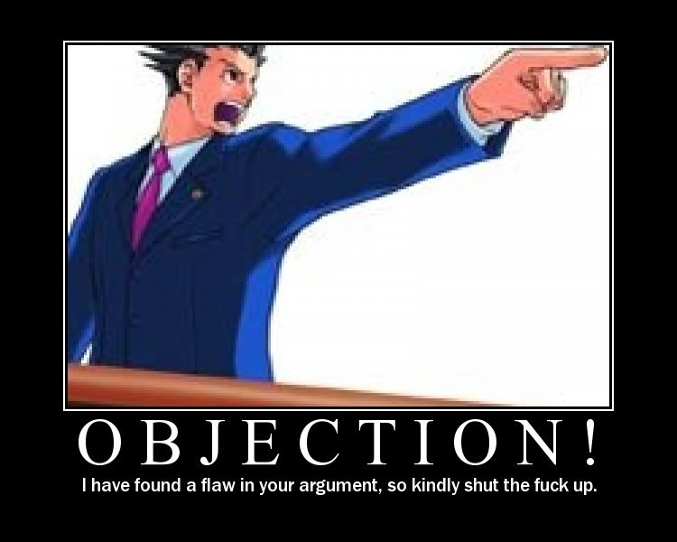
Objections

Slide 31
Persistence
The table that I am writing on exists, that is, I see and feel it; and if I were out of my study I would still say that it existed, meaning that •if I were in my study I would perceive it, or that •some other spirit actually does perceive it. Similarly, ‘there was an odour’—i.e. it was smelled; ‘there was a sound’—it was heard; ‘there was a colour or shape’—it was seen or felt.
Two options:
God perceives things at all times (“I am always about in the Quad”)
To say that there are books in the study even when no one is perceiving them is just to mean that if one were to go into the study then one would get appropriate sensations

Slide 32
“There is a Rerum Natura…”
the principles I have laid down don’t deprive us of any one thing in nature. Whatever we see, feel, hear, or in any way conceive or understand remains as secure as ever, and is as real as ever. There is a real world, and the distinction between realities and chimeras retains its full force…real things and chimeras both exist in the mind, and in that sense are alike in being ideas. [PHK 34]
Ideas of real things are “caused by the will of a more powerful spirit, namely God” [PHK 33]
We can recognize them because they’re more regular, vivid and constant [PHK 33]

Slide 33
Science
Objection: Immaterialism is unscientific
Response: [Scientific] ‘explaining’ consists in bringing events under general rules (see 62) that are based on the analogy and uniformness observed in the production of natural effects. We like such rules, and try to find them, because they extend our view beyond what is ·temporally· present and ·spatially· near to us, and enable us to make very probable conjectures about things that may have happened at very great distances of time and place, as well as to predict things to come.[ PHK 105]
In talking about one event causing another we speak with the vulgar—but should think with the learned.

Slide 34
Optical ( and Other) Illusions
Hylas. [H]ow can a man be mistaken in thinking the moon a plain lucid surface, about a foot in diameter; or a square tower, seen at a distance, round; or an oar, with one end in the water, crooked
Philonous. He is not mistaken with regard to the ideas he actually perceives; but in the inferences he makes from his present perceptions. Thus in the case of the oar, what he immediately perceives by sight is certainly crooked; and so far he is in the right. But if he thence conclude, that upon taking the oar out of the water he shall perceive the same crookedness; or that it would affect his touch, as crooked things are wont to do: in that he is mistaken. (3D 238)

Slide 35
Summary
There are spiritual substances, minds, or human souls, which cause •ideas in themselves through acts of the will, doing this as they please; but these ideas are faint, weak, and unsteady as compared with other •ideas that minds perceive by sense. The latter ideas, being impressed on minds according to certain rules or laws of nature tell us that they are the effects of a mind that is stronger and wiser than human spirits. The latter are said to have more reality in them than the former: by which is meant that they are more forceful, orderly, and distinct, and that they aren’t fictions of the mind that perceives them. In this sense, the sun that I see by day is the real sun, and what I imagine by night is the idea of the former. In the sense I am here giving to ‘reality’, it is evident that every plant, star, rock, and in general each part of the system of the world, is as much a real thing by my principles as by any others. Whether you mean by ‘reality’ anything different from what I do, I beg you to look into your own thoughts and see.

Slide 36
Immaterialism: Does it matter?
I’m happy…what’s the problem?

