Slide 1
The Identity of Indiscernibles
Max Black

Slide 2
Back Story and Some Terminology
indiscernibility of identicals
identity of indiscernibles
tautology
use-mention distinction
contrapositive
counterexample
incongruous counterparts
numerical identity/qualitative similarity
pure and impure properties
intrinsic/extrinsic/relational
verificationism

Slide 3
Indiscernibility and Identity
The ambiguity of “identity”: “identical” and cognates, and type-token ambiguity.
(“Numerical”) identity: the relation everything bears to itself and to no other thing.
Qualitative similarity: the relation between objects that have various properties in common—objects of the same type.
Indiscernibility of Identicals: x = y ⊃ ∀F(Fx ≡ Fy) if x is identical to y then they have exactly the same properties
substitutivity principle
Identity of Indiscernibles: ∀F(Fx ≡ Fy) ⊃ x = y if x and y have exactly the same properties then they are identical
For the PII to be interesting we have to specify what kind of properties matter

Slide 4
Kinds of Properties
Intrinsic properties
properties a thing could have even if it were “lonely”—even if it were the only thing in the universe.
Examples: being gray, being spherical, being made of iron
Extrinsic properties
properties that are not intrinsic, properties a “lonely” object couldn’t have
Examples: being married, being 2 miles away from an iron sphere
“Cambridge Changes”: changes in extrinsic properties
Relational properties: not all relational properties are extrinsic
Relational but not extrinsic: relation of a whole to parts, (controversially) the relation of a statue to the lump of clay of which it’s made

Slide 5
Properties
“Pure” properties (“Qualitative” properties) and relations: don’t require the existence of any specific object for their instantiation
Example: being red, being 2 miles from an iron sphere, being a mother
“Impure” properties (“Non-qualitative” properties) and relations: do require the existence of specific objects for their instantiation
Examples: composing the Eifel Tower, being 7 miles north of Tijuana
Note: as Black points out, being identical to a is not a purely qualitative property
Bundle Theory: on this account, objects are nothing more than bundles of properties—so same bundle, same object.

Slide 6
Other Terminology
The Use-Mention Distinction
Distinction between the use of a world to talk about something else and talk about the word itself, that is, mentioning the world rather than using it to do its usual job.
Compare: a = b where “a” and “b” are used to refer to an object with “a” and “b” are names of the same object.
Verificationism
Doctrine espoused by the Logical Positivists according to which a factual statement (one that isn’t a mere tautology) has meaning only if it is verifiable in experience.
Hume’s Fork: the ancestor of the Verification Principle
Tautology: a statement that is necessarily true in virtue of its truth-functional structure.

Slide 7
Identity of Indiscernibles Thought Experiments
Putative counterexamples to PII (the Principle of Identity of Indiscernibles) aim to show that there are cases where objects are
indiscernible (with respect to relevant properties
numerically distinct
The PII advocate’s response to putative counterexamples will be one of the following types:
The things really are identical (Hacking’s curved space)
The things are distinct but not indiscernible
There is just one exotic thing, multiply located or just weird
The thought experiment fails: conceivability is problematic

Slide 8
The Dispute
A defends Identity of Indiscernibles
If a and b are distinct then there must be some property that distinguishes them.
This is the contrapositive of identity of indiscernibles, equivalent to if a and b have all properties in common then they’re identical.
Remember, the contrapositive of “p ⊃ q” is “∼q ⊃ ∼p”
B denies identity of indiscernibles
It is possible for distinct things to be indistinguishible
For there to be no property that one has which the other lacks

Slide 9
A’s First Argument
Even if a and b have all ordinary properties in common they have different identity properties:
Only a has the property of being identical to a
Only b has the property of being identical to b
a
b

Slide 10
B’s Objection to First Argument
These supposedly distinct identity properties are bogus
What the predicates “__is identical to a” and “__is identical to b” designate is nothing more than the property of self-identity.
So all A really said was an empty tautology, viz. a and b each have the property of self-identity.
Note: tautologies are necessarily true—because they convey no information
Example: “Either today is Tuesday or today is not Tuesday.”

Slide 11
A’s Defense
But how about distinctness?
Only a has the property of being distinct from b
Only b has the property of being distinct from a
a
b

Slide 12
B’s Objection to A’s response
Same difference
In general “x has the property of being distinct from y” just says that x and y are numerically distinct.
So “a has the property of being distinct from b” just says “a and b are numerically distinct”--which was to be proven.
Note: we distinguish numerical identity from qualitative similarity.
Numerical identity is identity of objects—the ordinary counting relation
Qualitative similarity is similarity with respect to various qualities or properties

Slide 13
Purely Qualitative Properties
Allowing “identity properties” to count for the purposes of the discussion is question-begging: we have to restrict the range of properties that are to count for indiscernibility to avoid trivializing the issue.
Proposal: restrict consideration to purely qualitative properties:
Some properties essentially involve reference to particulars, e.g. being at the foot of Mt. Everest
Purely qualitative properties don’t, e.g. being red
For Identity of Indiscernibles, to be interesting, claims that if x and y have all the same purely qualitative properties then x = y

Slide 14
Is identity purely qualitative?
Being self-identical is but
Being identical to a isn’t
So A faces a dilemma:
a and b aren’t distinguished by self-identity since everything is identical to itself but
Being identical to a doesn’t count because it isn’t a purely qualitative property.

Slide 15
A’s Second Argument
a and b are distinguished by a relational property.
Relational properties include, e.g. being the wife of Socrates, being 4 miles away from a burning barn
They can be purely qualitative or not purely qualitative
The relational property we’re interested in is being distinguishable by some experience—which is purely qualitative
If a and b weren’t distinguishible in experience then calling them distinct would be meaningless.
By The Verification Principle

Slide 16
The Verification Principle
Ah-ha! Now we’re laying the cards on the table face up!
This dispute is about is the Logical Positivist doctrine of Verificationism!
Verificationism entails Identity of Indiscernibles
Which is, um, questionable.

Slide 17
B’s Response: Symmetrical Worlds
B proposes some thought experiments as counterexamples to A’s claim that for all x, y, if x and y have all the same properties then they are identical.
Thought experiments are interesting philosophically because we’re interested in seeing what’s logically possible—not what actually is.
A counterexample to a conditional is a case where the antecedent is true and the consequent false
So we need a case where objects have all the same properties but aren’t identical.
B’s putative counterexamples to Identity of Indiscernibles:
The Two-Qualitatively-Similar-Spheres World (Black’s Balls)
The Mirror World
The Radially Symmetrical World

Slide 18
Qualitatively Similar Spheres
a
b
B, opposing Identity of Indiscernibles, says the spheres are distinct because we could name them “a” and “b”

Slide 19
A proposes a dilemma
When we talk about “naming” the spheres we are, in effect, introducing something else into the picture, viz. ourselves as namers and this corrupts the thought experiment:
If “we” name them we’re introducing a third item (ourselves) into the thought experiment, so a and b are distinguished by a relational property, viz. being named by us.
If “we” don’t, then they’re not distinguishable so not distinct--by the Verification Principle
So the putative counterexample fails.

Slide 20
Berkeley’s Esse is Percipi Argument
Compare to Berkeley’s argument that unthought-about objects can’t exist.
X is possible only if it’s conceivable
You can’t conceive of an unthought-about object because in doing that you yourself are thinking about it
You’ve introduced yourself into the thought experiment.

Slide 21
The Verification Principle
Response to A’s Dilemma:
1st Horn: If “we” name them we’re introducing a third item (ourselves) into the thought experiment, so a and b are distinguished by a relational property, viz. being named by us.
2nd Horn: If “we” don’t, then they’re not distinguishable so not distinct--by the Verification Principle
If we don’t like Berkeley’s argument we shouldn’t find the first horn of the dilemma compelling.
If we don’t like the Verification Principle, we shouldn’t be bothered by the second.
B is offering a putative counterexample to the Verification Principle and A is arguing that it’s not a counterexample by making the case that objects that seem to be qualitatively the same are in fact qualitatively distinguishable.

Slide 22
Qualitatively Similar Spheres Redux
B notes that each of the spheres has the same spatial properties, i.e. being 2 miles from a sphere.
A argues that they have distinct spatial properties, i.e. being at different places in Newtonian space.
So, here’s another problem: A’s defense of Identity of Indiscernibles commits us to Newtonian space

Slide 23
Spheres in Newtonian Space
A says the spheres are qualitatively different because they occupy different regions of Newtonian Space, which we may imagine as a box with all the sides knocked out.

Slide 24
A on the attack!
A notes further (invoking the Verification Principle) that without rulers or other measuring instruments in the world it doesn’t even make sense to say that the spheres have same spatial properties.
But if we introduce rulers we’ve destroyed the thought experiment by introducing something else into the world.
B responds by suggesting another symmetrical world where rulers are ok.
In the checkerboard world we can introduce rulers and other instruments

Slide 25
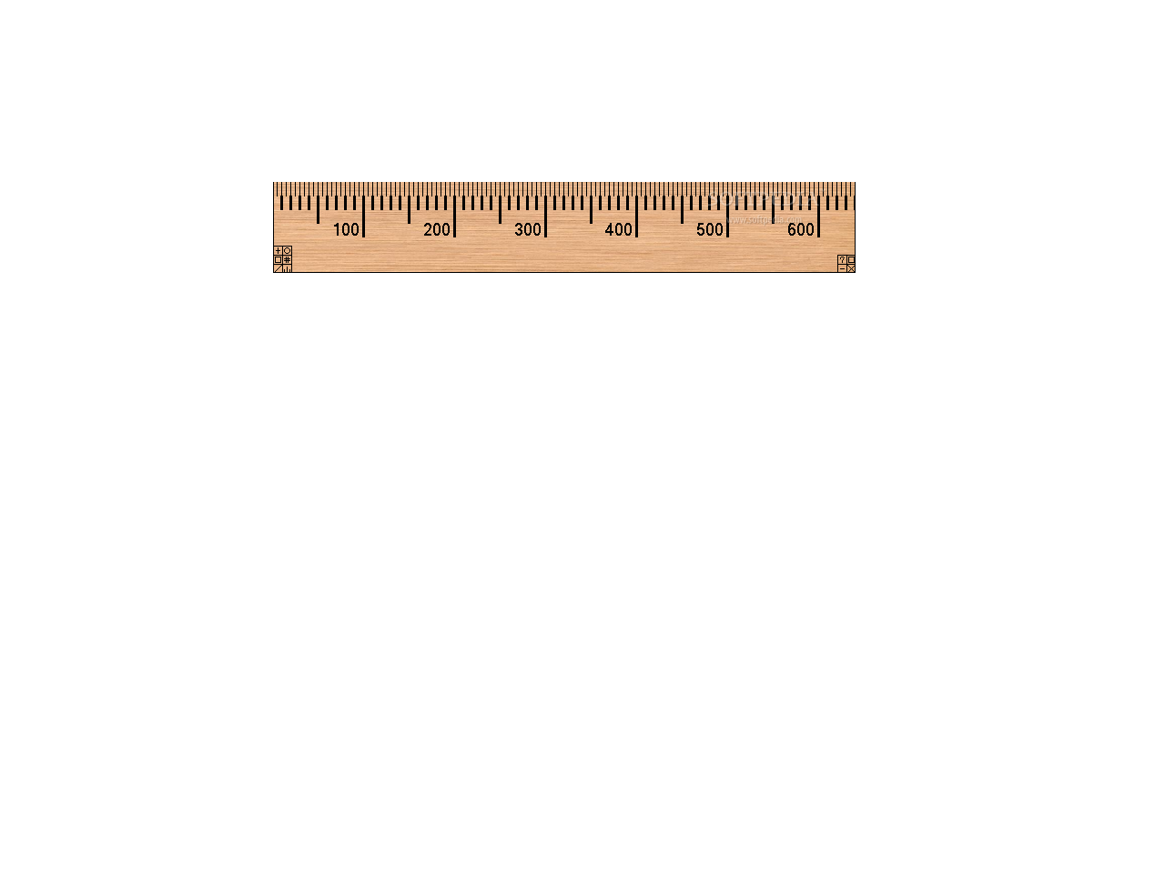
The Checkerboard World

Slide 26
Incongruous Counterparts
A points out that “mirror images” are not qualitatively the same.

Slide 27
A Radially Symmetrical Universe
This avoids the incongruous counterparts problem

Slide 28
An Impasse!
The radially symmetrical universe is empirically indistinguishable from a world where “there’s just one of everything.”
But A, committed to verificationism, will say that this just means that there’s no difference between these worlds!
And that we haven’t really conceived of what we thought we conceived of.

Slide 29
Some Inconclusive Conclusions
Verificationism has a counterintuitive result: the Identity of Indiscernibles
A determined verificationist can rebut putative counterexamples
Thought experiments are problematic because relying on “conceivability” as a criterion for logical possibility is problematic

Slide 30
A possible moral
We rarely get conclusive results in philosophy because most arguments turn out to be cost-benefit arguments
Most of what we do is a matter of drawing out the entailments of various claims so that we can assess the costs and benefits of buying them

