Slide 1
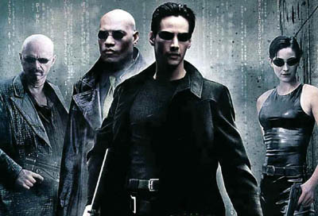
The Matrix
as Metaphysics

Slide 2
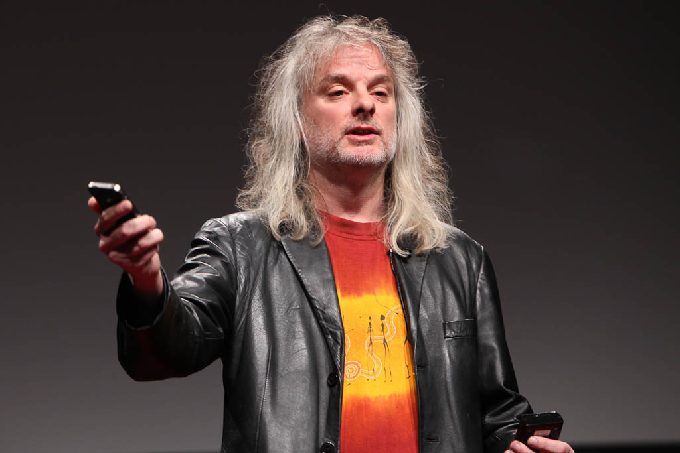
Against Global Skepticism
I’m happy. What’s the problem?

Slide 3
Skeptical vs. Metaphysical Hypotheses
Skeptical Hypothesis: A hypothesis that (1) I cannot rule out and (2) one that would rule out most of my beliefs if it were true.
Descartes intends his dream and evil demon hypotheses to be skeptical hypotheses.
Bouwsma, Berkeley, and Chalmers argue that it is not a skeptical hypothesis
Metaphysical Hypothesis: a hypothesis about the underlying nature of reality.
need not be incompatible with our ordinary beliefs about the world.

Slide 4
Thought Experiments
Can we tell the story without begging the question?
Can the thought experiment be described in different ways?
Is the Brain in the Vat thought experiment a skeptical hypothesis?

Slide 5
Chalmers’ Agenda
The Skeptical Hypothesis
Argument to show that the Matrix Hypothesis isn’t a skeptical hypothesis.
The Matrix Hypothesis
The Metaphysical Hypothesis: not a skeptical hypothesis
The Matrix Hypothesis is equivalent to the Metaphysical Hypothesis
Objections to the thesis that the Matrix Hypothesis isn’t a skeptical hypothesis
Variants on the Matrix hypothesis

Slide 6
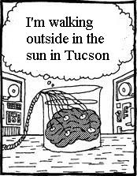
Brains in Vats
Matrix: an artificially-designed computer simulation of a world.
Envatted (“in a matrix”): has a cognitive system which receives its inputs from and sends its outputs to a matrix.
Notes:
How do I know (or do I know) that I’m not in a matrix?

Slide 7
The Matrix Hypothesis
The hypothesis that I am in, and have always been in a matrix, i.e. “envatted”
Is this a skeptical hypothesis: i.e. one that would falsify most of my beliefs if it were true? E.g.
I am in Tucson
I was born in Australia
I have hair
Chalmers will argue that, contrary to the conventional reading, the Matrix Hypothesis is not a skeptical hypothesis: all the above are true!

Slide 8
Semantic Externalism
“Which ever way you cut it, meanings are not in the head”
Hillary Putnam
My exact intrinsic duplicate could mean something different from what I mean
e.g. my envatted virtual duplicate does not mean the same thing that I mean when she says “Tucson”
or have the same beliefs that I have when she believes that Tucson is in Arizona, etc.
What we say and what we believe depend of circumstances outside the head
consider Twin Earth…

Slide 9
The Metaphysical Hypothesis
I will argue that the hypothesis that I am envatted is not a skeptical hypothesis, but a metaphysical hypothesis. That is, it is a hypothesis about the underlying nature of reality.
Physical processes are fundamentally computational
Our cognitive systems are separate from physical processes, but interact with these processes
Physical reality is created by beings outside physical space-time

Slide 10
Envattment Reconsidered
Nothing about this Metaphysical Hypothesis is skeptical…it does not entail that this reality does not exist…its just that their fundamental nature is a bit different from the way we may have thought
The Metaphysical Hypothesis tells us about the processes underlying chairs. They do not entail that there are no chairs. Rather, they tell us what chairs are really like.
So we’ll consider the three conditions of the Metaphysical Hypothesis in turn, and then see whether (1) they entail and (2) are entailed by the Matrix Hypothesis.
If so, then the Matrix Hypothesis is not a skeptical hypothesis: accepting it doesn’t mean we hold that ordinary claims about tables and chairs etc. are false, or unknowable.

Slide 11
Proving the Biconditional
Note Chalmers’ strategy—just like back in Phil 101!
The Metaphysical Hypothesis is true iff the Matrix Hypothesis is true
We want to “prove the conditional going both ways”
First Chalmers is going to argue from the the Metaphysical Hypothesis to the Matrix Hypothesis
by explaining and putting together the pieces of the Metaphysical Hypothesis: the Creation Hypothesis, the Computational Hypothesis and the Mind-Body hypothesis
which we see together clearly entail the Matrix Hypothesis
And second run the argument the other way around!

Slide 12
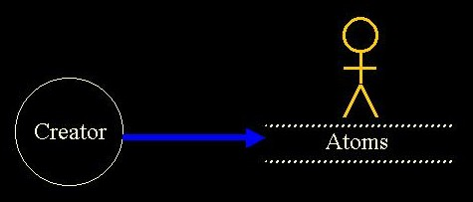
The Creation Hypothesis
Physical space-time and its contents were created by beings outside of physical space-time.

Slide 13
The Creation Hypothesis
Physical space-time and its contents were created by beings outside of physical space-time.
Note: we aren’t asking the question of whether this is plausible but rather the question of whether it’s coherent.
This view is held by many people—those who believe in a creator-god.
But it doesn’t imply there’s a creator-god—could be extra-terrestrials or whatever.
It’s not a skeptical hypothesis since its compatible with the truth of our ordinary commonsense and scientific beliefs.

Slide 14
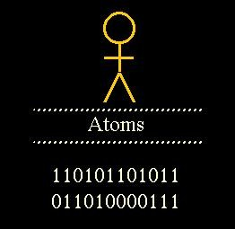
The Computational Hypothesis
Microphysical processes throughout space-time are constituted by underlying computational processes…underneath the level of quarks and electrons and photons is a further level: the level of bits…[producing] the processes that we think of as fundamental particles, forces, etc.

Slide 15
The Computational Hypothesis
One might worry that pure bits could not be the fundamental level of reality…
Because they’re abstracta—zeros and ones
But this is irrelevant...
We can suppose that the computational level is itself constituted by eneven more fundamental level, at which the computational processes are implemented.
The Computational Hypothesis is not a skeptical hypothesis. If it is true, there are still electrons and protons…[and] most of our ordinary beliefs are unaffected.

Slide 16
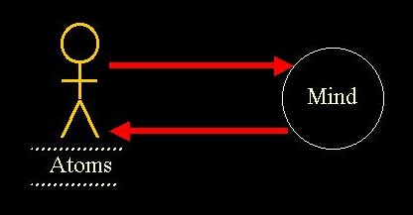
The Mind-Body Hypothesis
My mind is (and always has been) constituted by processes outside physical space-time, and receives its perceptual inputs from and sends its outputs to processes in physical space-time.
Coherent…not a skeptical hypothesis. Even if my mind is outside physical space-time, I still have a body, I am still in Tucson, and so on…Our ordinary beliefs about external reality will remain largely intact.

Slide 17
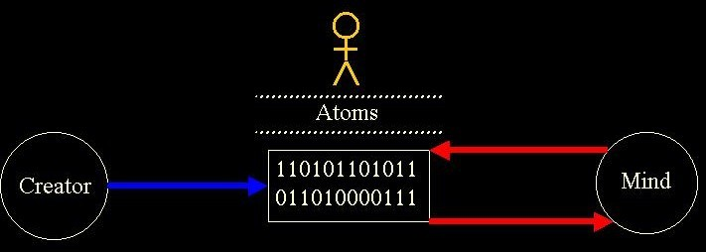
The Metaphysical Hypothesis
Combination Hypothesis which…says that physical space-time and its contents were created by beings outside physical space-time, that microphysical processes are constituted by computational processes, and that our minds are outside physical space-time but interact with it is coherent.
Metaphysical Hypothesis (with a capital M). Like the Combination Hypothesis, this combines the Creation Hypothesis, the Computational Hypothesis, and the Mind-Body Hypothesis. It also adds the following more specific claim: the computational processes underlying physical space-time were designed by the creators as a computer simulation of a world. .. Not a skeptical hypothesis.

Slide 18
The Matrix as a Metaphysical Hypothesis
I will argue that the Matrix Hypothesis is equivalent to the Metaphysical Hypothesis, in the following sense: if I accept the Metaphysical Hypothesis, I should accept the Matrix Hypothesis, and if I accept the Matrix Hypothesis, I should accept the Metaphysical Hypothesis. That is, the two hypotheses imply each other, where this means that if one accepts the one, one should accept the other.
The shape of the world according to the Matrix Hypothesis

Slide 19
Life in the Matrix
If this is right, it follows that the Matrix Hypothesis is not a skeptical hypothesis…[but] a complex picture of the fundamental nature of reality. The picture is strange and surprising, perhaps, but it is a picture of a full-blooded external world. If we are in a matrix, this is simply the way that the world is.
Other Minds: One may worry about beliefs about other people's minds…We could circumvent this issue by building into the Matrix Hypothesis the requirement that all the beings we perceive are envatted. But even if we do not build in this requirement, we are not much worse off than in the actual world.
Beliefs about Past and Future: These will be unthreatened as long as the computer simulation covers all of space-time, from the Big Bang until the end of the universe. This is built into the Metaphysical Hypothesis

Slide 20
What, Me Worry?
[N]one of these sources of skepticism — about other minds, the past and the future, about our control over the world, and about the extent of the world — casts doubt on our belief in the reality of the world that we perceive. None of them leads us to doubt the existence of external objects such as tables and chairs, in the way that the vat hypothesis is supposed to do. And none of these worries is especially tied to the matrix scenario. One can raise doubts about whether other minds exist, whether the past and the future exist, and whether we have control over our worlds quite independently of whether we are in a matrix. If this is right, then the Matrix Hypothesis does not raise the distinctive skeptical issues that it is often taken to raise.

Slide 21
Objections
When we look at a brain in a vat from the outside, it is hard to avoid the sense that it is deluded. This sense manifests itself in a number of related objections. These are not direct objections to the argument above, but they are objections to its conclusion.

Slide 22
Where Am I?
Objection 1: A brain in a vat may think it is outside walking in the sun, when in fact it is alone in a dark room. Surely it is deluded!
Response: The brain is alone in a dark room. But this does not imply that the person is alone in a dark room.
Objection 2: An envatted being may believe that it is in Tucson, when in fact it is in New York, and has never been anywhere near Tucson.
Response: The envatted being's concept of "Tucson" does not refer to what we call Tucson. Rather, it refers to something else entirely: call this Tucson*, or "virtual Tucson”...When the being says to itself "I am in Tucson", it really is thinking that it is in Tucson*, and it may well in fact be in Tucson*. Because Tucson is not Tucson*, the fact that the being has never been in Tucson is irrelevant to whether its belief is true

Slide 23
Reference
Objections 4 and 5: What sort of objects does an envatted being refer to. What is virtual hair, virtual Tucson, and so on?...[V]irtual hands are not real hands. Does this mean that if we are in the matrix we don’t have real hands?
Response: If I am envatted, then the objects that I refer to (hair, Tucson, and so on) are all made of bits…Virtual Tucson is not Tucson, but it exists inside the computer all the same…If we are not in the matrix but someone else is, we should day that their term ‘hand’ refers to virtual hands, but out term does not…But if we are in the matrix, then our term ‘hand’ refers to something that’s made of bits: virtual hands, or at least something that would be regarded as virtual hands by people in the next world up.

Slide 24
What are virtual objects made of?
Objection 6: Just which pattern of bits is a given virtual object? Surely it will be impossible to pick out a precise set.
Response: This question is like asking: just which part of the quantum wavefunction is this chair, or is the University of Arizona? These objects are all ultimately constituted by an underlying quantum wavefunction, but there may be no precise part of the micro-level wavefunction that we can say "is" the chair or the university. The chair and the university exist at a higher level. Likewise, if we are envatted, there may be no precise set of bits in the micro-level computational process that is the chair or the university. These exist at a higher level. And if someone else is envatted, there may be no precise sets of bits in the computer simulation that "are" the objects they refer to. But just as a chair exists without being any precise part of the wavefunction, a virtual chair may exist without being any precise set of bits.

Slide 25
Actions and Other Minds
Objection: An envatted being thinks it performs actions, and it thinks it has friends. Are these beliefs correct?
Response: One might try to say that the being performs actions* and that it has friends*. But for various reason I think it is not plausible that words like "action" and "friend" can shift their meanings as easily as words like like "Tucson" and "hair". Instead, I think one can say truthfully (in our own language) that the envatted being performs actions, and that it has friends. To be sure, it performs actions in its environment, and its environment is not our environment but the virtual environment. And its friends likewise inhabit the virtual environment (assuming that we have a multi-vat matrix, or that computation suffices for consciousness). But the envatted being is not incorrect in this respect.

Slide 26
How theory-laden is ordinary language?
Objection 8: Surely, if we are in a matrix, the world is nothing like we think it is!
Response: I deny this. Even if we are in a matrix, there are still people, football games, and particles, arranged in space-time just as we think they are. It is just that the world has a further nature that goes beyond our initial conception. In particular, things in the world are realized computationally in a way that we might not have originally imagined. But this does not contradict any of our ordinary beliefs. At most, it will contradict a few of our more abstract metaphysical beliefs. But exactly the same goes for quantum mechanics, relativity theory, and so on…We are not omniscient creatures, and our knowledge of the world is at best partial. This is simply the condition of a creature living in a world.

Slide 27
Other Skeptical Hypotheses
The Matrix Hypothesis is one example of a traditional "skeptical" hypothesis, but it is not the only example. Other skeptical hypotheses are not quite as straightforward as the Matrix Hypothesis. Still, I think that for many of them, a similar line of reasoning applies. In particular, one can argue that most of these are not global skeptical hypothesis: that is, their truth would not undercut all of our empirical beliefs about the physical world. At worst, most of them are partial skeptical hypotheses, undercutting some of our empirical beliefs, but leaving many of these beliefs intact.
If these involve illusions, they’re only imperfect illusions (like Paper Millie) so global skepticism is unwarranted.

Slide 28
New Matrix & Local Matrix Hypothess
New Matrix: I was recently created, along with all my memories, and was put in a newly-created matrix.
Compare to Russell’s 5-minute Hypothesis or Twilight Zone Jahane.
Doesn’t support global skepticism because beliefs about recent events are warranted.
Local Matrix: I am hooked up to a computer simulation of a fixed local environment in a world.
Comparable to the New Matrix: I have true, warranted beliefs about local phenomena, so again, doesn’t support global skepticism.

Slide 29
Recent Matrix Hypothesis
For most of my life I have not been envatted, but I was recently hooked up to a matrix.
My beliefs about current and recent events are false but my beliefs about the past are true—at least for the time being—because…
my conception of external reality is anchored to the reality in which I have lived most of my life. If I have been envatted all my life, my conception is anchored to the computationally constituted reality. But if I was just envatted yesterday, my conception is anchored to the external reality.
But vide Block on slow-switching: will there be a time when I’ve gone native so reference shifts?

Slide 30
Extendible Local Matrix Hypothesis
I am hooked up to a computer simulation of a fixed local environment in a world.
Compare to The Truman Show
Truman has many true beliefs about his current environment: there really are tables and chairs in front of him, and so on. But he is deeply mistaken about things outside his current environment, and further from home…It is common to think that while The Truman Show poses a disturbing skeptical scenario, The Matrix is much worse. But if I am right, things are reversed. If I am in a matrix, then most of my beliefs about the external world are true.
Compare to Berkeley’s beliefs about the unobserved tree in the quad…where arguably we don’t have false beliefs

Slide 31
The Macroscopic Matrix Hypothesis
I am hooked up to a computer simulation of macroscopic physical processes without microphysical detail…there are no microphysical processes, and instead macroscopic physical objects exist as fundamental objects in the world, with properties of shape, color, position, and so on. This is a coherent way our world could be, and it is not a global skeptical hypothesis.
I may have false scientific beliefs but again not a global skeptical hypothesis.
OR consider Berkeley’s instrumentalism…

Slide 32
The God Hypothesis
Physical reality is represented in the mind of God, and our own thoughts and perceptions depend on God’s mind.
A hypothesis like this was put forward by George Berkeley as a view about how our world might really be…The God Hypothesis can be seen as a version of the Matrix Hypothesis, on which the simulation of the world is implemented in the mind of God. If this is right, we should say that physical processes really exist: it's just that at the most fundamental level, they are constituted by processes in the mind of God.
Note: this should not be interpreted as a skeptical hypothesis.

Slide 33
Evil Genius and Dream Hypotheses
The Evil Genius: I have a disembodied mind, and an evil genius is feeding me sensory inputs to give the appearance of an external world.
If the “illusion” is complete, it’s no illusion; if local or purely macroscopic than we’re only mistaken about a limited subject matter.
The Dream Hypothesis: I am now and have always been dreaming.
If my dream-generating system simulates all of space-time, we have something like the original Matrix Hypothesis. If it models just my local environment, or just some macroscopic processes, we have analogs of the more local versions of the Evil Genius Hypothesis above. In any of these cases, we should say that the objects that I am currently perceiving really exist (although objects farther from home may not). It is just that some of them are constituted by my own cognitive processes.

Slide 34
The Chaos Hypothesis
I do not receive inputs from anywhere in the world. Instead, I have random uncaused experiences. Through a huge coincidence, they are exactly the sort of regular, structured experiences with which I am familiar.
My experiences of external objects are caused by nothing, and the set of experiences associated with my conception of a given object will have no common source. Indeed, my experiences are not caused by any reality external to them at all. So this is a genuine skeptical hypothesis: if accepted, it would cause us to reject most of our beliefs about the external world
If so, then if we are granted the assumption that there is some explanation for the regularities in our experience, then it is safe to say that some of our beliefs about the external world are correct.

Slide 35
We’re Happy…What’s the problem?

