Slide 1


Slide 2

The Story
Several years ago I was approached by Pentagon officials who asked me to volunteer for a highly dangerous and secret mission…the Department of Defense was spending billions to develop a Supersonic Tunneling Underground Device, or STUD. It was supposed to tunnel through the earth's core at great speed and deliver a specially designed atomic warhead “right up the Red's missile silos,” as one of the Pentagon brass put it.

Slide 3
The Plan
The problem was that in an early test they had succeeded in lodging a warhead about a mile deep under Tulsa, Oklahoma, and they wanted me to retrieve it for them…According to monitoring instruments, something about the nature of the device and its complex interactions with pockets of material deep in the earth had produced radiation that could cause severe abnormalities in certain tissues of the brain…which were apparently harmless to other tissues and organs of the body.
So it had been decided that the person sent to recover the device should leave his brain behind. It would be kept in a safe place as there it could execute its normal control functions by elaborate radio links…Would it really work? The Houston brain surgeons encouraged me… “We're simply going to make the nerves indefinitely elastic by splicing radio links into them.”

Slide 4
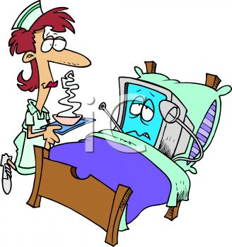
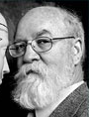
Dennett in Post-Op
The day for surgery arrived at last and of course I was anesthetized and remember nothing of the operation itself. When I came out of anesthesia, I opened my eyes, looked around, and asked the inevitable, the traditional, the lamentably hackneyed postoperative question: “Where am l?” The nurse smiled down at me. “You're in Houston,” she said, and I reflected that this still had a good chance of being the truth one way or another. She handed me a mirror. Sure enough, there were the tiny antennae poling up through their titanium ports cemented into my skull.

Slide 5

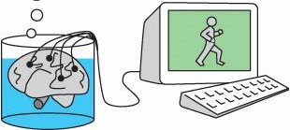
Where am I?
[F]loating in what looked like ginger ale, was undeniably a human brain, though it was almost covered with printed circuit chips, plastic tubules, electrodes, and other paraphernalia…: “Well, here I am…staring through a piece of plate glass at my own brain . . . But wait,” I said to myself, “shouldn't I have thought, ‘Here I am, suspended in a bubbling fluid, being stared at by my own eyes’?”

Slide 6
Hamlet meets Yorick
“Yorick,” I said aloud to my brain, “you are my brain. The rest of my body…I dub ‘Hamlet.’” So here we all are: Yorick's my brain, Hamlet's my body, and I am Dennett. Now, where am I?

Slide 7
Thought Experiments
Philosophical discussions, especially those concerning the mind-body problem and the problem of personal identity rely heavily on thought experiments
  Would we (should we) call XYZ “water”?
  What would we say about a computer that passed the Turing Test?
  What if the hemispheres of our brain were transplanted into two different bodies?
Dennett calls such thought experiments “intuition pumps” since they’re supposed to elicit our “intuitions” about these matters
But what, if anything, do our “intuitions” show?

Slide 8

How reliable are intuition pumps?

Slide 9
Am I where (most of) my body is?
Where Hamlet goes there goes Dennett. This principle was easily refuted by appeal to the familiar brain-transplant thought experiments so enjoyed by philosophers. If Tom and Dick switch brains, Tom is the fellow with Dick's former body — just ask him; he'll claim to be Tom and tell you the most intimate details of Tom's autobiography. It was clear enough, then, that my current body and I could part company, but not likely that I could be separated from my brain.
Note: this is the “orthodox” neo-Lockean view, which Olson will reject. Given this account, however…
The rule of thumb that emerged so plainly from the thought experiments was that in a brain-transplant operation, one wanted to be the donor not the recipient. Better to call such an operation a body transplant, in fact. So perhaps the truth was…

Slide 10
Am I were my brain is?
Where Yorick goes there goes Dennett. This was not at all appealing, however. How could I be in the vat and not about to go anywhere, when I was so obviously outside the vat looking in and beginning to make guilty plans to return to my room for a substantial lunch? This begged the question I realized, but it still seemed to be getting at something important. Casting about for some support for my intuition, I hit upon a legalistic sort of argument that might have appealed to Locke.
Suppose, I argued to myself, I were now to fly to California, rob a bank, and be apprehended. In which state would I be tried: in California, where the robbery took place, or in Texas, where the brains of the outfit were located? Would I be a California felon with an out-of-state brain, or a Texas felon remotely controlling an accomplice of sorts in California?... the state would be obliged to maintain the life-support system for Yorick though they might move him from Houston to Leavenworth, and aside from the unpleasantness of the opprobrium, I, for one, would not mind at all and would consider myself a free man under those circumstances. If the state has an interest in forcibly relocating persons in institutions, it would fail to relocate me in any institution by locating Yorick there. If this were true, it suggested a third alternative.

Slide 11
Am I wherever I think I am?
Dennett is wherever he thinks he is. Generalized, the claim was as follows: At any given time a person has a point of view and the location of the point of view (which is determined internally by the content of the point of view) is also the location of the person.
Point of view clearly had something to do with personal location, but it was itself an unclear notion. It was obvious that the content of one's point of view was not the same as or determined by the content of one's beliefs or thoughts.
For example, what should we say about the point of view of the Cinerama viewer who shrieks and twists in his seat as the roller-coaster footage overcomes his psychic distancing? Has he forgotten that he is safely seated in the theater?... In other cases, my inclination to call such shifts illusory was less strong. The workers in laboratories and plants who handle dangerous materials…can feel the heft and slipperiness of the containers they manipulate with their metal fingers. They know perfectly well where they are and are not fooled into false beliefs by the experience, yet it is as if they were inside the isolation chamber they are peering into.

Slide 12
Am I my brain?
Identifying with one’s brain, as suggested by traditional puzzle cases, supports mentalistic accounts of personal identity.
Dennett challenges the intuitions these cases pump:
Imagine you have written an inflammatory letter which has been published in the Times, the result of which is that the government has chosen to impound your brain for a probationary period of three years in its Dangerous Brain Clinic in Bethesda, Maryland. Your body of course is allowed freedom to earn a salary and thus to continue its function of laying up income to be taxed. At this moment, however, your body is seated in an auditorium listening to a peculiar account by Daniel Dennett of his own similar experience. Try it. Think yourself to Bethesda, and then hark back longingly to your body, far away, and yet seeming so near. It is only with long-distance restraint (yours? the government's?) that you can control your impulse to get those hands clapping in polite applause before navigating the old body to the rest room and a well-deserved glass of evening sherry in the lounge.

Slide 13

Underground in Tulsa
[I]t did seem undeniable that in some sense I and not merely most of me was descending into the earth under Tulsa in search of an atomic warhead.

Slide 14
Instantaneous relocation!
I had set to work with my cutting torch when all of a sudden a terrible thing happened. I went stone deaf. At first I thought it was only my radio earphones that had broken, but when I tapped on my helmet, I heard nothing. Apparently the auditory transceivers had gone on the fritz. I could no longer hear Houston or my own voice, but I could speak, so I started telling them what had happened. In midsentence, I knew something else had gone wrong. My vocal apparatus had become paralyzed. Then my right hand went limp — another transceiver had gone. I was truly in deep trouble. But worse was to follow. After a few more minutes, I went blind. I cursed my luck, and then I cursed the scientists who had led me into this grave peril. There I was, deaf, dumb, and blind, in a radioactive hole more than a mile under Tulsa.
Then the last of my cerebral radio links broke, and suddenly I was faced with a new and even more shocking problem: whereas an instant before I had been buried alive in Oklahoma, now I was disembodied in Houston.

Slide 15
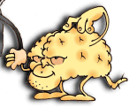
It occurred to me then, with one of those rushes of revelation of which we should be suspicious, that I had stumbled upon an impressive demonstration of the immateriality of the soul based upon physicalist principles and premises. For as the last radio signal between Tulsa and Houston died away, had I not changed location from Tulsa to Houston at the speed of light? And had I not accomplished this without any increase in mass? What moved from A to B at such speed was surely myself, or at any rate my soul or mind — the massless center of my being and home of my consciousness.
I could not see how a physicalist philosopher could quarrel with this except by taking the dire and counterintuitive route of banishing all talk of
persons.

Slide 16
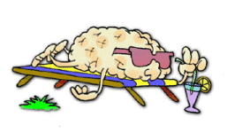
Disembodied in Houston
[M]y technical support team sedated me into a dreamless sleep from which I awoke, hearing with magnificent fidelity the familiar opening strains of my favorite Brahms piano trio. So that was why they had wanted a list of my favorite recordings! It did not take me long to realize that I was hearing the music without ears. The output from the stereo stylus was being fed through some fancy rectification circuitry directly into my auditory nerve. I was mainlining Brahms.

Slide 17

Body Exchange
My sleep lasted, I later learned, for the better part of a year, and when I awoke, it was to find myself fully restored to my senses. When I looked into the mirror, though, I was a bit startled to see an unfamiliar face.
I and my new body, whom we might as well call Fortinbras, strode into the familiar lab to another round of applause from the technicians, who were of course congratulating themselves, not me.

Slide 18

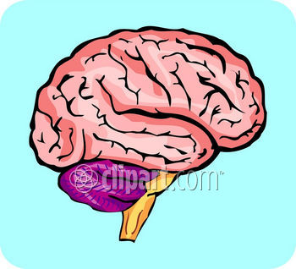
Computer Duplication
[B]efore they had even operated on the first occasion, they had constructed a computer duplicate of my brain, reproducing both the complete information-processing structure and the computational speed of my brain in a giant computer program. After the operation, but before they had dared to send me off on my mission to Oklahoma, they had run this computer system and Yorick side by side. The incoming signals from Hamlet were sent simultaneously to Yorick's transceivers and to the computer's array of inputs. And the outputs from Yorick were not only beamed back to Hamlet, my body; they were recorded and checked against the simultaneous output of the computer program, which was called “Hubert”
Hubert
Yorick
Fortinbras

Slide 19
Can the self divide?
The one truly unsettling aspect of this new development was the prospect, which was not long in dawning on me, of someone detaching the spare — Hubert or Yorick, as the case might be — from Fortinbras and hitching it to yet another body
[S]uppose that before the arrival of the second body on the scene, I had been keeping Yorick as the spare for years, and letting Hubert's output drive my body — that is, Fortinbras — all that time. The Hubert-Fortinbras couple would seem then by squatter's rights (to combat one legal intuition with another) to be the true Dennett and the lawful inheritor of everything that was Dennett's. This was an interesting question, certainly, but not nearly so pressing as another question that bothered me. My strongest intuition was that in such an eventuality I would survive so long as either brain-body couple remained intact.

Slide 20
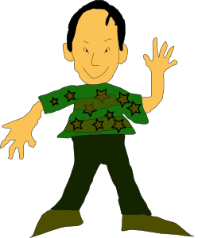


Why not both?
Transitivity of Identity violation!
… but I had mixed emotions about whether I should want both to survive.

Slide 21
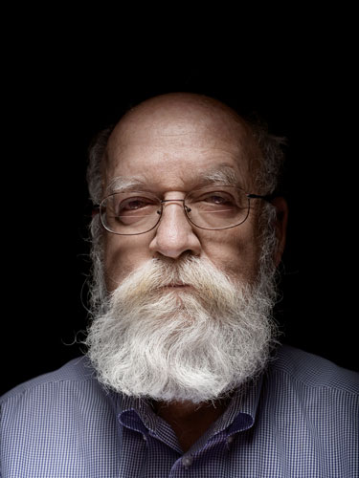
They can’t both be identical to Dennett!
≠
=
=

Slide 22
Two Dennetts?
I discussed my worries with the technicians and the project director. The prospect of two Dennetts was abhorrent to … My colleagues in the lab argued that I was ignoring the bright side of the matter. Weren't there many things I wanted to do but, being only one person, had been unable to do?... But my ordeal in Oklahoma (or was it Houston?) had made me less adventurous, and I shrank from this opportunity that was being offered (though of course I was never quite sure it was being offered to me in the first place).

Slide 23
Two persons/one body?
There was another prospect even more disagreeable: that the spare, Hubert or Yorick as the case might be, would be detached from any input from Fortinbras and just left detached. Then, as in the other case, there would be two Dennetts, or at least two claimants to my name and possessions, one embodied in Fortinbras, and the other sadly, miserably disembodied. Both selfishness and altruism bade me take steps to prevent this from happening…
[I]t was mutually decided that all the electronic connections in the lab would be carefully locked. Both those that controlled the life-support system for Yorick and those that controlled the power supply for Hubert would be guarded with fail-safe devices, and I would take the only master switch, outfitted for radio remote control, with me wherever I went. I carry it strapped around my waist and — wait a moment — here it is. Every few months I reconnoiter the situation by switching channels

Slide 24
“So let’s give it a try…”
“THANK GOD! I THOUGHT YOU'D NEVER FLIP THAT SWITCH! You can't imagine how horrible it's been these last two weeks — but now you know; it's your turn in purgatory. How I've longed for this moment! You see, about two weeks ago — excuse me, ladies and gentlemen, but I've got to explain this to my . . . um, brother, I guess you could say, but he's just told you the facts, so you'll understand — about two weeks ago our two brains drifted just a bit out of synch. I don't know whether my brain is now Hubert or Yorick, any more than you do, but in any case, the two brains drifted apart, and of course once the process started, it snowballed, for I was in a slightly different receptive state for the input we both received, a difference that was soon magnified. In no time at all the illusion that I was in control of my body — our body — was completely dissipated. There was nothing I could do — no way to call you. YOU DIDN'T EVEN KNOW I EXISTED!
“Now it's your turn, but at least you'll have the comfort of knowing I know you're in there.

Slide 25
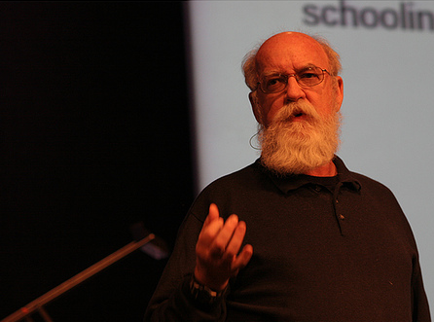
Ladies and gentlemen, this talk we have just heard is not exactly the talk I would have given, but I assure you that everything he said was perfectly true. And now if you'll excuse me, I think I'd — we'd — better sit down.”
Ladies and gentlemen, this talk we have just heard is not exactly the talk I would have given, but I assure you that everything he said was perfectly true. And now if you'll excuse me, I think I'd — we'd — better sit down.”

