Slide 1
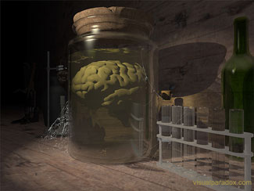
Perception & the External World
Is there anything ‘out there’?
Could I be a brain in a vat?

Slide 2
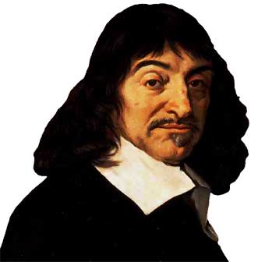
An Old Problem
Skepticism about the External World
Are things as they seem?
Are there objects independent of me?
Are there other minds?
And even if there are…
…how could I ever know any of these things?
Notes:
Note: Russell is not just replaying Descartes. He is concerned to formulate the question correctly.

Slide 3
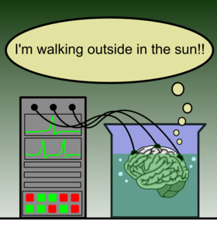
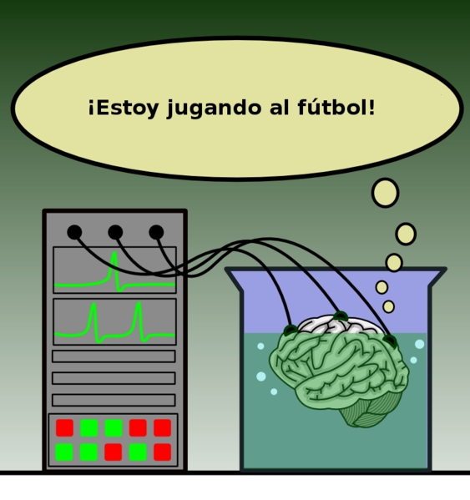
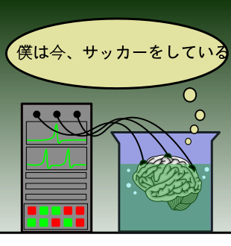
Causes of my experiences?
External objects?
Berkeley’s God?
Updated version of Berkeley’s God: I’m a brain in a vat and a computer is feeding in experiences?

Slide 4
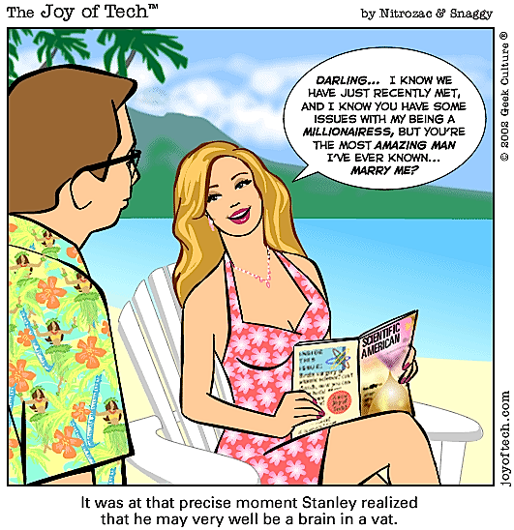
It was at that precise moment that Stanley realized that he may very well be a brain in a vat.

Slide 5
The Nature of Sensory Experience
What is it that we are immediately or directly aware of in perceptual experience?

Slide 6
The idea of immediacy or givenness
Inference: Something is immediately experienced if consciousness of it is not
Not arrived at via an inferential process
Or justified by reference to such a process
Certainty (infalibility): Something is immediately experienced if it is impossible for the individual having the experience to be mistaken about it.

Slide 7
The Classic Alternatives
Direct (“Naïve”) Realism
Sense Data Theories
Physical objects are directly (“immediately”) perceived
We don’t need to justify any inferences from objects of sensory experience to physical reality because physical objects are the objects of sensory experience.
The objects of immediate experience are sense-data or “ideas”
Representationalism: the immediate objects of experience represent the physical objects that cause them.
Phenominalism: physical objects are reducible to the occurrence of immediate objects of experience.

Slide 8
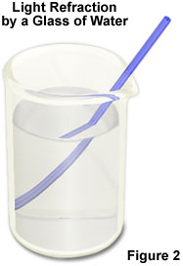
The Sense-Datum Theory
The objects of immediate experience are
Private
Non-physical
“seemings”: they actually possess the sensory qualities that a person experiences.
E.g. the stick in water seems bent
My visual sense datum is that shape

Slide 9
Argument from Illusion for Sense-Data
What is immediately perceived or given has different qualities fro different perspectives or under different perceptual conditions even though the relevant object doesn’t change.
Qualities immediately experience may not be those the relevant object possesses.
the bent stick in water…
Qualities are experienced in a situation in which there is no physical object of the relevant kind present.
Dreams, hallucinations, mirages…

Slide 10
Scientific Account of Perception Argument
Changes in conditions of perception, relevant sense-organs, or brain processes can cange experience with no change in external object
What matters is what’s at the end of the processess, regardless of what external object, if any, initiated it
E.g. Descartes on phantom limbs
Causal processes between external object and experience take time
E.g. we see distant stars as they were long ago

Slide 11
The Justification of Beliefs about the Physical World
Can we avoid skepticism?

Slide 12
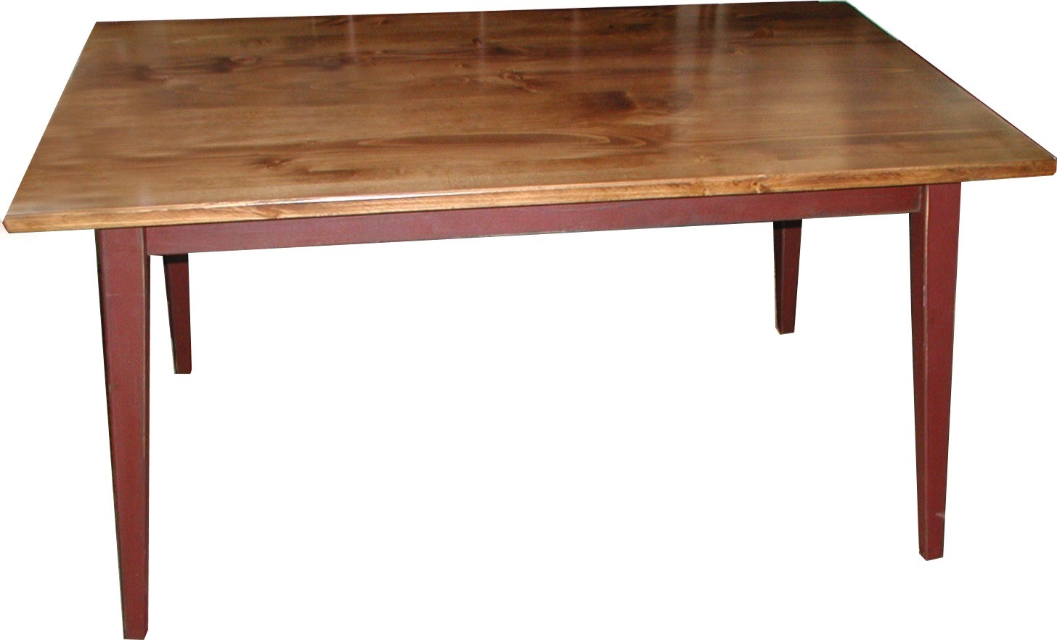
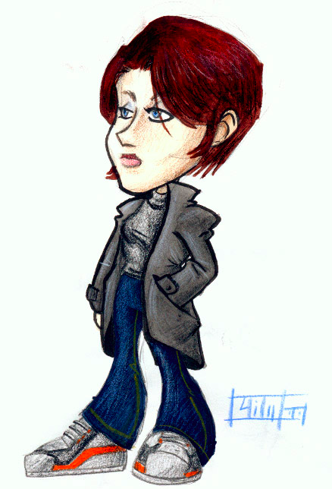
Representationalism
Veil of Perception
What’s the problem with this picture?

Slide 13
Direct & Indirect Realism fail
Direct Realism: we do need justification for beliefs about physical objects.
Argument from illusion: cases of non-veridical perception
Argument from perspectival differences
Argument from the scientific account of perception: the intervening medium affects experience, the finite speed of light.
Representationalism: we can’t know either that there are objects outside of experience that cause experience or that whatever objects there are ‘out there’ resemble the objects of immediate experience (i.e. sense data)
We can’t observe the alleged causal connection.
We can’t observe the alleged resemblance.

Slide 14
Descartes’ Methodological Doubt
I will apply myself earnestly and freely to the general overthrow of all my former ideas
None of these things are certain:
Empirical facts
Truths of mathematics
The existence of God

Slide 15
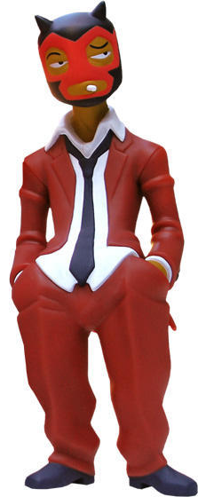
The Case for External World Skepticism
Any of my experiences could be non-veridical*
I could be dreaming
I have no good reason to believe that some experiences are privileged
Because I haven’t yet established the existence of a good, non-deceiving God
I have no good reason to believe there is an external world—a world of physical objects
*veridical experience: experience of real things as they really are—not illusion, dream, etc.

Slide 16
We don’t know either way…
Note: this argument doesn’t purport to establish that we have reason not believe in an external world—just that we have don’t have reason to believe in one.
Because the following form of argument isn’t valid:
I don’t have reason to believe that any x is P
Therefore I have reason to believe that no x is P

Slide 17
Counterexample
Bad Argument
I don’t have reason to believe that any one of my experiences is veridical.
I have reason to believe that none of my experiences is veridical.
Counterexample
I don’t have reason to believe that any one of the tickets for this lottery will win.
I have reason to believe that none of the tickets for this lottery will win.

Slide 18
Can the Demon be Defeated?
Given the possibility that our experiences are produced by Descartes Demon (or Berkeley’s God or Dennett’s team of scientists or machines operating the Matrix) can we have any reason to believe that our commonsense and scientific beliefs about the physical world are true???

Slide 19
A Demon Too Clever By Half
A perfect “illusion” is no illusion at all

Slide 20
Bouwsma on The Demon’s Dilemma
Can Descartes’ Evil Demon create the perfect illusion—a perfect fake of the real world?
Perfect Illusions: being a brain-in-a-Vat, the Matrix, etc.
All of our commonsense and scientific beliefs about the world are false
We are not even in principle capable of finding out that they’re false
Bouwsma argues that the Demon’s very success is his failure!

Slide 21
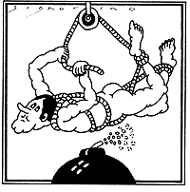
The Demon Hoist by his Own Petard
The Evil Demon’s Dilemma
If our experience is different from our experience of the real world then the illusion isn’t perfect.
If the simulation is perfect then it isn’t an illusion!

Slide 22
The Imperfect Illusion

Slide 23
The Perfect Illusion
The Demon creates an image of the real world that’s not, given normal human capacities distinguishable from

