Slide 1
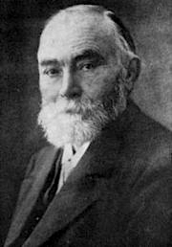
On Sense and Reference
Friedrich Ludwig Gottlob Frege (b. 1848, d. 1925) was a German mathematician, logician, and philosopher who worked at the University of Jena. Frege essentially reconceived the discipline of logic by constructing a formal system which, in effect, constituted the first ‘predicate
calculus’. In this formal system, Frege developed an analysis of quantified statements and formalized the notion of a ‘proof’ in terms that are still accepted today. Frege then demonstrated that one could use his system to resolve theoretical mathematical statements in terms of simpler logical and mathematical notions.

Slide 2
The Identity Dilemma
Either identity is a relation between names or a relation between objects.
If it’s a relation between names then the truth of identity statements is a matter of linguistic convention.
If it’s a relation between objects then all true identity statements are trivial.
In either case, we can’t explain how identity statements can be informative.

Slide 3
How can identity statements be informative?
Suppose identity is a relation between names:
Then the truth value of identity statements is a matter of linguistic convention
Since we can adopt whatever linguistic conventions we please, identity statements can’t be informative (and we shouldn’t need to investigate to discover, e.g. Hesphoros = Phosphoros)
Suppose it’s a relation between “objects”:
Then it just boils down to the relation between an object and itself, which is obvious and uncontroversial.
But not all true identity statements are either obvious or uncontroversial e.g. King George wondered whether Scott = the author of Waverly; he didn’t wonder whether Scott = Scott!)

Slide 4
Compositionality Thesis
Compositionality: The meaning of a whole sentence is determined by the meaning of its parts.
Substitutivity Principle: replacing parts of a sentence with other expressions that mean the same thing should leave the meaning of the whole sentence unchanged.
Why should we care about compositionality?
Because we want certain characteristics of sentences to be a function of characteristics of their parts, for example, we want the truth values of sentences to be a function of the truth values of their parts.
Putative counterexamples: failures of substitutivity
Frege’s Identity Puzzle
Frege’s Propositional Attitude puzzle

Slide 5
Frege’s Identity Puzzle
In general, sentences of the form a = a are a priori while sentences of the form a = b are a posteriori
a priori: can be known “prior to” experience
a posteriori (empirical): can only be known on the basis of experience (i.e. observation, experiment, etc.)
Example: true, informative identity statements like
(1) The Morning Star = The Evening Star
are different in “cognitive value” from trivially true ones like
(2) The Morning Star = The Morning Star
(2) appears to be true in virtue of language alone--everything is identical with itself--but (1) says something about the world: it was an empirical discovery.

Slide 6
Counterexample to substitutivity?
Although “The Morning Star” and “The Evening Star” are co-referential (pick out the same object) they can’t be substituted in all sentences preserving meaning.
(1) The Morning Star = The Evening Star
(2) The Morning Star = The Morning Star
The Argument: Since “The Morning Star” and “The Evening Star” both mean (refer to) the same heavenly body.
by substitutivity, (1) and (2) should mean the same thing.
But (as we shall see) they don’t so we have to either
reject substitutivity (which trashes compositionality) or
show that “The Morning Star” and “The Evening Star” don’t mean the same thing.

Slide 7
Frege’s Propositional Attitude Puzzle
Propositional attitudes: ways in which people are related to propositions, e.g. believing, hoping, fearing, etc.
We describe people as having propositional attitudes in sentences with subordinate clauses
Example: sentences of the form ‘x believes that P’ where ‘P’ stands for a subordinate clause (P is a complete sentence but ‘x believes that’ isn’t)
Problem: substitutivity fails within such subordinate clauses, for example
(3) George believes that Mark Twain wrote Huckleberry Finn.
(4) George believes that Samuel Clemens wrote Huckleberry Finn.
(3) may be true even if (4) is false, even though…

Slide 8
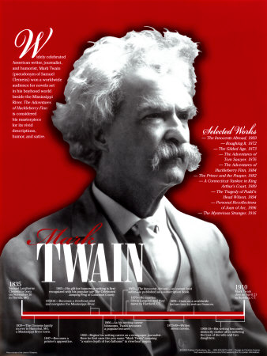
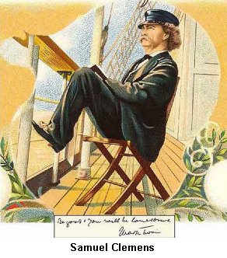
Mark Twain = Samuel Clemens
Mark Twain
Samuel Clemens

Slide 9
Counterexample?
(3) and (4) don’t have the same cognitive value: George may believe that Mark Twain wrote Huckleberry Finn but not believe that Samuel Clemens wrote Huckleberry Finn
(3) George believes that Mark Twain wrote Huckleberry Finn.
(4) George believes that Samuel Clemens wrote Huckleberry Finn.
So it could be that (3) is true but (4) is false
But (4) is just the result of substituting another name of the same person for “Mark Twain” since Mark Twain = Samuel Clemens
Again, substitutivity seems to be violated

Slide 10
Toward a solution: the sense/reference distinction
It is natural, now, to think of there being connected with a sign…besides that to which the sign refers, which may be called the reference of the sign, also what I should like to call the sense of the sign wherein the mode of presentation is contained…The reference of ‘evening star’ would be the same as that of ‘morning star,’ but not the sense
“meaning” is ambiguous
Sense: dictionary meaning, the “thought” behind an expression or sentence
NB: by “thought” Frege doesn’t mean an idea in someone’s head
Reference: “aboutness,” what an expression picks out

Slide 11
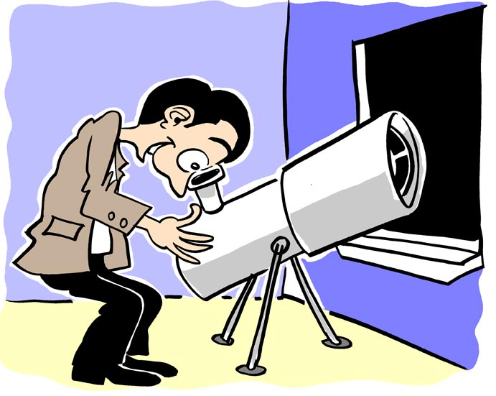
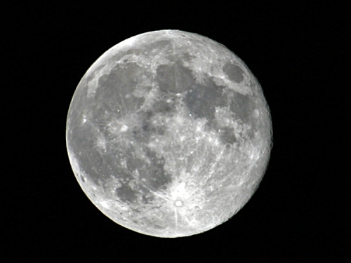
Senses aren’t ideas
I compare the Moon itself to the reference…mediated by the real image projected by the object glass in the interior of the telescope, and the retinal image of the observer.

Slide 12
Sense
The reference and sense of a sign are to be distinguished from the associated idea…This constitutes an essential distinction between the idea and the sign’s sense, which may be common property of many and therefore not a part of a mode of the individual mind…[different people] are not prevented from grasping the same sense; but they cannot have the same idea.
The sense of a name is an individual concept
The sense of a predicate is a property or relation
The sense of a sentence is a proposition
What are these things???

Slide 13
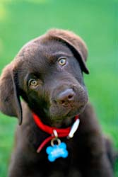
Sense and Reference
Sense
The reference of a name is an individual
A proper name (word, sign, sign combination, expression) expresses its sense, stands for or designates its reference.
The reference of a sentence is its truth value
Ducati
Ducati is a chocolate lab.
The True

Slide 14
Compositionality Thesis Revised
The meaning of a whole sentence is determined by the meaning of its parts, but “meaning” is ambiguous.
So we need two Substitutivity Principles:
replacing parts of a sentence with other expressions that have the same sense leaves the sense of the whole sentence unchanged.
replacing parts of a sentence with other expressions that have the same reference leaves the reference of the whole sentence unchanged.
(An interesting question: why The True or The False as the reference of sentences?)

Slide 15
Truth Values as Reference of Sentences
The thought loses value for us as soon as we recognize that the reference of one of its parts is missing. We are therefore justified in not being satisfied with the sense of a sentence, and in inquiring also as to its reference…Because, and to the extent that, we are concerned with truth value…We are therefore driven into accepting the truth value of a sentence as constituting its reference.
A point to ponder: Are we driven to this?
Would anything else do as the reference of sentences?
Why does Frege want truth values (The True or The False) as the references of sentences?

Slide 16
Truth Value as the Reference of Sentences
If our supposition that the reference of a sentence is its truth value is correct, the latter must remain unchanged when a part of the sentence is replaced by an expression having the same reference. And this is in fact the case…What else but the truth value could be found that belongs quite generally to every sentence if the reference of its components is relevant, and remains unchanged by substitutions of the kind in question?
Where expressions that have the same reference are substituted in sentences, truth value remains the same (even if other stuff changes)
Try it out on the Morning Star/Evening Star example!
Where substituting expressions in sentences changes truth value we can conclude that these expressions don’t have the same reference.
The point of the discussion of the Propositional Attitude Puzzle: substituting expressions that otherwise have same reference changes truth value so they don’t have their customary reference.

Slide 17
Frege’s Identity Puzzle
Informative identity statements like
(1) The Morning Star = The Evening Star
Are different in “cognitive value” from trivial ones like
(2) The Morning Star = The Morning Star
(2) is an a priori truth of logic since everything is identical with itself--but (1) says something about the world.
If identity is a relation between objects then (1) should be as trivial as (2) and wouldn’t be an important astronomical discovery.
If identity is a relation between names then (1) is a matter for decision rather than discovery: we make it true by adopting a linguistic convention.

Slide 18
Leaping between the horns
(1) The Morning Star = The Evening Star
(2) The Morning Star = The Morning Star
Frege needs to explain why some true identity statements, like (2) are trivial but others, like (1) aren’t.
He’ll do this by arguing that in true, non-trivial identity statements, the expressions on either side of the identity have the same reference but different senses.
He’ll go on to use that distinction in developing a theory that saves compositionality from putative counterexamples—like the Morning Star/Evening Star problem.

Slide 19
A Misguided Attempt
Maybe “The Morning Star” and “The Evening Star” don’t mean the same thing.
M.S.
E.S.
4 am
8 pm
Maybe The Morning Star consists of those temporal parts of Venus we see during mornings while The Evening Star is the sum of temporal parts of Venus we see during evenings.

Slide 20
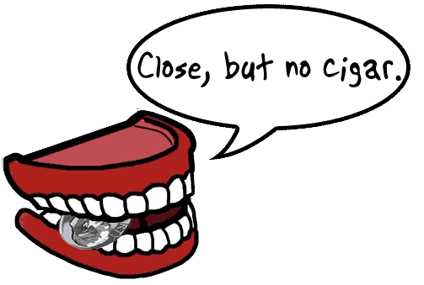

Slide 21
Why this solution fails
(1) The Morning Star = The Evening Star
(2) The Morning Star = The Morning Star
Different temporal parts of the same thing are not identical!
If “The Morning Star” and “The Evening Star” name different temporal parts of Venus then (1) is FALSE! The Morning Star ≠ The Evening Star!
Similarly, Samuel Clemens took the pen name “Mark Twain” as an adult but “Mark Twain” does not just name his adult person-stages: Mark Twain was born in Hannibal, MO even though as a baby he wasn’t called “Mark Twain.”

Slide 22
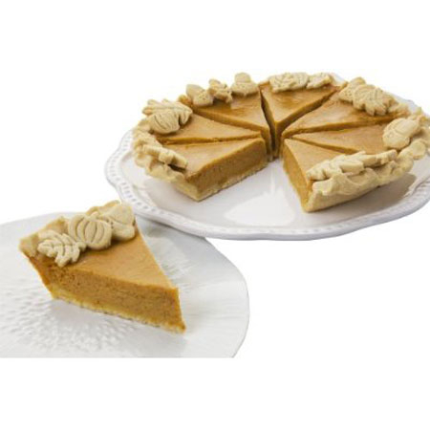
Some facts about identity
Identity is an equivalence relation
Reflexive: x = x
Symmetric: if x = y then y = x
Transitive: if x = y and y = z then x = z
Identity is an indiscernibility relation
If x = y, then whatever property x has y has and vice versa
Problem: this principle is sometimes stated as “x = y iff whatever is true of x is true of y and vice versa” but not every grammatical predicate assigns a property to the object of which it is true!
An equivalence relation partitions a set into equivalence classes.

Slide 23
Indiscernibility of Identicals
If x = y then x and y have exactly the same properties
Example: The Morning Star = The Evening Star therefore since the Morning Star is really a planet, The Evening Star is really a planet.
Example: Mark Twain = Samuel Clemens therefore since Mark Twain has the properties of being a journalist, being the author of Huckelberry Finn, etc. Samuel Clemens has those properties.
So if two names, a and b, refer to different temporal (or spatial) parts of an object, a ≠ b!

Slide 24
Solution to the Identity Puzzle
(1) The Morning Star = The Evening Star
(2) The Morning Star = The Morning Star
What makes (1) and (2) true is that fact that the referents of “The Morning Star” and “The Evening Star” are the same.
The same fact about the world makes them true
But the sense of these expressions isn’t the same

Slide 25
Same sense, same reference
(1) The Morning Star = The Evening Star
(2) The Morning Star = The Morning Star
Where the senses of expressions are the same, they refer to the same thing.
So we know the expressions on either side of the identity in (2), i.e “The Morning Star,” refer to the same thing--hence that (2) is true.
Synonomy is sameness of sense--so we know also that, e.g. the tallest bachelor in the class is the tallest unmarried male in the class.
We know these things by language alone

Slide 26
Different sense, same reference
(1) The Morning Star = The Evening Star
(2) The Morning Star = The Morning Star
But expressions with different sense may refer to the same thing
And we can’t determine whether or not they do that just by language alone
So The Morning Star = The Evening Star was an important astronomical discovery

Slide 27
Different sense, same reference
a
c
b
The point of intersection of a and b is then the same as the point of intersection of b and c. So we have different designations for the same point, and these names ('point of intersection of a and b', 'point of intersection of b and c') likewise indicate the mode of presentation; and hence the statement contains actual knowledge.

Slide 28
Substitutivity vindicated!
(1) and (2) express different thoughts since “Morning Star” and “Evening Star” have different senses so a person can know that (2) is true without knowing that (1) is true.
The senses of both (1) and (2) are determined by the senses of their parts!
They express different proposition so a person might know that one is true without knowing that the other is
The reference of (1) and (2) is determined by the reference of their parts
The reference of both sentences is The True
Our mistake was confusing sameness of reference with sameness of sense!

Slide 29
Frege’s Propositional Attitude Puzzle
(3) George believes that Mark Twain wrote Huckleberry Finn.
(4) George believes that Samuel Clemens wrote Huckleberry Finn.
“Mark Twain” and “Samuel Clemens” have the same reference—like “The Morning Star” and “The Evening Star” but
But that’s no guarantee that (3) and (4) have the same truth value!
Substitutivity fails!
So it looks like the solution to Frege’s identity puzzle doesn’t work for Frege’s Propositional Attitude puzzle!

Slide 30
Problem with truth value
Remember the reference of a sentence is supposed to be its truth value.
And the reference of the whole is supposed to be determined of the reference of its parts.
(4) George believes that Samuel Clemens wrote Huckleberry Finn
seems to be the result of substituting an expression that has the same reference as “Samuel Clemens,” i.e. “Mark Twain,” in
(3) George believes that Mark Twain wrote Huckleberry Finn
But (3) is true and (4) is false!

Slide 31
A misguided solution
(5) Mark Twain wrote Huckleberry Finn
(6) Samuel Clemens wrote Huckleberry Finn
Mark Twain = Samuel Clemens BUT “Mark Twain” ≠ “Samuel Clemens”
George may believe that sentence (5) makes a true statement but not that (6) makes a true statement but that’s because his beliefs are about different sentences.
This is no worse than recognizing that the English sentence makes a true statement but not recognizing that the French one does.
(E) The book is on the table.
(F) Le livre est sur le table.

Slide 33
Why this solution fails
George’s beliefs are not about a sentences but about people and books: he believes that Mark Twain wrote Huckleberry Finn and that the book is on the table.
Seeing a book on the table, he wouldn’t say “le livre est sur le table” or believe that that sentence was true but
a French speaker would be perfectly correct in saying, “George crois que le livre est sur le table.”
But incorrect in saying, “George crois que la phrase ‘le livre est sur le table’ est vrai.”

Slide 34
Sentences and Propositions
George believes the book is on the table.
George believes the proposition that speakers of other languages would express as, e.g. “le livre est sur le table,” “il libro é sul tavolo,” etc.
When English, French and Italian speakers say these things they’re uttering the different sentences but expressing the same proposition.
But he does not believe that those non-English sentences express true propositions because he does not know what the heck those sentences mean.

Slide 35
So we still have a problem…
George believes that Mark Twain wrote Huckleberry Finn.
Someone in the know would affirm that George believes it was Samuel Clemens that wrote the book and not someone else
Compare George who believes that that guy wrote the book even though he doesn’t know that guy was also called Samuel Clemens
With someone who believes that Huckleberry Finn was really written by H. L. Mencken.
But George does not believe that Samuel Clemens wrote Huckleberry Finn.

Slide 36
Substitutivity Fails
(7) George believes that ___ wrote Huckleberry Finn
(7) (apparently) designates the property of being-believed-by-George-to-be-the-author-of-Huckleberry-Finn
Plugging a name into the blank (apparently) ascribes that property to the individual to which the name refers, e.g. plugging in “Mark Twain” ascribes that property to Mark Twain—a.k.a. Samuel Clemens.
George has heard the author referred to as “Mark Twain”; George has never heard the name “Samuel Clemens” in that connection
So filling the blank with “Mark Twain” gets a true sentence while plugging in “Samuel Clemens” doesn’t.

Slide 37
How can this be?!!?!
Either a thing has a property or it doesn’t
The name by which we call it or the way in which we describe it shouldn’t make any difference to whether it has the property or not.
So how come the (supposed) property of being-believed-by-George-to-be-the-author-of-Huckleberry-Finn attaches to this guy when we call him “Mark Twain” but not when we call him “Samuel Clemens”???
Subordinate clauses like “Mark Twain wrote Huckleberry Finn” as it occurs in (3) pose a problem because we want the truth value of a compound sentence to be a function of their sentential parts.
The problem is that “x believes that…” isn’t truth functional!

Slide 38
Short answer
(7) George believes that ___ wrote Huckleberry Finn
(7) doesn’t really ascribe a property to the guy whose name plugs in the blank
In general, not all contexts in which names occur ascribe properties to the referents of those names
Why this is so, is a long story!

Slide 39
Propositional attitudes
“believe…”, and other propositional attitude verbs that introduce relative clauses create contexts where co-referential expressions cannot be intersubstituted salve veritate.
(3) George believes that Mark Twain wrote Huckleberry Finn.
(4) George believes that Samuel Clemens wrote Huckleberry Finn.
In (3) and (4) what George believes are the propositions expressed by (5) and (6), i.e. their senses.
(5) Mark Twain wrote Huckleberry Finn.
(6) Samuel Clemens wrote Huckleberry Finn

Slide 40
Propositional Attitudes: Frege’s Solution
In direct discourse expressions have their “customary” sense and reference.
Direct discourse: we’re simply expressing a proposition; we’re not quoting someone else or talking about someone else’s believing a proposition.
So the reference of “Mark Twain” and “Samuel Clemens” in the following sentences is the same--a certain person who is the “customary” reference of that name.
(5) Mark Twain wrote Huckleberry Finn.
(6) Samuel Clemens wrote Huckleberry Finn.
In (5) and (6), “Mark Twain” and “Samuel Clemens” refer to this guy

Slide 41
In indirect discourse reference shifts
property
sense
Individual concept
proposition
Mark Twain wrote Huckleberry Finn.
reference
The True
George believes that Mark Twain wrote Huckleberry Finn.
reference
proposition

Slide 42
Senses of Names and Sentences
The sense of “Mark Twain” is something like “the famous journalist and author who wrote Huckleberry Finn, etc.”
The sense of “Samuel Clemens” is something like “Mr. and Mrs. Clemens’ kid Sam”
So the customary senses of “Mark Twain” and “Samuel Clemens” are different.
Since the sense of the whole is determined by the sense of its parts,(5) and (6) have different senses, i.e. express different propositions.
(5) Mark Twain wrote Huckleberry Finn.
(6) Samuel Clemens wrote Huckleberry Finn

Slide 43
Indirect Discourse: Reference shifts
(3) George believes that Mark Twain wrote Huckleberry Finn.
(4) George believes that Samuel Clemens wrote Huckleberry Finn.
(5) Mark Twain wrote Huckleberry Finn.
(6) Samuel Clemens wrote Huckleberry Finn
In indirect discourse and propositional attitude ascriptions, e.g. (3) and (4), the customary senses of expressions become their references.
So in (3) the reference of “Mark Twain wrote Huckleberry Finn” is the sense of (5).
In (4) the reference of “Samuel Clemens wrote Huckleberry Finn” is the sense of (6).

Slide 44
Where we went wrong
(3) George believes that Mark Twain wrote Huckleberry Finn.
(4) George believes that Samuel Clemens wrote Huckleberry Finn.
Our mistake was thinking that the embedded sentences in (3) and (4) had their customary reference, i.e. The True.
If that were so then substituting one for the other shouldn’t change the truth value of the whole sentences.
But the reference of the embedded sentences has shifted to their customary senses, which are different!

Slide 45
So reference of the sentences may be different
(3) George believes that Mark Twain wrote Huckleberry Finn.
(4) George believes that Samuel Clemens wrote Huckleberry Finn.
The reference of the parts of (3) and (4) are different so the references of the whole sentences (3) and (4) can be different.
The embedded sentences refer to the customary senses of (5) and (6) respectively
And these senses are different!
So there is no reason why the reference, i.e. truth value of (3) and (4) should be the same!

Slide 46
Some predicates attribute properties to objects
Example: “___ is red”
The name that fills the blank refers to an individual
The predicate “___ is red” designates a property
The complete sentence, when a name is filled in, says that the individual to which the name refers has that property.

Slide 47
Some predicates don’t assign properties to objects
Example: “George believes that ____ wrote Huckleberry Finn.
The name that fills this blank doesn’t refer to an individual
The predicate doesn’t designate a property
The complete sentence doesn’t say that the individual whose name fills the blank has the property of being-believed-by-George-to-have-written-Huckleberry-Finn

Slide 48
Frege’s analysis: summary
“George believes that ___” is about the relation between George and a proposition, viz. the sense of the sentence that fills the blank.
It’s not about a relation between George and Mark Twain, a.k.a. Samuel Clemens.
“Mark Twain wrote Huckleberry Finn” and “Samuel Clemens wrote Hucklberry Finn” express different propositions
So you can’t substitute one for the other salve veritate in indirect discourse such as “George believes that ____”

Slide 49
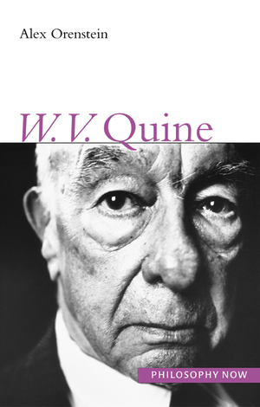
Frege’s theory solves both puzzles
Benefits: saves Indiscernibillity of Identicals, explains restrictions on substitutivity, explains how true identities can be informative.
Costs: commits us to:
individual concepts
properties
propositions
Creatures of Darkness!
W. V. O. Quine

Slide 50
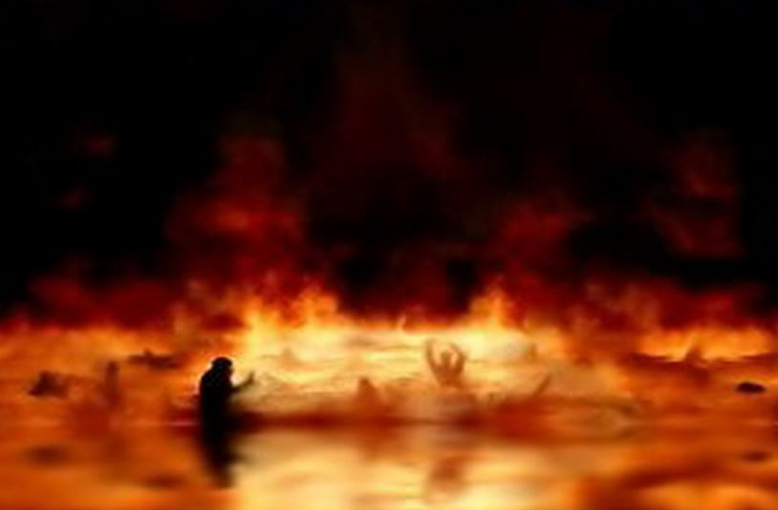
Can we avoid the netherworld of abstracta?
or is this..
The End

