Slide 1
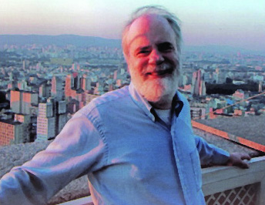
Identity and Necessity
Saul Kripke

Slide 2
Kripke in fiction

Slide 3
Kripke’s Puzzle
How are contingent identity statements possible?
Since everything that exists is necessarily self-identical
Answer: Contingent identity statements are possible; contingent identity isn’t.
Solution to the puzzle: referring expressions in some identity statements pick out different objects at different possible worlds.

Slide 4
An interesting consequence
Mental states are not identical to brain states.
The Argument
Mental states are identical to brain states only if that identity is contingent.
But it can’t be contingent.
So mental states aren’t identical to brain states.

Slide 5
Terminology and Concepts
Possible worlds
Necessary, contingent
Analytic, synthetic
A priori, a posteriori
Rigid designator
De dicto, de re
Essentialism

Slide 6
Possible Worlds
Kripke’s acheivement: semantics for modal logic
Ways things could have been
The actual world: the way things actually are.
We’ll use talk about possible worlds to explain modal notions like logical possibility, necessity and contingency.

Slide 7
Modality
A state of affairs is logically possible if it’s true at some possible world.
A proposition is necessarily true if it’s true at all possible worlds.
A proposition is contingently true if it’s true at the actual world (or the world we’re considering) but false at some other possible world.

Slide 8
A priori/a posteriori
A priori: knowable “before” (apart from) experience
Examples: All bachelors are unmarried.
A posteriori (empirical): can only be known “after” (on the basis of) experience
Examples: My dog has fleas

Slide 9
Analytic/Synthetic
Kant’s distinction (note: assumes subject-predicate form basic)
analytic proposition: a proposition whose predicate concept is contained in its subject concept
synthetic proposition: a proposition whose predicate concept is not contained in its subject concept
Quine is skeptical about whether this distinction can in fact be made (see his “Two Dogmas of Empiricism”)
Analytic statements are true “in virtue of language alone” – crude working definition.

Slide 10
Warning!
Analyticity and syntheticity are semantic concepts
Necessity and contingency are metaphysical concepts
A priority and a posteriority are epistemic concepts
So we can ask:
Are all and only a priori propositions necessary?
Are all and only a posteriori propositions contingent?

Slide 11
The Analytic-Synthetic Distinction: Pre-Kripkean Orthodoxy
Analytic
Necessary
Since analytic propositions are true in virtue of language alone nothing about the world we’re at makes a difference
A priori
Since nothing about the world we’re at makes a difference we don’t need to make observations about that world to determine that they’re true
Synthetic
Contingent
Their truth value is contingent on the way things are at a given world
A posteriori
So to know whether they’re true or false we need to make observations to determine what that world is like.

Slide 12
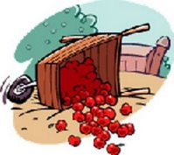
Kripke’s Unorthodox Answers
Some a priori propositions are contingent
The standard meter rod in Paris is one meter long.
Some a posteriori propositions are necessary
Water is H₂0

Slide 13
How can this be?!!?!

Slide 14
Contingent, but a priori
I know a priori that the standard meter rod is exactly 1 meter long because it sets the standard for what one meter is.
But it’s only a contingent fact that this rod was selected to set that standard.
This rod could have been other than 1 meter if, e.g. another standard had been adopted.

Slide 15
Necessary, but a posteriori
We learnt by experiment that water is H₂O
It’s not something we could just figure out
It isn’t true in virtue of language alone
But, having learnt that water is H2O we won’t count anything as water unless it’s H₂O

Slide 16
Water = H₂0 is not a definition
I know what water is!
People who don’t know that water is H₂O still know what water is

Slide 17
Rigid Designator
Water however is necessarily H2O: our natural kind term “water” picks out H2O at all possible worlds
Note: our term—i.e. “water” in English. People at other possible worlds might mean something else when they utter the word “water.”
A rigid designator designates (picks out, denotes, refers to) the same thing in all possible worlds in which that thing exists and does not designate anything else in those possible worlds in which that thing does not exist.
On Kripke’s account, ordinary proper names are rigid designators.

Slide 18
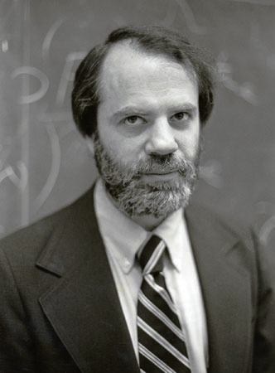
But can’t things have different names?
Actual World
Another Possible World
My name is Willard van Orman Quine--not Saul Kripke!
My name is Saul Kripke
He’s Kripke
Yes. But in saying that “Saul Kripke” is a rigid designator we mean that the name as we use it in our actual world language refers to the same individual at all possible worlds--including worlds in which he has a different name. Kripke couldn’t be Quine even though he could have been named “Quine.”

Slide 19
Both talking about the same number
Actual World
Another Possible World
√81 = 9
√81 = 7
Actualese
9 =
Possibilese
7 =
We cannot say…that the square root of 81 might have been a different number from the number it in fact is, for that number just has to be 9
--Even if we call it “7”!

Slide 20
Reference
According to the description theory of reference a name refers to an object in virtue of the object’s satisfying the description associated with the name.
Recall Russell’s suggestion the ordinary proper names are “disguised descriptions” and Frege’s view that they have senses
So the description theory is sometimes called “The Russell-Frege View”

Slide 21
If the description fits, it refers
You can think of the description theory as the if-the-shoe-fits-wear-it account of reference.
Names “attach” to objects by carrying descriptions (having senses) that uniquely describe them.
Kripke rejects Russell’s view that ordinary proper names are “disguised descriptions.”

Slide 22
Kripke’s Causal Theory
Ordinary proper names are mere tags (they don’t have senses or convey descriptions).
We confer names on objects by tagging (“baptizing,” “dubbing”) or
By means of descriptions that fix reference.

Slide 23
Reference-Fixing
Reference-fixing descriptions are not senses of names or descriptions they “disguise”!
I can successfully use a name to refer to an object even if I have no idea of the description (if any) by which the reference of the name was fixed.
Names are passed down in the linguistic community via a causal chain going back to the tagging or descriptive reference-fixing.

Slide 24
Natural Kind Terms are Tags
“Natural kinds,” like water, also get their names by tagging.
You do not need to know what the stuff is like to tag it successfully
Or to use the term correctly to designate the stuff that was tagged.
Let’s call this stuff “water”

Slide 25
Water is necessarily H₂O
“Water” designates H2O at all possible worlds
For an argument, see Putnam
So necessarily water is H2O
And the claim is that this is necessity de re:
i.e. it isn’t just that water is “by definition” H2O (because it isn’t): whatever we call it this stuff is necessarily H2O
Note: this is the kind of modality Quine—who insists that necessity can only attach to sentences—rejects modality in this sense.

Slide 26
De Dicto/De Re: Two kinds of aboutness
Statements involving belief, desire and modality can be read as de dicto or de re.
Example: George believes the tallest man in the room is a professional basketball player.
De dicto: George believes that whoever the tallest man in the room is, that guy is a professional basketball player.
De re: George believes of this guy (who as it happens is the tallest man in the room), that he’s a professional basketball player.

Slide 27
Modality de dicto and de re
Necessarily, the president of the United States is a politician.
De dicto: this seems to be true, since the presidency is an elective government office and, by definition, anyone who occupies that office counts as a politician
De re: this is false since read this way it says of Barak Obama that this guy couldn’t have been anything but a politician

Slide 28
Essentialism
Modality de re commits us to essentialism.
i.e. to “real” as well as “nominal” essences, in Locke’s terminology
Essential property: a property an object (or kind) cannot fail to have.
Example: being president is not essential to Barak Obama but being human (or at least not being a mosquito or not being a Bank of America credit card account) is essential to him.

Slide 29
Individual Essences
This lectern could not have been made of ice.
Lecterns can be made of ice.
There could have been a lectern here that looked just like this wooden lectern and was made of ice.
But it would not be the same lectern!

Slide 30
Kind Essences
Water is H₂O
There could be a colorless, tasteless liquid that behaved just like water and filled lakes, rivers, etc. (same “stereotype” as water)
It could be that people called this stuff “water”
Even though it wasn’t water
Because the essence of water is its molecular structure

Slide 31
Kripke’s Argument
At last!
How contingent identity statements are possible

Slide 32
Contingent Identity Statements
Identity is necessary: everything in necessarily identical with itself and with no other thing.
Necessarily water = H2O; necessarily heat = molecular motion
But theoretical identities like these seem contingent: it seems that we can conceive of states of affairs where they don’t hold.
Kripke proves Necessity of Identity
And then will explain how the “illusion of contingency” arises-and how contingent identity statements are possible.

Slide 33
Necessity of Identity Argument
(1) (x)(y)[(x = y) -> (Fx -> Fy)] | If x = y then whatever property x has, y has and vice versa
(2) (x) (x = x) | Everything is necessarily identical with itself
(3) (x)(y)(x = y) -> [ (x = x) -> (x = y)] | If x = y then, if x is necessarily identical with x, y is necessarily identical with x
(4) (x)(y)[(x = y) -> (x = y)] | If x = y then necessarily x = y

Slide 34
(4) Is de re!
(4) says of this thing x, a.k.a. y, that it is necessarily self-identical
It does not say anything about statements at all. It says that for every object x and object y, if x and y are the same object then it is necessary that x and y are the same object.

Slide 35
Contingent identity statements
Identity statements can be contingent because the referring expressions they contain may pick out different objects at different possible worlds.
The first Postmaster General = the inventor of bifocals is contingent because
“first Postmaster General” and “inventor of bifocals” are not rigid designators.

Slide 36
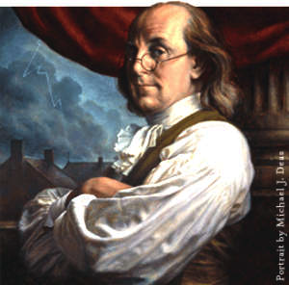
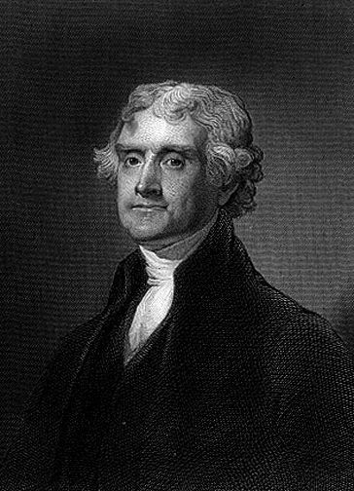
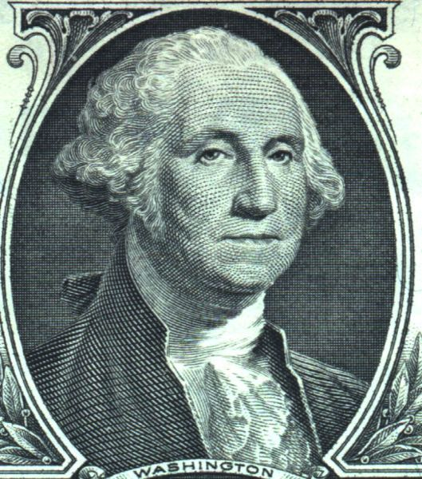
Two possible worlds
The Actual World
Another Possible World
First Postmaster General
Inventor of Bifocals
First Postmaster General
Inventor of Bifocals
Benjamin Franklin is self-identical at all possible worlds

Slide 37
The Hard Cases
But what about what seem to be contingent identity statements involving rigid designators, e.g.
Hesperus is Phosphoros
Heat is the motion of molecules
The supposed contingency of both these sentences is an illusion!
They’re a posteriori but necessary!

Slide 38
Necessity and a prioriticity
The illusion of contingency comes from confusing necessity and a prioriticity!
Both “Hesperus = Phosphorus” and “Water = H₂0 are a posteriori
But both are necessary

Slide 39
Reference-fixing again
We fix the reference of “Hesperus” as the heavenly body seen first in the evening and fix the reference of “Phosphorus” as last heavenly body seen in the morning.
But those descriptions fix the reference of both names to Venus: the names themselves are mere tags.
So even if a comet yanks Venus away so that Mars is the heavenly body seen first in the evening “Hesperus” still refers to Venus, and not to Mars!

Slide 40
Necessary a posteriori
It could be that the heavenly body we see in the morning is not the same as the heavenly body we see in the evening.
It is “epistemically possible” that Hesperus ≠ Phosphorus--but that’s not metaphysically possibility!
We can’t know whether the heavenly bodies we see in these two circumstances are the same a priori.
But necessarily Hesperus, a.k.a. Venus = Phosphorus, a.k.a Venus

Slide 41
Theoretical Reductions
Heat is the motion of molecules
This is a posteriori but, according to Kripke, necessary
Distinguish heat from the sensation of heat--the sensation that comes from touching hot things
Note: we fix the definition of heat by reference to the sensation but that doesn’t mean that heat is that sensation or is necessarily associated with that sensation!!!
Heat is the motion of molecules at all possible worlds
But heat doesn’t produce the sensation of heat at all possible worlds

Slide 42
Enter the Martians
The sun feels cold to Martians. Heat causes them to feel the sensation of cold so it is not necessary that heat cause the sensation of heat.

Slide 43
The Illusion of Contingency
It’s contingent that the sensation of heat is caused by the motion of molecules.
It is not contingent that heat is the motion of molecules.
The illusion of contingency comes from confusing the sensation of heat with heat.

Slide 44
Heat is necessarily the motion of molecules
We use both the terms ‘heat’ and ‘the motion of molecules as rigid designators for a certain external phenomenon…[so] it is going to be necessary that heat is the motion of molecules.
What gives us the illusion of contingency is the fact we have identified the heat by the contingent fact that there happen to be creatures on this planet…who are sensitive to it in a certain way.

Slide 45
Mental state-brain state identity?
Pain is the firing of C-fibers
According to Place, et. al. this is supposed to be a contingent identity statement analogous to heat is the motion of molecules
But that heat is the motion of molecules only seems contingent since we confuse heat with the sensation of heat
And it is only contingent that the sensation of heat is associated with heat.

Slide 46
Are the cases analogous?
To argue the cases are analogous we have to show that:
Pain is necessarily the firing of C-fibers
And that an illusion of contingency arises from our confusing the sensation associated with pain and pain itself because
We pick out pain contingently by the fact that it affects us in such and such a way

Slide 47
But the analogy fails!
Pain is essentially painful: pain necessarily hurts!
Both the terms ‘my pain’ and ‘my being in such and such a brain state’…are rigid designators. One cannot say this pain might have been something else, some other state.
Because they pick out their objects essentially, we cannot say the case where you seem to imagine the identity statement false is really an illusion like the illusion one gets in the case of heat and molecular motion

Slide 48
This would be an apocalyptic conconclusion if Kripke has established it.
Has he?

