Slide 1
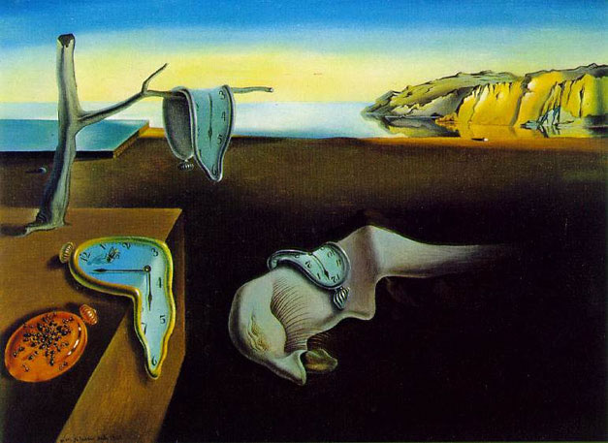
The Paradoxes of Time Travel
David Lewis

Slide 2
About Time
The topology of time
Bounded or unbounded: is there a beginning (end) in time?
Continuous or discrete?
Linear or closed: is there an Eternal Return?
Branching or non-branching?
Some problems
Determinism, fatalism and free will
Time travel

Slide 3
Lewis’ Assumptions
Enduring things have temporal as well as spatial parts
Eternalism vs. Presentism
Worm view vs. Stage account
Personal identity criteria
psychological continuity and connectedness
causal continuity
Distinction between external and personal time

Slide 4
The Four-Dimensional World
The world—the time traveler's world, or ours—is a four-dimensional manifold of events.
Time is one dimension of the four, like the spatial dimensions except that…Time remains one-dimensional, since no two time-like dimensions are orthogonal.
Enduring things are timelike streaks: wholes composed of temporal parts, or stages, located at various times and places.
Change is qualitative difference between different stages—different temporal parts—of some enduring thing, just as a “change” in scenery from east to west is a qualitative difference between the eastern and western spatial parts of the landscape.
To the 4-d world

Slide 5
Temporal Parts
time’s arrow
The Worm View (Lewis): enduring things are space-time “worms” composed of temporal (time) parts or stages.

Slide 6
Temporal Parts
time’s arrow
stage
The Worm View (Lewis): enduring things are space-time “worms” composed of temporal parts of stages.

Slide 7
Temporal Parts
time’s arrow
Change is qualitative difference between different stages—different temporal parts—of some enduring thing, just as a ‘change’ in scenery from east to west is a qualitative difference between eastern and western spatial parts of the landscape
Cambridge Changes: changes in relational or extrinsic properties, e.g. Xantippe’s being widowed.

Slide 8
Varieties of Time Travel
What is time travel?
[T]he time elapsed from departure to arrival (positive, or perhaps zero) is the duration of the journey. But… [for] a time traveler, the separation in time between departure and arrival does not equal the duration of his journey.
Back to the Future: time travel to the past and back
Around to the Past: travel around a closed time-like curve
Forward to the Future: time travel to the future

Slide 9
Personal Time
[H]ow it could be that the same two events were separated by two unequal amounts of time?…I reply by distinguishing time itself, external time as I shall also call it, from the personal time of a particular time traveler: roughly, that which is measured by his wristwatch.
born
dies
Ceasar’s Personal Time
External Time
100 B.C.
March 15, 44 B.C.

Slide 10
Forward to the Future
We’re always traveling to the future, but the duration of our journey in personal time is the same as the elapse from the beginning to the end in external time.
In Forward to the Future Time Travel the elapse of time from the beginning to the end of the time-traveler’s journey in external time is greater than the duration of his journey in personal time.
So the time traveller can land in the remote future without aging significantly.
LETS TRY IT!

Slide 11
Around to the Past

Slide 12
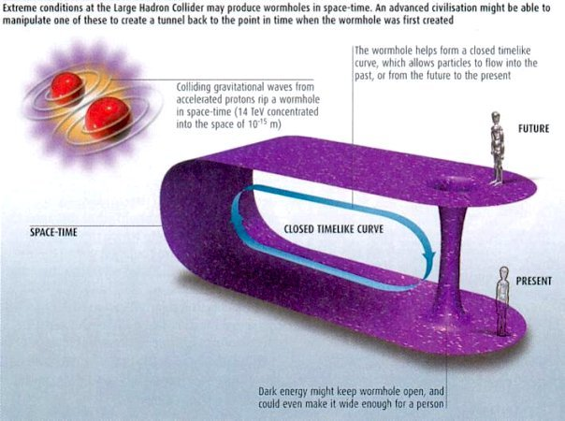
Through the Wormhole

Slide 13
Back to the Future

Slide 14
Traveling to the Past
Marty McFlye’s Personal Time
re-enters time machine and goes back to the future
meets parents as teenagers
enters time machine
born
External Time
1955
1958
1985

Slide 15
Could you meet your past self?

Slide 16
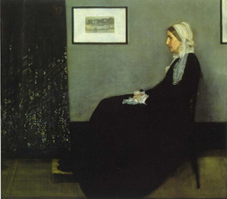
The man who was his own mother*
“Jane” is left at an orphanage as a foundling. When “Jane” is a teenager, she falls in love with a drifter, who abandons her but leaves her pregnant. Then disaster strikes. She almost dies giving birth to a baby girl, who is then mysteriously kidnapped. The doctors find that Jane is bleeding badly, but, oddly enough, has both sex organs. So, to save her life, the doctors convert “Jane” to “Jim.”
http://mkaku.org/home/?page_id=252
Notes:
Story by Michio Kaku at http://www.mkaku.org/article_timetravel.htm

Slide 17
And then . . .
“Jim” subsequently becomes a roaring drunk, until he meets a friendly bartender (actually a time traveler in disguise) who whisks “Jim” back way into the past. “Jim” meets a beautiful teenage girl, accidentally gets her pregnant with a baby girl. Out of guilt, he kidnaps the baby girl and drops her off at the orphanage. Later, “Jim” joins the time travelers corps, leads a distinguished life, and has one last dream: to disguise himself as a bartender to meet a certain drunk named “Jim” in the past…

Slide 18
The Man Who Was His Own Mother
Jim becomes distinguished
Time-Traveler
Jim meets Bartender who whisks
him back to the past
Disguised as Bartender
meets Jim The Drunk
Baby Jane dropped
Off at orphanage
Drops Baby Jane off
At orphanage
Jim becomes Baby
Jane’s father
Jane becomes
Baby Jane’s
mother:
Baby Jane
Is born
Jim meets Jane
Bartender takes Jim
Back to the past where
he meets Jane
Jane is born

Slide 19
Causation and the ‘Arrow of Time’
(External) time goes in only one direction.
On one account the direction of time just is the direction of causation: from past to future.
BUT if BTF time travel is possible then it is possible for later events to cause earlier events
Note: Given the for personal identity, events that occur to stages later in external time must cause events that occur to stages that are earlier in external time.
Is the ‘backward causation’ (required for BTF time travel) possible? And if so how?

Slide 20
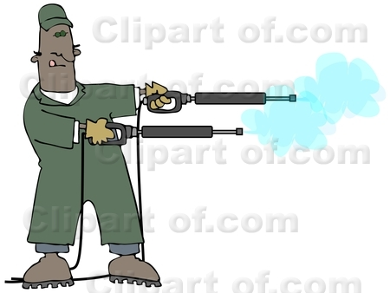
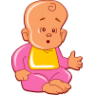
Could you kill your baby-self?

Slide 21
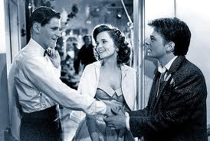
Uh-oh!

Slide 22
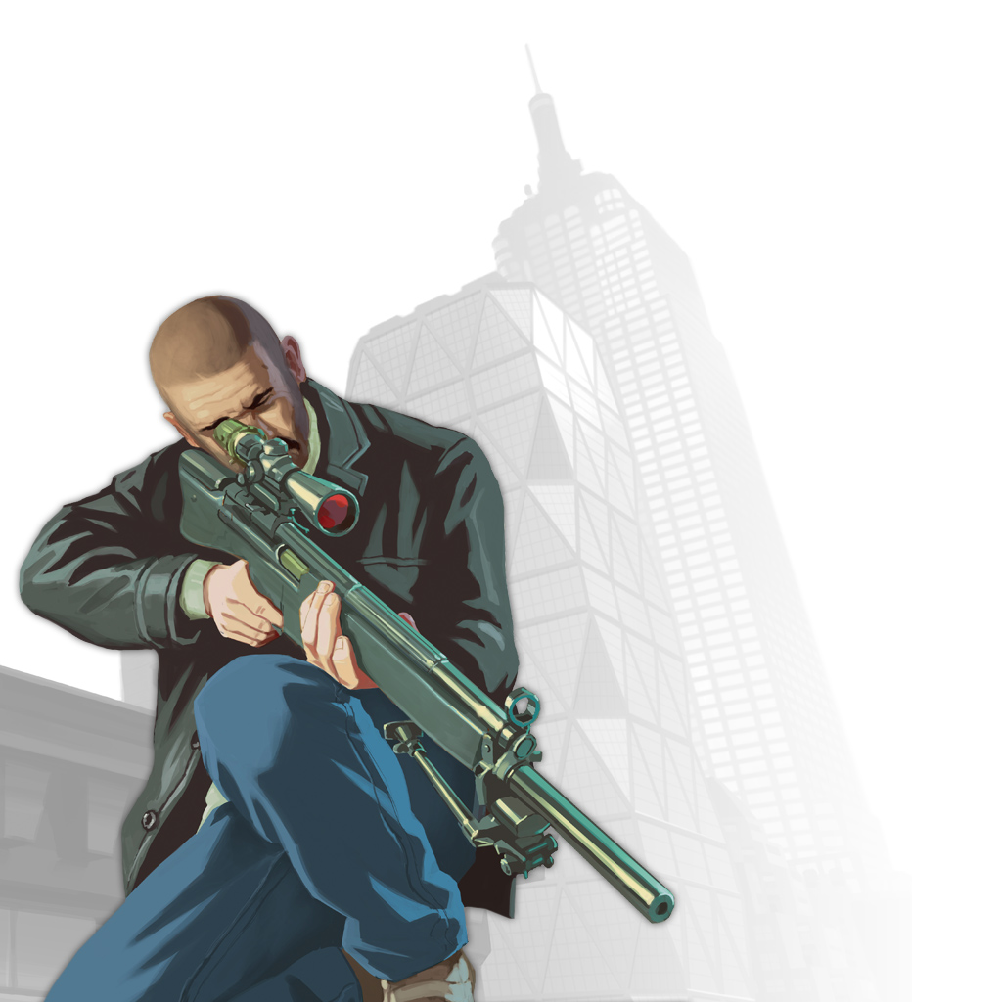
Can Tim kill his grandfather?
It seems that he can…
Tim…has what it takes. Conditions are perfect in every way: the best rifle money could buy, Grandfather an easy target only twenty yards away…Tim is as much able to kill grandfather as anyone ever is to kill anyone.

Slide 23
A duplicate of Tim could…
Suppose that down the street another sniper, Tom, lurks waiting for another victim, Grandfather’s partner. Tom is not a time traveler, but otherwise he is just like Tim.

Slide 24
…but it looks like Tim can’t!
Grandfather begat Father in 1922 and Father begat Tim in 1949. Relative to these facts Tim cannot kill Grandfather.

Slide 25
What I can do, relative to one set of facts, I cannot do relative to another more inclusive, set
[F]acts about my larynx and nervous system are compossible with my speaking Finnish. But don’t take me along to Helsinki as your interpreter.

Slide 26
Tim can’t kill Grandfather
Tim's killing Grandfather that day in 1921 is compossible…with all the facts of the sorts we would ordinarily count as relevant in
saying what someone can do…Relative to these facts, Tim can kill Grandfather.
But his killing Grandfather is not compossible with another, more inclusive set of facts…[including] the simple fact that Grandfather was not killed.

Slide 27
Tom can’t kill Grandfather’s partner
Exactly the same goes for Tom’s parallel failure. For Tom to kill Grandfather’s partner also is compossible with all facts of the sorts we ordinarily count as relevant, but not compossible with a larger set including, for instance, the fact that the intended victim lived until 1934.

Slide 28
Fatalism
The thesis that whatever will happen in the future is already unavoidable, i.e. that no one is able to prevent it from occurring.
There exist now propositions about everything that might happen in the future.
Every proposition is either true or else false
If (1) and (2), then there exists now a set of true propositions that, taken together, correctly predict everything that will happen in the future.
If there exists now a set of true propositions that, taken together, correctly predict everything that will happen in the future, then whatever will happen in the future is already unavoidable.
Therefore, whatever will happen in the future is already unavoidable.

Slide 29
Lewis’ objection to Fatalism
I am not going to vote Republican next fall. The fatalist argues that, strange to say, I not only won't but can't; for my voting Republican is not compossible with the fact that it was true already in the year 1548 that I was not going to vote Republican 428 years later.
My rejoinder is that this is a fact, sure enough; however, it is an irrelevant fact about the future masquerading as a relevant fact about the past, and so should be left out of account in saying what, in any ordinary sense, I can do.
Compare the sense in which I ‘can’t’ not raise my arm if that is what I in fact do, with the senses in which I can’t wiggle my ears, or fly, or buy a 2 million dollar house, or vote in the UK…or any of the other can’t we ordinarily care about.

Slide 30
There are true propositions about the future
Given the facts about the future that make them true we can’t ‘change the future’
But when we worry about what we can or can’t do, we aren’t concerned about future facts and so shouldn’t be worried about an irrelevant fact about the future “masquerading as a fact about the past.”

