Slide 1
Of Identity and Diversity
John Locke

Slide 2
The Problem of Personal Identity
Whether we are to live in a future state, as it is the most important question which can possibly be asked, so it is the most intelligible one which can be expressed in language. --Bishop Butler
The Persistence Question: what are non-trivial necessary and sufficient conditions for the persistence of persons?
Criterion for Personal Identity: answer to the persistence question
This is a question of numerical identity not qualitative similarity
It’s not a question about mere evidences of personal identity

Slide 3
Numerical Identity & Qualitative Similarity
Type-Token Ambiguity: “identical” and its cognates (e.g. “same”) are type-token ambiguous in the sense that we can mean either the same type (kind) of thing or the very same token (individual) thing.
Example: identical twins are type identical—two (token-)different individuals of the same type.
Numerical Identity is token-identity: being literally the very same individual
We’re not asking whether someone is, metaphorically, the “same person” after, e.g. religious conversion, but whether we have literally the same (numerically identical) person when we discuss the problem of personal identity.

Slide 4
Identity Criteria
We want to sort out identity criteria from mere evidences
R is criterial rather than merely evidential for F-identity: necessarily a is the same F as b iff a is R-related to b
Example: sameness of fingerprints are mere evidences of personal identity
Not necessary because we can imagine the same person’s fingerprints changing—or a person losing his fingers
Not sufficient because we can imagine two different people with the same fingerprints

Slide 5
Criteria and Mere Evidences
Criteria for Personal Identity aren’t mere evidences of someone we encounter now being the same person as someone we used to know
Example of Mere Evidences: similar appearance, same fingerprints or (on some accounts!) spatio-temporal continuity.
We’re interested in what makes a person the same over time
Example: What makes something water is it’s being H₂0; it’s being clear, colorless, tasteless and occupying lakes and rivers is merely evidential for it’s being water.

Slide 6
Identity
The problem of personal identity is a special case of the problem of identity-through-time (persistence, “diachronic identity”) for spatio-temporal objects generally
The identities of objects of different kinds are supposed to be “differently constituted” such that they have different persistence conditions.
In every case we want to elicit “our” identity criterion for the identity of F’s (where F is a sortal term)
And make sure that it’s consistent with the formal features of identity:
an equivalence relation
an indiscernibility relation

Slide 7
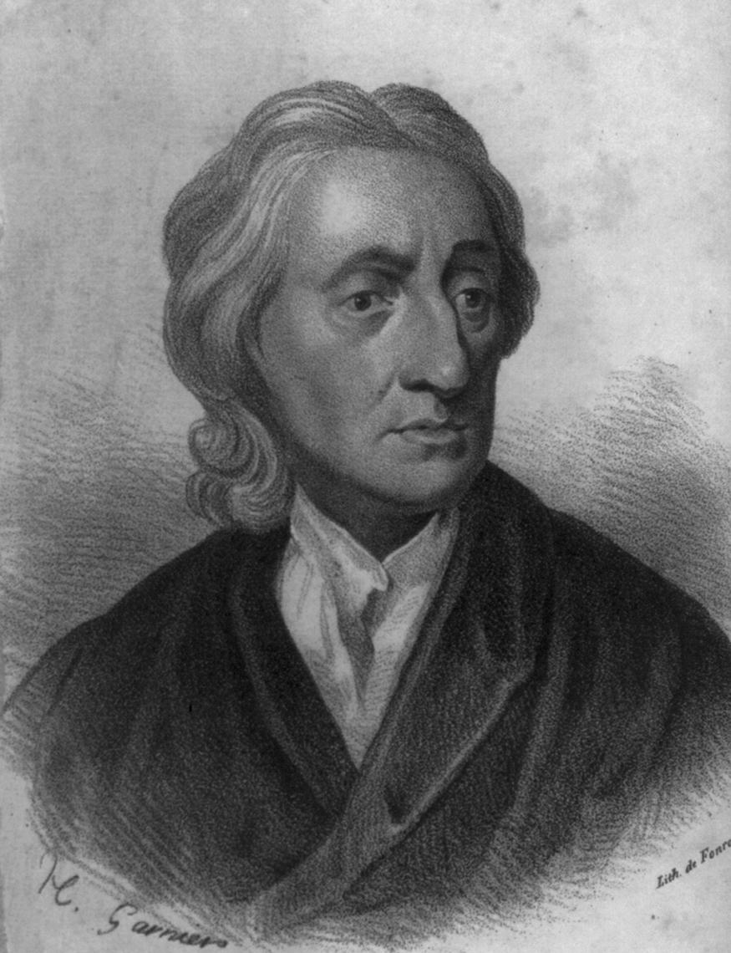
Locke: The Personal Identity Guy
All the great ends of Morality and Religion, are well enough secured without the philosophical Proofs of the Soul's Immateriality; since it is evident that he who, at first made us beings to subsist here, sensible intelligent Beings, and for several years continued us in such a state, can and will restore us to a like state of Sensibility in another World, and make us there capable to receive the Retribution he has designed to men, according to the doings in this life. [Essay IV:2:6]
Locke was (IMHO) the first person to recognize that the problem of personal identity should not be conflated with the mind-body problem and
That it was an open question whether physicalism regarding the mind-body problem was consistent with religious doctrines concerning post-mortem survival.

Slide 8
Locke on Identity
A thing can’t occupy two different places at the same time so
One thing can’t have two beginnings
Two things can’t have one beginning
Two things of the same kind can’t be at the same place at the same time
However, two things of different kinds can occupy the same place at the same time
And in fact do!

Slide 9
Locke’s Ontology
3 sorts of substances:
God
finite spirits (spiritual substances, souls)
material substances
modes and relations – identity conditions determined by substances on which they depend
Events – momentary so no question of what makes for identity through time.

Slide 10
Identity Conditions
Different kinds of substances can occupy the same place at the same time
e.g. an oak tree and the mass of matter that constitutes it
Substances of the same kind can’t occupy the same place at the same time
Mereological essentialism for masses of matter: can’t survive loss (or addition) or parts.
Organisms’ identity conditions allow loss, addition and gradual replacement of parts.

Slide 11
Identity of Organisms
[S]omething is one plant if it has an organization of parts in one cohering body partaking of one common life, and it continues to be the same plant as long as it partakes of the same life, even if that life is passed along to new particles of matter vitally united to the living plant, in a similar continued organization suitable for that sort of plants…An animal is a living organized body; and consequently the same animal…is the same continued life communicated to different particles of matter…the word ‘man’ as we use it stands for the idea of an animal of a certain form.
man (human being) = living homo sapiens organism
as distinct from person

Slide 12
Person not the same as Human Being
Man (Human Being): a living member of species homo sapiens; a particular kind of animal
Person: a thinking intelligent being that has reason and reflection and can consider itself as itself, the same thinking thing, in different times and places [Essay II:XXVII:11]
Locke will argue that the concept of human being and person are different (since something can count as a person without being a human) and hence that
The persistence conditions (criteria for identity-through-time) for persons and human beings are different

Slide 13
The Rational Parrot
[Prince Maurice told me] that he had heard of such an old parrot when he had been at Brazil; and though he believed nothing of it, and it was a good way off, yet he had so much curiosity as to send for it: that it was a very great and a very old one; and when it came first into the room where the prince was, with a great many Dutchmen about him, it said presently, What a company of white men are here! They asked it, what it thought that man was, pointing to the prince. It answered, Some General or other. When they brought it close to him, he asked it, D'ou venez-vous? It answered, De Marinnan. The Prince, A qui estes-vous? The Parrot, A un Portugais. The Prince, Que fais-tu la? Parrot, Je garde les poulles. The Prince laughed, and said, Vous gardez les poulles? The Parrot answered, Oui, moi; et je scai bien faire; and made the chuck four or five times that people use to make to chickens when they call them. I set down the words of this worthy dialogue in French, just as Prince Maurice said them to me. I asked him in what language the parrot spoke, and he said in Brazilian. I asked whether he understood Brazilian; he said No, but he had taken care to have two interpreters by him, the one a Dutchman that spoke Brazilian, and the other a Brazilian that spoke Dutch

Slide 14
Humanness not necessary for personhood
On Locke’s account the Rational Parrot would be a person in the relevant sense
So being human is not a necessary condition for being a person
Therefore the persistence conditions for person different from persistence conditions for man (i.e. human being)
Human beings may survive the persons with which they coincide
Persons may survive the human beings with which they coincide

Slide 15
Sortals Convey Identity Criteria
The complex idea we use when classifying a thing as being of a certain kind also determines what it is for a thing of that kind to continue in existence. (Essay II:xvii:29)
Sortal: a +count noun that conveys identity criteria
spirit, man, and person are sortals that
convey different identity criteria
In ordinary cases persons and human beings coincide but
Locke will produce puzzle cases to pump the intuition that it ain’t necessarily so!

Slide 16
Sortals and Identity Criteria
What, if anything, is the connection between criteria for being an F and criteria for F-identity, understood as persistence conditions for Fs?
According to the traditional view, to understand a sortal term, F, is precisely to understand how to trace Fs through space and time in at least normal cases
Example: If I understand the sortal river I should be in principle able to determine whether different waters in which I step are both (spatial or temporal) parts of the River Cäyster
Example: to understand our criterion for personal identity through time, we need to understand what it is to be a person

Slide 17
F-hood and F-identity
Locke argues that we get confused about persistence conditions for spatio-temporal objects because we literally don’t know what we’re talking about
At any given time, a spatio-temporal region may be occupied by different objects of different kinds
Example: an oak tree and the mass of matter that constitutes it
Example: a statue and the lump of clay of which it’s composed
To answer questions about an object’s identity we need to know which object we’re talking about

Slide 18
What are we talking about?
That wall, that building or the brick?
To determine identity conditions, how far the thing we’re talking about spreads, we need to specify a sortal

Slide 19
Stepping twice in the same what?
River-stage at t3
River-stage at t2
time
River-stage at t1
space
River and water give us different ways of tracing through time.

Slide 20
Personhood and Personal Identity
On this account, to understand the persistence conditions for person—our criterion for personal identity—we need to understand personhood—what it is to be a person.
We need to distinguish between person, human being (“man”) and soul (spirit or spiritual substance)
Locke argues that these are different sortals that convey different identity criteria via puzzle cases
Then getting at the concept of person, proposes “consciousness” as the criterion for personal identity

Slide 21
Puzzle Cases
We want to sort out genuine criteria from mere evidences
C is criterial for something’s being an F: necessarily a is an F iff a has C
Since these are claims about what’s necessarily the case, all we need to show that some proposed criterion, C* fails is that it’s logically possible for something to be an F without satisfying C*
Conceivability is traditionally thought to show possibility in the relevant sense—hence puzzle cases
Example: the twin-earth puzzle case shows it’s possible to have superficially water-like stuff that isn’t water hence that the superficial characteristics of water are mere evidences

Slide 22
Prince and Cobbler
[S]hould the soul of a prince, carrying with it the consciousness of the prince’s past life, enter and inform the body of a cobbler, as soon as deserted by his own soul, every one sees he would be the same person with the prince, accountable only for the prince’s actions: bu who would say it was the same man? [Essay II:XXVII:15]
Since the Rational Parrot case shows that being human isn’t the same thing as being a person there may be different identity criteria for human and person
Citing the Prince/Cobbler Body Exchange Case, Locke will argue that human being identity is neither necessary nor sufficient for personal identity

Slide 23
Souls
BUT…Locke is not claiming that that it’s the identity of “spiritual substance” that makes for personal identity either!
Locke (kinda) believes that there are souls and that they are the things that, at any given time, in fact do the thinking in persons
But he argues that soul-identity isn’t criterial for personal identity citing puzzle cases:
Not sufficient: the DayMan/NightMan
Not necessary: the dingbat who claimed to be the reincarnation of Socrates

Slide 24
DayMan/NightMan
time
Granting that the thinking substance in man must be necessarily supposed immaterial, it is evident that immaterial thinking thing may sometimes part with its past consciousness…Make these intervals of memory and forgetfulness to take their turns regularly by day and night and you have two persons with the same immaterial spirit. [Essay II:XXVII:23]

Slide 25
Do you believe this?
time
You are about to undergo a painful operation and are offered the choice of conventional aenesthesia or an amnesiac drug that will temporarily zap all past memories prior to the operation. Afterwards, you will remember everything prior to the operation but nothing that happened during the operation. The amnesiac drug is much cheaper…

Slide 26
Reincarnation?
I once met with one, who was persuaded his had been the soul of Socrates…would anyone say, that he, being not conscious of any of Socrates’s actions or thoughts, could be the same person with Socrates?
If my soul is memory-zapped but recycled do I survive?
If my brain is memory-zapped but reprogrammed do I survive?
Locke argues that neither soul-identity nor bodily (or brain) identity is sufficient for personal identity
Or at least for what matters for survival

Slide 27
Substance and Bundle Theories
Descartes held that personal identity was determined by the sameness of substance—in particular of the spiritual substance underlying our thoughts and other experiences.
Locke argues for a bundle theory: our experiences are bound together as the same person in virtue of relations they bear to one another so:
sameness of substance is not sufficient for personal identity: different persons can occur to the same (spiritual or material) substances at different times (DayMan/NightMan) or at the same time (brain splits, etc.)
sameness of substance is not necessary for personal identity: body exchange and resurrection are possible

Slide 28
Person as a “Forensic Term”
Our understanding of moral and legal notions like “responsibility” hang on our understanding of personal identity
We don’t hold people responsible for other people’s actions
We don’t reward or punish people for things that they didn’t do
So understanding the notion of responsibility and determining the legitimacy of reward and punishment assumes a proper understanding of personal identity

Slide 29
Resurrection World
In ordinary this-worldly cases we have no problem in principle determining whether we have the same person: fingerprints are good evidence and spatio-temporal continuity settles it
So in this-worldly cases this is evidence of who’s responsible for an action and so who deserves reward or punishment
In a resurrection world we wouldn’t have spatio-temporal continuity
According to Locke spatio-temporal continuity isn’t necessary for personal identity so
Resurrected individuals may be the same persons as pre-mortem individuals—and so responsible for their actions and worthy of reward or punishment!

Slide 30
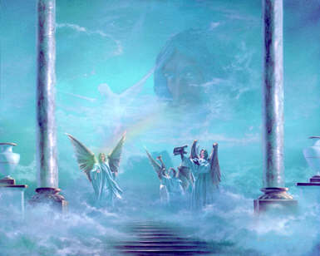
The problem of personal identity and the mind-body problem, though related, should not be conflated.
------John Perry

