Slide 1
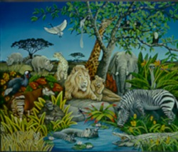
animalism

Slide 2
Some Related Questions
The Mind-Body Problem
Personhood: what makes something a person in the Lockean sense where “person is a forensic term”?
  What non-humans, if any, ought to be treated as persons?
  What humans, if any, ought not to be treated as persons?
Synchronic Identity: at any given time, what counts as the same person?
  Multiple personality, including brain-split cases
Individual Person Essences: in what ways could I have been different from the way I am and still be me?

Slide 3
Philosophical Orthodoxy
The problem of personal identity and the mind-body problem, though related, should not be conflated.
--John Perry
Persons are essentially persons (Olson will deny this)
Persons are material objects: the correct solution to the mind-body problem is some form of physicalism
Our criterion for personal identity is mentalistic: what makes me now the same person as me at some other time is some sort of psychological continuity (Locke says yes; Olson says no)
What matters for survival is identity (Parfit will deny this)

Slide 4
Lockean Orthodoxy
Most philosophers who work on personal identity are probably inclined to buy some neo-Lockean criterion for personal identity
  [P]robably nine out of ten philosophers writing about personal identity today either deny outright that we are animals. (Olson)
Most philosophers who work on personal identity probably don’t believe in post-mortem survival but do believe it’s logically possible
Most philosophers who work on personal identity assume that persons are essentially persons so that
  I don’t come into being until I become a person and
  I cease to exist when I cease to be a person

Slide 5
Olson’s Animalism
The claim that persons are essentially persons is controversial: we should argue for it or, if we assume it, make it explicit that that is an assumption
The traditional way of stating the question of personal identity through time is question-begging:
  Traditional formulation: under what possible circumstances is a person existing at one time identical with a person existing at another time?
  Olson’s formulation: Under what possible circumstances is a person who exists at one time identical with something that exists at another time (whether or not it is a person then)?

Slide 6
Animalism and Materialism
Animalism implies materialism (animals are material things), but not vice versa.
Animalism: each of us is numerically identical with an animal--we persist just as long as the human animal with which we are identical persist
According to many neo-Lockean accounts there are no non-material beings and, at any given time, a person is no more or other than a human animal but the identity conditions for person are different from the identity conditions for animal—so materialism doesn’t imply animalism

Slide 7
Animals have animal identity conditions
[I]magine that your cerebrum is put into another head. The being who gets that organ…will be mentally continuous with you…so if mental continuity of any sort suffices for you to persist, you would go along with the transplanted cerebrum
[But] no animal moves from one head to another. If this is right then no sort of psychological continuity suffices for the identity of a human animal over time.
So if we go with the cerebrum, it follows that we are not animals
So if we are animals we don’t go with the cerebrum—and don’t have animal identity conditions

Slide 8
The Thinking Animal Argument
There is a human animal sitting in your chair.
The human animal sitting in your chair is thinking.
The one and only thinking being sitting in your chair is you
You are that animal
This argument can be generalized (see symbolized version): the conclusion is that we are all animals and nothing else
Note: the most crucial premise is 3—Olson will argue that denying animalism we get the absurd conclusion that there are two thinkers: the person and the animal.

Slide 9
Alternatives One and Two
There are no human animals
  Few take this seriously
Human animals can’t think
  This is rather hard to believe. Anyone who denies that animals can think…needs to explain why they can’t. What stops a typical human animal from using its brain to think? Isn’t that what that organ is for?
The serious objection to the argument for animalism will take on Premise 3—arguing that a multiplicity of thinking beings sitting in your chair is innocuous.

Slide 10
Alternative Three: You are not alone
Lewis’s Proposal: When two beings are as intimately related as you and your animal are…we ‘count them as one’…Ordinary people have no opinion about how many numerically different thinking beings there are…What matters in real life is not how many thinkers there are strictly speaking, but how many non-overlapping thinkers.
Olson’s response
  Overcrowding: there are two thinkers
  Which one is you? “I” refers to the thinker so when the animal thinks an “I”-thought he thinks about the animal.

Slide 11
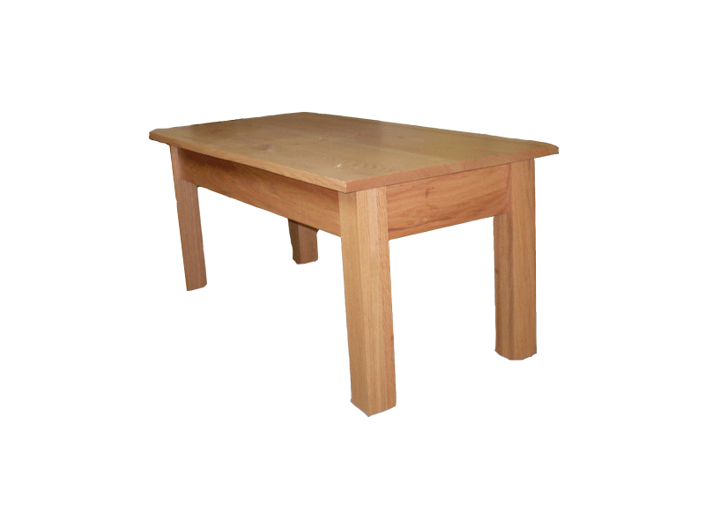
The Problem of the Many
“Overcrowding” isn’t peculiar to the problem of personal identity
  The table in the table in the table…

Slide 12
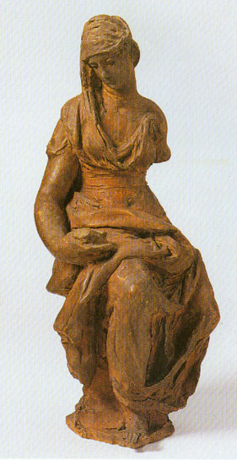
The Statue and the Clay
The statue and the clay occupy exactly the same place
  Both the statue and the lump of clay of which it’s made are shaped statuesquely, have the same weight, etc.
  But they have different identity conditions

Slide 13
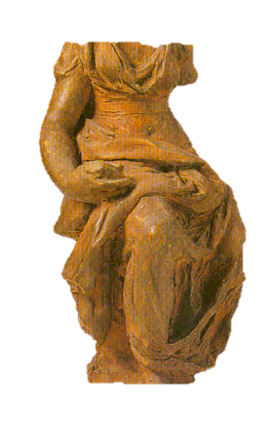
The Statue and the Clay
The lump can survive a radical change of shape
  but not loss or replacement of parts.
The statue can survive replacement of parts
  but not radical change of shape

Slide 14
Spatial and Temporal Parts
One way of understanding persistence is to regard spatio-temporal objects (or their histories) as having temporal parts
On this account, just as we consider tables within tables—and things that aren’t tables within tables—there are statues that are temporal parts (“stages”) of lumps of clay…
And statues that are temporal parts of statues
{
lump stages
statue stages
lump stages
time

Slide 15
Persons and Their Animals
There are lots of different (but at some times co-located) things here which count as one
Why should “I” refer to the human animal rather than the person?
If we don’t ascribe thinking to the body, why ascribe it to the animal?
human body stages
human animal stages
fetus stages
person stages
brain-dead stages
corpse stages
time

Slide 16
Are we animals?
Arguably, yes and no
At any given time I, the person, occupy the same region as an animal: to that extent I am an animal, i.e. the animal and I count as one
But as a person I have different persistence conditions than my animal so
  My animal may predate and postdate me, the person
  And conceivably I may survive my animal, e.g. in a resurrection world
A physicalist account of what persons are at any time doesn’t preclude a mentalistic account of personal identity through time

Slide 17
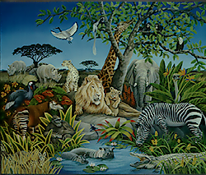

We’re People!

