Slide 1
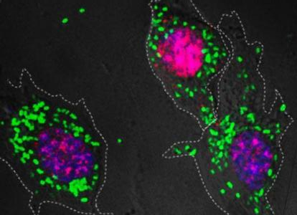
Personal Identity Fission, Fusion and Survival

Slide 2
What Matters for Survival?
“Surviving” in the memory of others? Having your good deeds live after you?
I don’t think so!
The continued existence of your mummified corpse?
The continued existence of a spiritual substance?
Is the existence of anything identical to me in the future a necessary condition on “what matters” for survival?

Slide 3
Does personal identity matter?
Derek Parfit, in a series of articles in the 1970s and his 1984 Reasons and Persons argues that identity is not “what matters”

Slide 4
Identity Problems for S-T Objects
Identity is transitive: if a = b and b = c then a = c
But there are cases in which identity seems to be one-many rather than one-to-one, so that a = b and b = c but a ≠ c
Identity does not admit of degree
But spatio-temporal objects can undergo gradual change and “become” other things
Intuitively identity is intrinsically grounded: nothing other than the intrinsic properties of a and b should make any difference to whether a = b is true
But there are puzzle cases where, it seems, we can only avoid violations of transitivity of identity by denying intrinsic grounding.

Slide 5
Personal Identity
Personal identity is identity
So all these problems arise in a particularly virulent form when we consider the identities of persons
Parfit will consider
“fission” and “fusion” cases in which transitivity is violated
cases in which personal survival seems to me a matter of degree
We’ll consider the general problem posed by the identities of spatio-temporal objects generally and then the way in which these problems arise in the special case of personal identity

Slide 6
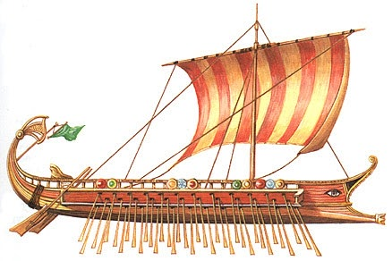
The Ship of Theseus
The ship wherein Theseus and the youth of Athens returned [from Crete] had thirty oars, and was preserved by the Athenians …for they took away the old planks as they decayed, putting in new and stronger timber in their place, insomuch that this ship became a standing example among the philosophers for the logical question of things that grow; one side holding that the ship remained the same, and the other contending that it was not the same.

Slide 7
Things can survive the gradual replacement of parts
Suppose the planks that composed the Ship of Theseus were gradually replaced until none of the original planks is part of the Continuously Repaired Ship at the end of the process
If you claim that it wouldn’t be the Ship of Theseus then you have to say at what point the Ship ceases to exist
We can’t say that with the replacement of each plank the resulting ship becomes “less identical” to the original Ship of Theseus until it ceases to be identical altogether since identity doesn’t admit of degree
It would be deeply counterintuitive to say that there is a crucial plank (first, last or something in between) so…
The Continuously Repaired Ship = The Ship of Theseus

Slide 8
Things can survive disassembly and reassembly
Suppose instead of being gradually repaired the Ship of Theseus had been disassembled by a Plank Hoarder and then reassembled somewhere else
We want to hold that artifacts like ships, bicycles, (mechanical) watches, etc. can be taken to bits and reassembled—it happens all the time!
Some things in fact are made to be disassembled and reassembled for storage or for shipping so…
The Plank Hoarder’s Ship = The Ship of Theseus

Slide 9
The Ship Repaired AND Reassembled
The Continuously Repaired Ship
≠
The Plank-Hoarder’s Ship
Transitivity of Identity violation!
time
=
=
The Ship of Theseus
We can’t say that both the Continuously Repaired ship and the Plank-Hoarder’s Ship are the Ship of Theseus because The Continuously Repaired Ship ≠ The Plank-Hoarder’s Ship

Slide 10
The Ship Repaired AND Reassembled
The Continuously Repaired Ship
≠
The Plank-Hoarder’s Ship
So why can’t it survive both?
time
≠
≠
The Ship of Theseus
The Ship of Theseus (we agreed) could survive either the gradual replacement of all its parts or (we agreed also), it could survive disassembly and reassembly.

Slide 11
The Ship Repaired AND Reassembled
The Continuously Repaired Ship
≠
The Plank-Hoarder’s Ship
Intrinsic Grounding violation!
time
=
≠
The Ship of Theseus
The Plank-Hoarder’s Ship would have been the Ship of Theseus if it weren’t for the Continuously Repaired Ship, which is the “better candidate” for being the Ship of Theseus.

Slide 12
Best Candidate Theory
Actual World
Another Possible World
Continuously Repaired Ship
Plank-Hoarder’s Ship
Plank-Hoarder’s Ship
Ship of Theseus
Ship of Theseus
On this account identity is extrinsicly grounded—the Continuously Repaired Ship fails to be identical to the Ship of Theseus because of an extrinsic property, viz.its coexisting with the Continuously Repaired Ship. But maybe this is OK…

Slide 13
Best Candidate Theory
Actual World
Another Possible World
Dead, written Latin
Modern Italian
Modern Italian
Roman Latin
Roman Latin
It seems plausible to adopt a best candidate theory when it comes to the identities of languages through time: Italian is no further from Latin then English is from Anglo-Saxon but in the absence of any better candidate we think English is the same language as Anglo-Saxon, a.k.a. “Old English.”

Slide 14
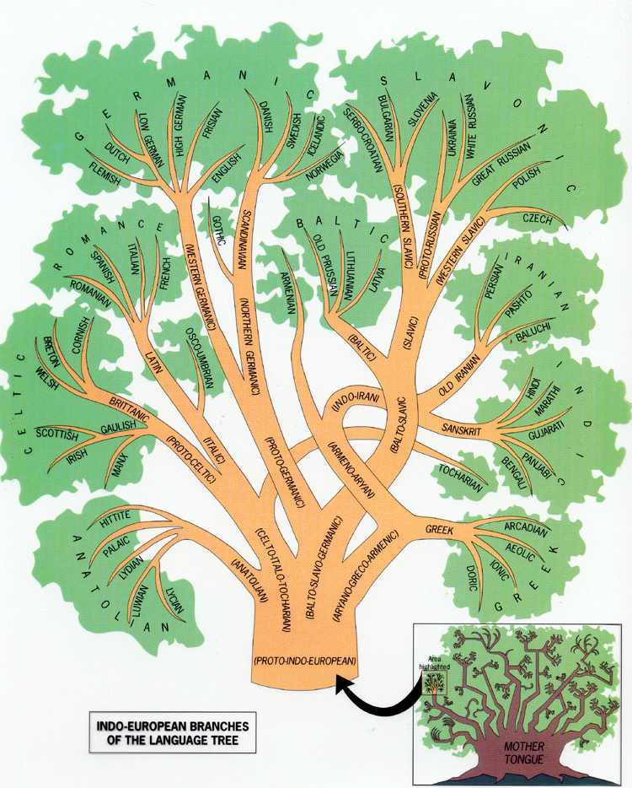

Slide 15
Best Candidate Theory
Western Germanic morphed into modern Flemish, Dutch, German, Frisian and English
But, unlike Latin, it didn’t survive unchanged alongside modern Germanic languages.
Arguably, all these languages are equally good candidates for identity with Western Germanic, so this is a case of symmetrical fission
To identify all these distinct languages with Western Germanic would violate Transitivity of Identity so
We say that Western Germanic has ceased to exist and has been replaced by English and other modern Germanic languages

Slide 16
Best Candidate Theory
Actual World
Another Possible World
Other Germanic Languages
English
English
Western Germanic
Western Germanic
But suppose Western Germanic hadn’t split into different modern languages but just changed in one direction. Then we might want to say that Western Germanic survived as English—though radically changed.

Slide 17
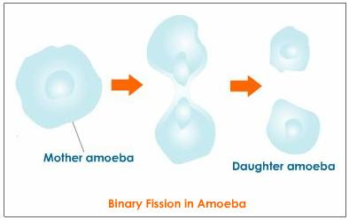
Symmetrical Fission
Suppose only this had happened
Similarly, when an amoeba divides symmetrically we say the mother amoeba ceases to exist.
If however the amoeba just “lost” half of its stuff and then regenerated so that only one amoeba remained at the end of the process we might want to say that the mother amoeba survived

Slide 18
Best Candidate Theory
Actual World
Another Possible World
Same Old Amoeba
New Amoeba
New Amoeba
Old Amoeba
Old Amoeba
At the Actual World, Amoeba survives the loss of half its body; at Another Possible World the “lost” half becomes a new amoeba. Since there are two equally good candidates, and both can’t be Old Amoeba, neither is: Old Amoeba ceases to exist.

Slide 19
A Person Undergoes Fission
We split Jones brain and transplant the two hemispheres (which duplicate information) into the otherwise brainless bodies of Smith and Brown.
After the operation, both Smith-Jones and Brown-Jones sincerely claim to be Jones.
And both are equally good candidates!
Smith-Jones
Brown-Jones
Jones

Slide 20
Best Candidate Theory: The Dividing Self
Actual World
Another Possible World
Smith-Jones
Brown-Jones
Brown-Jones
Jones
Jones
But Smith-Jones and Brown-Jones can’t both be Jones since that would violate Transitivity of Identity!
So according to Best Candidate Theory we get this!

Slide 21
Counterintuitive Results
Even if a best candidate theory is ok for languages it is very implausible as an account of personal identity in the fission case because it makes our existence and survival depend on external factors that seem entirely irrelevant since, on this account:
At the Actual World, Jones hopes that one and only one of his brain hemispheres will survive because if both do he’s as dead as he would be if neither did
At Another Possible World, Brown-Jones is grateful to Smith-Jones for existing because if Smith-Jones hadn’t existed he would never have existed.

Slide 22
Is identity “what matters”?
The relation of the original person to each of the resulting people contains all that interests us—all that matters—in any ordinary case of survival. This is why we need a sense in which one person can survive as two.
In light of the possibility of such fission cases (and also cases of extreme longevity to be considered), Parfit argues that identity is not “what matters” for survival
“What matters” for survival, according to Parfit, is psychological continuity—that an individual’s total mental state should be part of a succession on states related by
Similarity: change should be gradual
Lawful causal dependence (possibly featuring memory most prominently)

Slide 23
Parfit’s Argument
Identity is one-one and does not admit of degree.
What matters for survival is psychological continuity.
Psychological continuity need not be one-one and may admit of degree.
Therefore, identity is not what matters for survival.

Slide 24
Parfit’s Puzzle Cases
Psychological continuity is what matters for survival but
In cases of simple fission and fusion, psychological continuity is not one-one.
In cases of complex fission and fusion, in addition, psychological continuity seems to be a matter of degree.
Identity is necessarily one-one and does not admit of degree so identity cannot be what matters for survival!

Slide 25
Simple Fission and Fusion
Fission: one thing “becomes” two
Fusion: two things “become” one

Slide 26
This is a problem!
≠
=
=
=
=
≠
Identity is a one-one relation so that “becoming” can’t be identity!

Slide 27
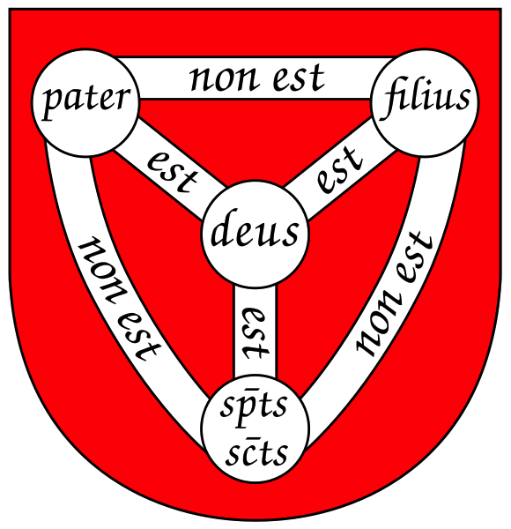
Another Transitivity of Identity Problem
The doctrine of the Trinity!

Slide 28
Complex fission-fusion is even worse!
Fall
Spring
Parfit imagines a species of individuals who undergo fission every spring and fusion every fall.
Who am I? Which future(s) should I care about?

Slide 29
Is continuity a matter of degree?
The complex fission-fusion case suggests that psychological continuity may be a matter of degree.
Lewis suggests that in the Methusalah case psychological continuity may be a matter of degree also.
{
{
{
{

Slide 30
Methusalah (not to scale)
{
{
{
{
time
Consider Methuselah. At the age of 100 he still remembers his childhood. But new memories crowed out the old. At the age of 150 he has hardly any memories that go back before his twentieth year. At the age of 200 he has hardly any memories that go back before his seventieth year…When he dies at the age of 969 he has hardly any memories that go beyond his 839th year.

Slide 31
Lewis on What Matters
What matters for survival?
Psychological continuity or connectedness?
Identity?
Lewis argues that these two answers are compatible and both are right.

Slide 32
Relations between stages
Assuming 4-dimensionalism persisting things (“continuants”) have temporal parts or stages at different times.
The relation between stages of the same thing at different times is not identity!
Just as the relation between spatial parts of the same thing at different places is not identity.

Slide 33
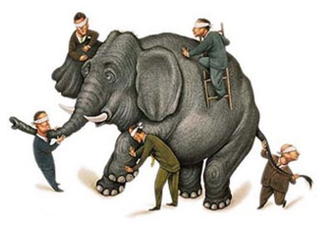
The relation between tail and trunk
Is not identity but…
The spatial unity relation for elephant
Spatio-temporal continuity
Causal connectedness in one organized system

Slide 34
The R-Relation
Lewis calls the temporal unity relation for person the R-Relation
The R-Relation is the relation of mental continuity and connectedness among person-stages that matters for survival.
And, Lewis argues, our “criterion” for personal identity through time such that:
A at t is the same person as B at t’ iff A’s stage at t is R-related to B’s stage at t’

Slide 35
The I-Relation
Lewis calls the relation that holds on person-person stages of a single person.
What’s the difference between the R-relation and the I-Relation?
Lewis argues nothing: they’re just two ways of characterizing the same relation.

Slide 36
So why distinguish them?
Because we went to put the question of whether the R-relation can be criterial for personal identity
Comparing the R-relation with identity won’t work because personal identity doesn’t hold on person-stages.
The I-relation by definition holds on stages of the same person since it’s defined as the relation that holds on a pair of stages if and only if they’re temporal parts of the same person
So the question of whether holding psychological connectedness/continuity is what matters is compatible with holding that identity is what matters is the question of whether the R-relation is the I-relation.

Slide 37
Lewis: What is a Person?
On Lewis’ account a person is
A maximal I-interelated aggregate of person-stages:
Every person-stage is I-related to every other person-stage in the aggregate and
There is no person-stage not in the aggregate that is I-related to any person-stage in the aggregate of I-interelated stages

Slide 38
Formal features of the I-Relation
Reflexive: every stage is I-related to itself
since every stage is part of the same person that it itself is part of.
Symmetric: if stage S1 is I-related to stage S2 then S2 is I-related to S1
since if one stage is part of the same person as another the other is part of the same person as the first.

Slide 39
Formal features of the R-relation
We stipulate that the R-relation is to be reflexive
We merge (individually antisymmetric) backward- and forward-R relations so that the R-relation which is the result of merging them is symmetric

Slide 40
Stage-sharing
It would be wrong to read my definition of the I-relation as saying that person-stages S1 and S2 are I-related iff the continuant person of whom S1 is a part is a stage of the continuant person of whom S2 is a state are identical.
Because “the” implies uniqueness and there may be more than one person to whom a stage belongs!
In fission and fusion cases different persons share stages

Slide 41
Fission
RRRRRRRR
RRRRRRRR
RRRRRRRR
A stage may be R-related to stages that are not R-related to one-another
Given such branching cases, the R-relation is not transitive!

Slide 42
Identity and I-relatedness
If the R-relation is the I-relation then the I-relation can’t be transitive either
But identity is transitive
No problem: person-stages S1 and S2 are I-related iff a continuant person of whom S1 is a part is a stage of a continuant person of whom S2 is a state are identical.

Slide 43
The I-relation is not transitive
S2
S3
S1
S1 is I-related to S2 because there’s a person of which both are stages and
S1 is I-related to S3 for the same reason
But there’s no person of which S2 and S3 are stages so S2 and S3 aren’t I-related to one another!

Slide 44
Lewis on Counting People
At any given time we count people by the relation of tensed-identity
Tensed-identity is not identity but a relation in which individuals stand when they share stages
X is identical-at-t to y iff x’s stage at t = y’s stage at t

Slide 45
Different people identical-at-t
t’
S2
S3
S1
t
Jones
There are two people at all times
They are identical-at-t
The name “George” is ambiguous

Slide 46
Tensed Identity
Is an equivalence relation, i.e. reflexive, symmetric, and transitive
Is an indiscernibility relation for a restricted range of properties, i.e. those individuals have wholly in virtue of the way things are at a given time.

Slide 47
Overcrowding?
There were two people all along
But we didn’t know that prior to fission
According to Lewis, this is ok because at any given time we count by tensed-identity and so count one person prior to fission and two afterwards.

Slide 48
Picky Problems
OK if we’re just interested in counting--at a time or for all time--tensed-identity does the job.
But how do we understand, e.g. future tensed claims about people who undergo fission?
Pre-fission names are ambiguous so we can’t assign truth value!

Slide 49
What will be true about Jones?
Retirement savings gone, Smith-Jones retires to Chula Vista
Brown-Jones cleans out the bank account and flies to Italy.
Spends rest of life
living well in Florence
S2
S3
S1
Jones
Jones will live in Chula Vista
Jones will live in Florence
Both are ambiguous, so neither is strictly either true or false!

Slide 50
Perry: The Lifetime Language
Retirement savings gone, retires to Chula Vista
Cleans out the bank
account, flies to Italy.
Spends rest of life
living well in Florence
Jones
Persons’ names unambiguously pick out lifetimes traced from stages that occur at different times.
A lifetime is the aggregate of stages we get tracing the whole path of the (intransitive!) R-relation from a given stage.
At times when there is no stage from which we can trace a given lifetime, that lifetime is not determinable.

Slide 51
The Lifetime Language
Retirement savings gone, retires to Chula Vista
Cleans out the bank
account, flies to Italy.
Spends rest of life
living well in Florence
Jones
At times when an individual’s lifetime is not determinable, his name fails to refer
Before fission, “Jones” refers to Purple (Red and Blue are not determinable so “Smith-Jones” and “Brown-Jones” fail to refer)
After fission, “Smith-Jones” and “Brown-Jones” refer to Red and Blue respectively; “Jones” fails to refer.

Slide 52
The Lifetime Language
Retirement savings gone, retires to Chula Vista
Cleans out the bank
account, flies to Italy.
Spends rest of life
living well in Florence
Jones
The following are unambiguous and true:
[Before fission] Jones will live in Chula Vista.
[Before fission] Jones will live in Florence.
[After fission] Smith-Jones is in Chula Vista
[After fission] Smith-Jones is not in Florence

Slide 53
The Lifetime Language
Retirement savings gone, retires to Chula Vista
Cleans out the bank
account, flies to Italy.
Spends rest of life
living well in Florence
Jones
The following are not true (since the names fail to refer):
[Before fission] Smith-Jones will live in Chula Vista.
[Before fission] Smith-Jones will not live in Florence.
[After fission] Jones is in Chula Vista
[After fission] Jones in Florence

Slide 54
Which language do we speak?
The Branch Language (Lewis): there are two persons all along
Before fission names are ambiguous
Before fission future-tense statements are neither true nor false
The Lifetime Language (Perry): there are three persons all along
Before fission we can only talk about one of them
After fission we can only talk about the other two

Slide 55
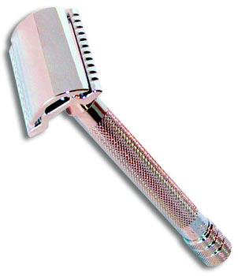
How do we decide?
Does Perry’s proposal multiply persons (and complications) beyond necessity?
Are the costs of Lewis’ simpler account too high?

Slide 56
Another alternative
worm
A stage is a “temporal slice” of a worm
stage
Both Lewis’ account and Perry’s assume that continuant persons are space-time worms rather than stages

Slide 57
The Stage Language
Jones
Jones
On the stage account individuals are just stages.
Names are systematically ambiguous (like indexicals)
They pick out different stages at different times

Slide 58
The Stage Language
Retirement savings gone, retires to Chula Vista
Jones
Cleans out the bank
account, flies to Italy.
Spends rest of life
living well in Florence
Jones
Jones
Future tense statements about a person really say that the stage which he is, is R-related to another stage that is whatever.
[Before fission] Jones will live in Florence
True because the pre-fission stage “Jones” picks out is R-related to a post-fission stage in Florence.

Slide 59
Worms or Stages?
Worm-talk captures our intuition that future (and past) tense statements are true of us and not just other beings to whom we’re R-related.
Stage-talk capture our intuition that even in exotic branching cases, before fission there’s just one person.
Arguably, our decision can only be a matter of convenience.

Slide 60
The Moral
Philosophy is a negotiation between our interest in making commonsense talk come out right and the demands of logic.
With enough fiddling we can make (most) commonsense talk come out right.
We choose the most cost-effective account--whatever that may be.

Slide 61
Philosophy is…
…fiddling!

