Slide 1
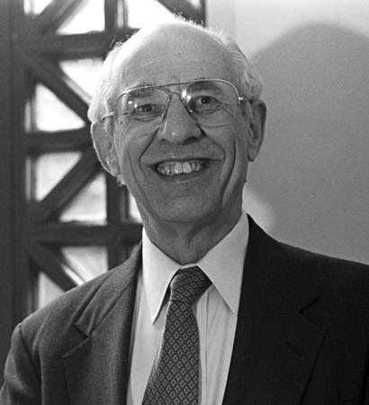
Hillary Putnam
Whichever way you cut it, meanings ain’t in the head

Slide 2
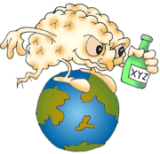
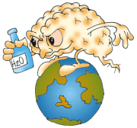
Twin Earth Thought Experiments
For a discussion of this and other cool stuff check out A Field Guide to the Philosophy of Mind

Slide 3
Mental Content
Typically indicated by the “that” clauses in , e.g.
I believe that the stuff in Lake Michigan is water
I hope that the Democrats will win
I imagine that Martians are green
Content determines the character of our intentional states, where intentionality is understood as “directedness” or “aboutness”
Our question: Does the character of our intentional states depend wholly on us apart from our physical and social environment or no?

Slide 4
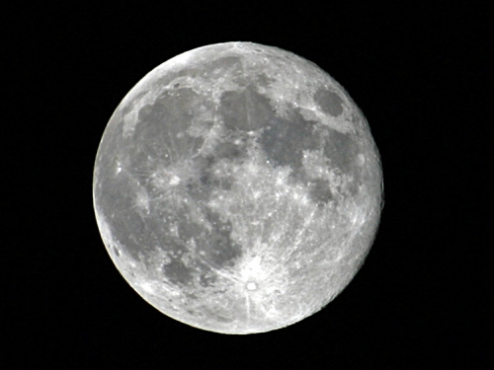
“Grasping” the sense?
The doctrine that the meaning of a term is a concept carried the implication that meanings are mental entities. Frege, however, rebelled against this ‘psychologism’…the same meaning can be ‘grasped’ by more than one person…he identified concepts…with abstract entities.

Slide 5
But Frege was an Internalist!
The doctrine that the meaning of a term is a concept carried the implication that meanings are mental entities. Frege, however, rebelled against this ‘psychologism’…the same meaning can be ‘grasped’ by more than one person…he identified concepts…with abstract entities.
Frege recognized that ‘meaning’ was ambiguous between sense (“intension”) and reference (“extension”)
On his account, to understand is to ‘grasp’ the sense—which is an abstract item—not an ‘idea.’
However, on Frege’s account, the ‘grasping’ is still itself a private, psychological (mysterious!) business.
This Putnam will deny!

Slide 6
Further disagreement with Frege
Putnam: Sense doesn’t determine reference!
It was taken to be obvious that…two terms cannot differ in extension and have the same intension…[since] the concept corresponding to a term provided…a criterion for belonging to the extension…in the strong sense of way of recognizing whether a thing falls into the extension or not.
This Putnam will also deny

Slide 7
Assumptions Putnam challenges
That the meaning a a term determines its extension (in the sense that sameness of intension entails sameness of extension
That knowing the meaning of terms is just a matter of being in a certain inner psychological state
Note: psychological states aren’t necessarily conscious states. Consider, e.g. believing that 2 + 2 = 4
The meaning of a term and content of psychological state supervene upon intrinsic properties of the individual.

Slide 8
Supervenience
A set of properties A supervenes upon another set B just in case no two things can differ with respect to A-properties without also differing with respect to their B-properties. In slogan form, “there cannot be an A-difference without a B-difference” (SEP Supervenience)
Thought experiments involving intrinsic duplicates, including twin-earth thought experiments, pump our intuitions about whether some property supervenes upon some other property
In the Twin Earth thought experiments we’re asking whether what a person means by “water” supervenes upon “what’s in the head.”
Putnam sez NO

Slide 9
Internalism
We distinguish intrinsic from extrinsic properties of objects
A thing has its intrinsic properties in virtue of the way that thing itself, and nothing else, is. Not so for extrinsic properties, though a thing may well have these in virtue of the way some larger whole is … If something has an intrinsic property, then so does any perfect duplicate of that thing; whereas duplicates situated in different surroundings will differ in their extrinsic properties. (Lewis)
Internalists hold that the character of our belief states is determined solely by our intrinsic properties--in particular, properties we have in virtue of what’s “in the head”
That is, what we believe supervenes upon what’s in our heads—”narrow content”

Slide 10
Narrow and Wide Content
Narrow mental content is a kind of mental content that does not depend on an individual's environment. Narrow content contrasts with “broad” or “wide” content, which depends on features of the individual's environment as well as on features of the individual. It is controversial whether there is any such thing as narrow content. Assuming that there is, it is also controversial what sort of content it is, what its relation to ordinary or “broad” content is, and how it is determined by the individual's intrinsic properties. (SEP Narrow Content)
Putnam argues that even if “what’s in the head” for earthlings and their Twin Earth duplicates is the same, they don’t mean the same thing when they say, e.g. “the stuff in lakes and rivers is water.”

Slide 11
This isn’t Conceptualism vs Platonism!
Locke identified concepts with mental entities or “ideas”
Frege “identified concepts…with abstract entities rather than mental entities
However, ‘grasping’ these abstract entities was still an individual psychological act.
Both are internalists insofar as they held that the character of belief states is determined by what’s in the head.

Slide 12
Putnam’s Externalism
Many of our mental states such as beliefs and desires are intentional mental states, or mental states with content.
Internalism (or individualism) with regard to mental content affirms that having such intentional mental states depends solely on our intrinsic properties.
Externalism with regard to mental content says that in order to have certain types of intentional mental states (e.g. beliefs), it is necessary to be related to the environment in the right way.

Slide 13
Externalism
Concerns intending, desiring, believing
The claim is that the character of such mental states does not supervene on the intrinsic properties of people so that
Perfect duplicates as regards intrinsic properties could be in different mental states.

Slide 14
The Twin Earth Argument
Everything is just the way it is for us on earth except that the stuff in lakes, rivers, etc. is XYZ rather than H₂O.
XYZ is exactly like water in its superficial properties and how it behaves
Every Twin-Earthian is a duplicate of an Earthian

Slide 15
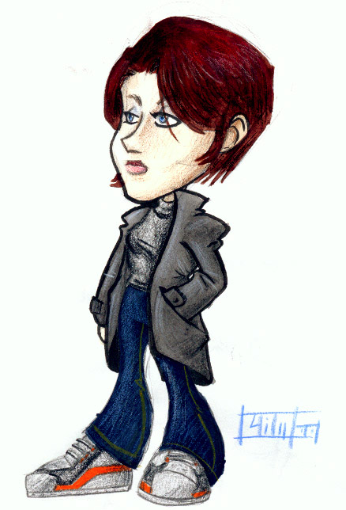
Externalism about mental content
Earth Girl thinking about water
Twin-Earth Girl not thinking about water

Slide 16
Twin-English
water
When Twin-Earthians say “water” in Twin-English they refer to this stuff on Twin Earth
Twin-Earth Girl
XYZ flowing out of a Twin-Earth faucet

Slide 17
But we’d say XYZ is not water!
When we get to Twin-Earth, once we discover that the stuff isn’t H₂O we’ll say it isn’t water
And that Twin-Earthians don’t mean the same thing we mean when we say “water”

Slide 18
Earthians mean what we do
I know what water is!
Even if they don’t know that water is H₂O
Because meaning is not in the head!

Slide 19
Indexicality and Rigidity
Indexicals: reference depends on context of utterance.
Rigid designators: refer to the same thing/kind at all possible worlds.
Reference of a rigid designator is fixed by the context of a world, w, and
At any world refers to the thing/kind at that world which is the same thing/kind as the thing/kind whose reference was fixed at w

Slide 20
Fixing Reference
I tag this stuff I’m standing in “water”
I tag this stuff I’m standing in “water”
H₂O
XYZ
“This” is indexical so they’re tagging different stuff

Slide 21
More stuff
water
water
Once a sample gets tagged, “water” refers to all other things that are the same stuff as the tagged sample

Slide 22
Same stuff
What makes it the same stuff?
Water is a natural kind
What makes something belong to a kind is its microstructure, e.g. being H₂O
So the tag attached to this stuff attaches to all other samples of stuff that are like it in being H₂O

Slide 23
Same stuff, different world
If you describe not another planet in the actual universe, but another possible universe in which the chemical formula XYZ…we shall have to say that that stuff isn’t water.
Nothing counts as another possible world in which water isn’t H₂O.

Slide 24
The stuff they call “water” isn’t water
Actual World
Another Possible World
Water is H₂O
Water is not H₂O
He’s not talking about water
Actualese Water = H₂O
Possibilese Water = XYZ
Twin Putnam is saying something true in Possibilese
Putnam and Twin Putnam don’t disagree because they aren’t talking about the same stuff
There’s no possible world at which the stuff we call water isn’t H₂O
So, water is necessarily H₂O!

Slide 25
Metaphysical & Epistemic Possibility
Kripke refers to statements that are rationally unrevisable…as epistemically necessary
“Water is H2O” is not epistemically unrevisable: we may be mistaken about the essential character of this stuff
But this stuff can’t be different in its essential character from the way it is.

Slide 26
Moral
Physical circumstances and history determine meaning.
Because Twin Earth is different from Earth, e.g. in the composition of the stuff in lakes and rivers, our Twin Earthian intrinsic duplicates don’t mean what we mean when they say the same things or believe what we believe.
Saying the same thing
Expressing the same proposition
Making the same statement
Uttering the same noises/inscribing the same marks

Slide 27
Social Circumstances determine meaning too
I don’t know no chemistry--whatever the experts a million years from now say is the same stuff as this is water!

Slide 28
Linguistic Division of Labor
beech
elm
Putnam doesn’t know difference between beeches and elms
But he means something different by “beech” and “elm” because expert members of the linguistic community do

Slide 29
Social Meaning
In case of doubt, other speakers would rely on the judgment of these “expert” speakers
Thus the way of recognizing possessed by these “expert” speakers is also, through them, possessed by the collective linguistic body
In this way the most recherché fact about water may become part of the social meaning of the word.

Slide 30
The Moral
Traditional semantic theory leaves out two contributions to the determination of reference
The contribution of society and
The contribution of the real world
A better semantic theory must encompass both

Slide 31
Worries about Externalism
Experimental philosophy, cross cultural studies and thought experiments
Linguistic and psychological content
Privileged access
Explanation of behavior
Are all psychological contents wide? Representationalism
The Extended Mind

Slide 32
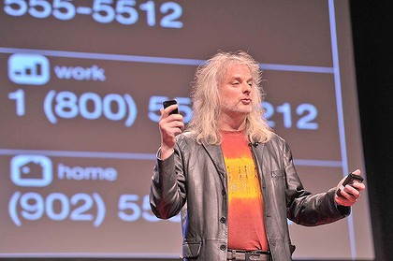
Active Externalism?

