Slide 1
Identity, Ostension and Hypostasis
W. v. O. Quine

Slide 2
Two Philosophical Problems
The Problem of Identity-Through-Time: Endurantism (3d-ism) or Perdurantism (4d-ism)
Endurantism: things are 3-dimensional and endure through change
Perdurantism: things are 4-dimensional and have temporal parts. Change is a matter of having temporal parts that are different in character.
The Problem of Universals: should we commit to abstracta?
Platonism: general terms designate abstract objects
Conceptualism: general terms designate ideas
Nominalism: general terms are, in effect, instructions for grouping within a given conceptual scheme
Notes:
Quine assumes perdurantism. He isn’t going to argue for it because he’s just setting up the problem of universals. He’ll argue for nominalism.

Slide 3
What Quine is going to do
Consider the problem of “identity through time”: the River Caÿster example
Note that we can, if we choose, consider some general terms, e.g. “red” as designating concrete universals analogous to ordinary extended particulars
But that appeal to concrete universals is not a general solution: it fails for general terms designating shapes
So we either commit to abstract universals named by abstract singular terms, e.g. “redness” or tell another story about how general terms can be learnt and understood without commitment to abstracta
We can tell another story—suggested by reflecting on how singular terms for extended physical objects like the Caÿster are introduced
And should because for pragmatic purposes we don’t need these abstracta and should avoid them.

Slide 4
Quine’s Pragmatism
It is meaningless…to inquire into the absolute correctness of a conceptual scheme as a mirror of reality. Our standard for appraising basic changes of conceptual scheme must be…a pragmatic standard. Concepts are language, and the purpose of concepts and of language is efficacy in communication and in prediction. Such is the ultimate duty of language, science, and philosophy, and it is in relation to that duty that a conceptual scheme has finally to be appraised.
We can’t sensibly ask the question “how much of our science is merely contributed by language and how much is a genuine reflection of reality?”
We can only ask of a given conceptual scheme or theory what the ontological commitment of that conceptual scheme or theory is
And we choose our conceptual schemes and theories on pragmatic grounds: to do the job for us.
Universals are not cost-effective

Slide 5
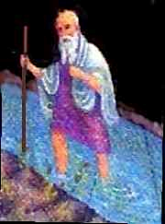
I. The River Caÿster & The Problem of Change
You can’t step twice in the same river…
Or can you???

Slide 6
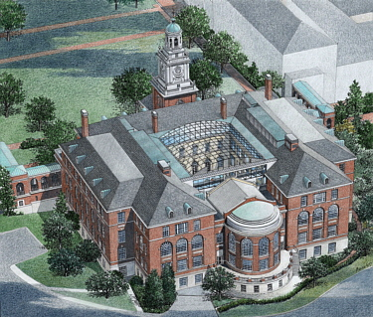
Reference to Particulars
“I contributed that to my old school!”

Slide 7
We identify here-now objects by ostension
But ostensive reference by itself is ambiguous: that what?
That brick? That wall? That building of which the wall is a part.
Quine will argue that pointing is also ambiguous when it comes to the ‘temporal spread’ of objects (like rivers, quantities of water, etc.)

Slide 8
Sortals & Identity Criteria
To disambiguate reference we introduce sortals: count nouns that convey criteria of identity.
Count nouns vs. mass terms
Intuitively, thing-words vs. stuff words
Syntactically, sortals take plural and it makes sense to precede them with a number (e.g. “one potato, two potatoes…”)
Sortals introduce the language of identity
Identity criteria for spatio-temporal objects tell us how to “trace” object through space and time: different for different sortals.

Slide 9
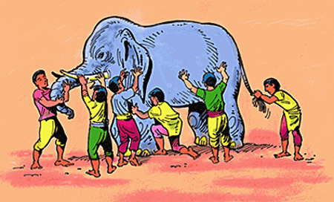
The Blind Men and the Elephant
Different parts of the same elephant
The sortal, elephant, provides rules for tracing by elephant-kinship.

Slide 10
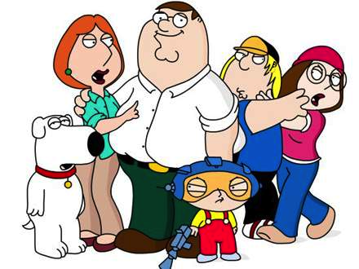
Different sortals, different rules
Republican
Democrat
Green
Same family, different political parties

Slide 11
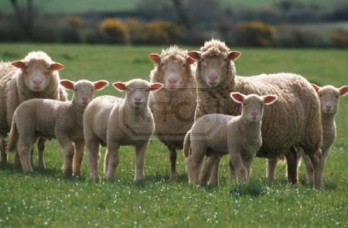
Objects can be gappy
Families and flocks of sheep are gappy
So are ordinary objects at the micro level--like Eddington’s table that’s mostly empty space

Slide 12
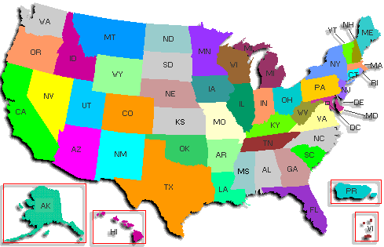
Another gappy object

Slide 13
Objects can overlap
2 families
3 political parties

Slide 14
Spatial River-Kinship
These places are spatially river-kin
We say they’re spatial parts of the same river

Slide 15
Temporal River-Kinship
River-stage at t3
River-stage at t2
time
River-stage at t1
space
We can also think of the Caÿster, and its spatial parts, as having temporal parts or stages

Slide 16
River-Kinship
Starting from the local bit of the Caÿster we can trace outward in space and time by the rules for river-kinship.
But we can also start from the same place and trace outward by water-kinship.
Trading same river and same water yield different results—just as tracing by family and tracing by political party do.

Slide 17
Water-Kinship
Tracing the same water yields a different result from tracing by river

Slide 18
River-Kinship and Water-Kinship overlap
100 cubic feet of
the Caÿster
from t1 to t2
Tracing by river- kinship this is connected to the Agean
Tracing by water- kinship this is connected to your toilet
We can trace water-wise or river-wise

Slide 19
Stepping twice in the same what?
Stepping in the Cayster at the same place at different times we step twice in the same river
but not the same water.
Stepping in the Cayster and in the toilet at different times we can step twice in the same water
but not the same river
But we can step twice in the same water and the same river if…

Slide 20
…we run downstream!

Slide 21
“Hypostasizing” objects
Sortals convey identity criteria—rules for various ways of grouping
We learn to group objects indicated by ostension according to various spatial and temporal unity relations (“kinship” relations) conveyed by various sortals.
x and y bear the spatial unity relation for a sortal term, F, if x and y are spatial parts of the same F
x and y bear the temporal unity relation for a sortal term, F, if x and y are temporal parts (“stages”) of the same F
When we affirm the identity of an object from ostension to ostension we cause our ostensions to refer to the same large object and so afford our listener an inductive ground from which to guess the intended reach of that object. Pure ostension plus identification conveys…spatio-temporal spread.

Slide 22
Identification of Indiscernibles
Identity is more convenient than river-kinship or other relations, because the objects related do not have to be kept apart as a multiplicity…Distinctions immaterial to the discourse at hand are thus extruded from the subject-matter. In general we might propound this maxim of the identification of indiscernibles: Objects indistinguishable from one another within the terms of a given discourse should be construed as identical for that discourse.
Having introduced river we don’t care about river-stages or kinship relations
So we exclude them from the discourse of ordinary English
The river at every time counts as the same river for the purposes of ordinary English
Compare to fungibility of currency: I want $20; which particular $20 I get is a don’t-care.

Slide 23
The Moral
We don’t discover physical objects (rivers, buildings, etc.) out there
We in effect construct them by adopting rules for grouping objects of ostension in ways that suit our practical purposes
If this story is plausible, we don’t have to assume that “the world” contains things that hang together in these ways to explain how we can understand singular terms that designate ordinary physical objects (e.g. “Caÿster,” “Gilman Hall”)
Introducing singular terms that pick out ordinary objects is a 2-step procedure:
We learn to group here-now objects by kinship relations
We introduce sortals, which carry with them the language of identity, for convenience

Slide 24
II. And now…general terms
I have been speaking…of integration of momentary objects into time-consuming wholes, but…analogous remarks hold…[for] conceptual integration: the integration of particulars into universals
We can understand the introduction of general terms (e.g. “river,” “water,” “red,” “triangle”) in the same way as we understand the introduction of singular terms
Note: commitment to universals is a 2-step procedure:
We learn to group objects by similarity relations, e.g. grouping similar objects as brown (good)
“Hypostasizing” properties: introducing abstract singular terms, e.g. brownness (bad)

Slide 25
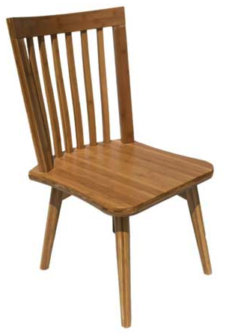
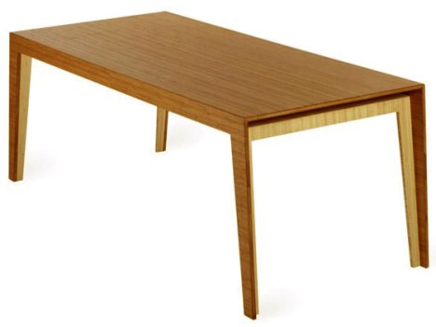
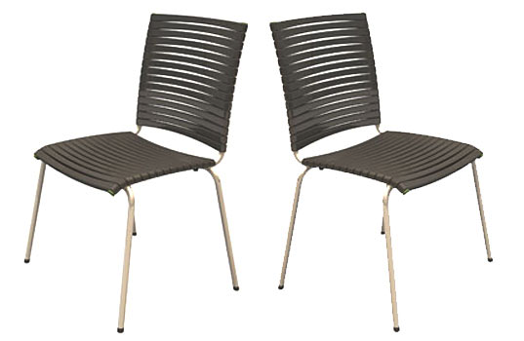
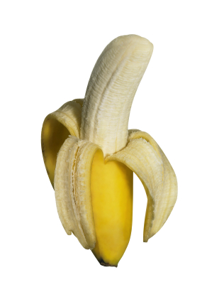
Introducing general terms
dog-or-banana
brown
chair

Slide 26
Universals
But should we take the next step?
And hypostasize these ways of grouping by introducing universals as the referents of singular terms like brownness, chairhood, or triangularity?
Hypothesis: maybe we can treat universals as concrete but scattered objects

Slide 27
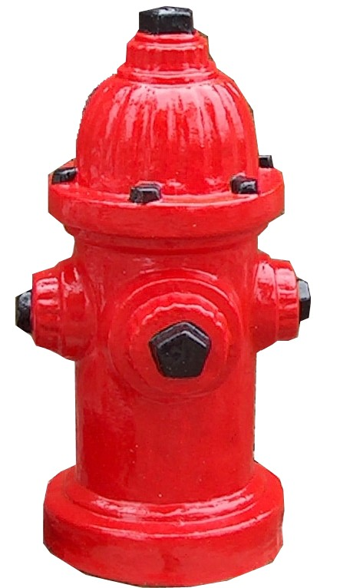
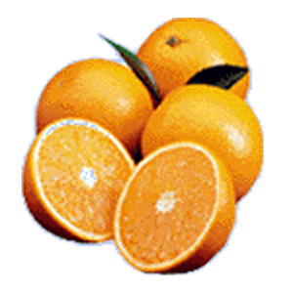
Red as a “concrete universal”

Slide 28
Universals and Other Abstracta
Abstracta (abstact objects) are problematic because
They’re not spatio-temporal (so a problem for naturalism)
They’re causally inefficacious (so how can we know about them?)
Taking on Platonic universals is costly because
They’re abstracta and
We have to explain what it is for a particular that has a property to “instantiate” that property
But concrete universals, understood as scattered spatio-temporal objects are cost-free!
And we can explain an object’s having a property, understood as a concrete universal, as the object’s being part of the universal!

Slide 29
General Terms: Identification of Indiscernibles
When we consider general terms, like red, the distinction between different red objects is a don’t-care in the way that the distinction between different river-stages in ordinary English is a don’t-care
Just as we point to the river at different times and say, truly, “That’s the Caÿster”
We can point to different objects and say, truly, “That’s red.”
The general term doesn’t distinguish between “parts” of red!
However, the concrete universals solution is not a general solution for our problem: the theory of universals as concrete, which happened to work for red, breaks down in general.

Slide 30
III. The concrete universal solution fails!
Pooling all the triangular regions gives simply the total square region…and similarly for the other…shapes.
So the theory of universals as concrete, which happens to work for red, breaks down in general

Slide 31
IV. But we don’t need universals at all!
No more need be demanded, in explication of ‘is square’ or any other phrase, than that our listener learn when to expect us to apply it to an object and when not; there is no need for the phrase itself to be a name in turn of a separate object of any kind…The use of a general term does not of itself commit us to the admission of a corresponding abstract entity into our ontology.
Distinguish general terms (e.g. “red”) from abstract singular terms (e.g. “redness”)
The 2-step story about how expressions for spatio-temporally extended objects were introduced shows this.
We learn to recognize similarity in the way we learn to recognize, e.g. river-kinship, as a way of grouping, e.g. red as a way of grouping red things
But we don’t take the second step of hypostasizing redness

Slide 32
Why particulars but not universals?
Introducing extended spatio-temporal particulars is efficient
Simplifies theorizing about experience
Doesn’t cause logical difficulties
Introducing universals isn’t cost-effective
Abstracta are problematic and
Once abstract entities are admitted, our conceptual mechanism goes on and generates an unending hierarchy of further abstractions as a matter of course course.

Slide 33
IV. Pragmatic standard
It is meaningless…to inquire into the absolute correctness of a conceptual scheme as a mirror of reality. Our standard for appraising basic changes of conceptual schemes must be…a pragmatic standard
The ontological question—what is there, what exists—can only be asked relative to a conceptual scheme or theory
We choose the conceptual schemes and theories with which to operate
But the choice is not arbitrary: some choices are better than others and some are out of out of the ballpark
Concepts are language and the purpose of concepts and of language is efficacy in communication and prediction. Such is the ultimate duty of language, science, and philosophy, and it is in relation to that duty that a conceptual scheme has finally to be appraised

Slide 34
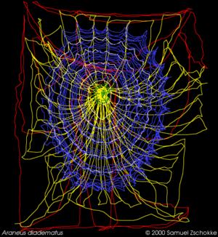
We spin the Web of Belief
The End

