Slide 1
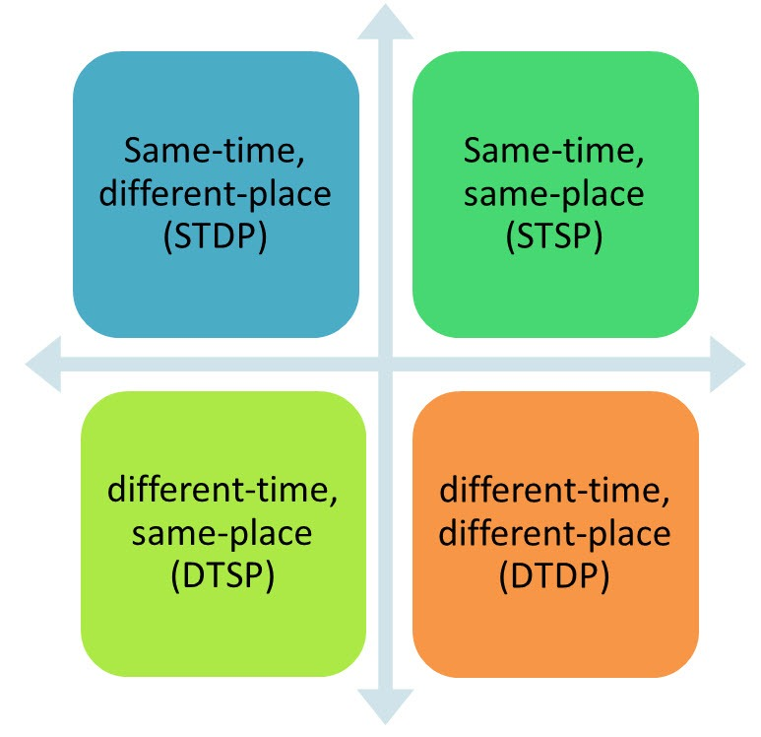
On Being in the Same Place at the Same Time
David Wiggins

Slide 2
Puzzles of Material Constitution
Can two different material things be in the same place at the same time?
If so, how?
If not, how should we deal with puzzle cases?
  The Debtor’s Paradox
  The Statue and the Clay
  Tib and Tibbles

Slide 3
The Debtor’s Paradox
A debtor, when approached for payment responds with a riddle. If you add a pebble to a collection of pebbles, you no longer have the same number
Since man is nothing more than a material object whose matter is constantly changing, we do not survive from one moment to the next. The debtor concludes that he is not the same person who incurred the debt, so he cannot be held responsible for payment.
The exasperated creditor then strikes the debtor, who protests the abusive treatment. The creditor expresses sympathy, but points out that he cannot be held accountable for the assault. After all, material change has already taken place so, by the debtor's own one line of reasoning, the guilty party is no longer present
If constitution is identity, the debtor's reasoning is sound: more generally the argument would show that it is impossible any material object to survive the addition of any new parts.

Slide 4
The Statue and the Clay
A sculptor forms a lump of clay, ‘Lumpl’ into a statue of David.
Intuitively David = Lumpl
But Lumpl and David differ in non-categorical properties, e.g.
  temporal properties: Lump existed before David came into being.
  persistence conditions: Lumpl could survive being squashed, David could not.
  difference in kind: Lump is a mere lump of clay, while David is a statue.
But Indiscernibility of Identicals sez for any x and y, if x = y, then x and y have all the same properties.
So looks like we have to say David ≠ Goliath though they occupy the same place at the same time.
Notes:
See Gibbard, “Contingent Identity” in the Journal of Philosophical Logic, 1975

Slide 5
Two Solutions (and More)
The Constitution View: the object and the lump of stuff of which it’s constituted are not identical
  Things of different kinds can be in the same place at the same time, e.g. things and what they’re constituted of
  Constitution is not identity
  Constitution is asymmetric
Four-Dimensionalism
  Ordinary objects are 4-dimensional: consisting of temporal as well as spatial parts
  4-dimensional objects can overlap

Slide 6
The Debtor’s Argument
P2 is responsible for P1’s debts if and only if P1 = P2
P1 = the mass of matter that composes him, M1
P2 = the mass of matter that composes him, M2
M1 ≠ M2 [the identity of a portion of matter depends on its having exactly the same constituents, e.g. add or subtract a pebble and you no longer have the same collection]
Therefore, P1 ≠ P2 [2, 3, 4 by transitivity of identity]
to tree

Slide 7

Defining Identity
Identity is an Equivalence Relation,
which means it is:
  Reflexive: For all x, x = x
  Symmetric: For all x, y, if x = y then y = x
  Transitive: For all x, y, z, if x = y and y = z then x = z
Identity is an Indiscernibility Relation
  Indiscernibility of Identicals: If x = y then x and y have exactly the same properties
back

Slide 8
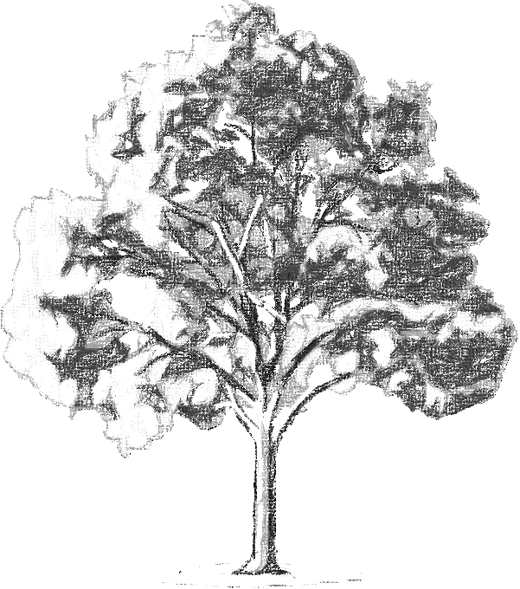

Response: Constitution is not Identity
How, then, does an oak differ from a mass of matter? The answer seems to me to be this: the mass is merely the cohesion of particles of matter anyhow united, whereas…something is one plant if it has an organization of parts in one cohering body partaking of one common life, and it continues to be the same plant as long as it partakes of the same life…This organization is at any one instant in some one collection of matter, which distinguishes it from all others at that instant .
-----Locke Essay II.xxvii

Slide 9
Tree and Cellulose Molecules
T
W

Slide 10
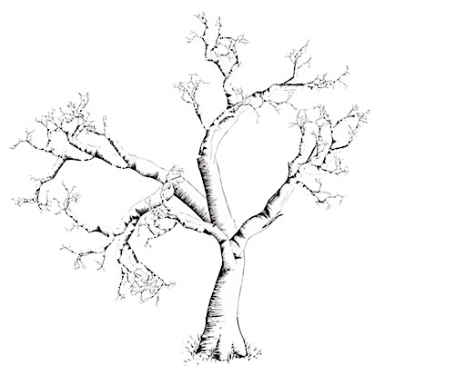
T loses its leaves
T
W

Slide 11
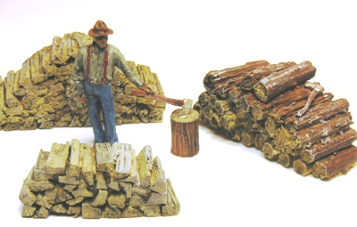
Tree is chopped up
T
W

Slide 12
Trees and their Stuff
Different kind of things have different persistence conditions
In general, material objects, e.g. trees, can survive the loss, or gradual replacement or parts but not radical dismemberment or changes of shape.
Heaps, like aggregates of cellulose molecules cannot survive the loss or gradual replacement of parts but can survive radical dismemberment and changes of shape.
So, Wiggins argues, T ≠ W—by Indiscernibility of Identicals, since T and W are NOT indiscernible, they’re NOT identical.

Slide 13
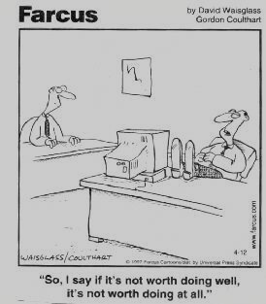
Contrapositive
Identical -> indiscernible so
not-indiscernible -> not identical
Conditional: If P then Q
Contrapositive: If Not-Q then Not-P
A statement and its contrapositive are logically equivalent: you can infer one from the other!
If it’s worth doing, then it’s worth doing well
Therefore (contrapositively) if it’s not worth doing well then it’s not worth doing

Slide 14
Wiggins argues T ≠ W
If T and W are identical then T and W have exactly the same properties (By Indiscernibility of Identicals)
T and W don’t have exactly the same properties since
  T can survive losing leaves but W can’t and
  W can survive being chopped up but T can’t
Therefore, T ≠ W

Slide 15
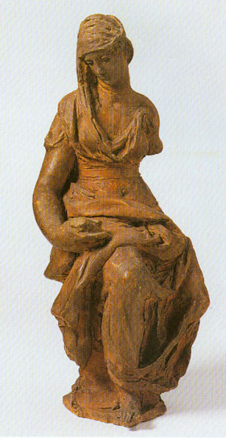
The same is true of artifacts
The statue and the clay occupy exactly the same place
  Both the statue and the lump of clay of which it’s made are shaped statuesquely, have the same weight, etc.
  But they have different identity conditions

Slide 16
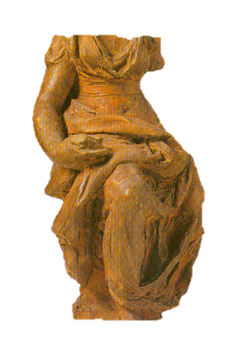
The Statue and the Clay
The lump can survive a radical change of shape
  but not loss or replacement of parts.
The statue can survive replacement of parts
  but not radical change of shape

Slide 17
The Constitution View
Constitution is the relation that the lump bears to the statue, the collection of cellulose molecules bear to the tree, etc.
Constitution is not identity
  The constitution relation is asymmetric: Lump constitutes Statue but not vice versa
Things are “nothing over and above” (Wiggins) what they are constituted by
  Lump and Statue have exactly the same parts
Things of different kinds can be in the same place at the same time, e.g. Lump and Statue

Slide 18
Reject S in favor of S*
S: Two things cannot be in the same place at the same time.
S*: No two things of the same kind (that is, no two things which satisfy the same substance sortal (substance concept) can occupy exactly the same volume at exactly the same time
Sortal: a +count noun that conveys criteria of identity, e.g. tree, statue.
S* allows for things of different kinds occupying the same place at the same time, e.g statues and the lumps which constitue them.

Slide 19
Identity Criteria
I_{m}: A is identical with B if there is some substance concept f such that A coincides with B under f (where f is a substance concept under which an object can be traced, individuated and distin- guished from other f’s, and where coincides under f satisfactorily defines an equivalence relation all of whose members <x,y> also satisfy the Leibnizian schema Fx = Fy)
substance concept: concept of a thing that “stands on its own”—not a property or a phase of an object
  e.g. person, tree, statue…
  not,e.g. red (a property) or child (a phase persons go throug)

Slide 20
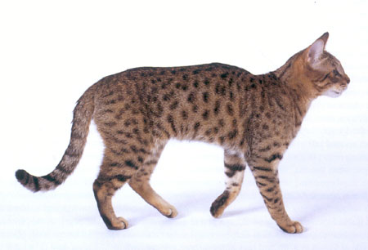
Tibbles and Tail
Problem: this seems to be a case where things of the same kind occupy the same place at the same time.

Slide 21
At t1, Tibbles consists of Tib and Tail
Tib
Tail

Slide 22
At t2, Tibbles loses Tail
Tib
Tib
Tail

Slide 23
At t3, Tibbles = Tib?
Tib

Slide 24
The Tibbles’ Timeline
t₁
t₂
t₃

Slide 25
At t₃, Tib is a cat
A cat can survive the loss of a tail, right?

Slide 26
At t₁, Tib ≠ Tibbles
At t₁ Tib is just a proper part of Tibbles
—so not identical to Tibbles.

Slide 27
At t₁, Tib ≠ Tibbles
At t₁ Tib is just a proper part of Tibbles
—so not identical to Tibbles.

Slide 28
Once Identical, Always Identical
Indiscernibility of Identicals: For all x, y, x = y iff whatever properties x has y has and vice versa
Being-identical-to-Tib-at-t₁ is a property that Tib has but Tibbles does not have
Therefore Tib ≠ Tibbles
Both Tib and Tibbles exist at t₃ and both are cats
Tib and Tibbles occupy exactly the same space
Therefore two things of the same kind occupy the same space

Slide 29
Wiggins Response
Tibbles is a cat; Tib is not and never was a cat.
At t₁, Tib was part of a cat: Tib partially constituted Tibbles.
At t₃, Tib constitutes Tibbles in the way that Lump constitutes Statue.
Since constitution is not identity, Tib ≠ Tibbles (at any time)
Even though Tib and Tibbles consist of the same parts and occupy the same place
Since they’re not both cats, S* is saved
Really? How can they be distinct?

Slide 30


Slide 31
The Extensionality Objection
The idea of different things having exactly the same parts is unintuitive—and means denying highly intuitive principles concerning the generic (i.e. proper-or-improper) parthood relation
Extensionality: for all x, y, x = y if and only if every part of x is part of y and vice versa.
Extensionality follows from intuitive features of parthood, viz
  Reflexivity: for all x, x is a part of itself
  Antisymmetry: for all x, y, if x is part of y and y is part of x then x = y

Slide 32
The Grounding Objection
Categorical Properties: Intuitively a thing’s most fundamental properties, those in virtue of which it has other properties, e.g. weight, shape, size, color
Non-Categorical Properties: Properties that are grounded in a thing’s categorical properties, e.g. temporal properties, persistence conditions and kind properties.
Problem: An object, and what constitutes it, have the same categorical properties…
But different non-categorical properties, e.g.modal properties including persistence conditions, kind properties, temporally indexed properties, etc.

Slide 33
The Anthropic Objection
Counting two objects in a given space, i.e. the thing and what constitutes it seems arbitrary—depends on our language.
At t₃ Tibbles, a cat, and Tib, the mass of cat-stuff that constitutes Tibbles are on the mat.
But so is Tib-micro, the collection of sub-atomic particles
And Tibblemat, the cat-on-mat that will cease to exist when Tibbles leaves the mat…
So it looks like either there are either
indefinitely many things occupying Tibbles space
as many things as we invent words for.

Slide 34
An Alternative to Constitution
One way of understanding persistence is to regard material things as four-dimensional objects with temporal parts
On this account there are statues that are temporal parts (“stages”) of lumps of clay…and lumps that are stages of statues.
statue stages
time

Slide 35
Four-Dimensionalism
The Exetensionality Objection Response: coinciding objects share some, but not all, of the same temporal parts—even if at a given time they share all spatial parts. (“identity-at-a-time”)
The Grounding Objection Response: Objects that coincide at a given (stretch of) time are different with respect to categorical properties because they have different temporal parts so no problem they differ in non-categoricial ones too.
The Anthropic Objection Response: Embracing Mereological Universalism: there is a material object correspoinding to every filled region of spacetime: we just name those that interest us. (is this acceptable?)

Slide 36
Problem with Four-Dimensionalism
Goliath and Lumpl: the statue and lump that come into existence and cease to exist at the same time
1. Goliath is essentially statue-shaped.
2. Lumpl is not essentially statue-shaped.
3. If (1) and (2), then Goliath is not identical to Lumpl. 4. [So] Goliath is not identical to Lumpl.
(1) appears true, since Goliath could not survive being rolled up into a ball, for example. But Lumpl could survive that change in shape, so (2) appears true as well. Finally, (3) appears to follow from Leibniz's Law. Goliath has the property of being essentially statue-shaped and Lumpl does not, so Goliath is not identical to Lumpl.

Slide 37
Response: Counterpart Theory
David Lewis defends a counterpart theory of modal ascriptions according to which ordinary individuals like Goliath and Lumpl are worldbound—exist in only one possible world —but have counterparts at many other possible worlds.
Counterpart relations determine what is possible for an individual
Different counterpart relations trace an individual to different counterparts at different possible worlds, e.g. tracing by the statue counterpart relation and the lump counterpart relation we get different results.
Names, like “Goliath” and “Lumpl” indicate which way of counterpart-tracing we’re considering.

Slide 38
Goliath and Lumpl
At every time, Goliath and Lumpl occupy the same region, have the same parts, and the same categorical properties.
An object has some non-categorical properties, e.g. persistence conditions, kind properties, in virtue of the properties of its counterparts at other possible worlds.
There are different counterpart relations that hook things up to different other-worldly counterparts, which are indicated by different names/kind-designations so
  Since Goliath/Lumpl’s statue-counterpart survives change of parts, Goliath can survive that change.
  Since Goliath/Lumpl’s lump-counterpart doesn’t, Lumpl can’t.

Slide 39
Problem: Heavy Metaphysics
Four-Dimensionalism: ordinary material objects aren’t wholly present at any given time.
Possible Worlds: there are other possible worlds
Possibility: what is possible for a given individual cashes out as what is the case for a different individual at some other possible world

Slide 40
Eliminativism
The Doctrine of Arbitary Undetached Parts (DAUP): For every material object m, time t, and regions r₁ and r₂ if m occupies r₁ at t and t₂ is a sub-region of t₁ then there is a part of m that occupies t₂ at t. [van Inwagen]
Eliminativists reject DAUP: e.g. at t₁ there is no such thing as Tib; at t₃ Tib = Tibbles
  There is no thing at t₁ such that Tib is identical with it.
So, at t₃ there is just one thing on the mat with two names: Tib and Tibbles.

Slide 41
Problems with Eliminativism
Unintuitive: proper parts of things (e.g. Tib) don’t exist? Give me a break.
Seems to imply that identity is extrinsically grounded
  Tib would not have existed if Tail hadn’t been cut off, because it would have been, throughout its history, an arbitrary undetached part.
  Since Tail is cut off, Tib = Tibbles—so it exists. But…
  Jeez, why should something extrinsic make a difference to whether I exist???

Slide 42
Summery
The Spatial Coincidence Problem
  Can two different material things be in the same place at the same time?
  If so, how?
Solutions
  The Constitution View
  Four-Dimensionalism
  Eliminativism

Slide 43
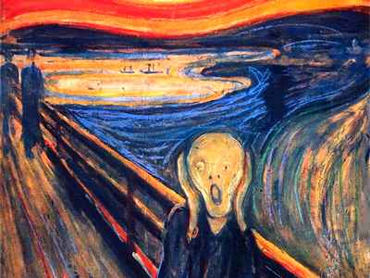
Go Figger!!!

