Slide 1

Conditionals and Arguments

Slide 2
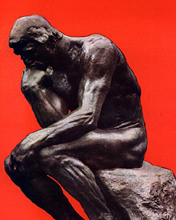
Concepts
Conditional
Antecedent and Consequent
Necessary and sufficient conditions: how to identify
Biconditional
Contrapositive
Corresponding conditional
Argument
Premises and Conclusions: how to identify
Deductive and Inductive arguments: how they differ
Validity
Soundness
Logical form
  Logical and non-logical expressions
  Substitution instance: how to identify
  Method of counterexample

Slide 3
Conditionals
A conditional is an if-then sentence: ‘If .................. , (then) ...................’
In a conditional the clause that follows the ‘if’ is the antecedent; the other clause is the consequent.
Example: If it rains then it pours.
antececent
consequent

Slide 4

Necessary & Sufficient Conditions
‘Necessary’ and ‘sufficient’ mean exactly what you think they mean!
‘Necessary’ means ‘required’
  Being at least 21 is a necessary condition for drinking legally in California.
‘Sufficient’ means ‘enough’
  A blood alcohol level of exactly
  0.08 is a sufficient condition on
  being legally drunk in California.

Slide 5
Necessary & Sufficient Conditions
The state of affairs described in the antecedent is asserted to be a sufficient condition on the state of affairs described in the consequent.
The state of affairs described in the consequent is asserted to be a necessary condition on the state of affairs described in the antecedent
is sufficient for
If it rains then it pours.
is necessary for

Slide 6
Antecedent sufficient for consequent
(1) If someone is a mother then they’re female
If you know that someone is a mother that is enough to show that the person is female therefore being a mother is a sufficient condition on being female.
Being a mother is not a necessary condition on being female since you can be female without being a mother.

Slide 7
Consequent necessary for antecedent
(1) If someone is a mother then they’re female
Being female is necessary for being a mother: if someone is not female they can't possibly be a mother.
Thus (1) says that being a mother is a sufficient condition on being female and being female is a necessary condition on being a mother.

Slide 8

Let’s try some examples!

Slide 9
Necessary or sufficient?
Being a tiger is a ____ for being an animal.
Being an animal is a ____ condition for being a tiger
Drinking water is a ____ condition for quenching one’s thirst.
Having a racket is a ____ for playing tennis.
Pulling the cork is a ____ for drinking an expensive bottle of wine.

Slide 10
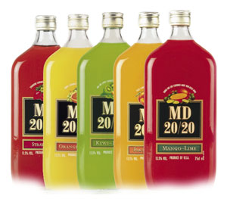
I said expensive wine.
Not the kind that comes with screw caps.

Slide 11
Necessary or sufficient?
Stepping on a cat’s tail is a ____ condition for making the cat yowl.
Burning leaves is a ____ condition for producing smoke.
Paying attention is a ____ condition for understanding a lecture.
Taking a swim in the North Sea is a ____ for cooling off.
Opening a door is a ____ for crossing the threshold.

Slide 12
Antecedent sufficient Consequent necessary
In general, for any conditional whatsoever, the antecedent is a sufficient condition on the consequent and the consequent is a necessary condition on the antecedent.

Slide 13
Sometimes it’s not obvious
(2) If you study then you pass
Passing is necessary for studying? Huh???
Yes! Forget about tense.
(3) If you didn’t pass then you didn’t study
(2) and (3) are logically equivalent: (3) is the contrapositive of (2)
If P then Q <--> contrapositive: If not-Q then not-P
Notes:
the relation of one thing coming after the other in time.
We'll talk about this in the second half of the semester when we "go formal." In fact it reveals an important feature of the conditional of ordinary English in which it differs from the sanitized and well-behaved "truth functional" conditional of classical logic.
If we strip away the causal and temporal connotations of (2) it becomes more plausible to see passing as a necessary condition on studying, especially if you recognize that once you discount tense (2) is equivalent to

Slide 14
A condition can be both necessary and sufficent!
There is a difference between necessary and sufficient conditions
BUT: some times one thing is both necessary and sufficient for something else.

Slide 15
Biconditionals
(4) For any integers x and y, xy is odd if and only if both x and y are odd
(4) says that the oddness of xy is both necessary and sufficient for the oddness of both x and y .
Statements of necessary and sufficient conditions like (4) are two way conditionals: each of the conditions is necessary and sufficient for the other.
The standard strategy to prove such biconditionals is to prove that the first condition is sufficient for the second and then that the second is sufficient for the first.

Slide 16
A true conditional can have false antecedent & false consequent!
(5) If Donald Trump is elected then I'll eat my hat.
(6) Donald Trump will be elected, therefore I will eat my hat.
Someone who asserts (5) is convinced that neither the antecedent nor the consequent is true--he is betting against Donald Trump!
(6) is not a conditional but an argument..

Slide 17
The difference between conditionals and arguments is the BIG IF:
In an argument both the premises and the conclusion are asserted—put forth as true.
In a conditional neither the antecedent nor the consequent is asserted.

Slide 18

ARGUMENTS
s

Slide 19
Argument
A group of statements, one or more of which (the premises) are claimed to provide evidential reasons to believe one of the others (the conclusion)
Factual claim: premises are asserted, i.e. put forth as true.
Inferential claim: premises provide evidential reasons to believe the conclusion.

Slide 20
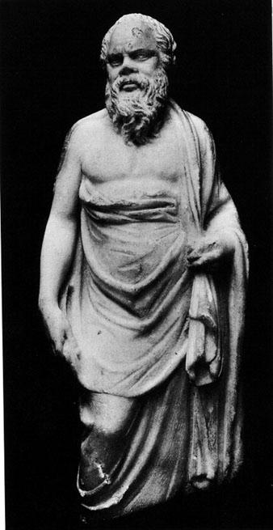
Example of an argument
All men are mortal.
Socrates is a man.
[therefore] Socrates is mortal.
1 and 2 are premises;
3 is the conclusion.

Slide 21
Not everything is an argument
“A string of statements asserting or clarifying…views does not an argument make”
Not an argument: ‘Trump is a buffoon!’ (assertion)
Not an argument: ‘I can’t stand Hillary: she’s such a Woman of the ‘80s--you can imagine her in a power-suit with shoulder-pads out to there and a scarf tied in a bow as a pretend necktie.’ (clarification)
Not an argument: ‘Ugh. I don’t like any of the candidates’. (statement in the interest of being Fair and Balanced)

Slide 22

SHOUTING doesn’t make it an Argument!

Slide 23
Symptoms of an argument
Premise indicators
  Since
  Because
  …
Conclusion indicators
  Therefore
  So
  It follows that
  …

Slide 24
An argument is as an argument does!
An argument makes an inferential claim
The easiest way to identify an argument is to find the conclusion.
Ask: ‘What claim is the writer or speaker trying to get me to accept?’

Slide 25
Example of an argument
Poverty offers numerous benefits to the nonpoor. Antipoverty programs provide jobs for middle-class professionals in social work, penology, and public health. Such workers’ future advancement is tied to the continued growth of bureaucracies dependent on the existence of poverty. (J. John Palen, Social Problems)

Slide 26
Conclusion
Poverty offers numerous benefits to the nonpoor. Antipoverty programs provide jobs for middle-class professionals in social work, penology, and public health. Such workers’ future advancement is tied to the continued growth of bureaucracies dependent on the existence of poverty. (J. John Palen, Social Problems)

Slide 27
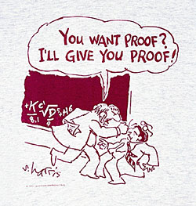
Conclusion: what the arguer wants to prove
The conclusion is typically less obvious, more controversial than premises
Premises are what we assume the hearer already believes

Slide 28
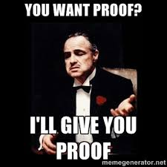
The Logic Center

Slide 29
More arguments…
Since the good, according to Plato, is that which furthers a person’s real interests, it follows that in any given case when the good is known, men will seek it.

Slide 30
More arguments…
Premise
indicator
Since the good, according to Plato, is that which furthers a person’s real interests
it follows that in any given case when the good is known, men will seek it.
Conclusion indicator
Look for indicator words. This argument includes both a premise indicator and a conclusion indicator. But be careful because these are just clues!

Slide 31
More arguments…
To every existing thing God wills some good. Hence, since to love any thing is nothing else than to will good to that thing, it is manifest that God loves everything that exists.
------Thomas Aquinas

Slide 32
More arguments…
To every existing thing God wills some good. Hence, since to love any thing is nothing else than to will good to that thing, it is manifest that God loves everything that exists.
------Thomas Aquinas
Conclusion indicator
Premise
indicator
Look for indicator words. This argument includes both a premise indicator and a conclusion indicator. But be careful because these are just clues!

Slide 33
More arguments…
To every existing thing God wills some good. Hence, since to love any thing is nothing else than to will good to that thing, it is manifest that God loves everything that exists.
------Thomas Aquinas
‘Hence’ really attaches to ‘it is manifest…’ so this is the conclusion.

Slide 34
More arguments…
Neither a borrower nor a lender be
For loan oft loses both itself and friend
And borrowing dulls the edge of husbandry
------William Shakespeare
Sometimes it helps to paraphrase. Don’t think of the conclusion as a piece of text, but as the proposition that the arguer wants to prove—which you can state in your own words.

Slide 35
More arguments…
Don’t borrow or lend stuff, because if you lend stuff to a friend, lots of times you don’t get it back and that breaks up the friendship. And borrowing makes you a careless manager.
------Shakespeare made easy
This is the conclusion. On quizzes/tests when I ask you to identify the conclusions of arguments, paraphrase is ok.

Slide 36
More arguments…
Since private property helps people define themselves, since it frees people from mundane cares of daily subsistence, and since it is finite, no individual should accumulate so much property that others are prevented from accumulating the necessities of life.
Don’t get hung up on premise and conclusion indicators or other textual clues. Remember what an argument is supposed to do, viz. to convince the hearer of something he doesn’t already believe.

Slide 37
More arguments…
Since private property helps people define themselves, since it frees people from mundane cares of daily subsistence, and since it is finite, no individual should accumulate so much property that others are prevented from accumulating the necessities of life.
So the conclusion is typically less obvious and more controversial than the premises. The conclusion of this argument is clearly controversial!

Slide 38
Deductive and Inductive Arguments
Difference in inferential claim
Deductive: premises are supposed to force (necessitate, guarantee) the conclusion
Inductive: premises are just supposed to make conclusion probable
NOTE: deductiveness and inductiveness are a matter of what is supposed to happen--not all arguments do what they’re supposed to do!

Slide 39
Example: Inductive Generalization
Premise: 32% of all Nielson households watch The Simpsons.
Conclusion: 32% (+/- 2%) of all American households watch The Simpsons
This is a good inductive argument because the sample is large and fair
The premise can’t force the conclusion because there’s more information in the conclusion!

Slide 40
Inductive Generalization
Sample: Nielson Households
Target: All Households

Slide 41
Other kinds of inductive arguments
Analogical induction (‘Argument from analogy’)
  X and Y both have property 1.
  X has property 2.
  Therefore, Y probably has property 2 also.
Abduction (‘Argument to the best explanation’)
  P
  E is the best explanation for P
  Therefore E

Slide 42
Argument from analogy
Example
  My Nissan Sentra is very reliable--209,000+ miles on the clock and it hasn’t given me a lick of trouble!
  Therefore your Nissan Sentra will probably do good for you.
The Argument from Analogy for Other Minds is probably the most famous analogy argument in philosophy.

Slide 43
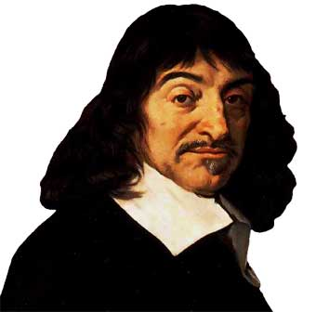
X and Y both have Property #1
We look pretty much the same, behave pretty much the same …and both of us have brains.

Slide 44
X has property #2
Cogito, ergo sum
I think!

Slide 45
Y has property #2
Cogito, ergo sum
Cogito, ergo sum
Therefore, (probably) he thinks too!

Slide 46

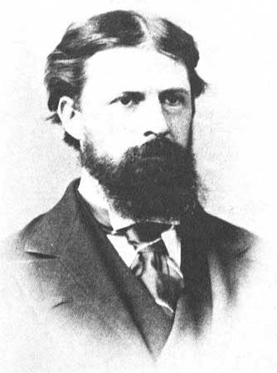
Abduction: inference to the best explanation
My experience is coherent, predictable (but sometimes surprising) and sometimes comes to me against my will

Slide 47
Abduction: inference to the best explanation
The best explanation for this is that there’s an external world causing my experiences.

Slide 48
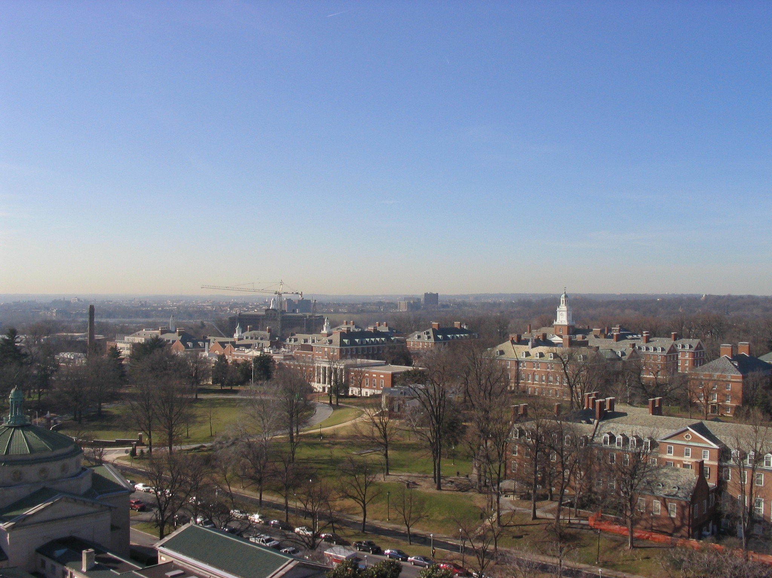
Abduction: Inference to the Best Explanation
Therefore, there the external world probably exits!

Slide 49
Inductive Arguments
There’s supposed to be information in the conclusion that’s not in the premises
So even in a good inductive argument the premises don’t necessitate the conclusion
I.e. it is logically possible for the premises to be true and the conclusion false
Even though that’s improbable

Slide 50
Deductive Arguments
Premises are supposed to necessitate (“force,” “guarantee”) the conclusion
A deductive argument is valid if this really happens: the premises really do necessitate the conclusion
Validity is ‘internal’ to the argument: it concerns the connection between premises and conclusion whether they’re true or not.

Slide 51
Validity
The premises necessitate (force, guarantee) the conclusion
It is not logically possible for the premises to be true and the conclusion false (“There is no possible world at which the premises are true and the conclusion is false”)
It is truth-preserving: IF the premises are true then the conclusion must be true
There is no information in the conclusion that’s not in the premises (“The conclusion is ‘contained’ in the premises”)
It is not possible to represent the premises without representing the conclusion

Slide 52
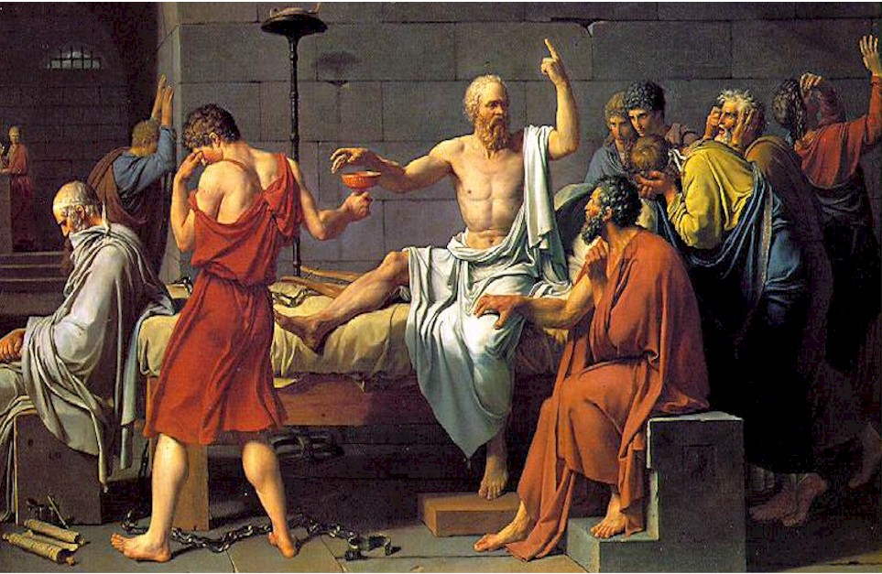
A valid argument
All men are mortal.
Socrates is a man.
[therefore] Socrates is mortal.

Slide 53
All men are mortal
men
mortals

Slide 54
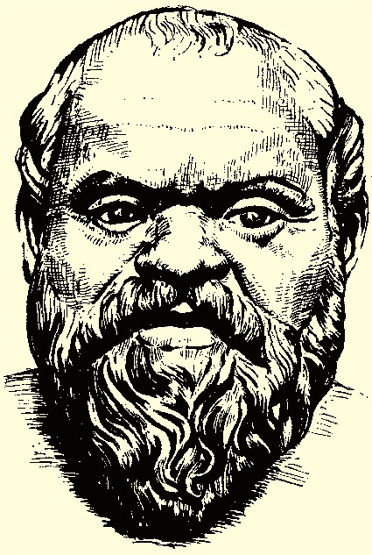
Socrates is a man
men

Slide 55

Socrates is mortal
men
mortals

Slide 56
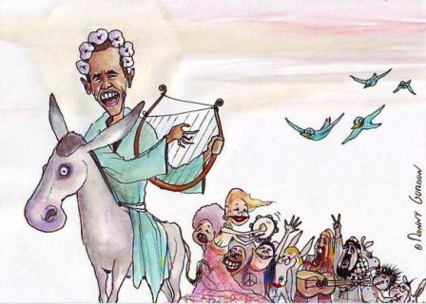
Stupid arguments can be valid!
All Greeks are mathematicians
Obama is a Greek
[Therefore] Obama is a mathematician
a² + b² = c²

Slide 57
Same form as Socrates Argument!
Greeks
Mathematicians

Slide 58
Soundness
Validity + all true premises
So sound arguments have true conclusions too
The Obama argument is valid but not sound!

Slide 59
Conditionals can be parts of arguments
(7) If you study then you'll pass. If you pass then you'll graduate. Therefore if you study you'll graduate.
(8) If a number is even then it's divisible by 2 without a remainder. 4 is divisible by 2 without a remainder. Therefore, 4 is even.

Slide 60
Conditionals, Arguments & Inferences
Like arguments, conditionals may express inferences.
A conditional by itself is not an argument.
Difference: when you put forth an argument you commit yourself to the truth of all its parts--even if "only for the sake of the argument.”
When you assert a conditional, you do not commit yourself to the truth of either its antecedent or its consequent.
The whole conditional can be true even if both its antecedent and consequent are false.

Slide 61
Corresponding Conditional
For any given argument, the conditional that is formed by taking the conjunction (the "and-ing") of its premises as the antecedent and the conclusion of the argument as its consequent is the corresponding conditional to that argument.
The corresponding conditional to an argument is the conditional that expresses the same inference as the argument.

Slide 62
Corresponding Conditional
Argument
All men are mortal
Socrates is a man
Therefore, Socrates is mortal
Conditional
If all men are mortal and Socrates is a man then Socrates is mortal
Not an
argument!

Slide 63
Validity and Necessary Truth
The Socrates argument is valid
Its corresponding conditional is necessarily true
In general, an argument is valid if and only if its corresponding conditional is necessarily true.

Slide 64
Validity is a matter of form
All men are mortal
Socrates is a man
Socrates is mortal
All Greeks are mathematicians
Obama is a Greek
Obama is a mathematician
Both arguments are substitution instances of this form
All S are P
X is an S
X is a P

Slide 65
Validity and Truth Value
Valid
  True premises/true conclusion (sound)
  False premises/false conclusion
  False premises/true conclusion
Invalid
  True premises/true conclusion
  False premises/false conclusion
  False premises/true conclusion
  True premises/false conclusion
Ruled out for
valid arguments
by definition

Slide 66
Logical form
Logical expressions: all, no, some, are, not, and, or, if-then, if and only if . . .
Non-logical expressions: “content” words, e.g. men, mortal, mathematician, Greek, Socrates, Obama . . .
We can’t give a firm list of logical expressions apart from a system of formal logic that studies the their behavior so for now we’ll leave it intuitive.

Slide 67
Same logical form
Same logical expressions
Same pattern of same non-logical expressions
So, what’s the
logical form
of this?

Slide 68
Same logical form
All dogs are mammals
All mammals are vertebrates
All dogs are vertebrates
All ants are insects
All insects are arthropods
All ants are arthropods

Slide 69
Different logical form
All dogs are mammals
All mammals are vertebrates
All dogs are vertebrates
All cats are vertebrates
All mammals are vertebrates
All cats are mammals

Slide 70
Validity is a matter of form
If two arguments are of the same form then they’re either both valid or both invalid
Is this true?
No. But we will define ‘validity’ as ‘formal validity’ to make it true.

Slide 71
Valid but not formally valid
George is a bachelor
Therefore, George is not married

Slide 72
Why not formally valid?
George is a bachelor
George is not married
Ducati is a dog
Ducati is not warm-blooded
The argument at left is valid but its validity doesn’t come from its form. We resolve to ignore such arguments!
We stipulate that from now on “valid” means “formally valid”!

Slide 73
Given our definition of validity…
Arguments of the same form are the same as regards validity/invalidity
  So, if one argument of a given form is invalid, so are all other arguments of the same form
If an argument has all true premises and a false conclusion then it must be invalid

Slide 74
The Method of Counterexample
To test an argument for validity, we try to find another argument of the same form that has all true premises and a false conclusion.
If we can find such an argument then, given our definition of validity, the original argument is shown to be invalid
If we can’t, it shows nothing!

Slide 75
Counterexample
Argument C is a counterexample to Argument A iff
  A and C are substitution instances of the same logical form, and
  C has all true premises and a false conclusion
If an argument has a counterexample then it is invalid!

Slide 76
Example
All dogs are vertebrates
All mammals are vertebrates
All dogs are mammals
All x > 2 are x > 1
All x > 10 are x > 1
All x > 2 are x > 10
These arguments are of the same form so must be the same as regards validity/invalidity. The argument at the right must be invalid because it has all true premises and a false conclusion so the argument at the left must be invalid also. The argument at the right is a “counterexample” to the argument at the left.

Slide 77

So, what do I have to know about this stuff?
Arguments and conditionals
How to recognize the conclusions of arguments (multiple choice)
Determining when 2 arguments are of the same form, when one is a counterexample to another, and what that shows about (in)validity.

