Slide 1
Ontological Commitment
Quine On What There Is

Slide 2
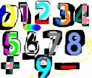
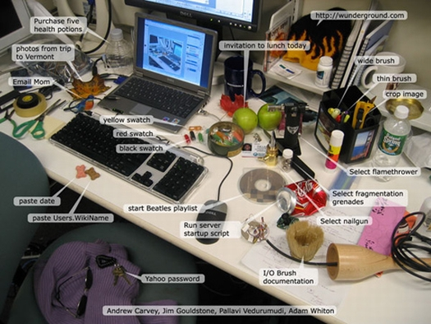
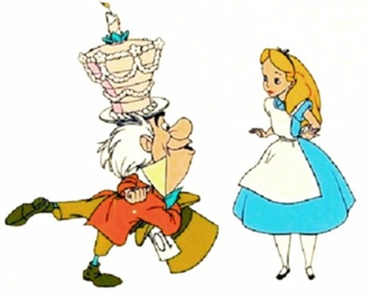
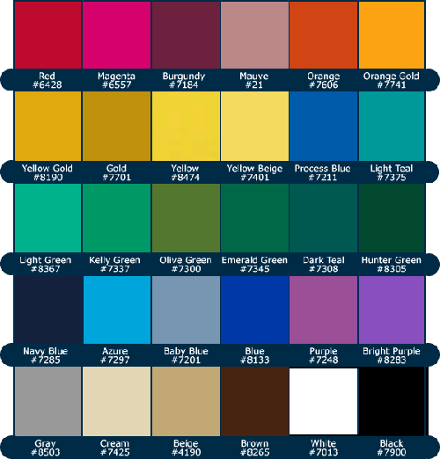
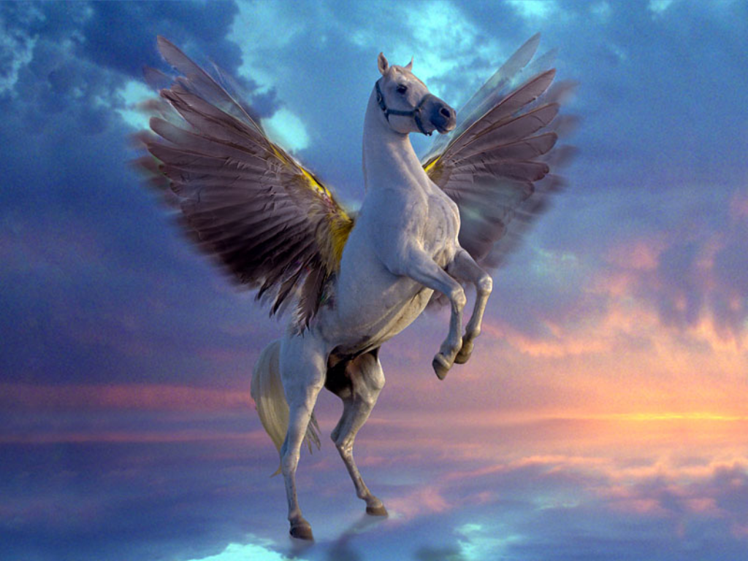
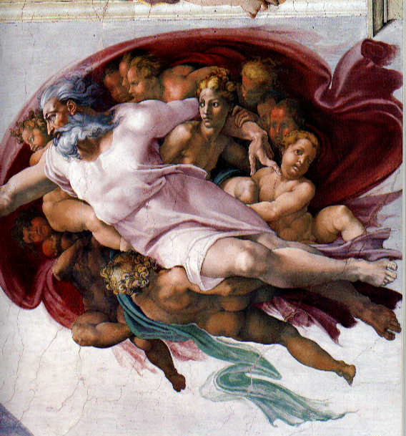

The Problem of Ontology: What is there?
ideas?
numbers?
physical objects?
fictional characters?
colors?
Pegasus?
God?
The Present King of France?
Notes:
The ontology of a theory: the list of (kinds of) objects to whose existence a theory is committed.
Spatio-temporal: occupies space and lasts through time
Abstracta: objects that are not spatio-temporal and don’t have causal powers
Universals: objects that have instances

Slide 3
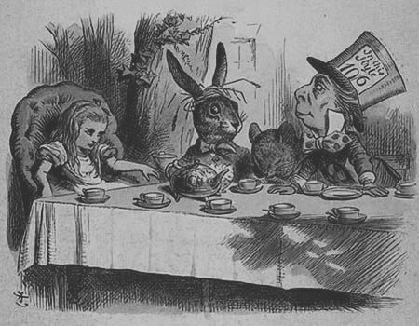
The Back-Story: Russell’s Theory of Descriptions
On Denoting
Bertrand Russell

Slide 4
Denoting Phrase
By a `denoting phrase' I mean a phrase such as any one of the following: a man, some man, any man, every man, all men, the present King of England, the center of mass of the solar system at the first instant of the twentieth century, the revolution of the earth round the sun, the revolution of the sun round the earth. Thus a phrase is denoting solely in virtue of its form. [Russell. “On Denoting”]
Note: Russell characterizes denoting phrases in terms of form rather than the semantic job they do because—because that’s controversial.
Denoting phrases may be the surface-grammatical subjects of sentences
  All men are mortal
  The present King of France is bald
But surface grammar is misleading: if we take denoting phrases to pick out objects we’re thinking or talking about, we get into trouble…

Slide 5
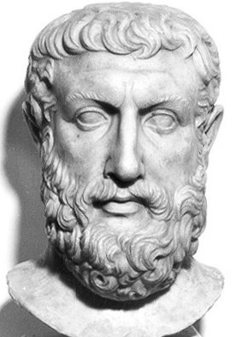
The Paradox of Non-Being
What can be spoken of and thought must be;
for it is possible for it to be, but it is not possible for “nothing” to be.
Parmenides posed the Paradox of Non-Being

Slide 6
Speaking of Nothing
We need to explain how we can understand sentences whose surface-grammatical subjects don’t seem to pick anything out, e.g.
  Unicorns don’t exist.
  The present King of France
  The Fountain of Youth doesn’t exist.
  Apollo is the Greek sun god.
Note: in 1 the surface-grammatical subject is a general term, not strictly a denoting phrase by Russell’s criterion, in 2 and 3 a definite description, and in a name
Russell will argue that in each case surface grammar is misleading (and Quine’s will rehearse Russell’s argument)

Slide 7
Motivation: Ontological Parsimony
Logic . . . must no more admit a unicorn than zoology can.
To avoid commitment to “non-existent objects” we paraphrase sentences like this, recognizing that their surface-gramatical subjects aren’t really their subjects—i.e. not what we’re talking or thinking about.
  Unicorns don’t exist.
    It is not the case that there exists and x such that x is a unicorn.
Subject-predicate form is misleading
Sentence 1is the negation of a sentence that’s existential and general (when you say “There exists…” your aren’t talking about any individual)
“__ is a unicorn” is a predicate—what, if anything does it designate???

Slide 8
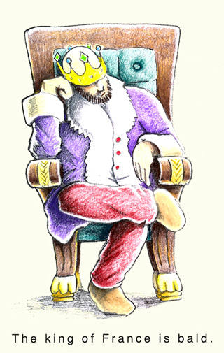
Definite Descriptions
Sentences whose surface-grammatical subjects are definite descriptions are not really in subject-predicate form but are existential and general.
“The F is G” is paraphrased as ” There is exactly one object that is F and that object is G, i.e. the conjunction of the following
  There exists an x such that x is F
  For all y, if y is F then y = x
  x is G
“The present King of France is bald” is paraphrased as
“There is exactly one object that is King of France and
that object is bald.”
False because the first conjunct is.

Slide 9
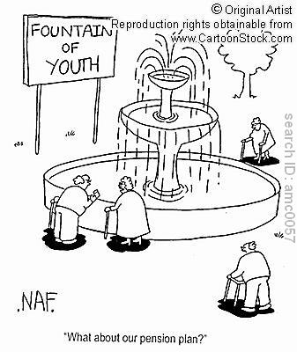
Negative Existentials
The Fountain of Youth doesn’t exist
Note: unlike “bald,” “exists” isn’t a predicate so we don’t paraphrase this one like “The Present King of France is bald.”
Rather we treat it like
“Unicorns don’t exist””
“It is not the case that there exists
and x such that x is Fountain of Youth”
Note: being fussy, if you think “The Fountain
of Youth doesn’t exist” is true if the
uniqueness condition fails,
i.e. if there’s more than one Fountain of Youth
you can add “and for all y if y is Fountain
of Youth then y = x.”

Slide 10
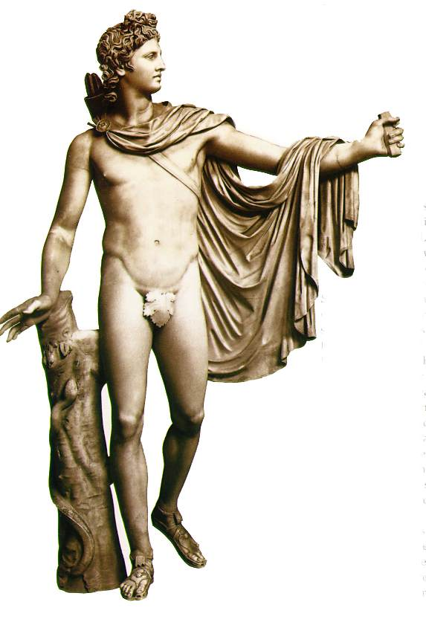
Names of “non-existent objects”
Apollo is the Greek sun god
“Apollo” and other names that fail to refer are “disguised descriptions” and, according to Russell, should be understood in terms of long conjunctions assigning the various properties the individual is supposed to have, e.g.
There exists and x such that x is the twin brother of Artemis and son of Leto and has an oracle at Delphi…and x is Greek sun god (and for all y, y is Greek sun god only if y = x)

Slide 11
What’s the point?
Responding to Parmenides Paradox of Non-Being
  negative existentials seem to commit us to assuming, absurdly, that things that don’t exist, exist (otherwise how could we talk or think about them)
  Russell’s solution: sentences that seem to be about non-existent objects aren’t really about (i.e. not singular statements)
Avoiding commitment to Meinong’s inflated ontology which includes objects that “subsist” but do not exist, e.g. the present King of France
But what about those predicates? Do we have to have things for them to refer to, i.e. properties?
Quine argues that we can push Russell’s analysis further to get rid of properties understood as Platonic universals, and Fregian senses.

Slide 12
Quine’s goals
Show that some common arguments in favor of certain ontologies* are fallacious, including:
  Arguments for Meinongian objects (see Russell!)
  Arguments for Platonic universals
  Arguments for Fregean senses (“meanings”)
Establish a standard for deciding what the “ontological commitment” of a theory is
Suggest how we should decide between competing theories
* Ontology: an account of what there is. The ontology of a theory is the list of (kinds of) objects to which a theory is committed.

Slide 13
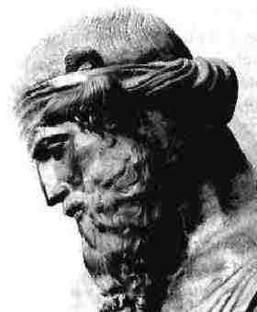
The Riddle of Non-Being
Plato’s Beard: Non-being must in some sense be, otherwise what is it that there is not?
Statements to the effect that some object or kind of objects don’t exist appear to be self-refuting since
  they are meaningful only if there is something which one claims doesn’t exist and
  if there is something about which one makes that claim
  the claim must be false so
[I]n any ontological dispute the proponent of the negative
side suffers the disadvantage of not being able to admit
that his opponent disagrees with him.
To enter into an argument with McX is, ipso facto, to lose!

Slide 14

McX’s Proposal: Non-Existent Things are Ideas
McX cannot, indeed, quite persuade himself that any region of space-time…contains a flying horse…Pressed for further details on Pegasus, then, he says that Pegasus is an idea in men’s minds.
Notes:
McX’s Bad Argument
If something isn’t physical it must be mental.
Non-existent objects aren’t physical.
So they must be ideas in our heads!

Slide 15



Talking about real things
But wait! When I talk about real things I distinguish talk about those things from talk about ideas of those things! I ask, e.g. whether my idea of the table is a brain state or a state of a spiritual substance or whatever. I say my idea of the table is private. I don’t ask these questions or say these things about tables but about table-ideas which are quite a different thing!

Slide 16
“Nonexistent objects” aren’t “ideas”
“We may for the sake of argument concede that there is an entity, and even a unique entity…which is the mental Pegasus-idea; but this mental entity is not what people are talking about then they deny Pegasus…McX never confuses the Parthenon with the Parthenon-idea…But when we shift from the Parthenon to Pegasus confusion sets in.”
Moral: The mind is not a dump for ontolological debris!
When we seem stuck with weird things that aren’t ordinary physical objects--numbers, properties, propositions, possibilia, mythological beasts, etc.--saying “they’re not physical so they must be mental” doesn’t help.
Saying, e.g. “God is an idea” is just saying “people have an idea of God but God doesn’t exist,” however this leaves us with the original question: what is it to say that God (or anything else) doesn’t exist?
Notes:
The myth that if something isn’t physical it must be mental, the mind as a dumping ground for whatever doesn’t belong anywhere else, e.g. God is an “idea” or “belief.

Slide 17
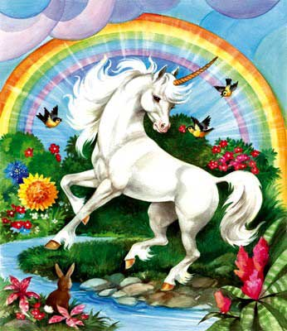
Are there unicorns?
If what I’m talking about are unicorn-ideas of course there are! We’re having those unicorn-ideas right now!
There are unicorn-ideas
We’re not asking whether unicorn-ideas are physical either--that’s another question, i.e. whether they’re brain-states.
We’re asking whether there are unicorns
And if there are…where?

Slide 18

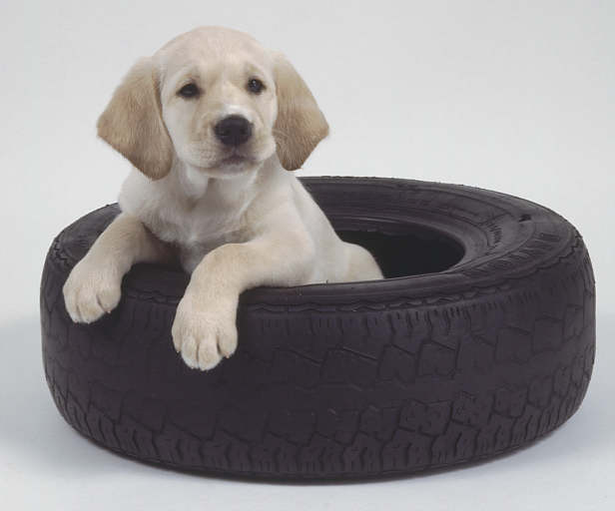
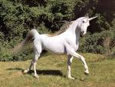


Meinong’s Wyman’s Bloated Ontology
Real things (things that actually exist)
Possibilia (don’t actually exist but could: they “subsist”)
Impossibilia (don’t exist, can’t exist and don’t even “subsist”)
Round Squares
Married Bachelors
Notes:
Note: Quine’s claim here is controversial. Modal realists, like David Lewis, argue that we ought to understand possible worlds as aggregates of concrete objects

Slide 19
Problems with Meinongianism
“Exist” is unambiguous: spatio-temporality is a feature of the kinds of thing we’re talking about--not a special kind of existence: “exist doesn’t mean “occupies a spatio-temporal region.
  It isn’t Pegasus failure to occupy a region of space that’s the problem: we’re ok with the cube root of 27
Violates Ockham’s Razor
Impossibilia (e.g. the round square cupola) can’t be talked about without contradiction (as Russell noticed!)
Identity criteria for mere possibilia unclear: “No entity without identity”
So what do we do about “possible objects?
Notes:
Mean Value Theorem: If f is a differentiable function on the interval [a,b] then there exists a number c between a and b s.t. f’(c) = f(b) - f(a)/b - a, i.e.there is at least one point on the graph wehre the slope of the tangent line is the same as the slope of the secant line.

Slide 20
Modality limited to whole sentences
There is a possible winged horse → Possibly, there is a winged horse.
This gets rid of merely possible objects
There are modal sentences, e.g.
  It is possible that pigs fly
  Necessarily, for any two real numbers there is another one in between them.
  It is not possible that there be married bachelors
There are no merely possible objects, e.g. possible flying pigs

Slide 21
Shaving Plato’s Beard
Russell, in his theory of so-called singular descriptions showed clearly how we might meaningfully use seeming names without supposing that the entities allegedly named be…The burden of objective reference which had been put upon the descriptive phrases is now taken over by…bound variables…No unified expression offered as an analysis of the descriptive phrase, but the statement as a whole which was the context of that phrase still gets its full quota of meaning.
Variables: think of them as a pronouns…
There’s a hole in the bottom of the sea
  (∃x)(Hx • Bsx)
  There’s an x such that it is a hole and it is at the bottom of the sea.
There’s a song everybody knows
  (∃x)[(Sx • (y)Kyx)]

Slide 23
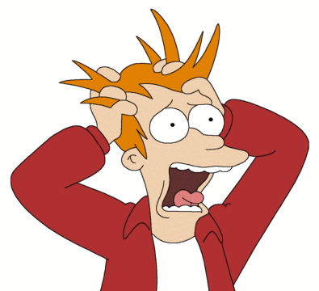
Paraphrasing away singular terms
Definite descriptions, e.g. “the author of Waverly,” are paraphrased away as, e.g. “There is one and only one x such that x wrote Waverly and x [does whatever].”
Proper names, e.g. “Pegasus,” can be paraphrased away in similar manner, e.g. “There is one and only one x such that x Pegasizes and [does whatever]”
In both cases the meaning is sucked out of singular terms, which are reduced to mere variables, and loaded into predicates.
Buy what about those predicates into which the meaning
is loaded…
Could this analysis stick us with…universals??!!?

Slide 24
The Problem of Universals
Now let us turn to the ontological problem of universals: the question whether there are such entities as attributes, relations, classes, numbers, functions. McX, characteristically enough, thinks there are. Speaking of attributes, he ways: ‘There are red houses, red roses, red sunsets…These houses, roses, and sunsets, then have something in common; and this which they have in common is all I mean by the attribute of redness.
McX’s Argument for Universals
We correctly classify red houses, red roses and red sunsets as same-colored.
There must be something in the world that makes grouping them as same-colored correct (throwing in a green avocado would be incorrect)
Therefore, there exists an x that is the shared property of redness: assuming there are properties is the best explanation for classifying.

Slide 25
Quine Against Universals
One may admit that there are red houses, roses, and sunsets, but deny…that they have anything in common. ..[T]he word ‘red’ or ‘red object’ denotes each of sundry individual entities which are red houses, red roses, red sunsets; but there is not, in addition, any entity whatsoever, individual or otherwise, which is named by the word ‘redness.’ That houses and roses and sunsets are all of them red may be taken as ultimate and irreducible.
Quine argues that universals don’t do any explanatory work
  Q: Why do we classify all these things together as ‘red’?
  A: Because they have a common property, viz. redness
  Q: And what is this redness property?
  A: Oh, um…it’s the property that all red things have in common.

Slide 26
Just say no to properties!
Commitment to properties isn’t informative as an explanation of similarity
We may as well say that similarity is a brute fact
[Is this satisfactory? If classification is something we “just do” how can we make sense of the difference between getting it right and getting it wrong?]
Two Good Principles
Ockham’s Razor: Do not multiply entities unnecessarily--aim for “ontological parsimony.”
Minimize brute facts
Unfortunately, sometimes ontological parsimony introduces brute facts and minimizing brute facts multiplies entities!

Slide 27
Meanings
McX hits upon a different strategem. ‘Let us grant,’ he says, ‘this distinction between meaning and naming of which you make so much. Let us even grant that ‘is red,’ ‘pegasizes,’ etc. are not names of attributes. Still, you admit they have meanings. But these meanings, whether they are named or not, are still universals.
McX’s Argument for Meanings
As competent English-speakers we usually get it right when we classify things as, e.g. red things.
So there must be something responsible for our ability to do this, i.e. meanings (in our heads or elsewhere) we compare to objects to be classified.
Otherwise this ability seems to be a brute fact.

Slide 28
Quine against Meanings
The fact that a given linguistic utterance is meaningful…is an ultimate and irreducible matter of fact; or, I may undertake to analyze it in terms directly of what people do in the presence of the linguistic utterance in question and other utterances similar to it.
Behavioristic account of language-use: understanding can be understood as the disposition to behave in certain ways.
  “having a meaning” doesn’t mean that there’s a meaning something has any more (or less) than having a grudge means there’s this thing, a grudge, that someone has.
Sameness of meaning can be paraphrased as synonomy and cashed out in behavioristic terms
[Is this satisfactory? Quine will elaborate this account in Word and Object]

Slide 29
Ontological Commitment
We can very easily involve ourselves in ontological commitments by saying, e.g., that there is something (bound variable) which red houses and sunsets have in common…but that is, essentially, the only way we can involve ourselves in ontological commitments: by our use of bound variables…[W]hen we say that some zoölogical species are cross-fertile, we are committing ourselves to recognizing as entities the several species themselves, abstract though they be. We remain so committed at least until we devise some way of so paraphrasing the statement as to show that the seeming reference to species on the part of our bound variable was an avoidable manner of speaking.
To be, according to Quine, is to be the value of a bound variable.
A theory is committed to those and only those entities to which the bound variables of the theory must be capable of referring in order that the affirmations made in the theory be true.
We avoid ontological commitment by paraphrase.

Slide 30
Paraphrase
There is a tide in the affairs of men,
Which, taken at the flood, leads on to fortune.
  Men who time things right do well
Where there’s a will there’s a way.
  If you want to achieve a goal you will be able to achieve it.
When I have an afterimage, even though there is no physical object I am seeing there is nevertheless a sense-datum I experience.
  When I have an afterimage, even though there is no physical object I am seeing, I seem to see a physical object.

Slide 31
Example: Does math need universals?
Realism: The Platonic doctrine that universals or abstract entities have being independntly of the mind | Logicism, represented by Platonists as Frege, Russell, Whitehead, and Carnap, condones the use of bound variables to refer to abstract entities, known and unknown
Conceptualism holds that there are universals but they are mind-made | Intuitionism, espoused…by Poincaré, Brouwer, Weyl, and others, countenances the use of bound variables to refer to abstract entities only when those entities are capable of being cooked up…[C]lasses are invented
Nominalism: Nominalists…object to admitting abstract entities at all | Formalism, associated with the name of Hilbert, echoes intuitionism in deploring the logicist’s unbridled recourse to universals. But…might…object to the crippling of classical mathematics or…to admitting abstract entities at all

Slide 32
Adjudicating Among Rival Ontologies
We look to bound variables in connection with ontology not in order to know what there is, but in order to know what a given remark or doctrine…says there is
Ontological commitment is relative to a theory: “to be is to be the value of a bound variable” doesn’t tell us what theory to choose
Our acceptance of an ontology is…similar in principle to our acceptance of a scientific theory…we adopt…the simplest conceptual scheme into which the disordered fragments of raw experience can be fitted and arranged. Physical objects are postulated entities which round out and simplify our account of the flux of experience just as the introduction of irrational numbers simplifies laws of arithmetic.
We choose the theory on pragmatic grounds: what’s the best mathematical theory or physical theory?
We then apply the criterion for ontological commitment to the theory.

Slide 33
Example: Physicalism or Phenomenalism
Here we have two competing conceptual schemes, a phenomenalistic one and a physicalistic one…Each has its advantages…the one is epistemologically, the other physically, fundamental.
Note the motivation for Russell’s adopting a conceptual scheme in which sense-data are fundamental—to avoid skepticism.
The physical conceptual scheme simplifies our account of experience because of the way myriad scattered sense events come to be associated with single so-called objects…Physical objects are postulated entities which round out and simplify our account of the flux of experience, just as the introduction of irrational numbers simplifies that laws of arithmetic.
There is a way things are but we choose the conceptual scheme to account for it on pragmatic grounds

Slide 34
Conclusion: Inconclusive
The question of what ontology actually to adopt still stands open…Let us by all means see how much of the physicalistic conceptual scheme can be reduced to a phenomenalistic one…Viewed from within the phenomenalistic conceptual scheme, the ontologies of physical objects and mathematical objects are myths. The quality of myth, however, is relative; relative in this case, to the epistemological point of view. This point of view is one among various, corresponding to one among our various interests and purposes.
The End
The Beginning

