Slide 1
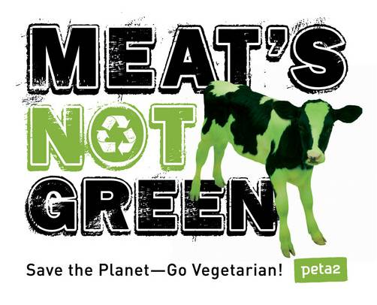
Vegetarianism By Brooke aspinall Alex Shalosky allain andry amanda D’acquisto

Slide 2
What about protein?
Myth: It is Hard to Get Enough Protein on a Vegetarian Diet
Protein does not just come in the form of meat. Vegetables contain over 20% protein on average, legumes almost 30%, whole grains 13%, and even fruits contain protein.
There are many health problems with consuming too much protein. Most people end up eating about double the amount of protein that their body requires, which creates health problems especially to the kidneys.
Diseases stemming from the overconsumption of protein are common in wealthy countries. In China, 10% of their protein obtained is from meat. In the US this number is 70%.

Slide 3
Meat-eating and Vegetarianism
Medical costs in the United States related to meat consumption were estimated to be $30-60 billion a year, based upon the higher prevalence of hypertension, heart disease, cancer, diabetes, gallstones, obesity and food-borne illness among those who ate meat.
The consumption of a diet avoiding meat will result in lower blood cholesterol levels, lower blood pressure, less obesity as well as less heart disease, stroke, diabetes, cancer, and mortality.

Slide 4
Healthy Heart
Vegetarians have a lower cholesterol level.
Cholesterol levels are greatly increased by meat, especially red meat.
Vegetarian diets are low in saturated fats that are common in meat.

Slide 5
Lower Blood Pressure
Vegetarian diets are low in salt – salt has been identified as the main cause of high blood pressure and hypertension.
High blood pressure also occurs when blood tries to flow faster because of obstructed blood vessels. The obstruction is usually caused by cholesterol ingested from eating meat.

Slide 6
Easier Digestion of Food
Human beings have a challenging time digesting meat and fish. People who eat such foods eventually experience weakening of their digestive systems which brings such problems as inability to eliminate waste rapidly.
Foods such as fruits and vegetables are easily and rapidly digested

Slide 7
Prevention of Cancer
Lower our risk of cancer by choosing predominantly plant-based diets rich in a variety of vegetables and fruits, legumes and minimally processed starchy staple foods, and to eliminate the intake of meats and fish.
Over 200 studies have revealed that a regular consumption of fruits and vegetables provides significant protection against cancer at many sites.

Slide 8
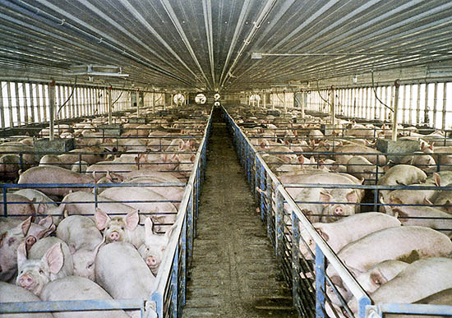
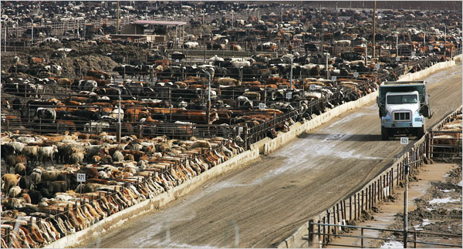
Livestock Farm Emissions
Hydrogen Sulfide- Causes serious health effects. Hydrogen sulfide is generally associated with hog production facilities.
Ammonia -It is released in large quantities by chicken and hog farms. responsible for 64 percent of ammonia.
Particulate matter- leading cause of bronchitis and asthma and can also be a cause of cardiac disorders.
Endotoxins- are poisons produced by dying bacteria and causes respiratory problems.
Carbon dioxide- caused by decomposing manure that causes shortness of breath and dizziness in humans, and often kills animals.
Methane- Accounts for 16 percent of global greenhouse gas emissions from human activity.
Nitrous Oxide- Farming accounts for 65 percent of human-related Nitrous Oxide. Contributes to the “nitrogen cascade” and GHG’s.

Slide 9
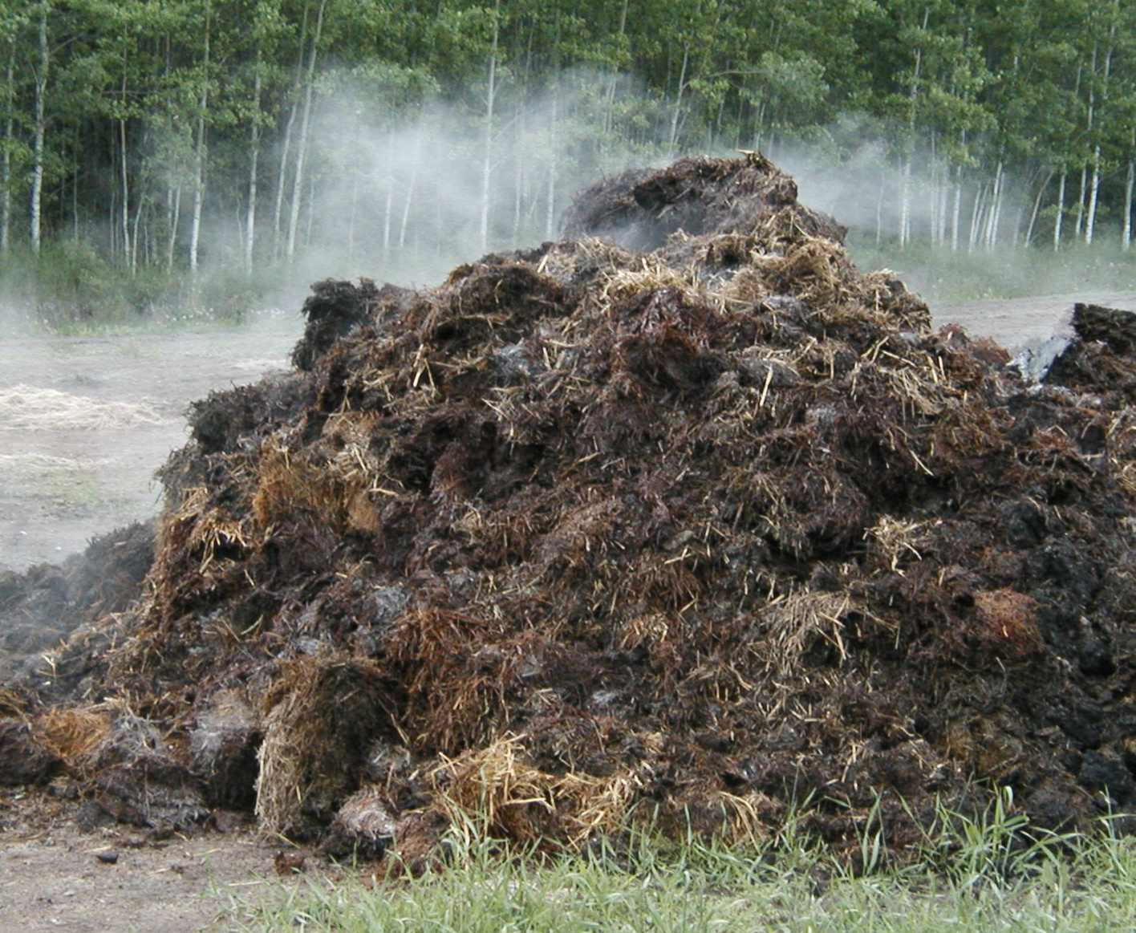
Livestock Waste
More than 335 million tons of manure are produced annually on U.S. farms.
Manure is commonly mixed with water and held in pits (called “lagoons”), and then spread or sprayed on cropland. But the system often suffers from an excess of manure and becomes a major pollutant.
Hydrogen sulfide, methane, ammonia, Nitrous Oxide, and carbon dioxide are the major hazardous gases produced by decomposing manure.
The EPA estimates that methane emissions from manure increased by 26 percent in the United States between 1990 and 2004.
When huge amounts of stored manure are sprayed onto fields it can reduce soil fertility and put croplands out of use.

Slide 10
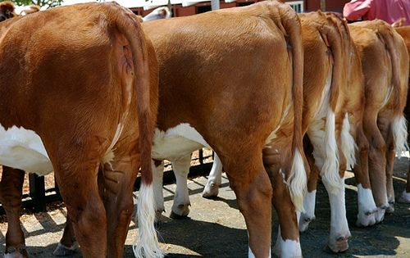
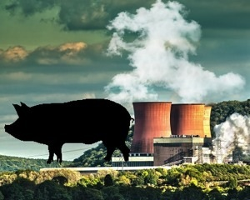
Air Pollution
CAFOs (confined animal feeding operations) pollute the air in many ways, emitting foul odors, airborne particles, greenhouse gases, and numerous toxic chemicals.
United States farms alone produce more than 400 different gases
Through the production of greenhouse gases—primarily methane and nitrous oxide—the agricultural industry was directly responsible for 6 percent of the U.S. contribution to global warming in 2004
Cattle-rearing generates more global warming greenhouse gases, as measured in CO2 equivalent, than transportation
Air pollution from industrial farms can cause health problems in agricultural workers, in residents of neighboring communities, and in farm animals.

Slide 11
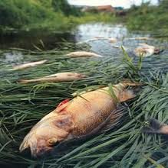
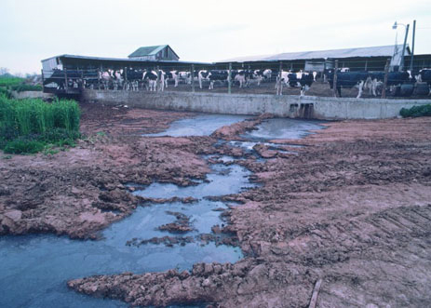
Water Pollution
Runoff from factory farms kills fish, degrades aquatic habitats and threatens drinking water supplies.
When the manure is over-applied to fields or leak from lagoons, It can run off into surface waters.
Nutrients in animal waste cause algal blooms, which use up oxygen in the water, contributing to a "dead zone".
Animal waste contains disease-causing pathogens, such as Salmonella, E. coli, Cryptosporidium, and fecal coliform which can contaminate freshwater ways and infect humans.
Ammonia, a toxic form of nitrogen released in gas form during waste disposal, can be carried more than 300 miles through the air before being dumped back onto the ground or into the water, where it causes algal blooms and fish kills.

Slide 12
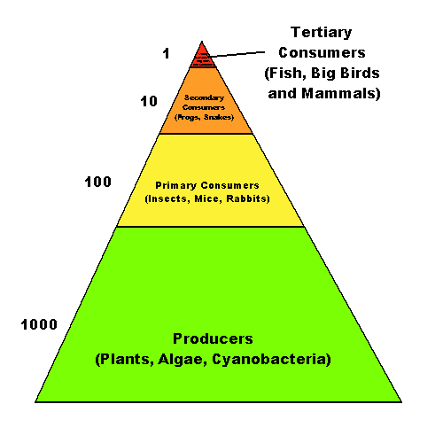
Trophic Levels
Plants are primary producers.
Most livestock animals are primary consumers.
By consuming meat we are eating higher up in the trophic level, with each increase in level 90% of the energy is lost.
This means in a perfectly efficient system 10 pounds of plant energy goes into every pound of meat.

Slide 13
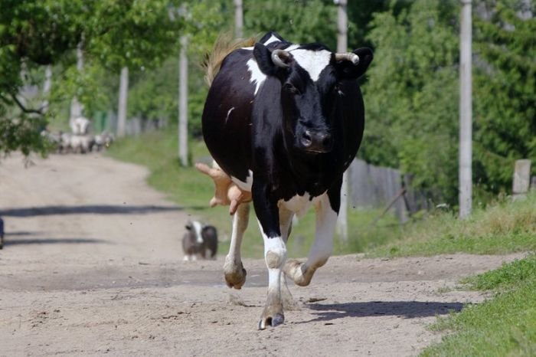
Why the loss?
Most of the food (energy) that an animal ingests goes to something other than building mass.
These other sources include basic life functions, (respiration, heartbeat, ect) movement, and heat production.

Slide 14
More energy!!?
On top of the the 90% of energy that is naturally lost humans input more in the making of meat and meat products!

Slide 15
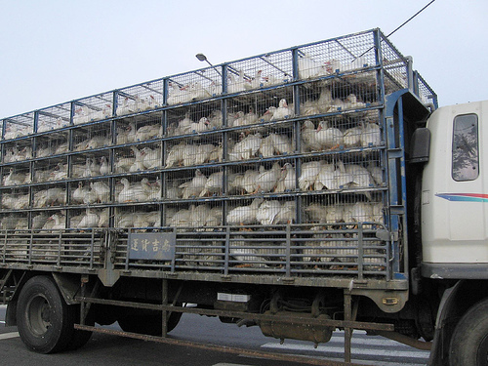
Transportation
Grain that is grown to feed livestock has to be taken to the farms and feedlots where the animals are raised
The animals must be taken to where they will be slaughtered and processed
The processed meat must then be distributed to consumers.

Slide 16
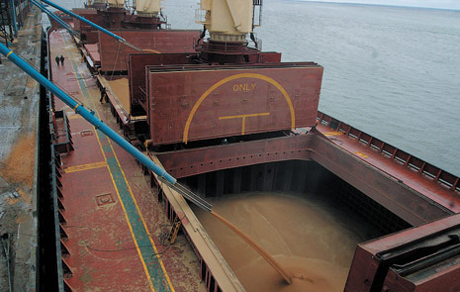

Slide 17
Energy used in processing
Poultry slaughtering and processing, sausage and other prepared meat plants, and meat packing plants used $850,000,000 worth of energy in 1994.
Hot water production/cleanup, boiler losses, ovens, and refrigeration were cited as the biggest energy drains in the meat industry.

Slide 18
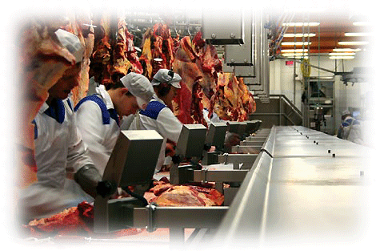

Slide 19
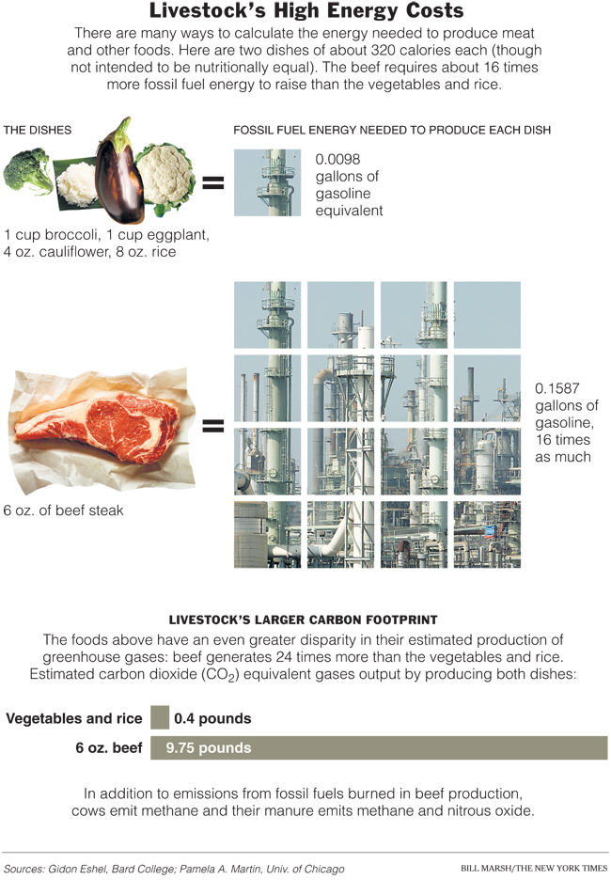

Slide 20
Disturbing Trends
The world’s total meat supply was 71 million tons in 1961. In 2007, it was estimated to be 284 million tons.
Per capita consumption has more than doubled over that period.
In the developing world (where populations are growing fastest), it rose twice as fast, doubling in the last 20 years.

Slide 21
What this means
The increasing prevalence of meat will magnify all of the problems associated with its production.
As we struggle to feed an ever increasing population without degrading the environment we just cannot afford to live with the inherent inefficiencies in meat production!

Slide 22
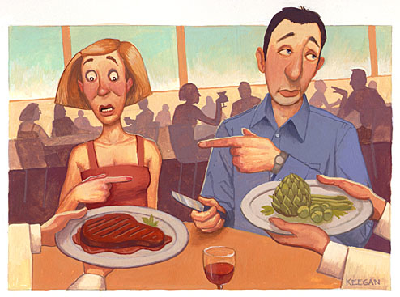
In order to survive, livestock...
Needs to be fed
Needs water to drink
Needs land to roam and a place for their food to grow
What impacts to the environment does this create?

Slide 23
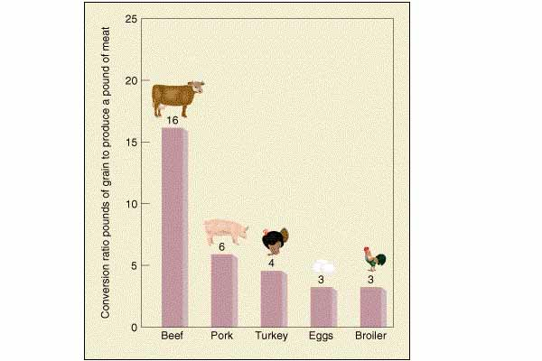
Food Usage
16 pounds of grain ➞ 1 pound of meat
While animals eat large quantities of grain, soybeans, oats, and corn, they only produce comparatively small amounts of meat, dairy products, or eggs in return
Amount of U.S. grain fed to farm animals: 70%
If all the grain currently fed to livestock in the United States were consumed directly by people, the number of people who could be fed would be nearly 800 million

Slide 24
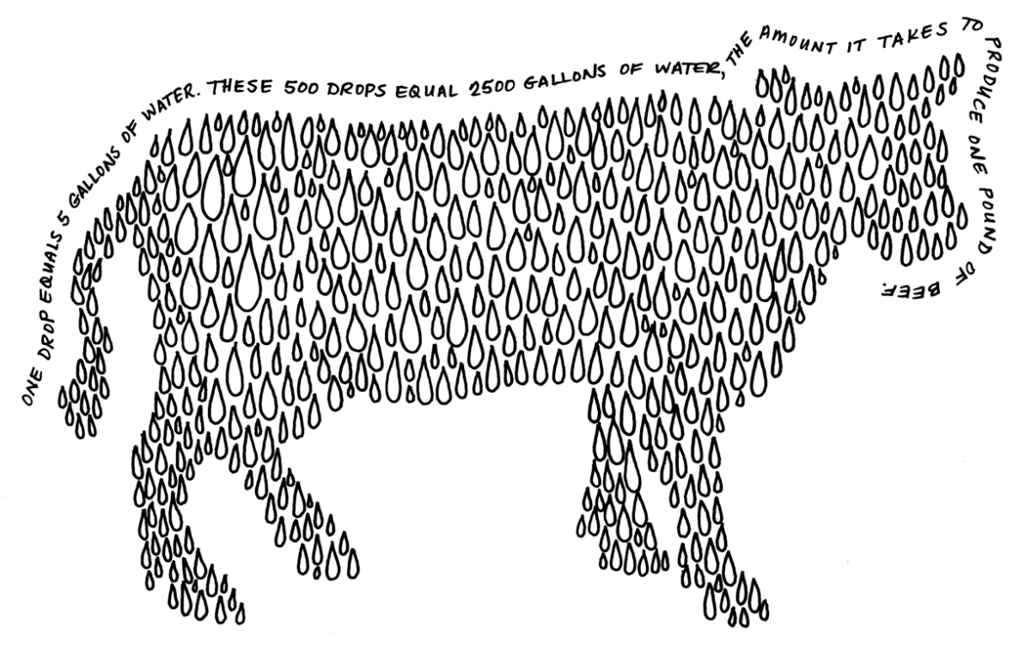
Water Usage
Water-Intensive Process:
2,500 gallons of water ➞ 1 pound of meat
250 gallons of water ➞ 1 pound of soy
25 gallons of water ➞ 1 pound of wheat
With the water used to produce a single hamburger, you could take the best shower every day for two and a half weeks
Chickens, pigs, cattle, and other animals raised for food are the primary consumers of water in the U.S
Of all water used for all purposes in the United States, more than half goes to: livestock production

Slide 25
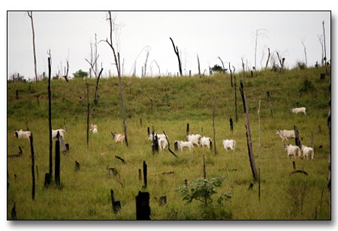
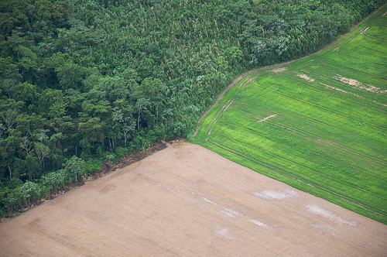
Land Usage
Vast amounts of land are bulldozed in order to create more room for livestock as well as crops to feed them
Seven football fields' worth of land is bulldozed every minute to create more room for farmed animals and the crops that feed them
For each hamburger that originated from animals raised on rainforest land, approximately 55 square feet of forest have been destroyed
Notes:
-Tropical rain forests in Brazil to ancient pine forests in China
-Of all the agricultural land in the U.S., 80 percent is used to raise animals for food and grow grain to feed them—that’s almost half the total land mass of the lower 48 states.
-In the “finishing” phase alone, in which pigs grow from 100 pounds to 240 pounds, each hog consumes more than 500 pounds of grain, corn, and soybeans; this means that across the U.S., pigs eat tens of millions of tons of feed every year.
-In the United States, more than 260 million acres of forest have been clear-cut for animal agriculture (2). With increased per capita meat consumption, and an ever growing population, we can only expect to see more deforestation in the future.
-Can lead to deforestation

Slide 26
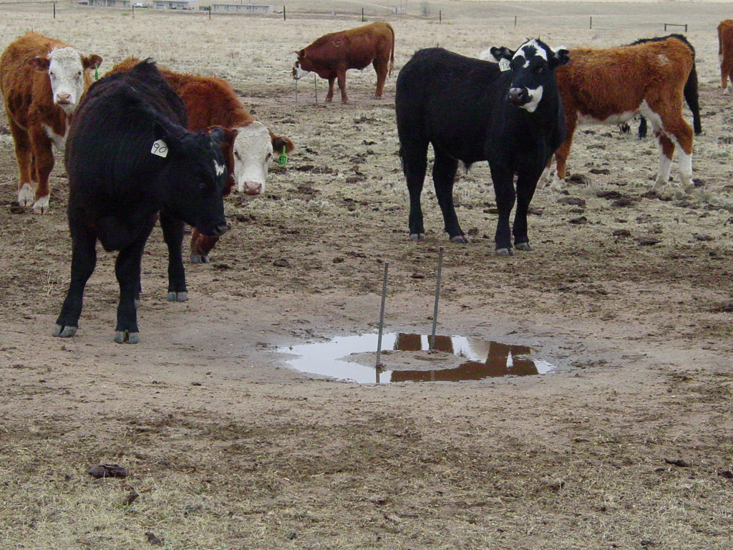
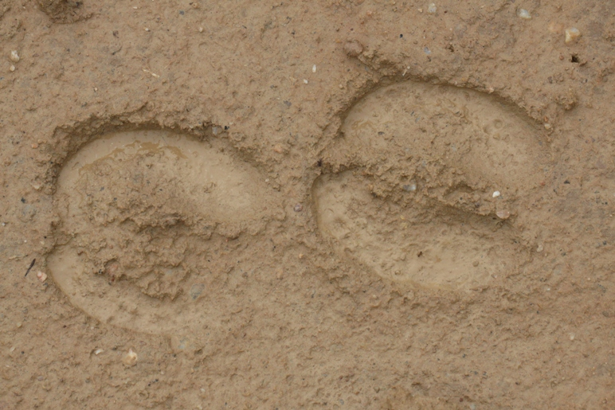
Soil
Heavy livestock compact soil structure and destroy vegetation on parts of a field that they tread most often
Known as “poaching” and restoration of vegetation does not always occur spontaneously once the grazing animal is withdrawn
Soil particles from these zones will be susceptible to erosion and flooding because of the compact soil
Soil compaction and erosion resulting from overgrazing has severely degraded about 20% of pastures worldwide

Slide 27
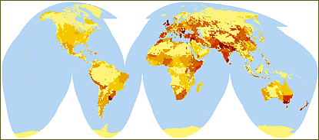
Biodiversity
Because of clear cutting and the overgrazing of livestock...biodiversity is severely impacted
15 out of 24 important ecosystem services are in decline due to livestock
For example historical grazing, along with other land conversion, in Northern and Central California has reduced native chaparral and forest lands by approximately 70%
Ongoing grazing expansion driven by human population growth in this region threatens the remaining integrity of California chaparral and woodlands habitat in this region
World Resources Institute - PAGE, 2000
Notes:
- all the wild animals and trees in more than 2.9 million acres of the Amazon rain forest in Brazil were destroyed in the 2004-2005 crop season in order to grow crops that are used to feed chickens and other animals in factory farms.

Slide 28
References
http://onlinelibrary.wiley.com/doi/10.1002/jsfa.2740290215/abstract?systemMessage=Wiley+Online+Library+will+be+disrupted+3+Dec+from+10-12+GMT+for+monthly+maintenance
http://sparkleberrysprings.com/v-web/b2/?p=615
http://www.nytimes.com/2008/01/27/weekinreview/27bittman.html?pagewanted=all
http://www.aceee.org/sites/default/files/publications/researchreports/ie981.pdf
http://www.vegetarian-nutrition.info/updates/vegetarian_diets_health_benefits.php
http://www.benefitsofvegetarianism.com/vegetarian-health-benefits.html
Diet for a New America
http://www.sustainabletable.org/issues/airpollution/
http://www.sustainabletable.org/issues/environment/
http://www.un.org/apps/news/story.asp?newsID=20772&CR1=warning
http://www.nrdc.org/water/pollution/ffarms.asp
https://facultystaff.richmond.edu/~sabrash/110/How_does_eating_meat_affect_water.pdf
http://www.fao.org/newsroom/en/news/2006/1000448/index.html
http://www.agriculture.de/acms1/conf6/ws4lives.htm
http://en.wikipedia.org/wiki/Grazing#Ecological_effects
http://earthtrends.wri.org/updates/node/125
Smithsonian Institution, "Smithsonian Researchers Show Amazonian Deforestation Accelerating," Science Daily Online, 15 Jan. 2002.
Earth Talk, "The Environmental Beef With Meat," The Bay Weekly, 6 Jan. 2005.
USDA. (1991, April). World Cereals Used for Feed.
Cattle-Fax. (1989, Dec. 8). Grain Utilization in the Livestock and Poultry Industries.
L. Beckett & J. W. Oltjen. (1993). Estimation of the water requirement for beef production in the United States. Journal of Animal Science, 71, 818-8268.
Resolutions for a new millennium. (2000, Jan 1). Audubon News.

Slide 29
Rebuttal

Slide 30
Myths About Vegetarianism: Health
Myth: You need animal protein in your diet.
A vegetarian diet is high in protein and healthier in other nutrients than the average meat-eater’s diet.
A vegetarian diet is healthier which reduces your long-term medical care costs and saves you a whole lot of money over time.
Myth: Meat is necessary to get enough iron in the diet.
You can get healthy amounts of iron from sources including whole grains and dried beans and fruit.
Myth: A vegetarian diet is unhealthy
A vegetarian diet has a good proportion of complex carbohydrates, protein, and fat - the three macro nutrients that are the cornerstone of any diet.
Vegetarian food sources (plants) are higher sources of most of micro nutrients.
The average meat eater consumes one or fewer servings of vegetables a day and no servings of fruit.
A well-balanced vegetarian diet provides all the nutrients you need for good health.

Slide 31
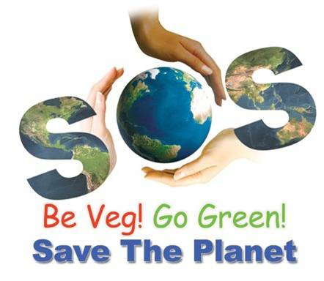
Think About It!
If everyone went vegetarian just for one day, the U.S. would save:
100 billion gallons of water, enough to supply all the homes in New England for almost 4 months;
1.5 billion pounds of crops otherwise fed to livestock, enough to feed the state of New Mexico for more than a year;
70 million gallons of gas — enough to fuel all the cars of Canada and Mexico combined with plenty to spare;
3 million acres of land, an area more than twice the size of Delaware;
33 tons of antibiotics.
If everyone went vegetarian just for one day, the U.S. would prevent:
Greenhouse gas emissions equivalent to 1.2 million tons of CO2, as much as produced by all of France;
3 million tons of soil erosion and $70 million in resulting economic damages;
4.5 million tons of animal excrement;
Almost 7 tons of ammonia emissions, a major air pollutant.

Slide 32
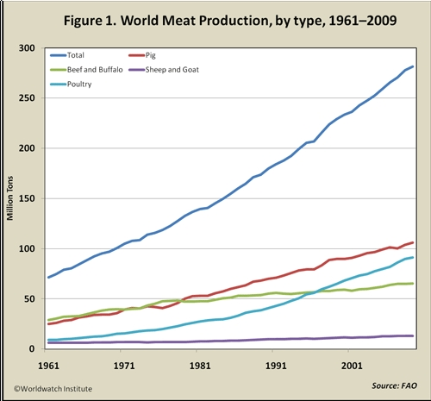
Meat Production
The environmental costs per unit of livestock production must be cut by one half, just to avoid the level of damage worsening beyond its present level.
Global meat production is projected to more than double from 229 million tons in 2001 to 465 million tons in 2050.

