Slide 1

Phil 101: Logic
Fall 2015

Slide 2
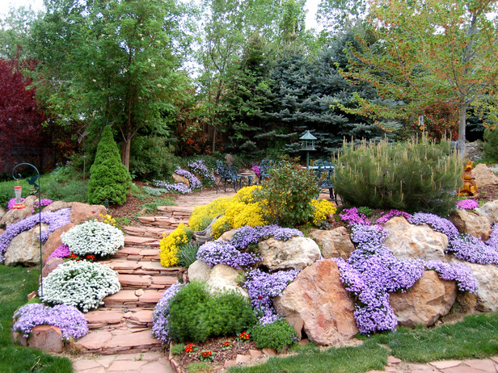
Phil 101: Logic
Spring 2016

Slide 3
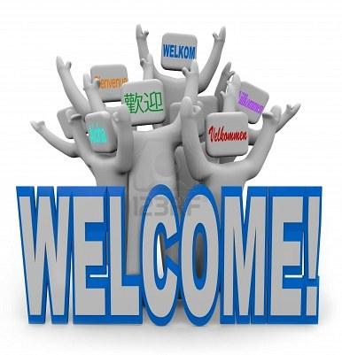
Introduction: Today’s Class
Mechanics of course and expectations
  Syllabus
  Class website and message board
Introductory readings
  Chapter 0: Introduction and comments about survey
Homework: A Prelude to Logic Ch 0, Ch 1 and Logical Possibility

Slide 4
Printing PowerPoints
How to print the text of PowerPoints for note-taking

Slide 5
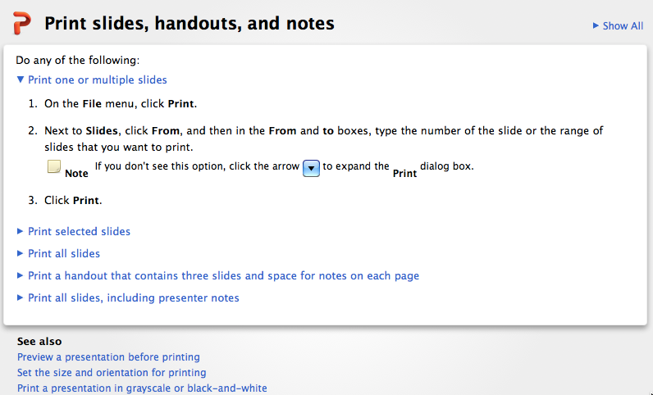
If you don’t have access to powerpoint or have trouble opening or printing files
—let me know! I can send you the material as pdfs or in any other format you can use—including <gasp> hardcopy!

Slide 6
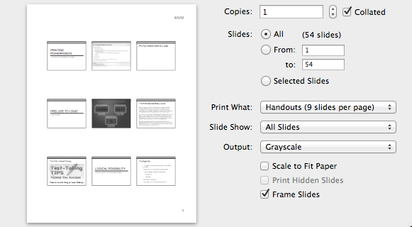
Printing multiple slides to a page
Select how many slides you want

Slide 7
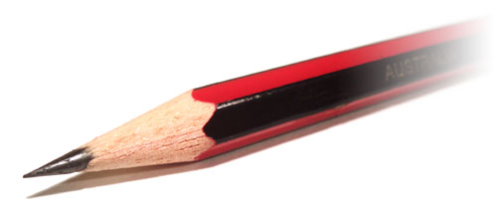
The Agenda
Critical Thinking (“Informal Logic”)
  The real informal fallacies
  A survey of some philosophical problems (this is a philosophy course!
  Introduction to concepts that figure in the study of formal logic
Symbolic Logic
  Propositional Logic: translation, truth tables, truth trees and proofs
  Introduction to predicate logic (if time permits): translation, equivalences, identity and definite descriptions

Slide 8
The Real Informal Fallacies
Reflections on Behavioral Economics

Slide 9
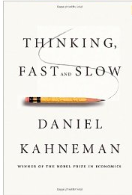
Cognitive Biases
Bounded Rationality: humans are not
  fully informed
  strictly rational
  completely self-interested.
People have two different thinking systems.
People are subject to cognitive biases—systematic errors of perception and judgment.
People are good at perceiving causation but very bad at statistical reasoning…as the results of our survey show.
Just for fun: a list of cognitive biases
Notes:
The Rationality Assumption in Econ as an idealization: Simon on 'Bounded Rationality'
How it used to be (1970s): Cognitively we're rational - we only make mistakes when emotions interfere. Kahneman & Tversky argued persuasively that irrationality (biases - systematic errors of reasoning) was built into our cognitive apparatus: because we're not omniscient we need shortcuts to survive, but the short-cuts sometimes lead to error.

Slide 10
Spring 2016 Logic Students Survey
Notes:
We're wired (literally according to Kahneman) to perceive causation, and ignore statistical effects: The hospital - statistics vs. causation. Good evolutionary reasons for it!

Slide 11
Non-Explanations
Current semester
Whatever
Fall 2015
Dunno
Simply random events.
Nothing can explain this. There is no correlation.
There is no reason for this. This is merely a case of coincidence where people often confuse correlation with causation.
Correlation is not causation, therefore I cannot give a precise reason.

Slide 12
Read the question!
there are fewer people there
There's not as many people in these areas.
There are less people that live there, thus there are less people that could potentially be infected with kidney cancer
These rural areas have less people! Therefore less people with kidney cancer
Less people will be diagnose because the population is smaller.
The question was about the incidence of kidney cancer: the percentage of the population that get it—not absolute numbers!
(If you don’t know what ‘incidence’ means look it up!)

Slide 13
Explain--don’t just repeat
Fall 2015 Responses
Kidney cancer is more prevalent in traditionally Democratic states where urban life exists.
Kidney cancer is more prevalent in traditionally Democratic states where urban life exists.

Slide 14
Causal Explanations
people living in more rural areas live more organically due to the foods they eat, as opposed to people who reside in much more densely populated areas that are exposed to more unhealthy practices.
i would say that in rural areas you live a healthier lifestyle rather than in big cities because of exposure to contamination
Less toxins or carcinogens in the rural areas.
lower obesity rates (???)
fewer processed foods that put more strain on kidneys (???)
disease doesn't spread as quickly (???)

Slide 15
More Causal Explanations
From Fall 2015…
Democrats must be more susceptible to kidney cancer
Incest?
it could be liberals and their government have created some disease that spreads kidney cancer through our water supply! Thanks Obama!
  [Comment: this was from The Onion, right?

Slide 16
Healthy Skepticism
Random non-essential information that has nothing to do with kidney cancer.
…Has nothing to do with politics.
If this is true, that’s amazing. I don’t think we can draw a conclusion from this information. Although interesting, I doubt political beliefs have anything to do with it.
…lack of nearby hospitals could make some people try home remedies…it would explain that cancer rates seem lower [emphasis added]
Lack of information—does not imply that the countries with the highest incidence of kidney cancer are the opposite characteristics.

Slide 17
You didn’t get all relevant information…
The countries that have the highest incidence cancer are also rural, sparsely populated and located in traditionally Republican states in the Midwest, the South, and the West.

Slide 18
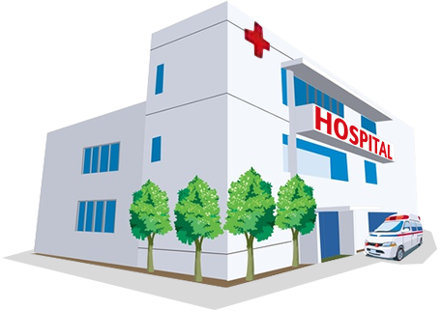
Statistical Explanation
Counties that have small populations will have fewer cases of kidney cancer than a larger population—and more cases of kidney cancer!
Moral: One of our biases (systematic errors in reasoning) comes from our fixation on causal explanations so that we overlook statistical explanations…and there are many more biases…

Slide 19
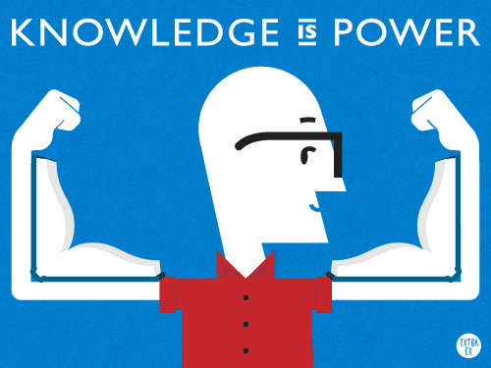
Overcoming Cognitive Bias

Slide 20
A Cognitive Bias: Against ‘Overthinking’
Google search on ‘overthinking’…
9 Ways To Stop Overthinking Everything | Refocuser
Tips to Stress Less and Stop Overthinking | Fitness Magazine
Overthinking Clinton's Favorability Numbers - Bloomberg View
Could neuroticism stem from overthinking? - Medical News ...
Researchers have proposed a new cognitive model for neuroticism, suggesting that this personality trait could be explained by overthinking
Eating, Drinking, Overthinking - Amazon.com
The Toxic Triangle of Food, Alcohol, and Depression--and How Women Can Break Free
Link between Overthinking and Neuroticism | Psych Central ...

Slide 21
The First Instinct Fallacy
‘Research shows that first instincts can stink, but we trust them anyway’
the researchers examined the introductory psychology midterm exams of 1,561 University of Illinois students for eraser marks. They counted the number of times students changed answers and found that
  51 percent of the changes were from wrong to right
  25 percent were from right to wrong and 23 percent were from wrong to wrong.
  Changes from wrong to right outnumbered changes from right to wrong 2-to-1
It feels worse to change a correct answer to an incorrect one than to stick with an original incorrect answer. And that feeling makes changing right answers to wrong more memorable.

Slide 22
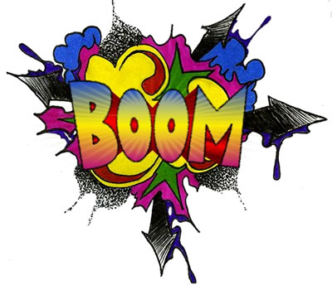
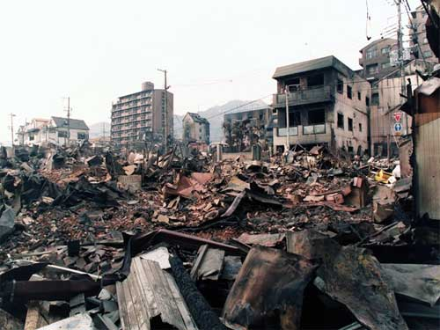
Availability Error
The availability heuristic is a mental shortcut that relies on immediate examples that come to a given person's mind when evaluating a specific topic, concept, method or decision….under the availability heuristic people tend to heavily weigh their judgments toward more recent information, making new opinions biased toward that latest news.
When are people most likely to buy earthquake insurance?
You guessed it…

Slide 23
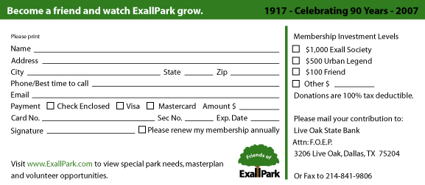
Anchoring
The tendency to rely too heavily, or ‘anchor’, on one trait or piece of information when making decisions (usually the first piece of information that we acquire on that subject)

Slide 24
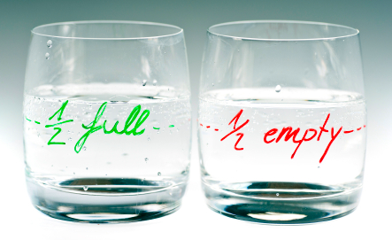
Framing Effect
Drawing different conclusions from the same information, depending on how or by whom that information is presented

Slide 25
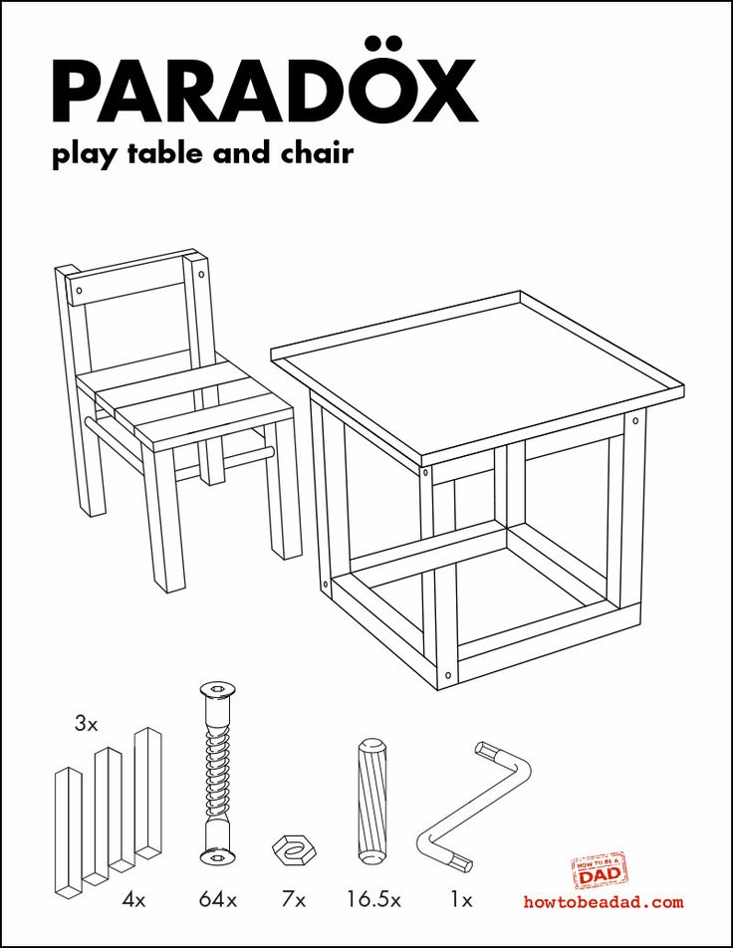
The IKEA Effect
The tendency to place a disproportionately high value on objects that they partially assembled themselves

Slide 26
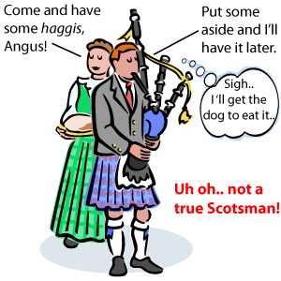
The No True Scotsman Fallacy
When faced with a counterexample to a universal claim ("no Scotsman would do such a thing”) this fallacy modifies the subject of the assertion to exclude the specific case or others like it without reference to any specific objective rule. If Angus doesn’t like haggis then instead of concluding that not all Scotsmen like haggis, that Angus is not a true Scotsman.(attributed to philosopher Anthony Flew)

Slide 27

The Halo Effect
Halo effect – the tendency for a person's positive or negative traits to ‘spill over’ from one area of their personality to another in others' perceptions of them (see also physical attractiveness stereotype).

Slide 28
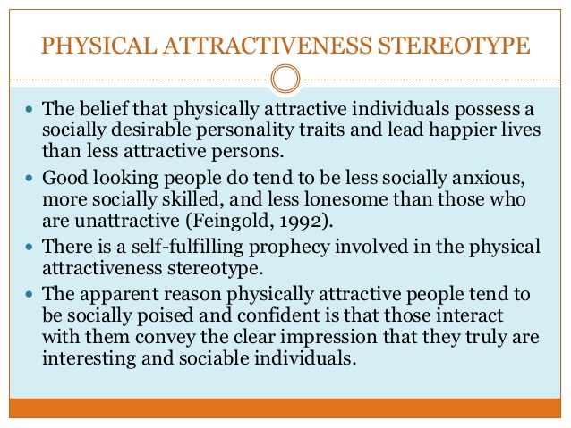

Slide 29
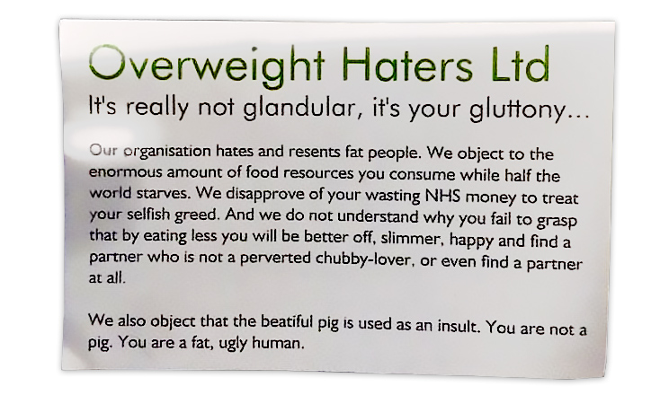
‘Fat’ cards are being handed out on London’s Tube
A group claiming to call itself 'Overweight Haters Ltd' has been handing out abusive cards to commuters on London's underground rail network, branding them as "fat" and "ugly.” CNBC, Tuesday, December 1, 2015

Slide 30
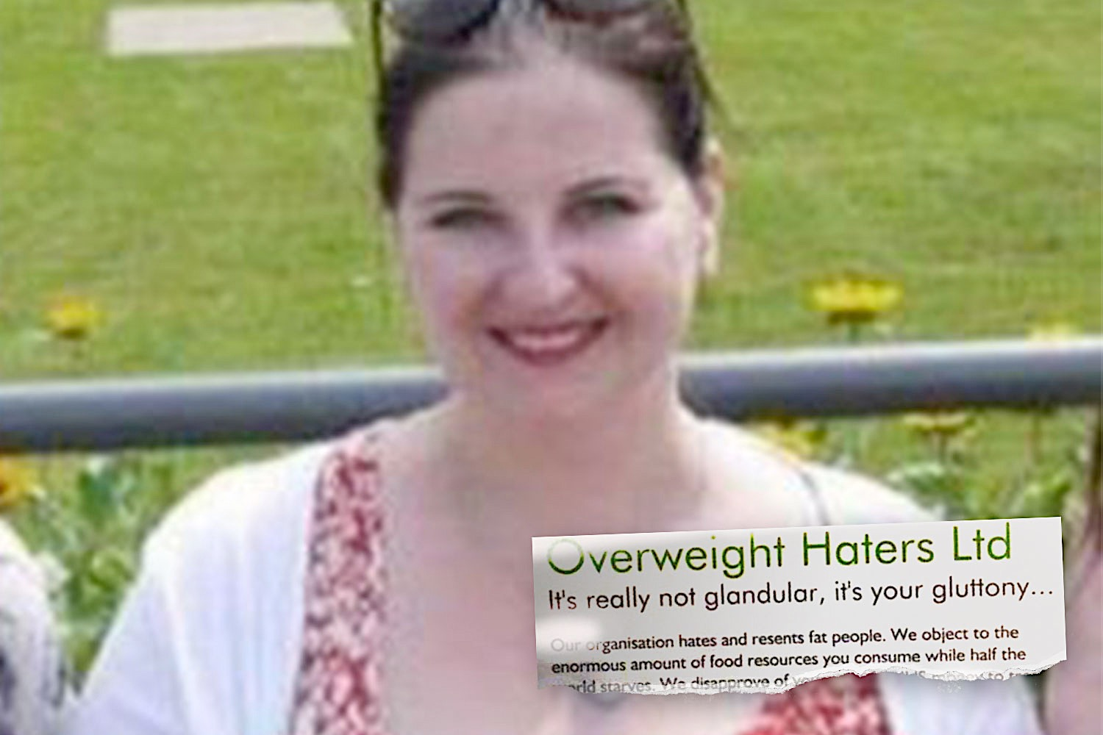

Slide 31
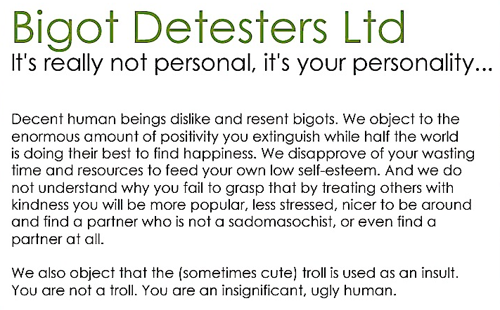

Slide 32
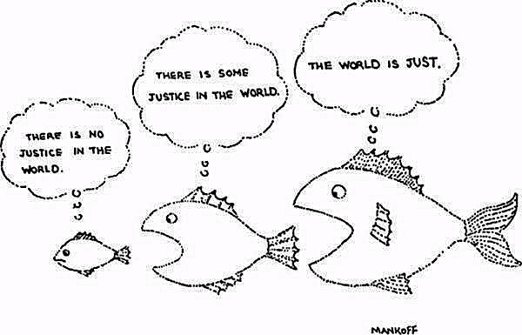
The Just World Fallacy
The tendency for people to want to believe that the world is fundamentally just, causing them to rationalize an otherwise inexplicable injustice as deserved by the victim. https://en.wikipedia.org/wiki/Just-world_hypothesis

Slide 33
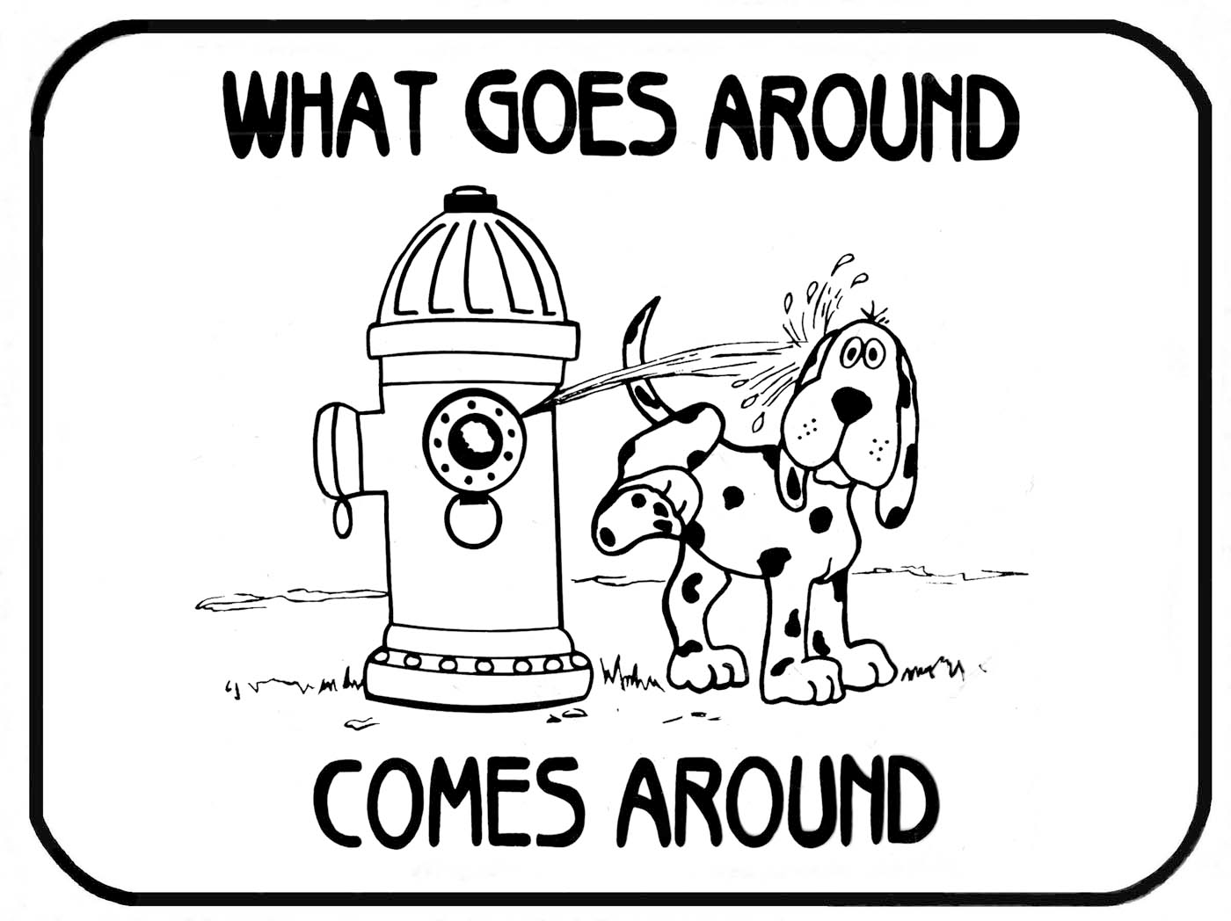

Slide 34
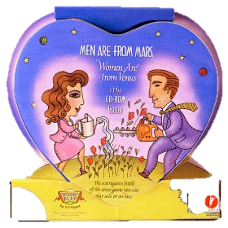
Confirmation Bias
The tendency to search for, interpret, focus on and remember information in a way that confirms one's preconceptions

Slide 35
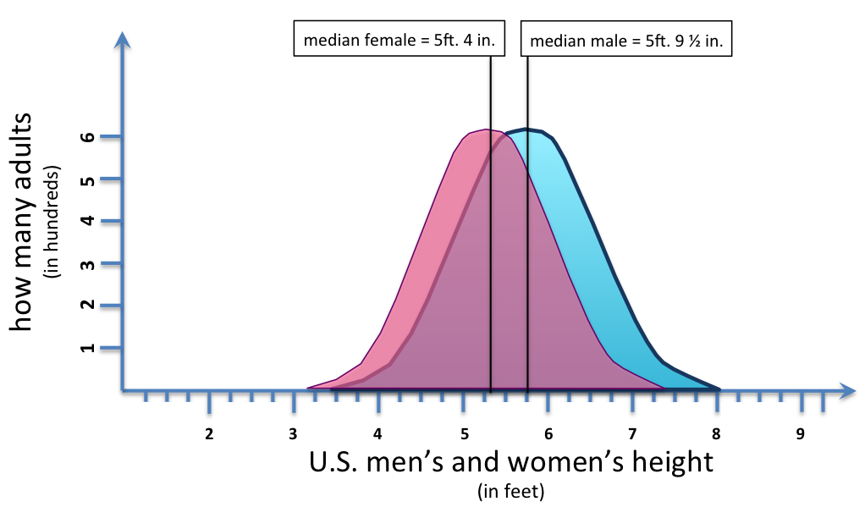
Statistical vs. Individual Difference

Slide 36
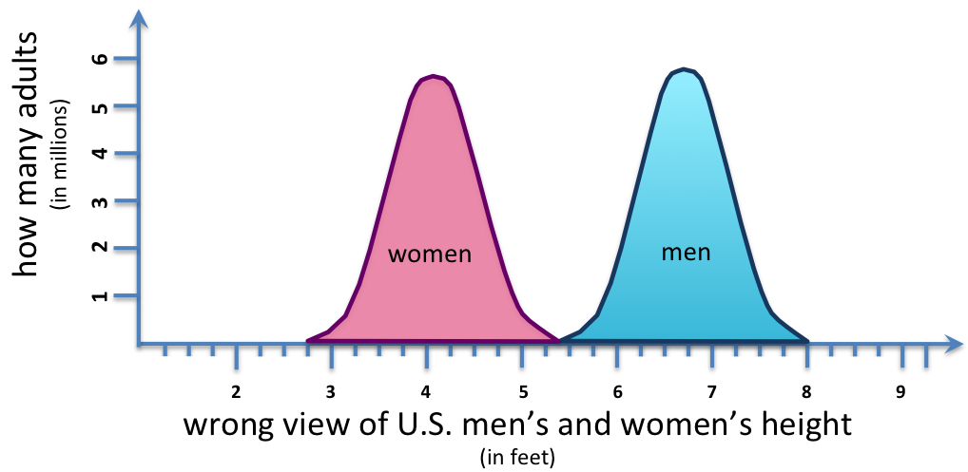
Statistical vs. Individual Difference

Slide 37
Whom Should Should Trust?
Most of us can’t hope to fully understand every issue that impinges on our lives.
Even scientists at the pinnacle of their own fields are novices outside those fields.
Nearly always, we must turn to the opinions of experts in the field which concerns us. But how do we decide whom to trust
The world is full of pretenders who are eager to persuade us that they have discovered the indisputable truth on issues from cosmic consciousness to the secrets of perfect health.

Slide 38
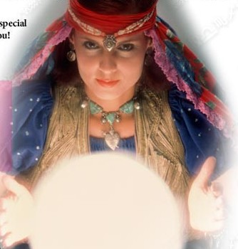
Psychics?
2014 Failed and Forgotten Psychic Predictions

Slide 39
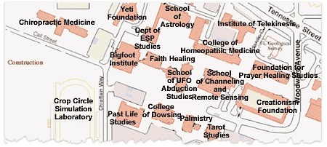
Chiropracters?

Slide 40
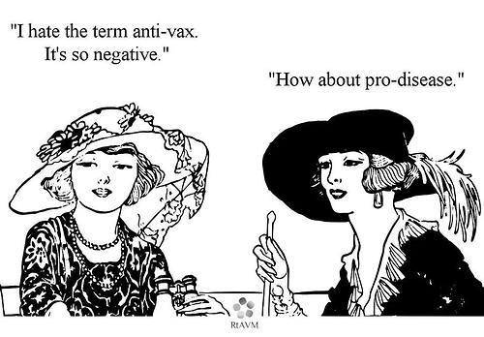
Anti-Vaxxers?

Slide 41
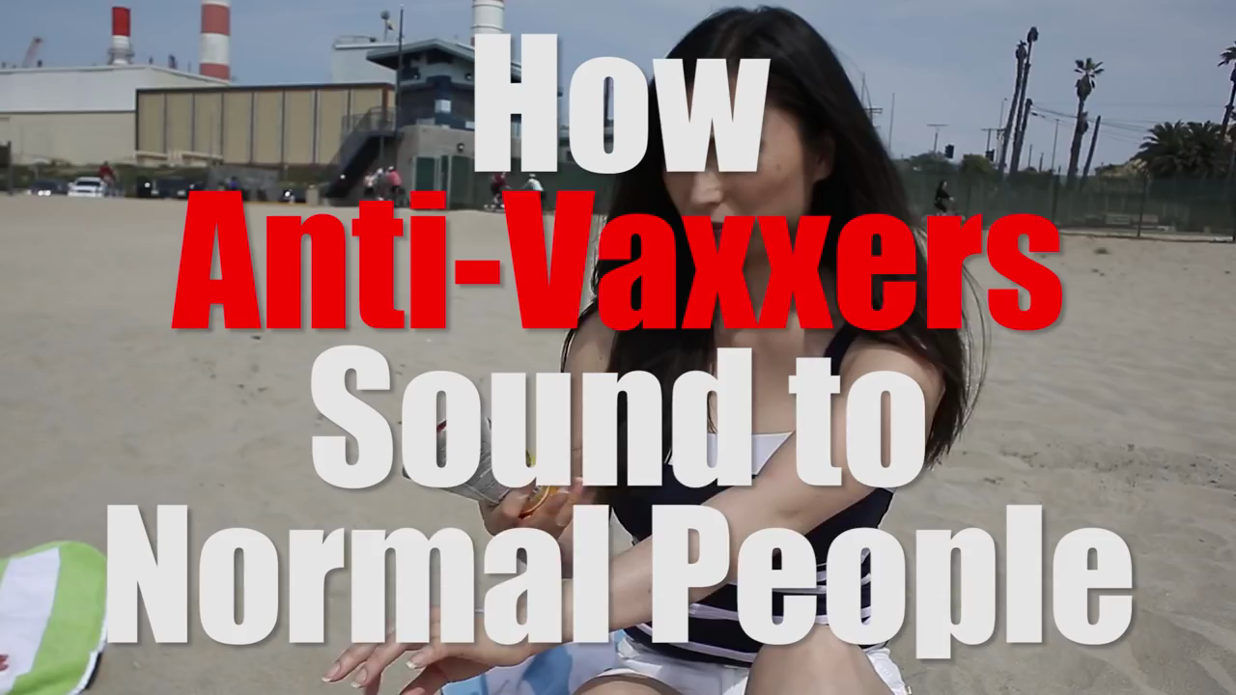

Slide 42
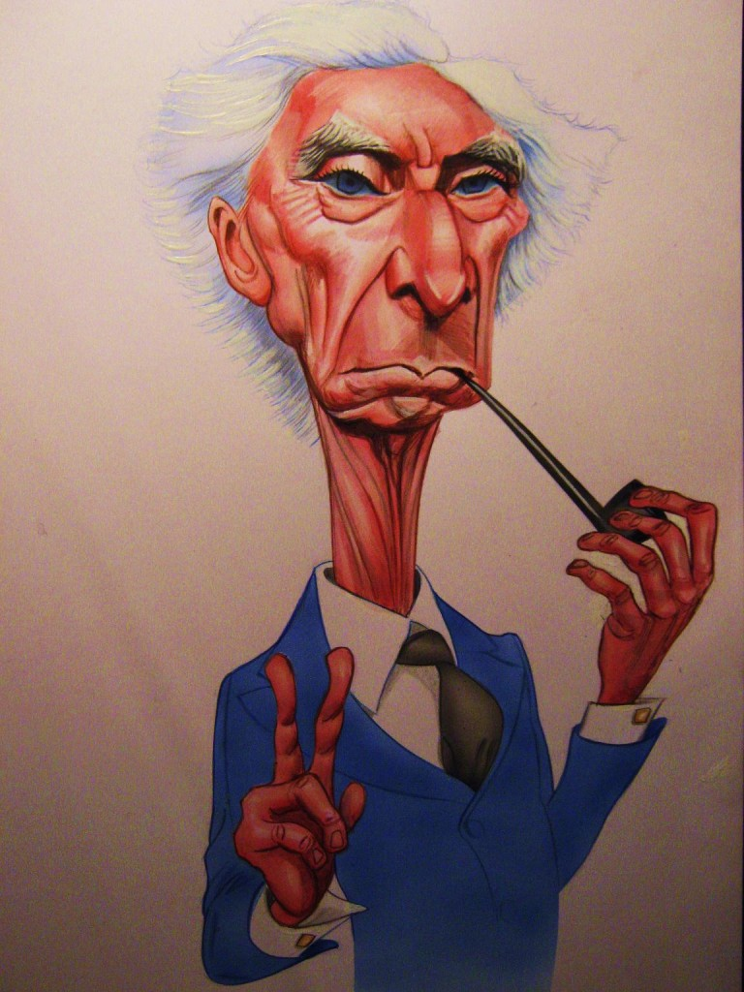
Bertrand Russell says…
The scepticism that I advocate amounts only to this:
that when the experts are agreed, the opposite opinion cannot be held to be certain;
that when they are not agreed, no opinion can be regarded as certain by a non-expert; and
that when they all hold that no sufficient grounds for a positive opinion exist, the ordinary man would do well to suspend his judgment.

Slide 43
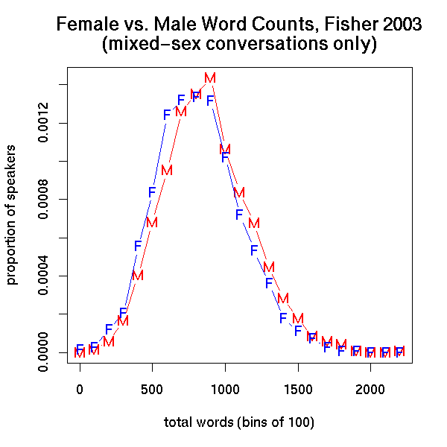
Female vs. Male Word Counts

Slide 44
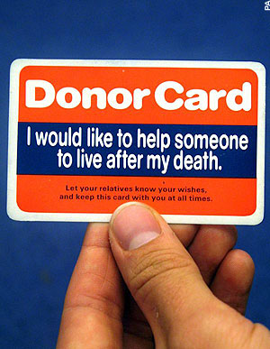
Defaults: opting in vs. opting out
Opt-out legislative systems dramatically increase effective rates of consent for donation (the so-called default effect).^{[1]} For example, Germany, which uses an opt-in system, has an organ donation consent rate of 12% among its population, while Austria, a country with a very similar culture and economic development, but which uses an opt-out system, has a consent rate of 99.98%

Slide 45
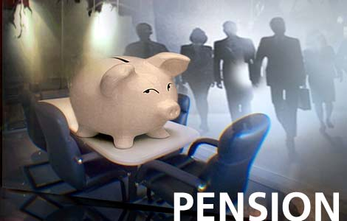
Opt in vs opt out pension plans
An automatic enrollment policy in a 401(k) savings plan results in substantially more employees participating in the pension plan-a jump from one-third to nearly 90%.

Slide 46
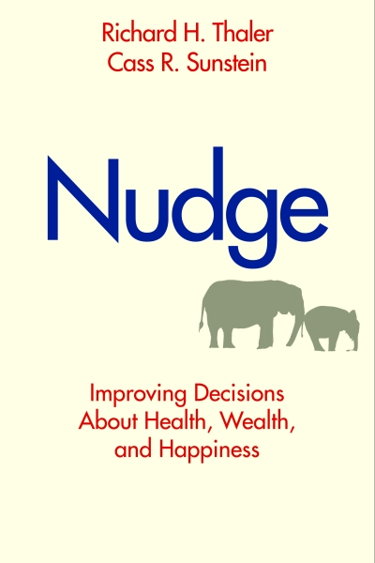
Choice architecture: ways in which choices can be presented to consumers, and the impact of that presentation on consumer decision-making

Slide 47
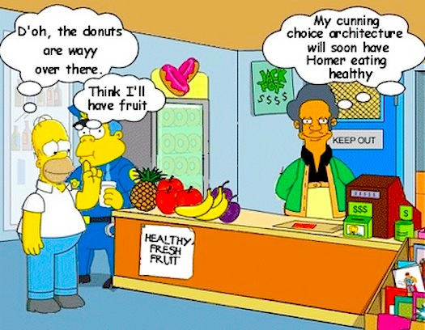
Libertarian Paternalism
Notes:
When are the costs prohibitive? What is coercion? Unger on women in philosophy: no one is stopping them. But at what point is it effectively doo costly or risky to buy something, pursue a career, engage in a practice, etc. Can Homer buy the donut if it’s not on the counter? If it’s taxed by 5 cents, 10 cents, a dollar? Compare opt-in and opt-out schemes for pensions and organ donation.

Slide 48
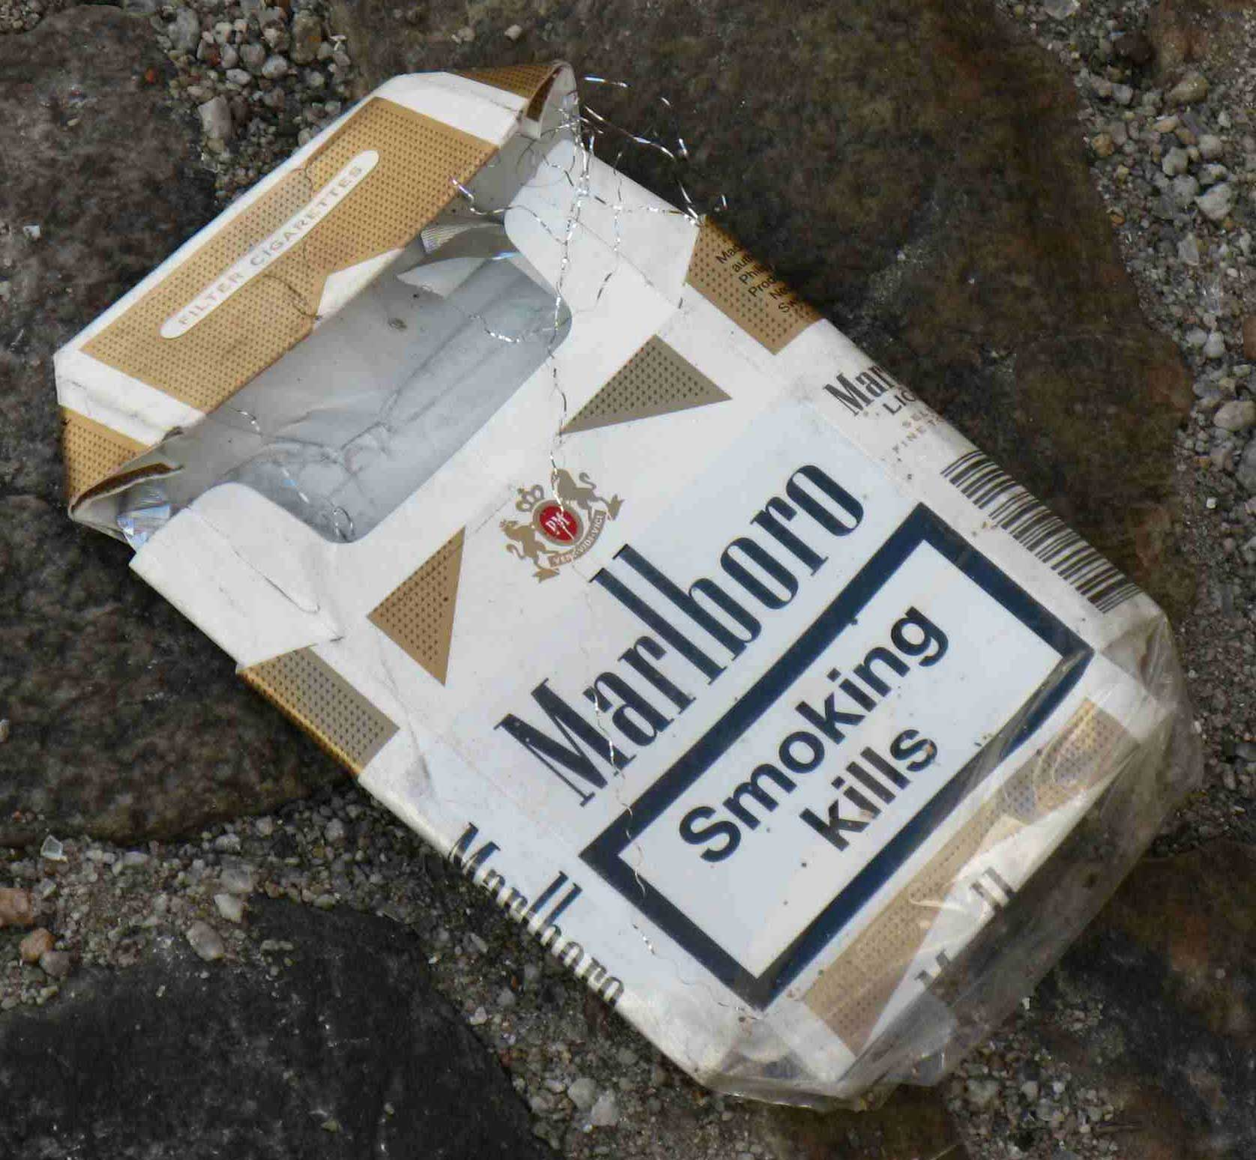

Slide 49
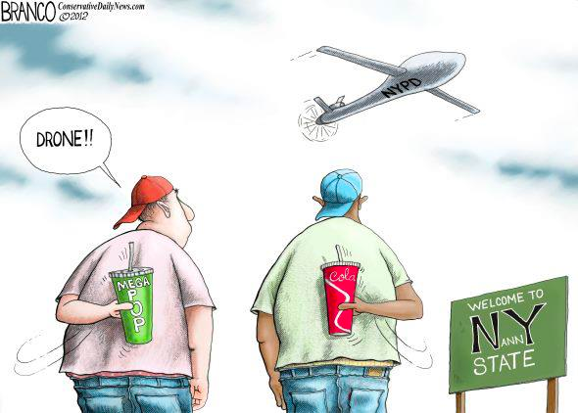
The Bloomberg “soda ban”

Slide 50
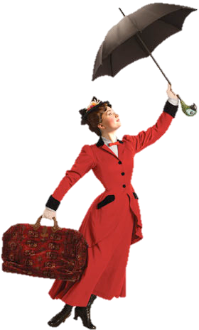
Paternalism?
Liberty Limiting Principles
The Harm Principle
Legal Moralism
Legal Paternalism

Slide 51
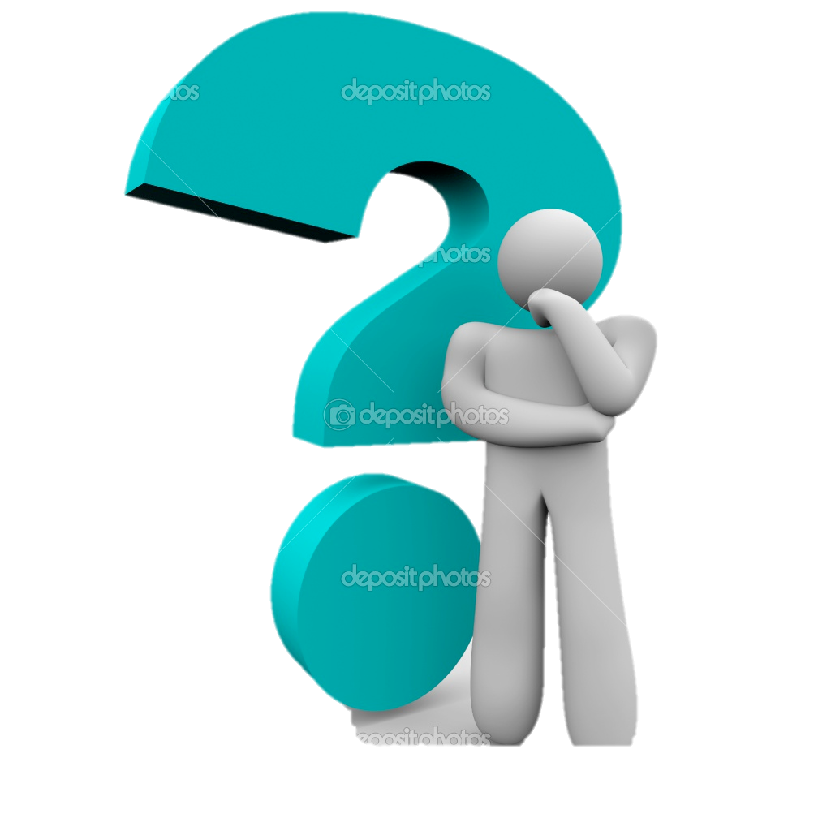
Welcome to Philosophy!

Slide 52
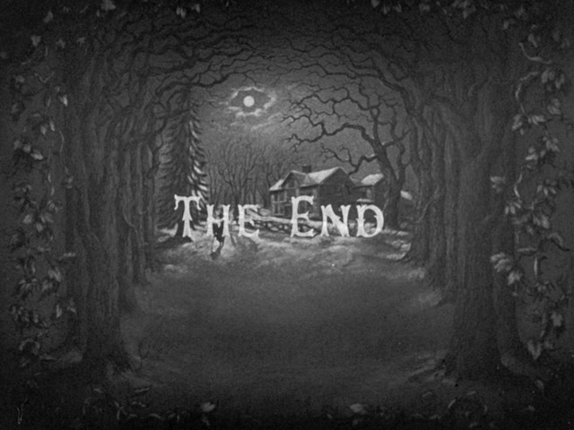
On to metaphysics!
At our next class meeting we’ll talk about possible worlds

