Slide 1
Printing powerpoints
How to print the text of powerpoints for note-taking

Slide 2
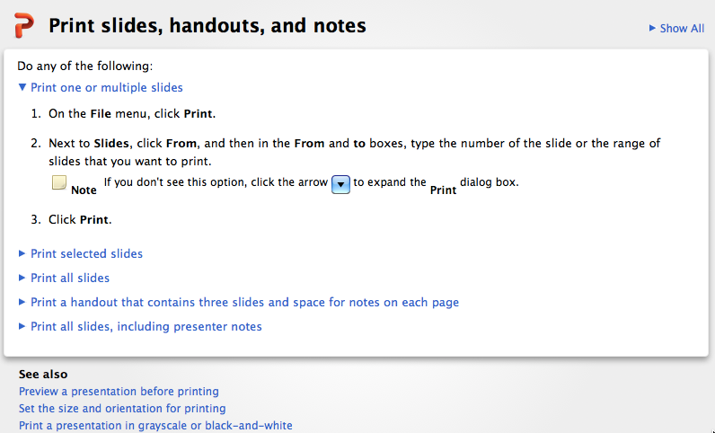
If you don’t have access to powerpoint or have trouble opening or printing files
—let me know! I can send you the material as pdfs or in any other format you can use—including <gasp> hardcopy!

Slide 3
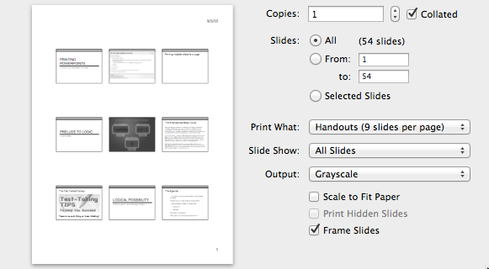
Printing multiple slides to a page
Select how many slides you want

Slide 4
Logical Possibility
A Prelude to Logic Ch 1 and handout ‘Logical Possibility’

Slide 5
The Agenda
The concept of logical possibility as distinct from physical possibility
Possible worlds as a way of talking about possibility
Necessity and contingency
What is logically possible: some hard cases
  precognition
  time travel
A final puzzle: are there really necessary truths?

Slide 6
What’s possible?
Logical possibility and physical possibility

Slide 7
Is ESP impossible?
All descriptions of ESP imply violations of conservation of energy…as well as violations of all principles of information theory and even of the principle of causality…Strict application of physical principles requires us to say that ESP is impossible.
        ---------Milton Rothman
Impossible? It depends on what you mean by impossible…
Does it actually happen?
Is it possible?
What do you mean by ‘possible’?
Notes:
Quote from Milton Rothman, p. 16

Slide 8

Does ESP actually occur?
Is there any scientific evidence for or against ESP?
  During the 1930s J. B. Rhine and colleagues at Duke University conducted a series of experiments to determine whether ESP phenomena actually occurred using Zener cards
  You may have observed experiments like those Rhine conducted…

Slide 9


Slide 10
What’s wrong with Venckman’s experiment
(and with Rhine’s original one)?
Face-to-face situation with minimal screening allows for ‘sensory leakage’
  In original, subjects could read figures from backs of cards
  Subjects could see reflection in experimenter’s glasses, or eyes
  Subjects could read experimenter’s expression, and voice
No double-blind
Rhine’s results not duplicated when more rigorous experimental methods adopted

Slide 11
Logical Possibility vs.
Physical (“Nomological”) Possibility
Logically possible
  ‘conceivable’
  consistent: describing it doesn’t imply a contradiction
    Reductio ad absurdum is a mode of argumentation that seeks to establish a contention by deriving an absurdity from its denial, thus arguing that a thesis must be accepted because its rejection would be untenable.
Physically possible
  consistent with “laws of nature”

Slide 12
Physical possibility, logical possibility and actuality
Whatever is actual is possible
…but not vice versa
Whatever is physically possible is logically possible
…but not vice versa

Slide 13



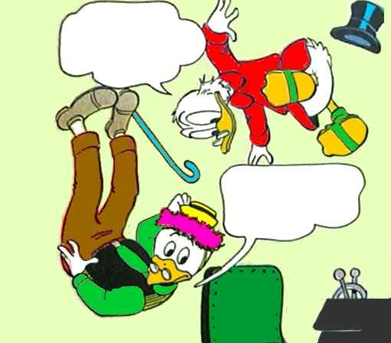



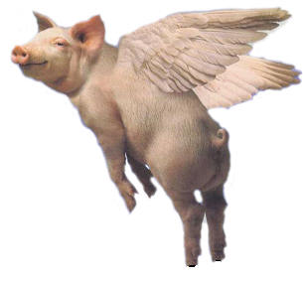
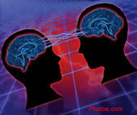
Having your cake and eating it (simultaneously)
Round Square
Actual
Precognition?
Physically Possible
Time Travel?
Logically Possible
Trisecting an angle with only compass and straight-edge
P and not-P
Logically Impossible

Slide 14
Possible Worlds:
ways that things can be, could have been
or could come to be

Slide 15
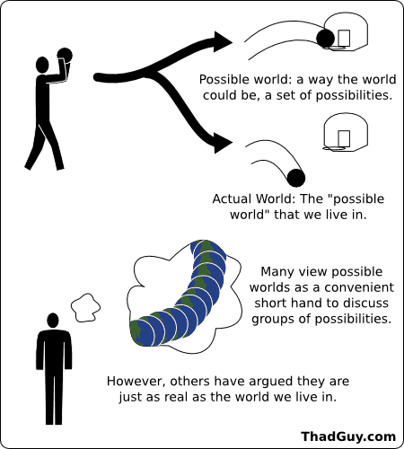
Possible worlds

Slide 16
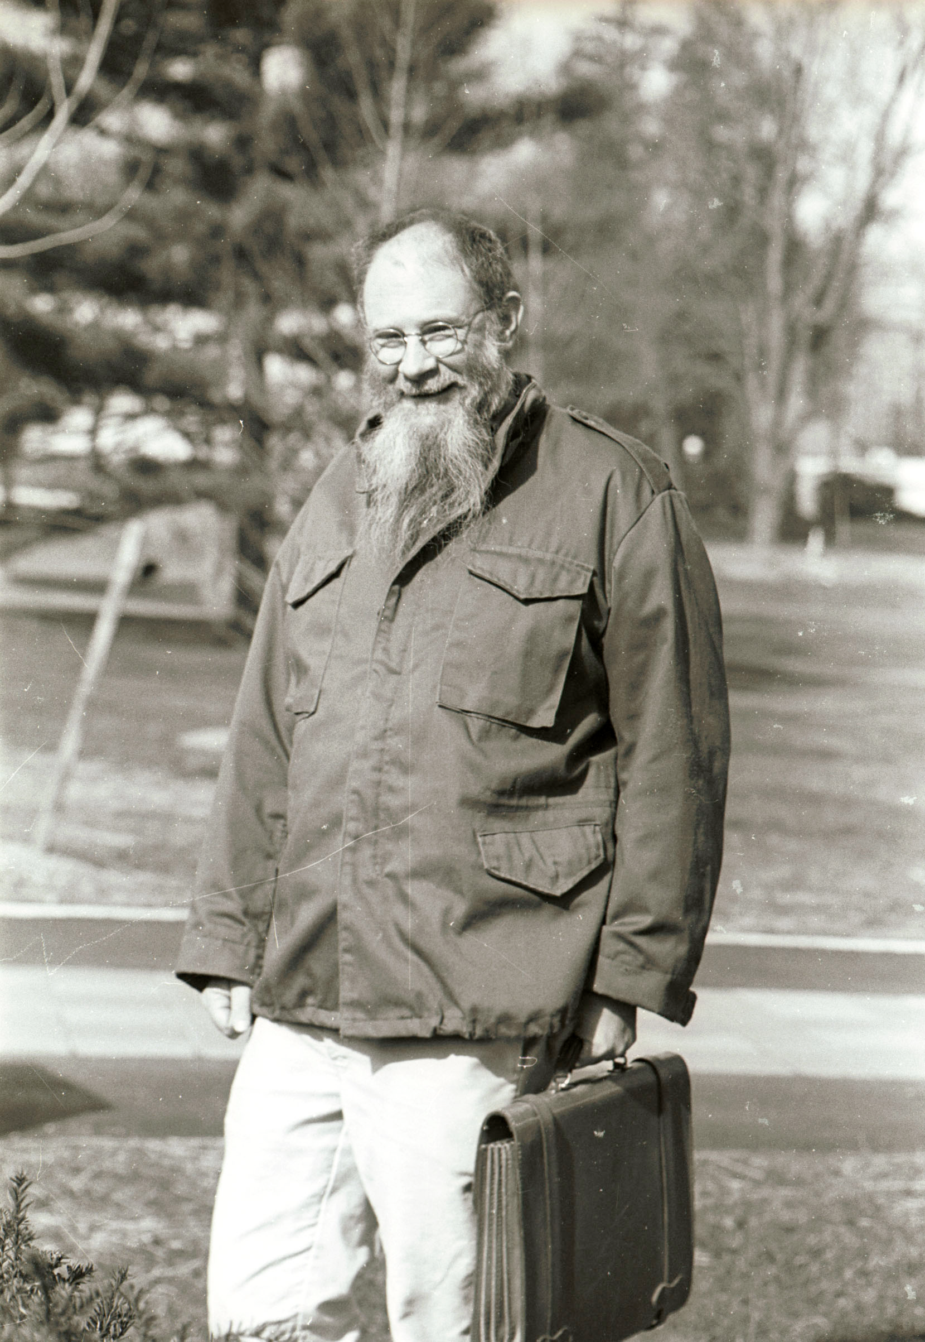
David Lewis: Modal Realist

Slide 17

Accessibility: worlds we can can ‘see’
A proposition (state of affairs), P, is possible at a world, w, if there’s some world where P is true and w can ‘see’ that world.
  We say a world that can be ‘seen’ from w is accessible to w
We understand different kinds of possibility in terms of different accessibility relations amongst worlds
  Logical Possibility: All possible worlds are accessible.
  Physical Possibility: Only those worlds at
  which the laws of nature are the same as
  they are at a given world are accessible from
  that world.

Slide 18
Physical Possibility
From the Actual World this is as far as I can see
Actual
Physically Possible
Logically Possible
Logically Impossible

Slide 19
Logical Possibility
From the Actual World I can see all the way out to here
Actual
Time Travel?
Physically Possible
Precognition?
Logically Possible
Logically Impossible

Slide 20
Possibility and necessity
Propositions are possible at worlds
  What’s possible at a given world depends upon which worlds that world can ‘see’ (given the kind of possibility in question)
    Logical possibility: assume we can ‘see’ all possible worlds.
For worlds, w, w’, where w’ is accessible to w (w can ‘see’ w’)
  P is necessary at world, w, iff at all accessible worlds, w’, P is true.
  P is possible at world, w, iff there is some accessible world, w’, at which P is true.
Intuitively, everything necessary is possible, but not vice versa.

Slide 21
We’re interested in logical possibility so we don’t have to worry about accessibility: P is logically possible iff there’s some world at which P is true.
Actual
Time Travel?
Physically Possible
Precognition?
Logically Possible
Logically Impossible

Slide 22
Some puzzles about possibility
Transitivity of the accessibility relation
  Could Socrates have been an alligator? A bacterium? A virus?
  A Visa account with Bank of America? A number?
‘Metaphysical’ possibility: is there a kind of possibility ‘between’ logical possibility and physical possibility?
Twin Earth thought experiments:
  Is water necessarily H20?
  Can I conceive of a world at which this stuff fails to be H2O?
Notes:
Salmon (1982) ‘The Four Worlds Paradox’. To illustrate the puzzle: suppose that the actual world (w₁) contains a bicycle, a, that is (actually) originally composed of A1 + B1 + C1, and suppose that there is a possible world, w₅, containing a bicycle, b (not identical with a), that is originally composed (in w₅) of A2 + B2 + C1 (where A1 ≠ A2 and B1 ≠ B2). Then, it seems, the application of the tolerance principle to each of a and b may generate two further possible worlds, in one of which (w₆) there is a bicycle with the original composition A1 + B2 + C1 that is identical with a, and in the other of which (w₇) there is a bicycle with the original composition A1 + B2 + C1 that is identical with b.

Slide 23


Twin Earth Thought Experiments
A Field Guide to the Philosophy of Mind ( A Field Guide to Philosophy of Mind), Twin Earth Thought Experiment (Wikipedia)

Slide 24
Summing up…
Logical possibility is possibility in the broadest sense.
A state of affairs is logically possible if
  It is ‘conceivable
  Doesn’t imply a contradiction
‘possible world’ is shorthand for ‘way that things could be, could have been or could come to be’.
In possible worlds talk: a state of a affairs is logically possible if there is a possible world at which it obtains.

Slide 25
Necessary and contingent statements

Slide 26
Necessity and Contingency
A proposition, P , necessary iff it has the same truth value at all possible worlds.
  P is necessarily true iff it is true at all possible worlds
  P is necessarily false iff it is false at all possible worlds
A proposition, P, is contingent if it has different truth values at different possible worlds.
  P is contingently true, iff P is true at the actual world but there is some possible world at which it is false.
  P is contingently false , iff P is false at the actual world but there is some possible world at which it is true.

Slide 27
Necessary or contingent: examples
Contingently true
The earth goes around the sun.
On earth, things fall at 32 feet per second per second.
The first day Fall 2015 classes at USD was Sep 2
San Diego is in California.
Contingently false
The sun goes around the earth.
There’s no such thing as gravity--everything just floats.
The first day of Fall 2015 classes at USD was Sep 1
San Diego is in Texas.
Notes:
Note: past tense sentences can be contingent even if we can’t chance the past since the past could have been otherwise
To test whether a sentence is contingent, we try to tell a story about a possible world at which it has opposite truth value.
Sometimes this is straight-forward, but sometimes what seems to be such a story really isn’t so we have to be careful!
“San Diego is in California” is one of those tricky cases.

Slide 28
Necessary or contingent?
How can we tell whether a true statement is contingently true rather than necessarily true?
Check to see whether you can conceive of a possible world at which it’s false.
  If you can conceive of such a world, it’s contingent
  If you can’t it’s either necessary…or you’re lacking in imagination
But careful! Can we be absolutely certain about the character of our own mental states?
  Can we mistakenly think we’re conceiving of something when we’re not—when we’re conceiving of something different?

Slide 29
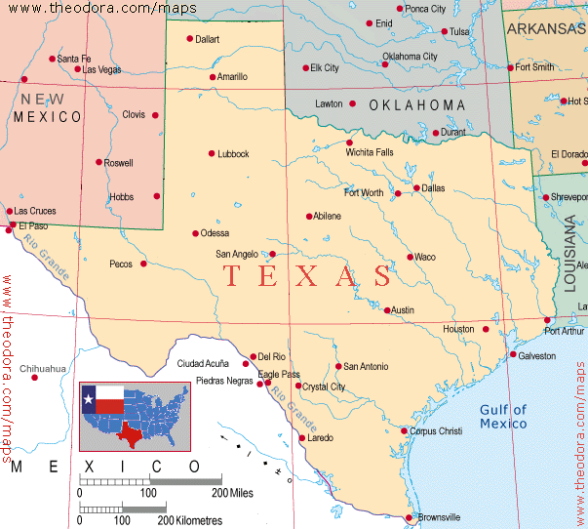
Could San Diego have been in Texas?
San Diego, Texas
“San Diego is in California” is contingently true if there’s some possible world at which the city in which we now are isn’t in California.

Slide 30
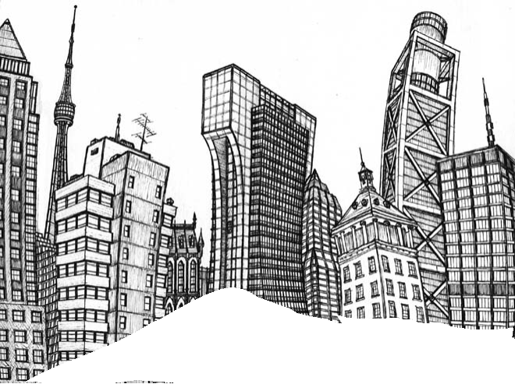

San Diego could be somewhere else!

Slide 31

What’s the point?
A proposition is contingently true if it’s actually true and there’s some possible world at which it’s false.
But what seems to be a possible world that makes the proposition false may not really be one.
‘Thought experiments’ can be misleading!

Slide 32
Necessary or contingent: examples
Necessarily true
All bachelors are unmarried.
Que sera sera. [Whatever will be, will be.]
2 + 2 = 4
Either San Diego is entirely in California or San Diego is not entirely in California.
Necessarily false
Some bachelors are married
Some things that will happen will not happen
2 + 2 = 5
San Diego is both entirely in and not entirely in California

Slide 33
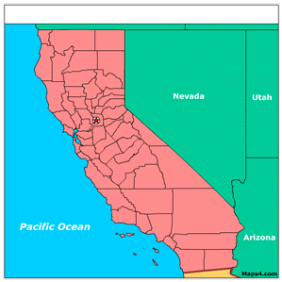
San Diego at 3 Possible Worlds
San Diego is
entirely in California
San Diego is not
entirely in California
San Diego is not
entirely in California
Either San Diego is entirely in California or San Diego is not entirely in California

Slide 34
True in virtue of language
Be careful to distinguish between sentences which are true in virtue of language and those that are about language!
(1) is necessarily true but (2) is contingently true:
    All bachelors are unmarried.
    ‘Bachelor’ means ‘unmarried male’.

Slide 35
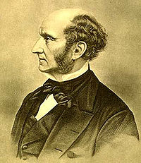
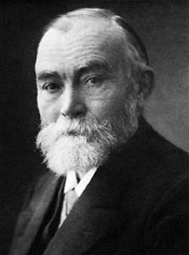

Are mathematical truths necessary?
2 + 2 = 4
Lucky for Mill things aren’t nailed down.
The course of maintaining that the truths of logic and mathematics are not necessary or certain was adopted by Mill. He maintained that these propositions were inductive generalizations based on an extremely large number of instances.
Notes:
Even in a world of Ooblick, 2 + 2 = 4. Even in a world without anyone who can do arithmetic 2 + 2 = 4. Being non-physical doesn’t mean being “merely subjective.” “Mental” isn’t the opposite of “physical” so to speak.

Slide 36
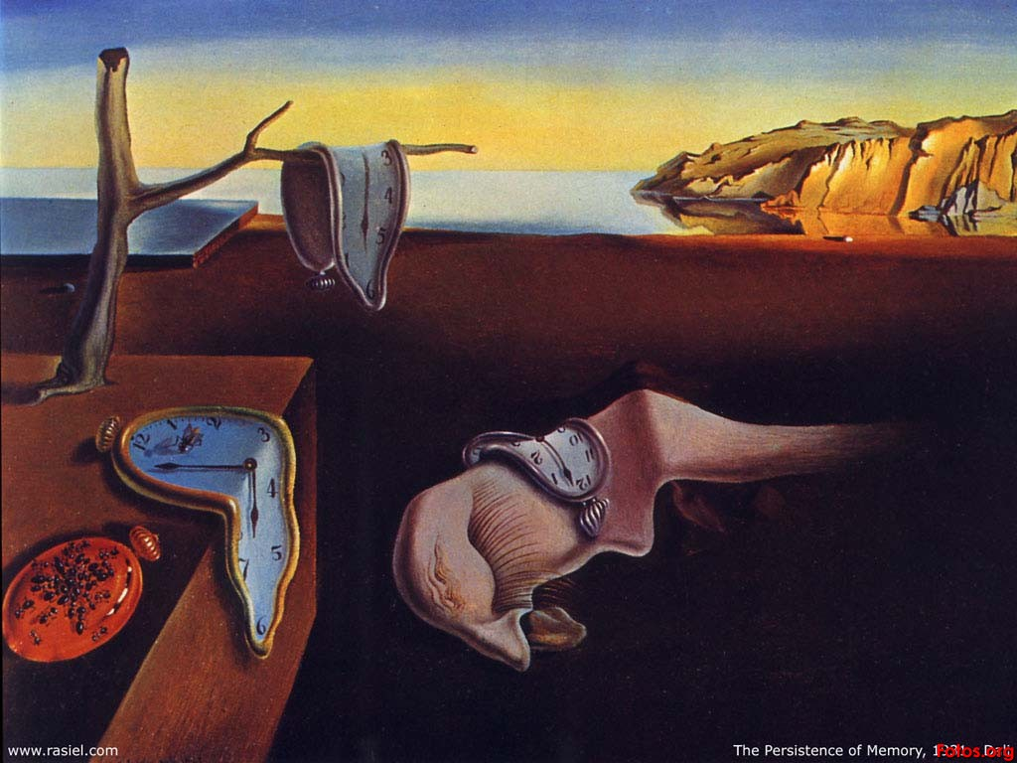
It’s about time…
Is precognition logically possible?
Is God’s foreknowledge compatible with free-will?
Is time-travel possible?

Slide 37
Precognition
Is it (logically) possible to ‘see into the future’?

Slide 38

Time viewed timelessly: landscape changes
Four-dimensionalists
contend that there is a deep
analogy between the structure of
ordinary material objects and the
structure of the space-time of modern physics; three-dimensionalists question this analogy. Three-dimensionalists tend to embrace the slogan ‘persisting things are wholly present at each time that they exist;’ four-dimensionalists tend to reject it.

Slide 39
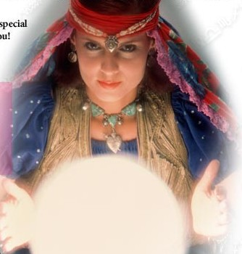
Precognition & the Open Future
The secular version of the problem of God’s foreknowledge

Slide 40
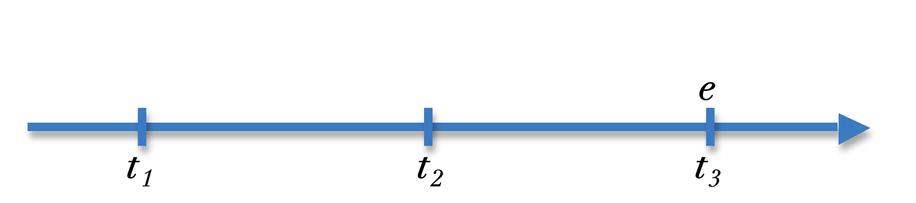

Precognition & Psychic Predictions
In the future, e will happen. Watch out!
If the psychic was right, then it was true at t1 that e was going to happen at t3
But you immediately take action a in order to prevent e from happening
You’re successful! At t2 it isn’t true that e was going to happen at t3
Is this logically possible???

Slide 41
Tensed vs. timeless propositions
Let us assume that at on September 8 the psychic ‘looked into the future’ and saw e occurring at September 10.
On Tuesday, September 8, she says, ‘In the future, two days from now, e will occur’.
What she said can be translated into the timeless sentence:
e occurs on Thursday, September 10, 2014.
e will occur two days from now
e
Tue, Sep 8
Wed, Sep 9
Thu, Sep 10

Slide 42
Timeless propositions
If the psychic was correct, then the following timeless sentence was true on Tuesday: Event e OCCURS on Thursday, September 11, 2014.
But following her advice, you immediately do an action, a, that prevents e’s occurring.
So whereas it was true on Tue, Sept 8 that e would OCCUR on Thu, Sep 10 (the psychic ‘saw’ it coming) it was no longer true at Wednesday.
e will occur two days from now
a
e
NOW
NOW
Tue, Sep 8
Wed, Sep 9
Thu, Sep 10

Slide 43
Timeless propositions
But wait! If the Psychic was right on Tuesday that e was going to occur in two days then it is timelessly true that e OCCURS on Thursday
And if timelessly true, it was true at all times…including Tuesday!
So it looks like we have a contradiction: timelessly both
  e occurs on Thursday (because the psychic was correct) and
  e does not occur on Thursday (because a prevented it)
e will occur two days from now
NOW
a
e
NOW
Tue, Sep 8
Wed, Sep 9
Thu, Sep 10

Slide 44
Time travel
Is it possible to go into the future…or the past?

Slide 45
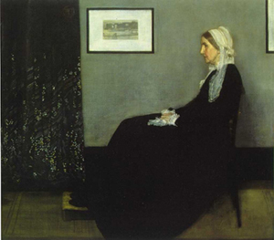
The man who was his own mother
“Jane” is left at an orphanage as a foundling. When “Jane” is a teenager, she falls in love with a drifter, who abandons her but leaves her pregnant. Then disaster strikes. She almost dies giving birth to a baby girl, who is then mysteriously kidnapped. The doctors find that Jane is bleeding badly, but, oddly enough, has both sex organs. So, to save her life, the doctors convert “Jane” to “Jim.”
Notes:
Story by Michio Kaku at http://www.mkaku.org/article_timetravel.htm

Slide 46
And then . . .
“Jim” subsequently becomes a roaring drunk, until he meets a friendly bartender (actually a time traveler in disguise) who whisks “Jim” back way into the past. “Jim” meets a beautiful teenage girl, accidentally gets her pregnant with a baby girl. Out of guilt, he kidnaps the baby girl and drops her off at the orphanage. Later, “Jim” joins the time travelers corps, leads a distinguished life, and has one last dream: to disguise himself as a bartender to meet a certain drunk named “Jim” in the past…

Slide 47
The Man Who Was His
Own Mother
Jim becomes distinguished
Time-Traveler
Jim meets Bartender who whisks
him back to the past
Disguised as Bartender
meets Jim The Drunk
Baby Jane dropped
Off at orphanage
Drops Baby Jane off
At orphanage
Jim becomes Baby
Jane’s father
Jane becomes
Baby Jane’s
mother
Baby Jane
Is born
Jim meets Jane
Bartender takes Jim
Back to the past where
he meets Jane
Jane is born

Slide 48
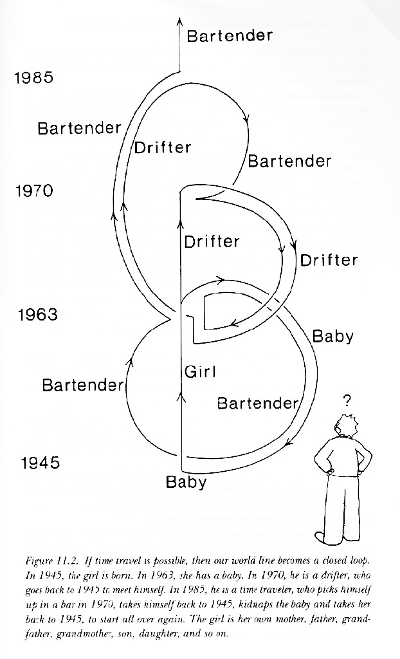
1945- A baby is an orphan who then grows up into a girl
1963- The girl becomes pregnant by a drifter who than disappears. The girl becomes a guy after labor complications and the baby is kidnapped. The girl who is now a guy becomes a drifter.
1970- The drifter walks into a bar and a bartender offers him a time machine ride to go back in time and change his past.
1963- the drifter meets a girl and gets her pregnant.
1985- the bartender drops the drifter off to enlist in the time travelers corps.
1963- the bartender kidnaps the newborn baby girl
1945- the bartender drops the baby off at an orphanage
1985- the drifter becomes a member of the corps and gets a mission to meet a drifter at a bar as a bartender in 1970

Slide 49


Is time travel logically possible?
Suppose you travel back into the past to kill your baby-self…

Slide 50
Closed Time-Like Curves

Slide 51
Logical possibility

Slide 52
Logic deals with logical possibility
The possibility of propositions being true (necessity and contingency)
The possibility of groups of propositions all being true together (consistency)
The impossibility of the premises of an argument being true and the conclusion being false (validity)

Slide 53
A puzzle: is necessity possible?
How can there be necessary truths? Take "all bachelors are unmarried": I can describe a world were "bachelor" means "male under 30" and such a world is one in which there are married bachelors, right? Similarly "2+2=4" and "2+2=5": it's just a matter of how you define the symbols, right?

Slide 54

To Be Continued…

