Slide 1
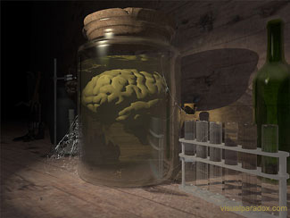
Perception & the External World
Is there anything ‘out there’?
Could I be a brain in a vat?

Slide 2
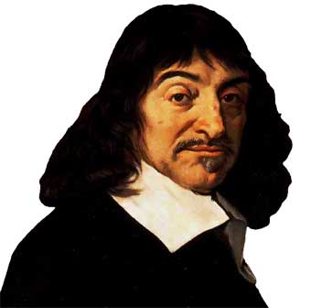
An Old Problem
Skepticism about the External World
Are things as they seem?
Are there objects independent of me?
Are there other minds?
And even if there are…
…how could I ever know any of these things?

Slide 3

Solipsism
Since I realized I created my own reality in every way, I must therefore admit that, in essence I was the only person alive in my universe.
The idea that ‘I alone exist’ and create all of reality
Should we prefer solipcism to the external world hypothesis?

Slide 4
What we’re going to do
Part I: some optical illusions
  these make us distrust the ‘evidence of the senses’ and generate skepticism.
Part II: arguments for and against skepticism, illustrating some logical concepts
[Part III (optional): More fun--Dennett’s piece ‘Where Am I’]
  are the states of affairs Dennett describes logically possible?]

Slide 5
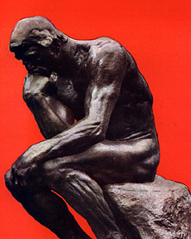
Concepts
Veridical and non-veridical experience
Perception and memory as ‘constructive’
Judgment: if we know what’s going on we can avoid being fooled!
Inference to the best explanation
Argument
Parts of an argument: premise(s) and conclusion
Validity
Logical form
Counterexample

Slide 6

Things are not always as they seem

Slide 7
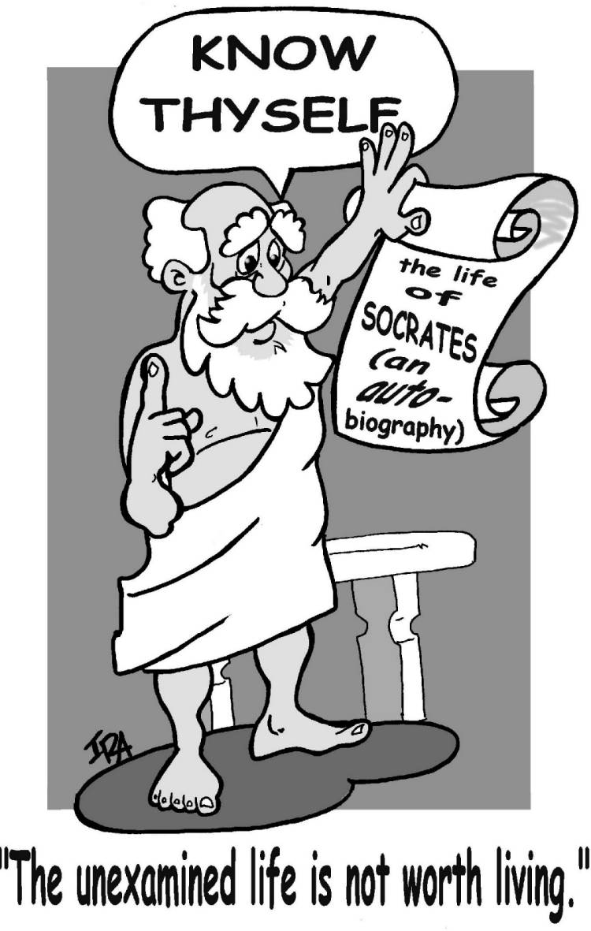
The morals to be drawn from the discussion that follows:
Perception is reliable but not infallible.
Knowledge doesn’t require certainty--but we should know when to be careful.
If we know what’s going on we can avoid being fooled!

Slide 8
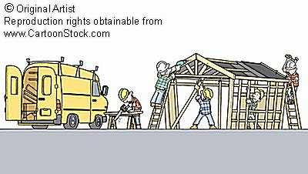
Perception is constructive
What we perceive is determined not only by the senses but by
  What we know
  What we expect
  What we believe
  What our psychological state is

Slide 9
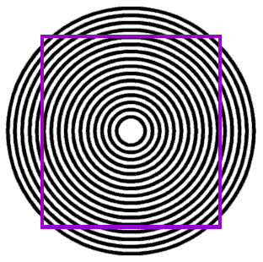
Deceptive Illusions

Slide 10

Checks
…and more scintillating grids

Slide 11

Parallel lines?
The Café Wall Illusion in motion

Slide 12
Size and Perspective

Slide 13

Poggendorff Interactive
The Poggendorff Illusion

Slide 14
What’s the illusion here?

Slide 15
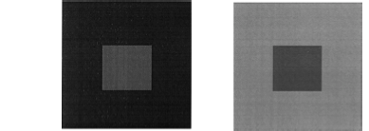
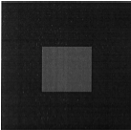

Maybe you don’t believe me so . . .

Slide 16
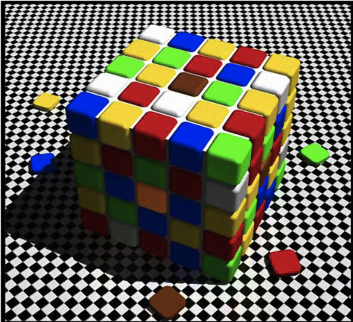

Slide 17
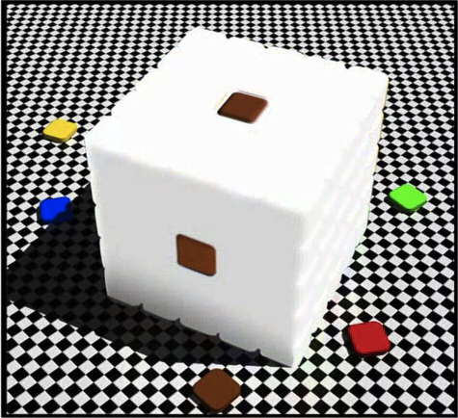

Slide 18

We see what we expect to see

Slide 19
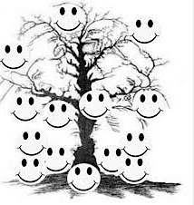
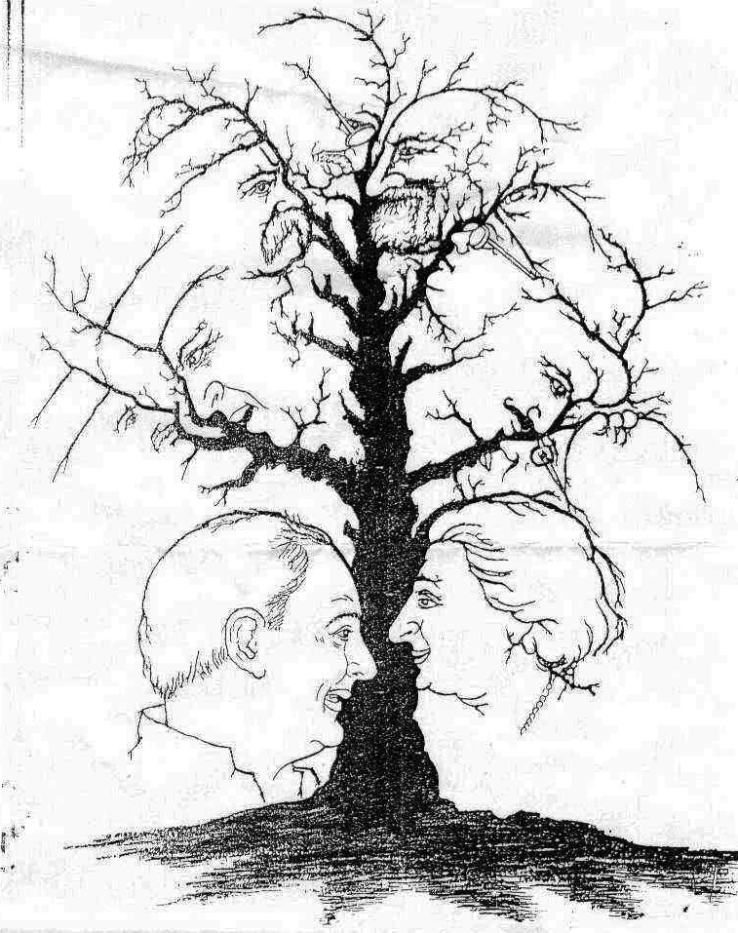
We expect to see faces

Slide 20
We expect to see faces
Face on Mars,
Face in beans,
...and more faces

Slide 21
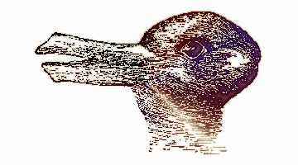
Ambiguity Illusions

Slide 22

Figure-ground ambiguity

Slide 23
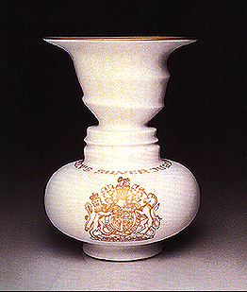
Rubin vase

Slide 24
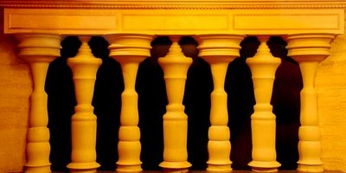
More Rubin Illusions

Slide 25

And this

Slide 26

Escher Face(s)

Slide 27

How old is she?

Slide 28
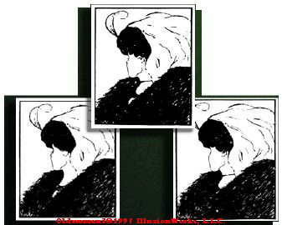
Young Woman/Old Woman

Slide 29
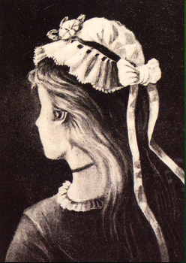
Another young/old woman

Slide 30
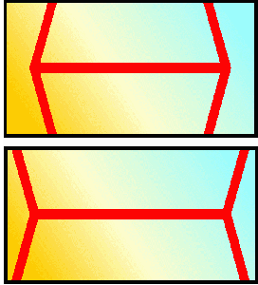
Look familiar?
Müller-Lyer Illusion (interactive)

Slide 31
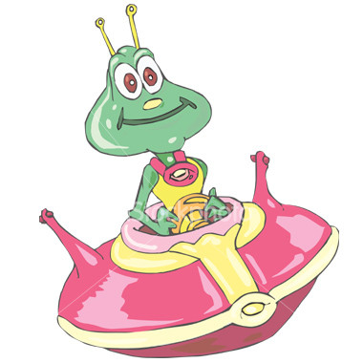
Autokinetic effect: illusions of motion
UFOs
The Rotating Snake (nausea warning)
Stepping Feet

Slide 32

Totally mad illusions!

Slide 33
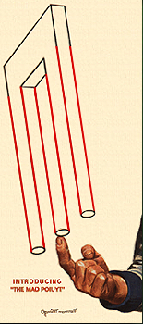
Close up

Slide 34

The Greek version

Slide 35
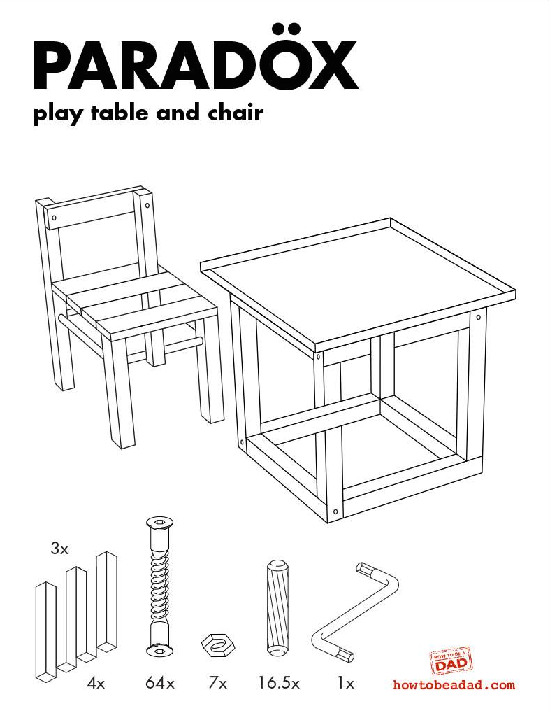

Slide 36
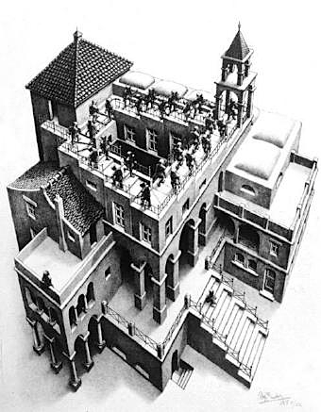
Escher stairs

Slide 37


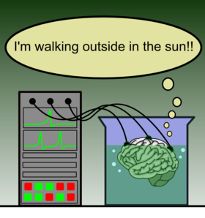
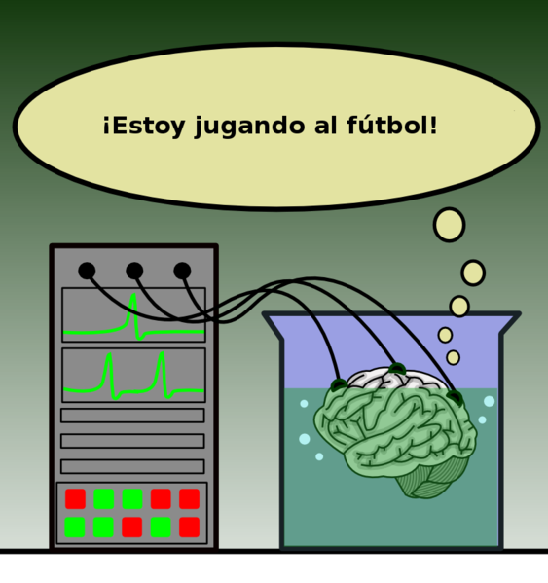
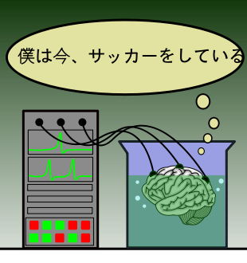
Deep skepticism
Russell’s 5 minute hypothesis
Descartes Evil Demon
The Brain-in-the-Vat hypothesis

Slide 38

It was at that precise moment that Stanley realized that he may very well be a brain in a vat.

Slide 39


Could we have reason to believe that all our experiences are non-veridical?
I’m happy…what’s the problem?

Slide 40
Skepticism
The following are two different questions:
Is it possible that all my experiences are non-veridical?
  Yes.
Is it possible for me to have good reason to believe that all my experiences are non-veridical?
  ???
  (what would be a good reason to believe that a given experience is non-veridical)

Slide 41
Three Arguments
Argument #1: A bad argument that is supposed to show that we have reason to believe there is all our experiences could be non-veridical and so that there is no external world.
Argument #2: A good argument showing that we could not have reason to believe that all our experiences are non-veridical.
Argument #3: A plausibility argument showing that we have reason to believe that some of our experiences are veridical, and so that there is an ‘external world’.

Slide 42
A Bad Argument
Any experience is such that I could have good reason to believe that it is non-veridical
Therefore, I could have good reason to believe that all my experiences are non-veridical
Note the form of this argument: ‘any one of these things could have a certain property, therefore all of these things could could have that property.
Is this form of argument valid?

Slide 43
Validity
The premises of an argument are statements which are cited as evidence for the argument’s conclusion--the claim we’re arguing for.
An argument is valid if its premises make its conclusion true—i.e. if it’s logically impossible that its premise be true and its conclusion false.
One way of showing that an argument is invalid is producing a counterexample to the original argument: an argument
  of the same form
  with all true premises and a false conclusion
  which must, therefore, be invalid.

Slide 44
Counterexample
We can show that an argument is invalid by producing a counterexample argument: an argument of the same form that has all true premises and a false conclusion and is, therefore, invalid.
The form of the original argument is:
  Any x could be F
  Therefore, all x’s
  could be F
So we need another argument of this form that’s plainly invalid to serve as a counterexample.
Any experience is such that I could have reason to believe it is non-veridical
Therefore I could have reason to believe that all experiences are non-veridical

Slide 45

Great! That means we can order all the items on the menu.
We have enough money to order any item on the menu.
Any menu item is affordable.
Therefore, all the items together are affordable.
INVALID!

Slide 46
What does this show?
This doesn’t show that it’s not possible that all of our experiences be non-veridical.
It doesn’t even show that we couldn’t have good reason to believe that all of our experiences are non-veridical.
All we’ve shown is that one argument for that conclusion is invalid
But that doesn’t show that the conclusion is false! An invalid argument may have a true conclusion!

Slide 47
An invalid argument can have true premises and a true conclusion!
All dogs are mammals
Ducati is a mammal
Therefore, Ducati is a dog
Counterexample Argument
All cats are mammals
Shamu is a mammal
Therefore, Shamu is a cat
Validity isn’t about the truth or falsity of the premises or conclusion but about how they hang together!

Slide 48
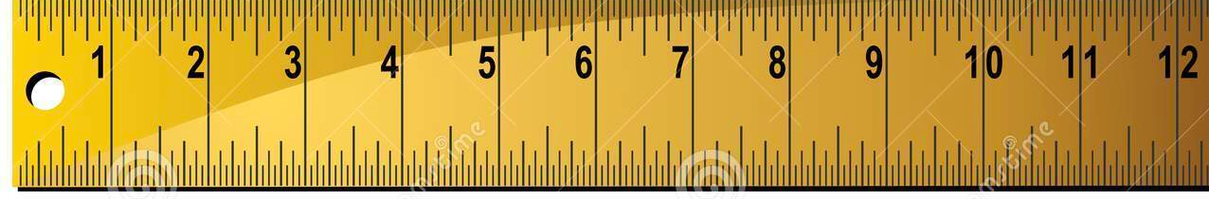
Argument #2
There is a better argument to show that we couldn’t have reason to believe that all our experiences are non-veridical.
We determine that an experience is non-veridical by checking it against experiences we assume are veridical
We assume the measuring experience is veridical!

Slide 49

To determine whether it’s a mirage…

Slide 50



…we test it against experience we assume is not a mirage.
Now I’m having a
veridical experience
and see that there’s
nothing here!

Slide 51
A Pretty Good Argument
An argument that we can’t have reason to believe that all our experiences are non-veridical
We have reason to believe that an experience is
non-veridical only if we assume that some other experience is veridical.
Therefore we could never have reason to believe
that all our experiences were non-veridical.
This doesn’t show that it’s impossible that all our experiences are non-veridical--it only shows that we could never have good reason to believe that they are.

Slide 52
Argument #3
An Inference to the Best Explanation
Things happen against our will
Things happen unexpectedly
Experience is coherent
The existence of an independent world explains our experiences better than any known alternative.

Slide 53

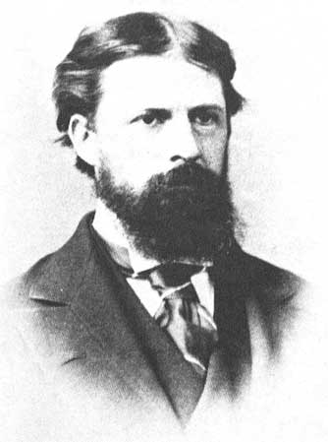
Abduction: inference to the best explanation
My experience is coherent, predictable (but sometimes surprising) and sometimes comes to me against my will.
The best explanation for this is that there’s an external world causing my experiences!

Slide 54

Abduction: Inference to the Best Explanation
Therefore, the external world hypothesis is probably true!

Slide 55
But, is it logically possible…
Is it logically possible that we could be grossly mistaken about our situation?
Is it logically possible that we are brains in vats…or worse?
Could all of our experience be non-veridical?

Slide 56
Could all this be an illusion?

Slide 57
It’s logically possible.

Slide 58

Where Am I? by Daniel Dennett
(Optional: just for fun)
Several years ago I was approached by Pentagon officials who asked me to volunteer for a highly dangerous and secret mission…the Department of Defense was spending billions to develop a Supersonic Tunneling Underground Device, or STUD. It was supposed to tunnel through the earth's core at great speed and deliver a specially designed atomic warhead “right up the Red's missile silos,” as one of the Pentagon brass put it.

Slide 59
The Plan
The problem was that in an early test they had succeeded in lodging a warhead about a mile deep under Tulsa, Oklahoma, and they wanted me to retrieve it for them…According to monitoring instruments, something about the nature of the device and its complex interactions with pockets of material deep in the earth had produced radiation that could cause severe abnormalities in certain tissues of the brain…which were apparently harmless to other tissues and organs of the body.
So it had been decided that the person sent to recover the device should leave his brain behind. It would be kept in a safe place as there it could execute its normal control functions by elaborate radio links…Would it really work? The Houston brain surgeons encouraged me… “We're simply going to make the nerves indefinitely elastic by splicing radio links into them.”

Slide 60
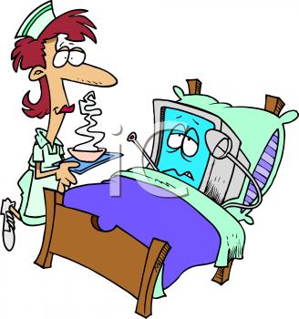
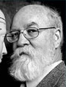
Dennett in Post-Op
The day for surgery arrived at last and of course I was anesthetized and remember nothing of the operation itself. When I came out of anesthesia, I opened my eyes, looked around, and asked the inevitable, the traditional, the lamentably hackneyed postoperative question: “Where am l?” The nurse smiled down at me. “You're in Houston,” she said, and I reflected that this still had a good chance of being the truth one way or another. She handed me a mirror. Sure enough, there were the tiny antennae poling up through their titanium ports cemented into my skull.

Slide 61

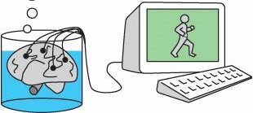
Where am I?
[F]loating in what looked like ginger ale, was undeniably a human brain, though it was almost covered with printed circuit chips, plastic tubules, electrodes, and other paraphernalia…: “Well, here I am…staring through a piece of plate glass at my own brain . . . But wait,” I said to myself, “shouldn't I have thought, ‘Here I am, suspended in a bubbling fluid, being stared at by my own eyes’?”

Slide 62
Hamlet meets Yorick
“Yorick,” I said aloud to my brain, “you are my brain. The rest of my body…I dub ‘Hamlet.’” So here we all are: Yorick's my brain, Hamlet's my body, and I am Dennett. Now, where am I?

Slide 63
Thought Experiments
Philosophical discussions, especially those concerning the mind-body problem and the problem of personal identity rely heavily on thought experiments—stories that purport to describe other possible worlds
Dennett calls such thought experiments “intuition pumps” since they’re supposed to elicit our “intuitions” about these matters
But what, if anything, do our “intuitions” show?

Slide 64

How reliable are intuition pumps?

Slide 65
Am I where (most of) my body is?
Where Hamlet goes there goes Dennett. This principle was easily refuted by appeal to the familiar brain-transplant thought experiments so enjoyed by philosophers. If Tom and Dick switch brains, Tom is the fellow with Dick's former body — just ask him; he'll claim to be Tom and tell you the most intimate details of Tom's autobiography. It was clear enough, then, that my current body and I could part company, but not likely that I could be separated from my brain.
The rule of thumb that emerged so plainly from the thought experiments was that in a brain-transplant operation, one wanted to be the donor not the recipient. Better to call such an operation a body transplant, in fact. So perhaps the truth was…

Slide 66
Am I were my brain is?
Where Yorick goes there goes Dennett. This was not at all appealing, however. How could I be in the vat and not about to go anywhere, when I was so obviously outside the vat looking in and beginning to make guilty plans to return to my room for a substantial lunch? This begged the question I realized, but it still seemed to be getting at something important. Casting about for some support for my intuition, I hit upon a legalistic sort of argument that might have appealed to Locke.
Suppose, I argued to myself, I were now to fly to California, rob a bank, and be apprehended. In which state would I be tried: in California, where the robbery took place, or in Texas, where the brains of the outfit were located? Would I be a California felon with an out-of-state brain, or a Texas felon remotely controlling an accomplice of sorts in California?... the state would be obliged to maintain the life-support system for Yorick though they might move him from Houston to Leavenworth, and aside from the unpleasantness of the opprobrium, I, for one, would not mind at all and would consider myself a free man under those circumstances. If the state has an interest in forcibly relocating persons in institutions, it would fail to relocate me in any institution by locating Yorick there. If this were true, it suggested a third alternative.

Slide 67
Am I wherever I think I am?
Dennett is wherever he thinks he is. Generalized, the claim was as follows: At any given time a person has a point of view and the location of the point of view (which is determined internally by the content of the point of view) is also the location of the person.
Point of view clearly had something to do with personal location, but it was itself an unclear notion. It was obvious that the content of one's point of view was not the same as or determined by the content of one's beliefs or thoughts.
For example, what should we say about the point of view of the Cinerama viewer who shrieks and twists in his seat as the roller-coaster footage overcomes his psychic distancing? Has he forgotten that he is safely seated in the theater?... In other cases, my inclination to call such shifts illusory was less strong. The workers in laboratories and plants who handle dangerous materials…can feel the heft and slipperiness of the containers they manipulate with their metal fingers. They know perfectly well where they are and are not fooled into false beliefs by the experience, yet it is as if they were inside the isolation chamber they are peering into.

Slide 68
Am I my brain?
Identifying with one’s brain, as suggested by traditional puzzle cases, supports mentalistic accounts of personal identity.
Dennett challenges the intuitions these cases pump:
Imagine you have written an inflammatory letter which has been published in the Times, the result of which is that the government has chosen to impound your brain for a probationary period of three years in its Dangerous Brain Clinic in Bethesda, Maryland. Your body of course is allowed freedom to earn a salary and thus to continue its function of laying up income to be taxed. At this moment, however, your body is seated in an auditorium listening to a peculiar account by Daniel Dennett of his own similar experience. Try it. Think yourself to Bethesda, and then hark back longingly to your body, far away, and yet seeming so near. It is only with long-distance restraint (yours? the government's?) that you can control your impulse to get those hands clapping in polite applause before navigating the old body to the rest room and a well-deserved glass of evening sherry in the lounge.

Slide 69

Underground in Tulsa
[I]t did seem undeniable that in some sense I and not merely most of me was descending into the earth under Tulsa in search of an atomic warhead.

Slide 70
Instantaneous relocation!
I had set to work with my cutting torch when all of a sudden a terrible thing happened. I went stone deaf. At first I thought it was only my radio earphones that had broken, but when I tapped on my helmet, I heard nothing. Apparently the auditory transceivers had gone on the fritz. I could no longer hear Houston or my own voice, but I could speak, so I started telling them what had happened. In midsentence, I knew something else had gone wrong. My vocal apparatus had become paralyzed. Then my right hand went limp — another transceiver had gone. I was truly in deep trouble. But worse was to follow. After a few more minutes, I went blind. I cursed my luck, and then I cursed the scientists who had led me into this grave peril. There I was, deaf, dumb, and blind, in a radioactive hole more than a mile under Tulsa.
Then the last of my cerebral radio links broke, and suddenly I was faced with a new and even more shocking problem: whereas an instant before I had been buried alive in Oklahoma, now I was disembodied in Houston.

Slide 71
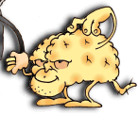
It occurred to me then, with one of those rushes of revelation of which we should be suspicious, that I had stumbled upon an impressive demonstration of the immateriality of the soul based upon physicalist principles and premises. For as the last radio signal between Tulsa and Houston died away, had I not changed location from Tulsa to Houston at the speed of light? And had I not accomplished this without any increase in mass? What moved from A to B at such speed was surely myself, or at any rate my soul or mind — the massless center of my being and home of my consciousness.
I could not see how a physicalist philosopher could quarrel with this except by taking the dire and counterintuitive route of banishing all talk of persons.

Slide 72
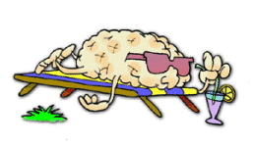
Disembodied in Houston
[M]y technical support team sedated me into a dreamless sleep from which I awoke, hearing with magnificent fidelity the familiar opening strains of my favorite Brahms piano trio. So that was why they had wanted a list of my favorite recordings! It did not take me long to realize that I was hearing the music without ears. The output from the stereo stylus was being fed through some fancy rectification circuitry directly into my auditory nerve. I was mainlining Brahms.

Slide 73
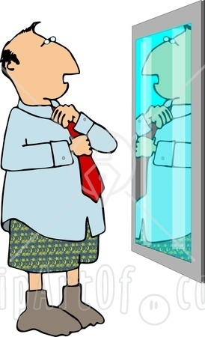
Body Exchange
My sleep lasted, I later learned, for the better part of a year, and when I awoke, it was to find myself fully restored to my senses. When I looked into the mirror, though, I was a bit startled to see an unfamiliar face.
I and my new body, whom we might as well call Fortinbras, strode into the familiar lab to another round of applause from the technicians, who were of course congratulating themselves, not me.

Slide 74

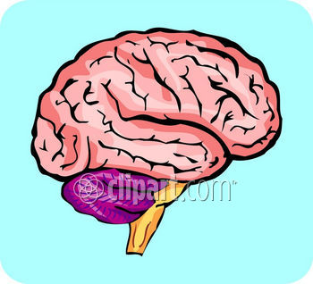
Computer Duplication
[B]efore they had even operated on the first occasion, they had constructed a computer duplicate of my brain, reproducing both the complete information-processing structure and the computational speed of my brain in a giant computer program. After the operation, but before they had dared to send me off on my mission to Oklahoma, they had run this computer system and Yorick side by side. The incoming signals from Hamlet were sent simultaneously to Yorick's transceivers and to the computer's array of inputs. And the outputs from Yorick were not only beamed back to Hamlet, my body; they were recorded and checked against the simultaneous output of the computer program, which was called “Hubert”
Yorick
Hubert
Fortinbras

Slide 75
Can the self divide?
The one truly unsettling aspect of this new development was the prospect, which was not long in dawning on me, of someone detaching the spare — Hubert or Yorick, as the case might be — from Fortinbras and hitching it to yet another body
[S]uppose that before the arrival of the second body on the scene, I had been keeping Yorick as the spare for years, and letting Hubert's output drive my body — that is, Fortinbras — all that time. The Hubert-Fortinbras couple would seem then by squatter's rights (to combat one legal intuition with another) to be the true Dennett and the lawful inheritor of everything that was Dennett's. This was an interesting question, certainly, but not nearly so pressing as another question that bothered me. My strongest intuition was that in such an eventuality I would survive so long as either brain-body couple remained intact.

Slide 76
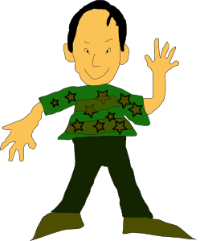


Why not both?
Transitivity of Identity violation!
… but I had mixed emotions about whether I should want both to survive.

Slide 77
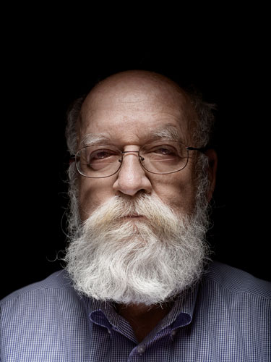
They can’t both be identical to Dennett!
≠
=
=

Slide 78
Two Dennetts?
I discussed my worries with the technicians and the project director. The prospect of two Dennetts was abhorrent to me … My colleagues in the lab argued that I was ignoring the bright side of the matter. Weren't there many things I wanted to do but, being only one person, had been unable to do?... But my ordeal in Oklahoma (or was it Houston?) had made me less adventurous, and I shrank from this opportunity that was being offered (though of course I was never quite sure it was being offered to me in the first place).

Slide 79
Two persons/one body?
There was another prospect even more disagreeable: that the spare, Hubert or Yorick as the case might be, would be detached from any input from Fortinbras and just left detached. Then, as in the other case, there would be two Dennetts, or at least two claimants to my name and possessions, one embodied in Fortinbras, and the other sadly, miserably disembodied. Both selfishness and altruism bade me take steps to prevent this from happening…
[I]t was mutually decided that all the electronic connections in the lab would be carefully locked. Both those that controlled the life-support system for Yorick and those that controlled the power supply for Hubert would be guarded with fail-safe devices, and I would take the only master switch, outfitted for radio remote control, with me wherever I went. I carry it strapped around my waist and — wait a moment — here it is. Every few months I reconnoiter the situation by switching channels

Slide 80
“So let’s give it a try…”
“THANK GOD! I THOUGHT YOU'D NEVER FLIP THAT SWITCH! You can't imagine how horrible it's been these last two weeks — but now you know; it's your turn in purgatory. How I've longed for this moment! You see, about two weeks ago — excuse me, ladies and gentlemen, but I've got to explain this to my . . . um, brother, I guess you could say, but he's just told you the facts, so you'll understand — about two weeks ago our two brains drifted just a bit out of synch. I don't know whether my brain is now Hubert or Yorick, any more than you do, but in any case, the two brains drifted apart, and of course once the process started, it snowballed, for I was in a slightly different receptive state for the input we both received, a difference that was soon magnified. In no time at all the illusion that I was in control of my body — our body — was completely dissipated. There was nothing I could do — no way to call you. YOU DIDN'T EVEN KNOW I EXISTED!
“Now it's your turn, but at least you'll have the comfort of knowing I know you're in there.

Slide 81
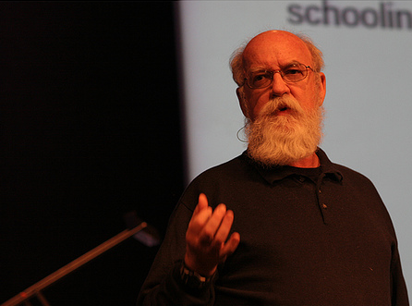
Ladies and gentlemen, this talk we have just heard is not exactly the talk I would have given, but I assure you that everything he said was perfectly true. And now if you'll excuse me, I think I'd — we'd — better sit down.”
Ladies and gentlemen, this talk we have just heard is not exactly the talk I would have given, but I assure you that everything he said was perfectly true. And now if you'll excuse me, I think I'd — we'd — better sit down.”

