Slide 1
Doing ‘Evo-devo’ with C. elegans
and other nematodes
How are neurons ‘specified’?

Slide 2
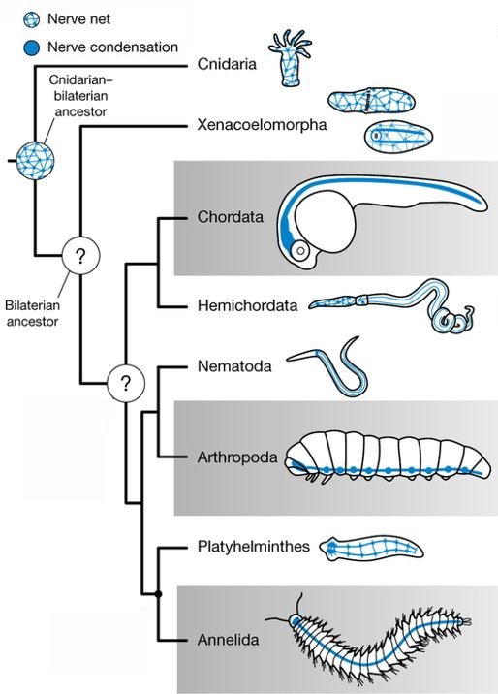
Nervous systems have common neuronal types
Neurotransmitters
Acetylcholine
Serotonin
GABA
Dopamine
Glutamate
etc
Acetylcholine
Serotonin
GABA
Dopamine
Glutamate
etc
Acetylcholine
Serotonin
GABA
Dopamine
Glutamate
etc
Acetylcholine
Serotonin
GABA
Dopamine
Glutamate
etc
Representative
Bilaterians
Acetylcholine
Serotonin
GABA
Dopamine
Glutamate
etc
Acetylcholine
Serotonin
GABA
Dopamine
Glutamate
etc
Acetylcholine
Serotonin
GABA
Dopamine
Glutamate
etc

Slide 3
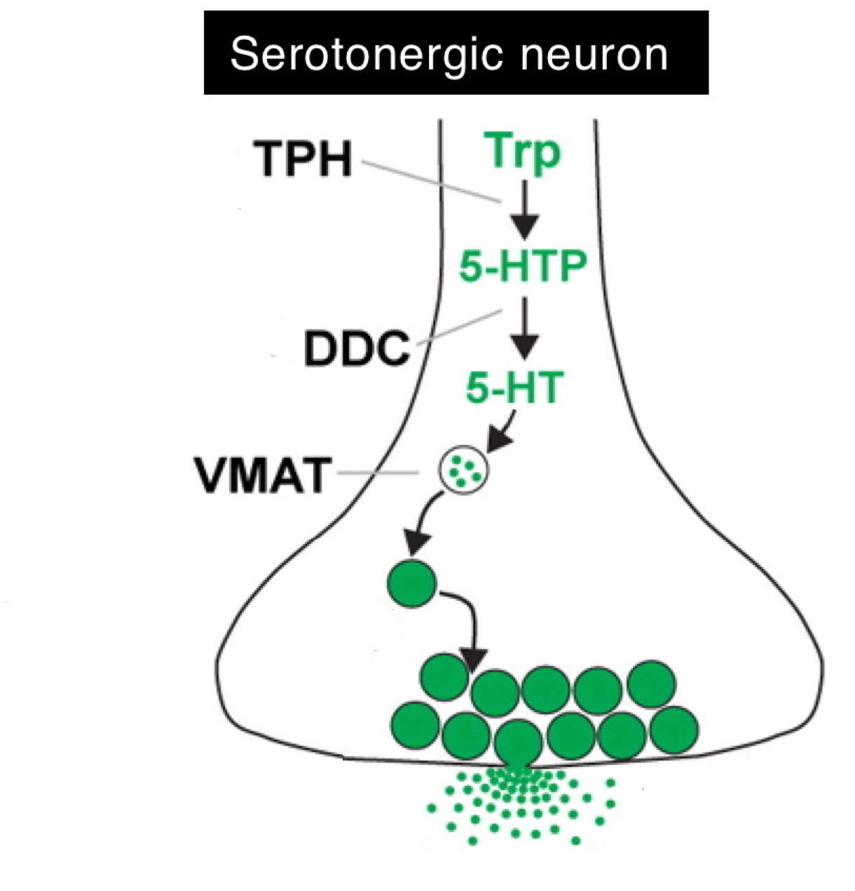
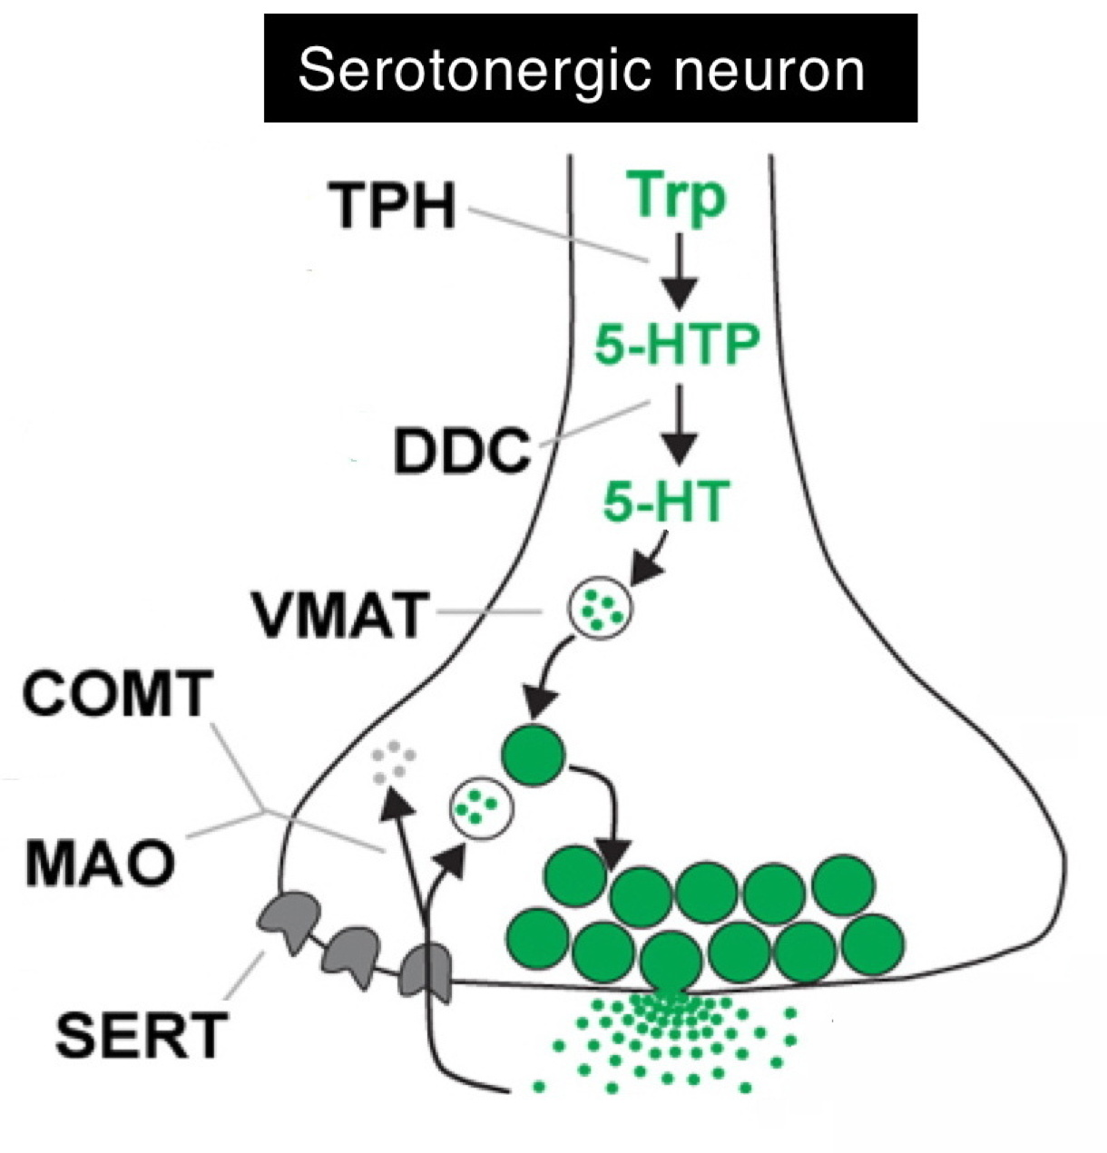
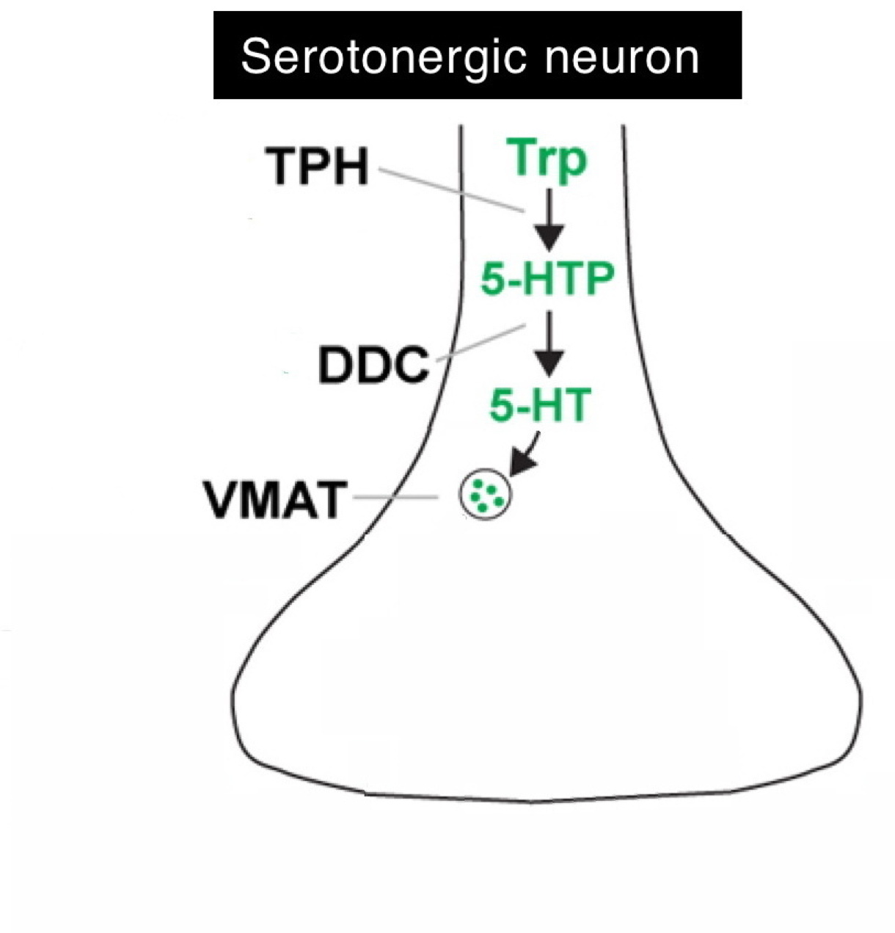
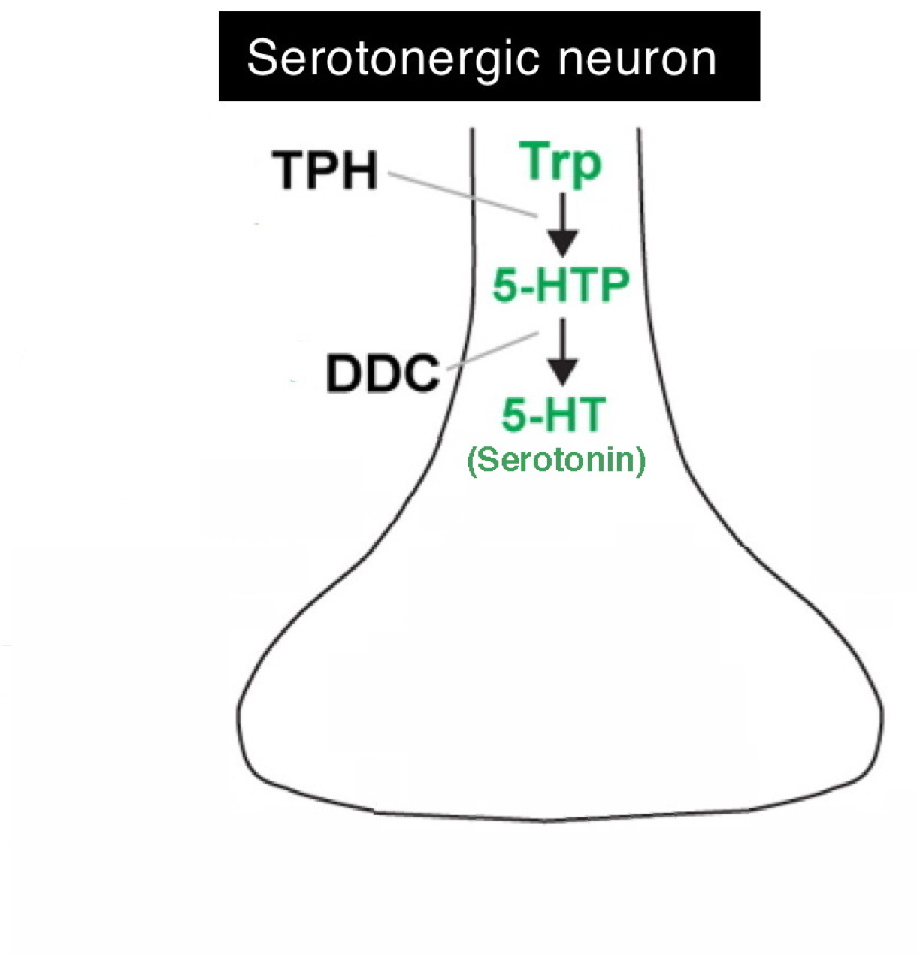
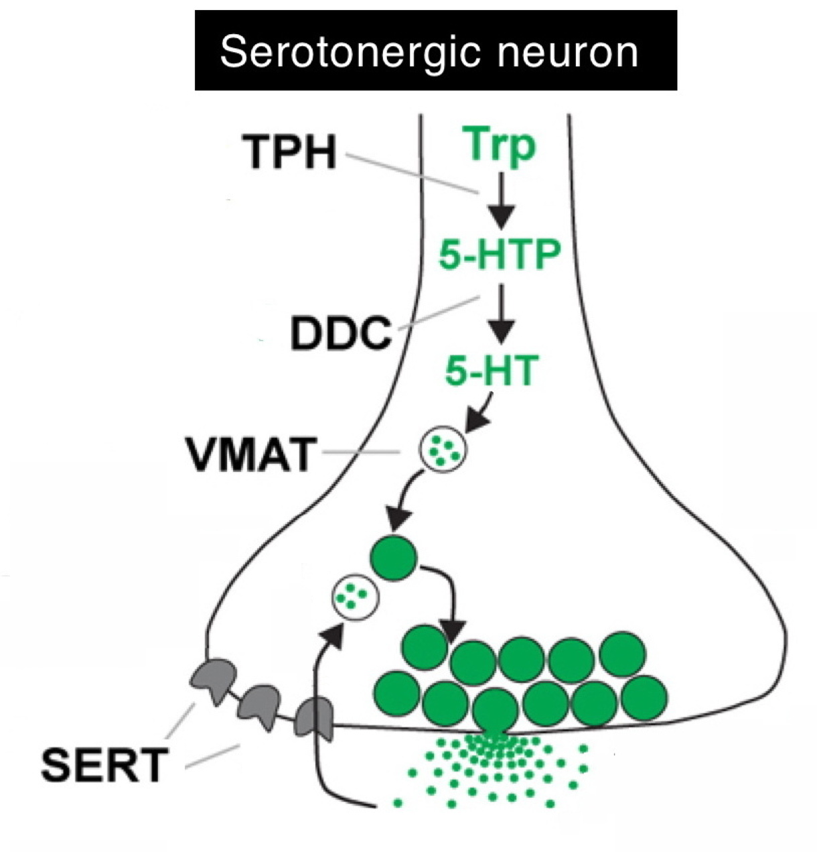
Requirements for using a specific neurotransmitter
Synthesis
Serotonergic
‘Markers’
Packaging
Degradation
Release
‘Re-uptake’ after release

Slide 4
How does a neuron become serotonergic?
All genes required are turned ON
E.g., Serotonergic:
TPH, DDC, VMAT, SERT, COMT, MAO
What turns genes ON?
Transcription factors:
DNA-binding proteins regulating genes

Slide 5
C. elegans has yielded important insights in Biology
including neuronal specification
Transcription factors bind DNA in genes, turn them ON
Transcription factors
Promoter
modified from
Hobert, 2016
TF binding sites
Protein coding region

Slide 6
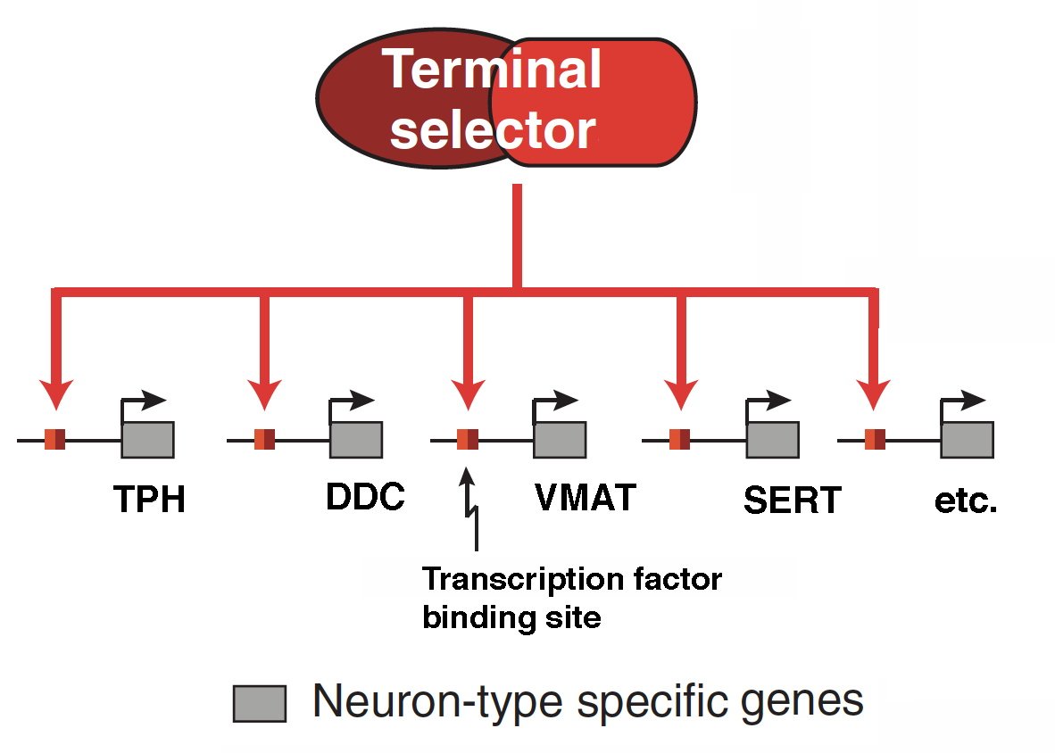
Some TFs act as “Terminal Selectors”
modified from
Hobert, 2016
One TF (or pair) turns on all genes for a neuron type

Slide 7
Roles of Terminal Selectors
1. Trigger differentiation into specific neuron type
(by turning ON many genes during development)
2. Maintain specific neuronal identity
(required continuously to keep genes ON)

Slide 8
Terminal Selectors can control many neuron features
i.e., not just neurotransmitter type
Hobert, 2016
Example: C. elegans unc-3 gene – specifies cholinergic
motor neurons but not just neurotransmitter type

Slide 9
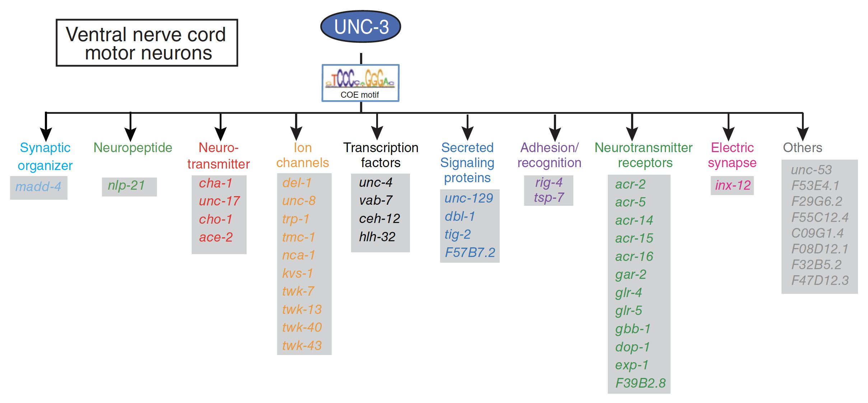
Terminal Selectors can control many neuron features
Unc-3 terminal selector:
specifies cholinergic motor neurons fully
Unc-3 turns ON at least 47 genes !
Unc-3 binding site – found in all genes below
Hobert, 2016

Slide 10
Some Terminal Selectors first found in C. elegans also specify the same neuron types in Mammals
Unc-3 – a ‘COE’ type transcription factor
specifies cholinergic motor neurons
Unc-86 – a POU-type homeodomain TF
specifies some serotonergic neurons

Slide 11
Some Terminal Selectors first found in C. elegans also specify the same neuron types in Mammals
Unc-86 – a POU-type homeodomain TF
specifies some serotonergic neurons (w/ partner)
Unc-86
Ttx-3
modified from
Hobert, 2016

Slide 12
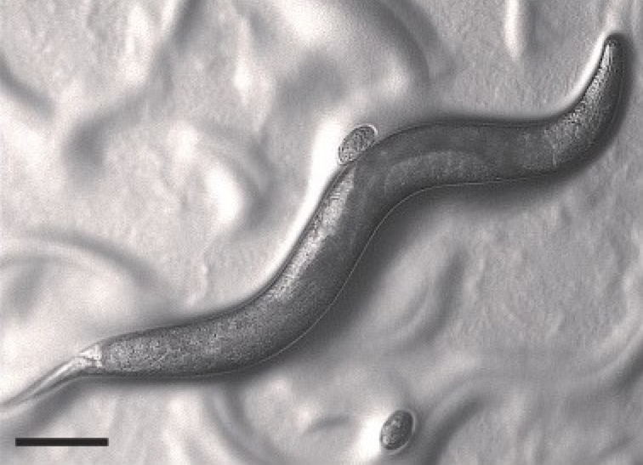
To study evolution of neuronal specification,
we are working with a nematode relative
A ‘satellite model organism’:
Pristionchus pacificus
R. Sommer
- sequenced genome + genetics
- genomic modification possible, including CRISPR
- very similar, but not identical nervous system

Slide 13
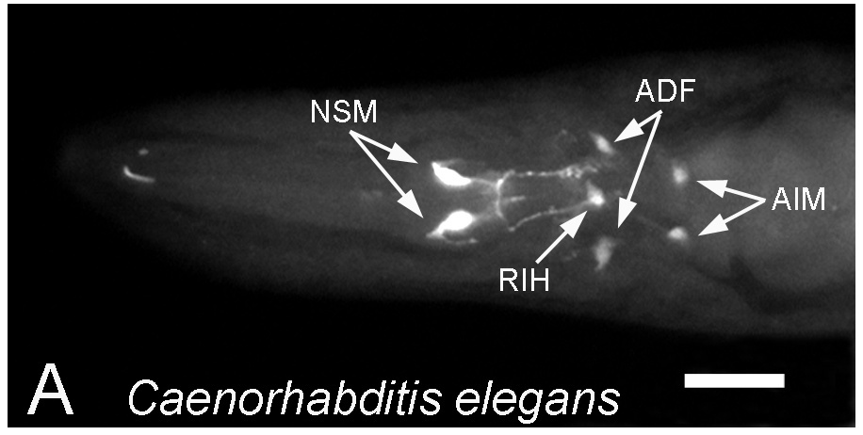
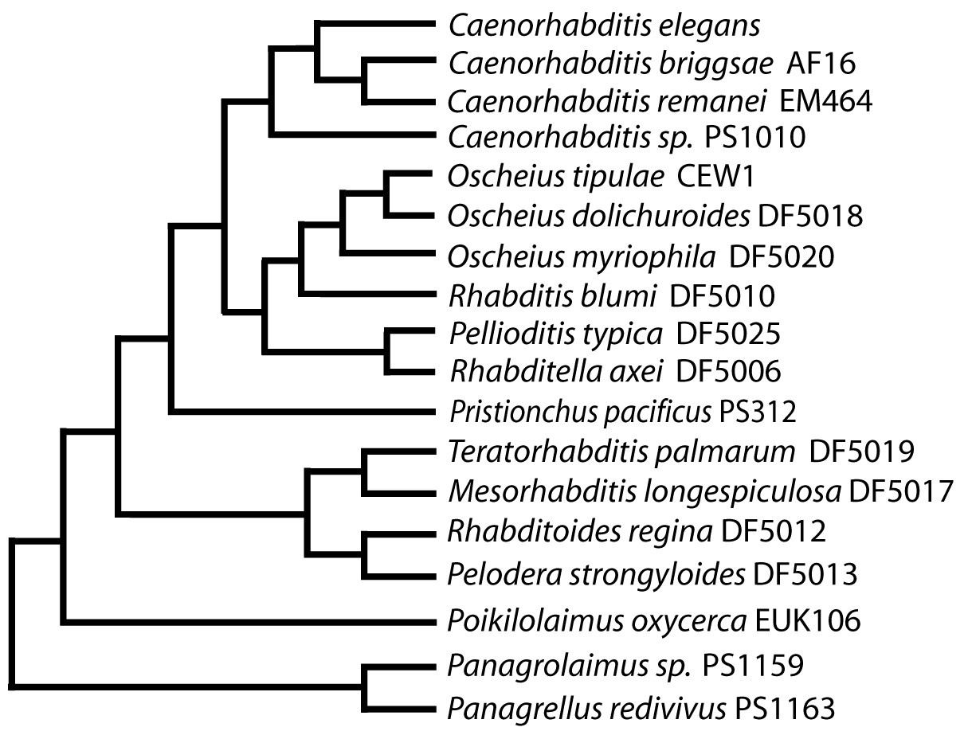
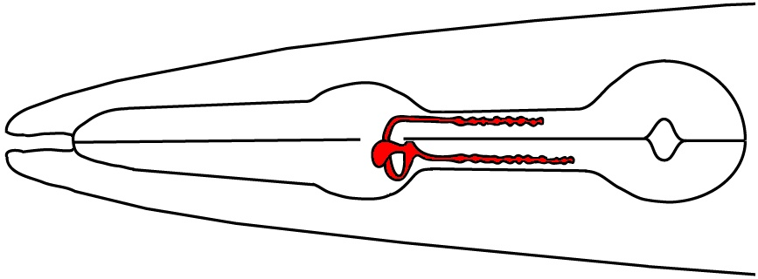
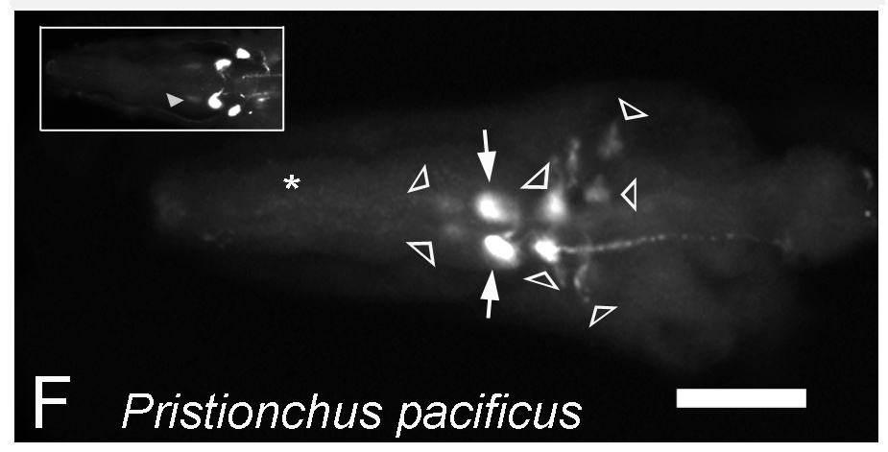
Serotonergic neurons in other nematodes
NSM
Loer & Rivard, 2007; Rivard et al., 2010

Slide 14
Serotonergic neurons - C. elegans vs. P. pacificus
C. elegans:
7 head
neurons
Differences:
extra pair – who?
1. I1’s +5HT
2. AIMs - no
5HT
3. ?’s +5HT
I1s
NSMs
ADFs + RIH likely
no AIMS
(w / 5HT)
How do these differences arise?

Slide 15
How do differences in the nervous system arise?
Strategy:
Examine genes known to function in C. elegans
Modify genes via CRISPR-Cas9 – mark, mutate
Not as easy as C. elegans, but possible

Slide 16
Using CRISPR to mark genes in Pristionchus
TF proteins tagged with ‘FLAG’ peptide
unc-3 protein coding
FLAG
Role in cholinergic neurons
unc-86 protein coding
FLAG
Role in serotonergic neurons
FLAG peptide attached to TF detected using antibody to FLAG

Slide 17
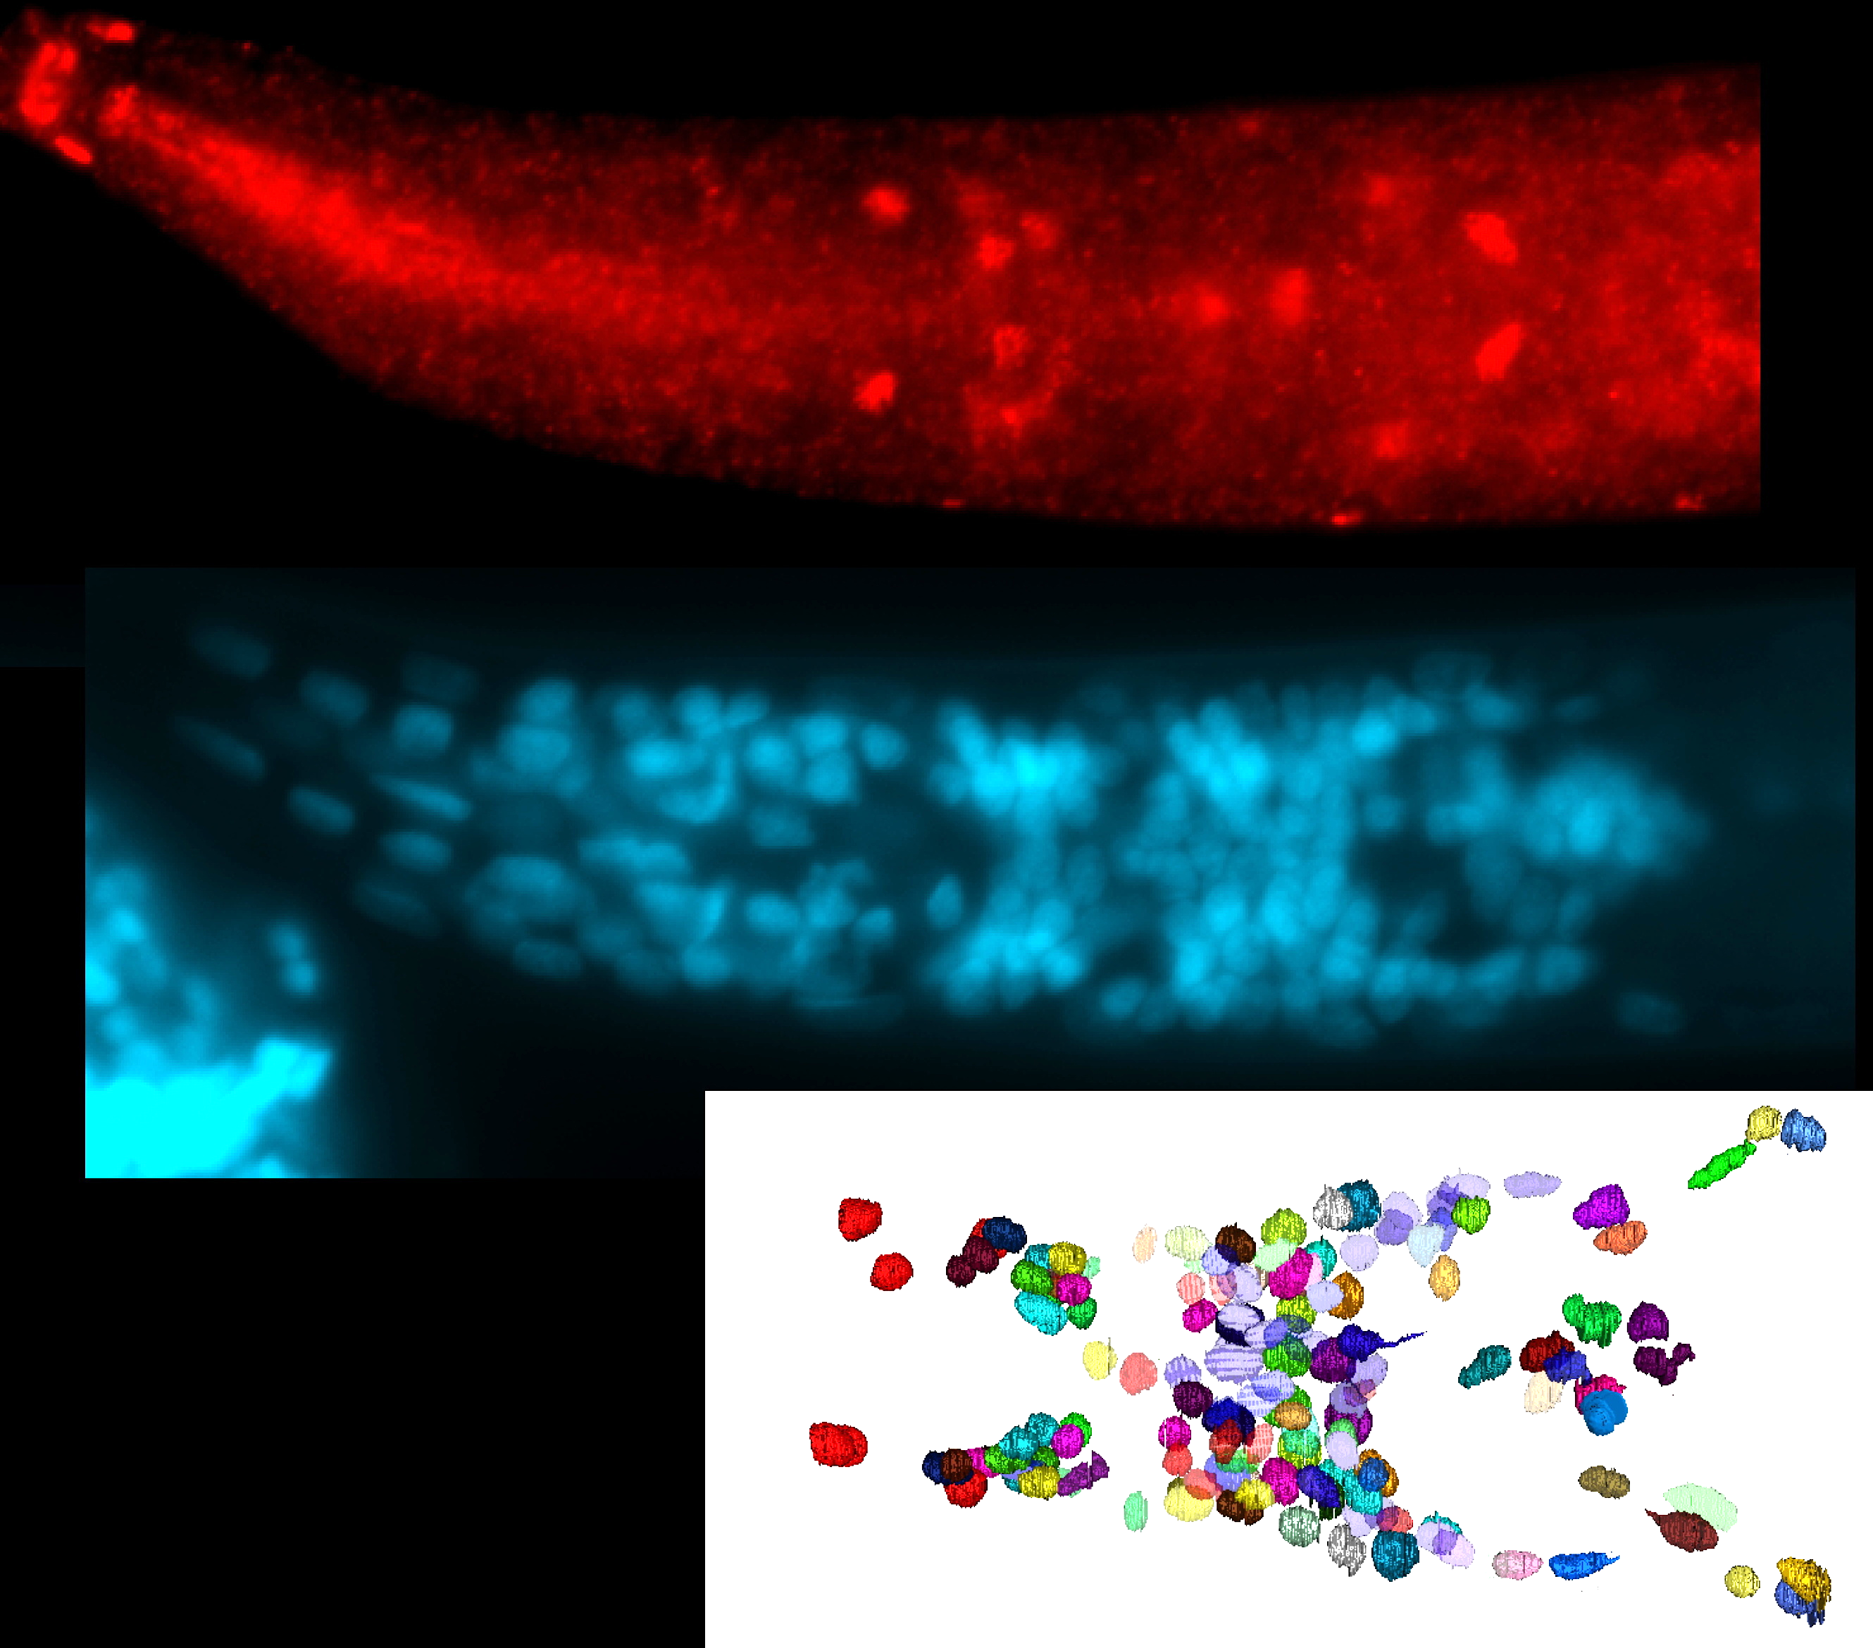
NSM
AIM?
Unc-86-FLAG
ventral view
NSM
DAPI –
all nuclei
n.r.
Pristionchus unc-86
expression
All unc-3+ nuclei in VNC -- neurons using acetylcholine
Pristionchus ventral nerve cord now fully characterized
Head map of most neuronal nuclei
Steve’s adult head map modified to look more like a larval head

Slide 18
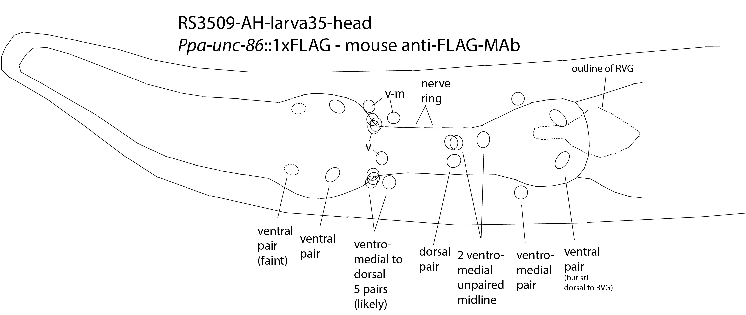
Possible changes in unc-86 role in Pristionchus vs. C. elegans
AIMs?
I1s
NSMs
AIMs
?
I1s
NSMs
‘LAG’
cells

Slide 19
Summary of Ppa differences –
and, therefore, possible unc-86 role change
C. elegans
P. pacificus
unc-86 role
in 5HT spec?
Cell
5HT unc-86
5HT unc-86
+
+
+
+
NSM
unchanged
-
+
+
+
Gain in Ppa?
I1
+
+
-
+?
AIM
Loss in Ppa?
‘LAG’
-
?
+
+?
Gain in Ppa?
NSM AIM
I1s LAG

Slide 20
Unc-86 - terminal selector for some serotonergic neurons
Its role is likely altered in Pristionchus
How?
- Changes in TF binding sites?
- Changes in partner TF in some neurons?

Slide 21
Unc-86 - terminal selector for some serotonergic neurons
C. elegans w/ Cel-unc-86 antibody
P. pacificus w/ Cel-unc-86 antibody
- Changes in TF binding sites?
- Changes in partner TF in some neurons?

Slide 22
Serotonergic neurons & unc-86 in other nematodes

