Slide 1
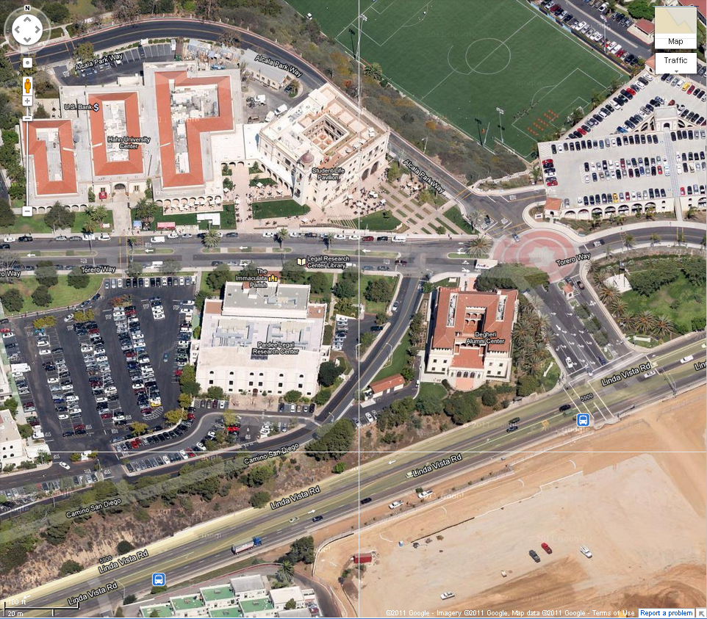
Shari & Greg’s Rehearsal Reception
Friday, October 19, 2012
La Gran Terraza
(proceed through the University Center and to the back/north end of the building)
Enter
Parking
Parking
Enter at USD’s west/main entrance from
Linda Vista Road, turning left on Torero Way
Linda Vista Road
You can park anywhere on campus with a white space

